Slide 1
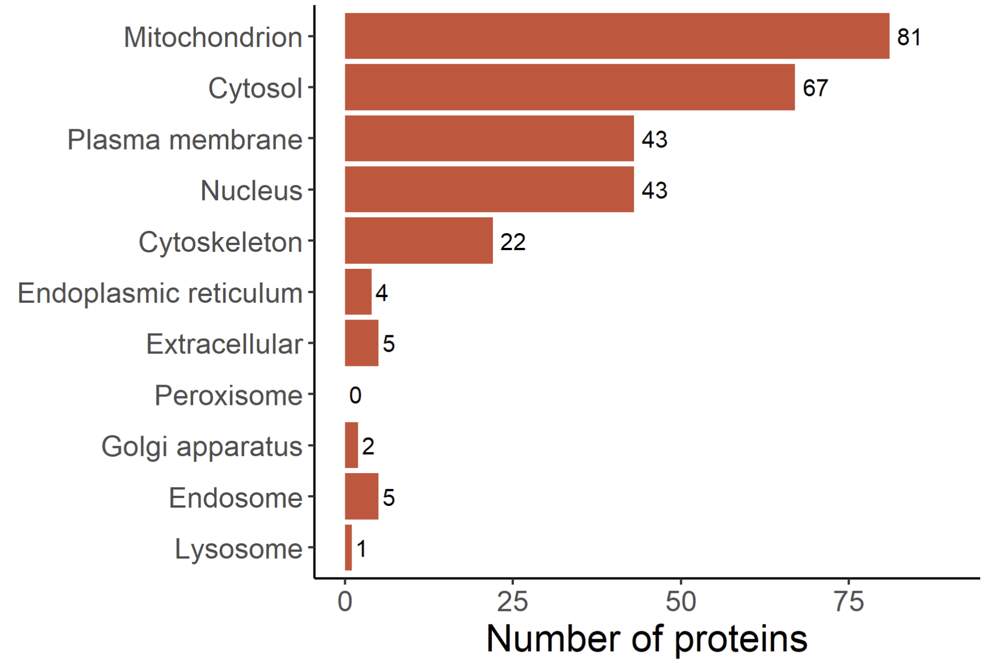
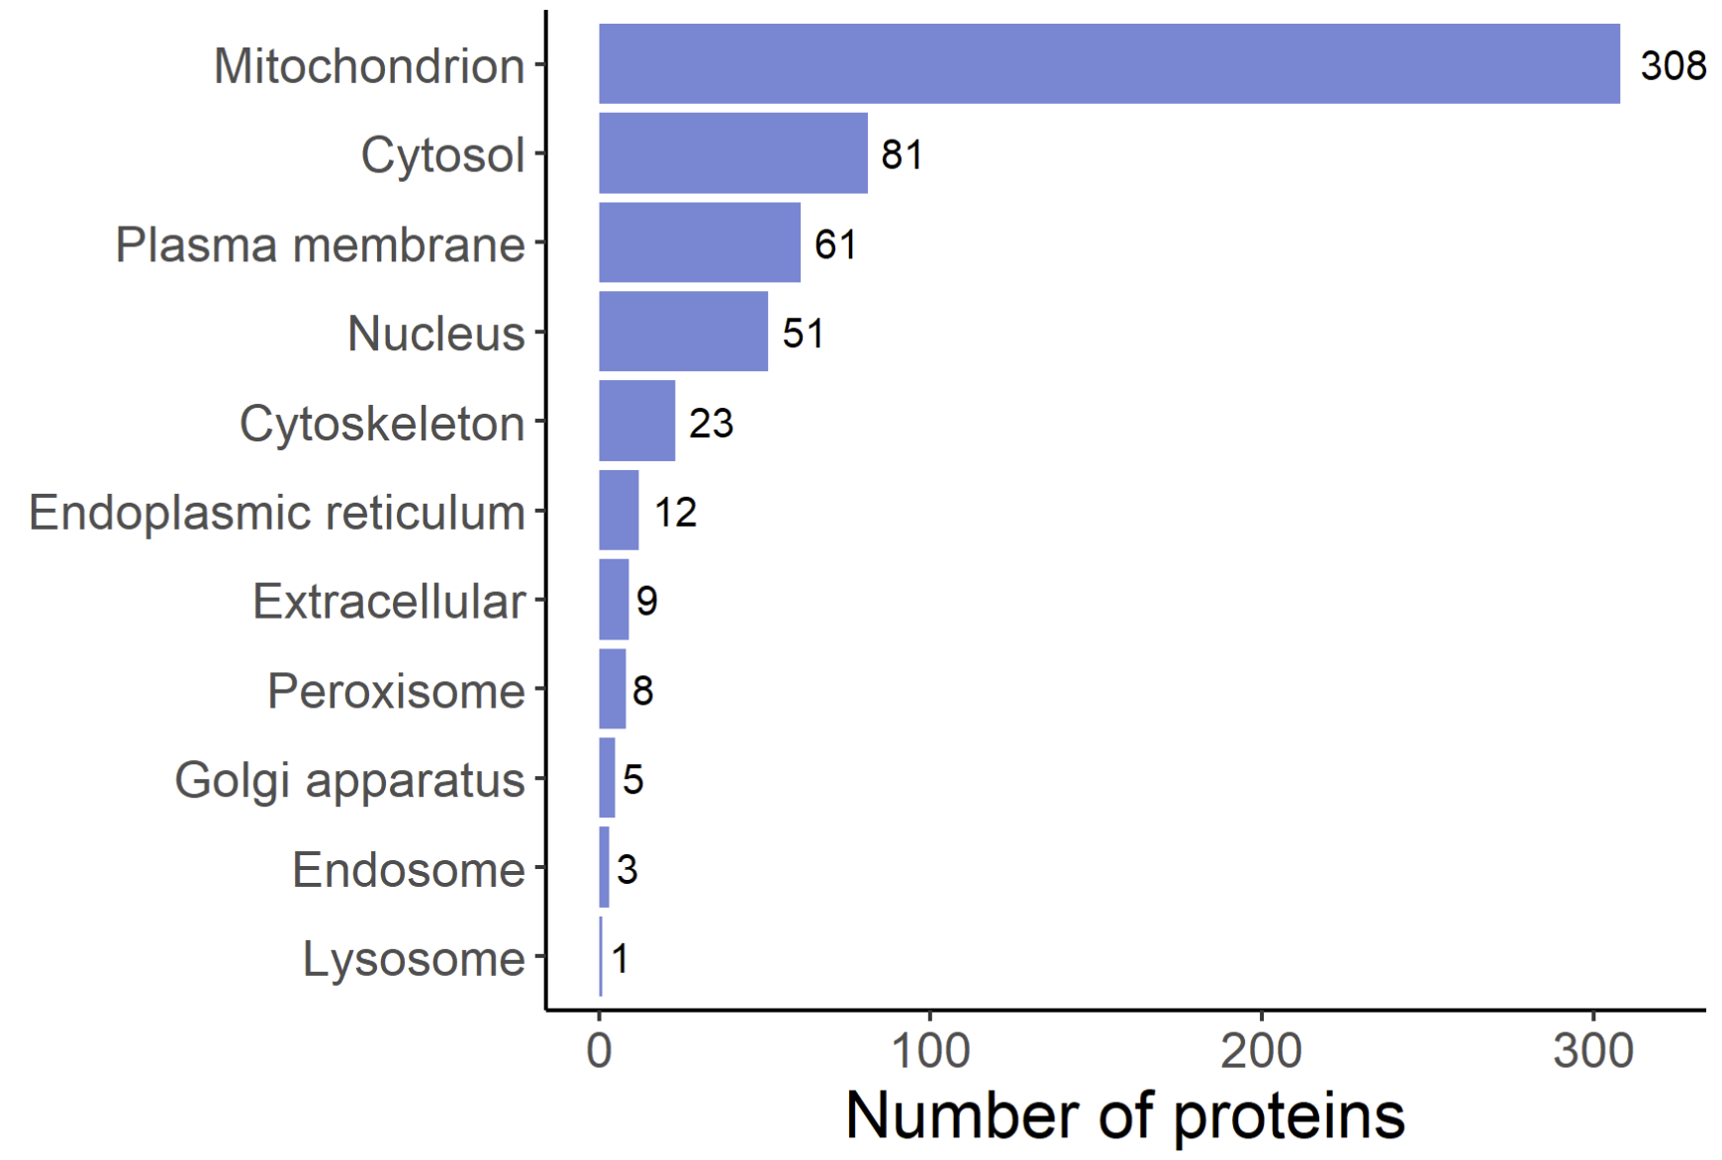
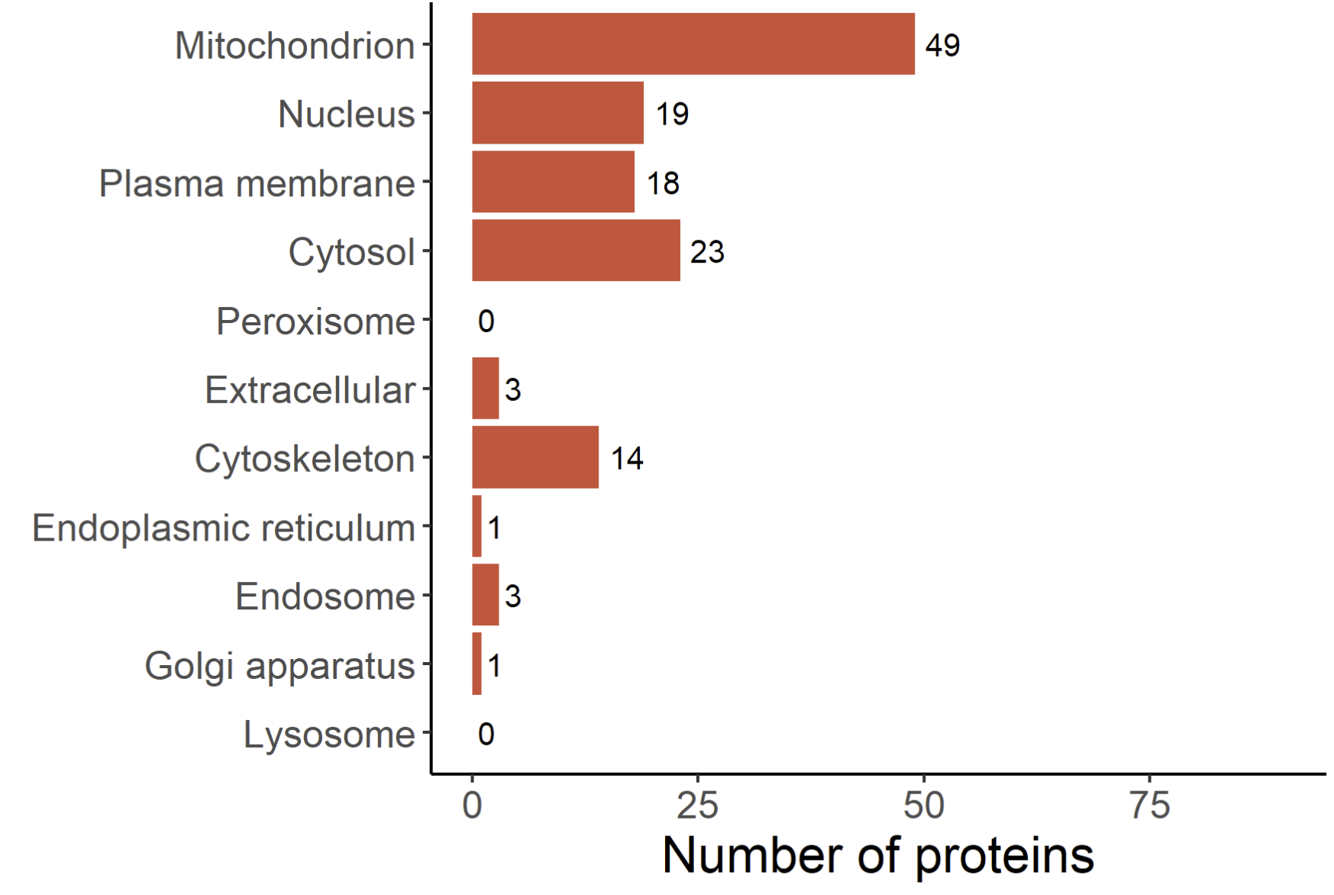
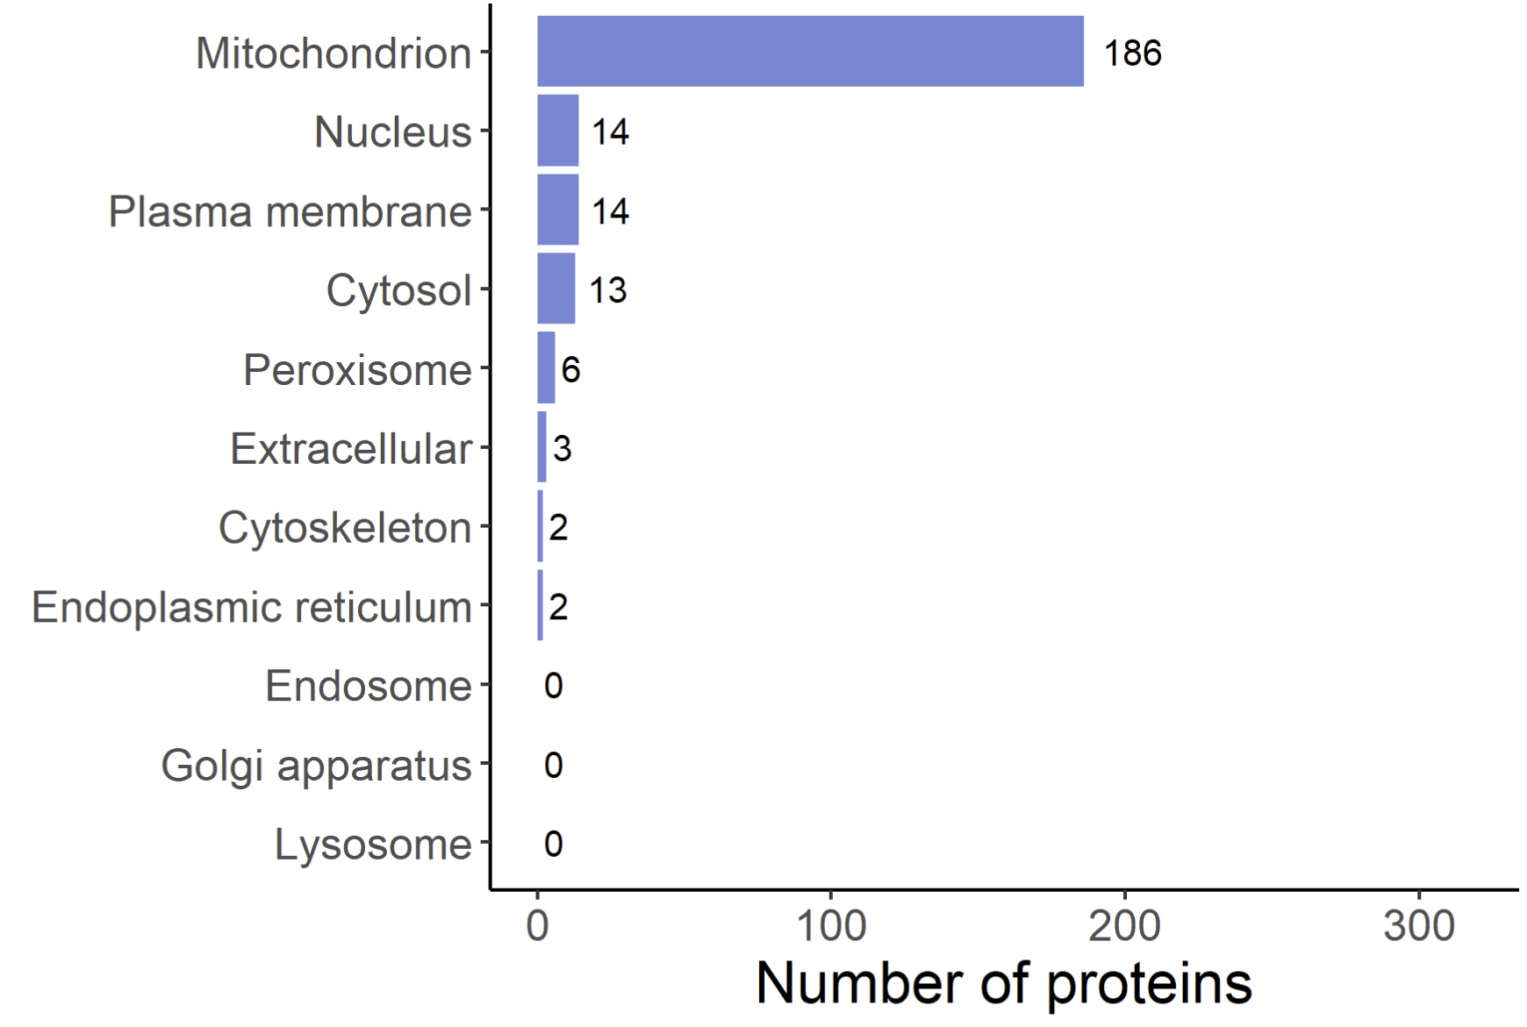
Supplementary Figure S6
A. Subcellular localization for quantifiable malonyl proteins
B. Subcellular localization for quantifiable succinyl proteins
81
81
308
43
67
61
43
51
22
23
4
12
5
9
0
8
2
5
5
3
1
1
C. Subcellular localization for
SIRT5-targeted malonyl proteins
D. Subcellular localization for
SIRT5-targeted succinyl proteins
49
186
19
14
18
14
23
13
0
6
3
3
14
2
1
2
3
0
1
0
0
0
Supplementary Figure S6. Subcellular localization of the malonyl and succinyl peptides. Protein subcellular localizations were determined using stringAPP (Szklarczyk et al., 2015, Nucleic Acids Res, 43, D447-52), and the compartment score threshold was set at 4.5, resulting in a final dataset of 189 quantifiable malonylated proteins and 433 quantifiable succinylated protein groups used here. Excluded proteins had a compartment score below 4.5 for each of the listed subcellular compartments or corresponding information could not be retrieved. Distribution of the subcellular localization of the quantifiable malonyl (A) and succinyl (B) proteins as well as the SIRT5-targeted malonyl (C) and succinyl (D) proteins.

