Slide 1
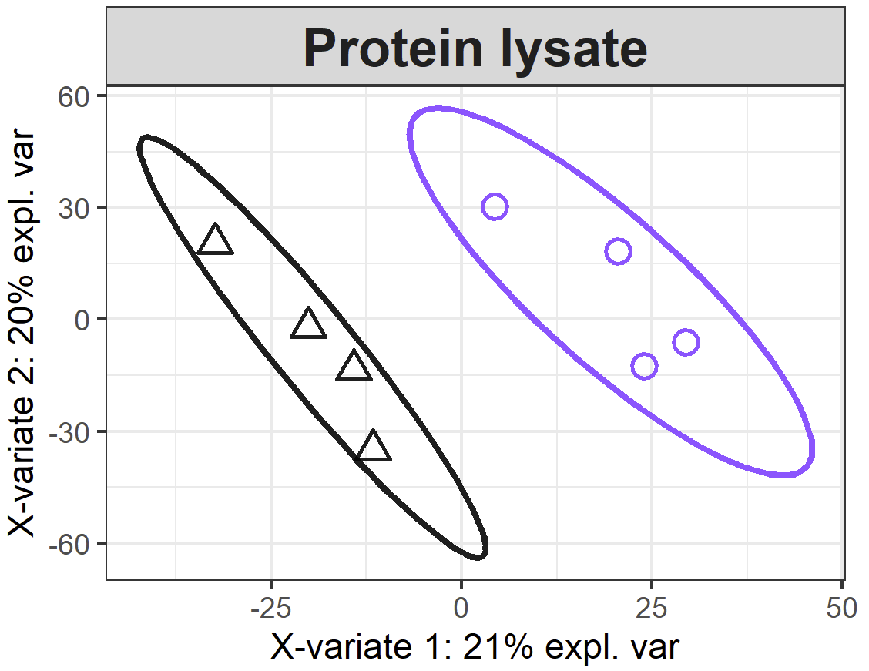
Supplementary Figure S7
SIRT5-KO
WT
Supplementary Figure S7. Supervised clustering analysis of the protein lysate. Supervised clustering analysis using partial least squares-discriminant analysis (PLS-DA) performed on all protein groups quantified in the wild-type (WT, black) and SIRT5-KO (purple) samples.

