Slide 1
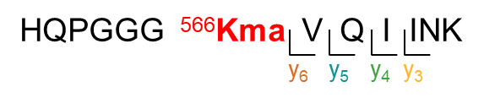
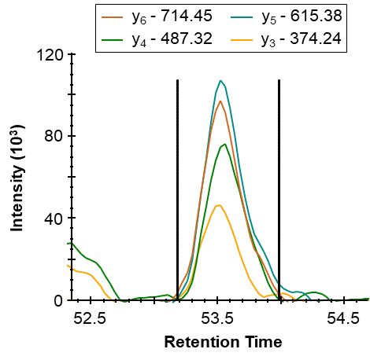
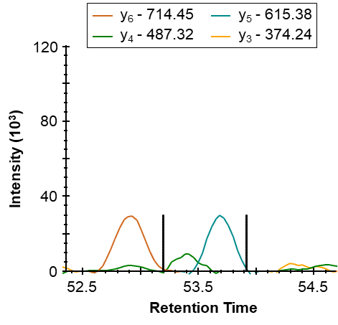
Supplementary Figure S8
A. Detected malonylated and succinylated sites of the mouse tau protein
PTM site | Log₂(FC) malonyl | P-value malonyl | Log₂(FC) succinyl | Q-value succinyl
K566 | 3.22 | 9.93E-05
K573 |  |  | -0.47 | 0.59
K590 | 1.92 | 0.34
K603 | -1.09 | 0.57
B. XIC MS2 of HQPGGG⁵⁶⁶KmaVQIINK of the tau protein
SIRT5-KO
WT
Supplementary Figure S8. Increased malonylation at K566 of the Alzheimer’s disease-related tau protein by SIRT5 in mouse brains. (A) Malonylated and succinylated lysine sites detected in mouse microtubule-associated protein tau protein (TAU). Malonylation of lysine K566 was significantly up-regulated in SIRT5-KO vs WT mouse brains. (B) Extracted ion chromatograms of the malonylated peptide HQPGGG⁵⁶⁶KVQIINK (m/z 487.93, z = 3+) of tau protein in a SIRT5-KO and WT replicate.

