Slide 1
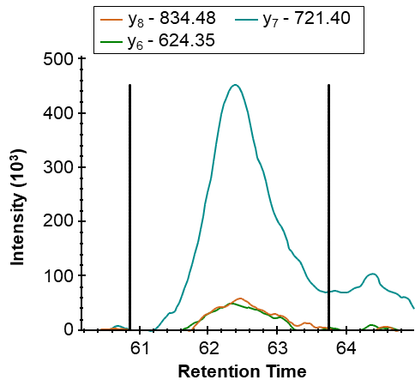
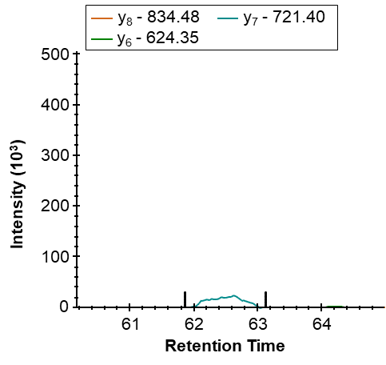
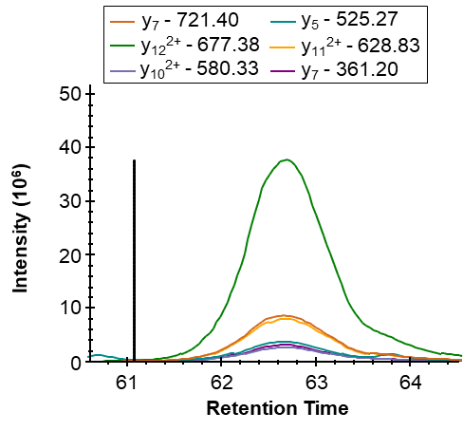
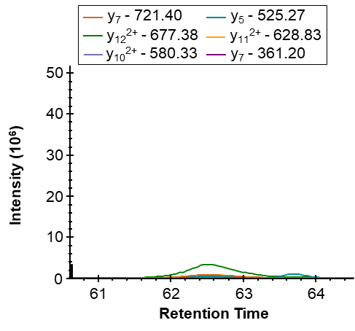
Supplementary Figure S9 A-B
A. XIC MS2 of TQPPP⁴⁰KmaLPVGPSHK of the NADH dehydrogenase [ubiquinone] 1 alpha subcomplex subunit 7 (NDUA7)
SIRT5-KO
WT
TQPPP⁴⁰KmaLPVGPSHK
(NDUA7)
B. XIC MS2 of TQPPP⁴⁰KsuccLPVGPSHK of the NADH dehydrogenase [ubiquinone] 1 alpha subcomplex subunit 7 (NDUA7)
SIRT5-KO
WT
TQPPP⁴⁰KsuccLPVGPSHK
(NDUA7)

Slide 2
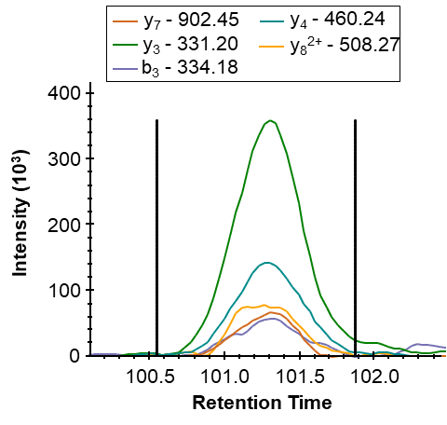
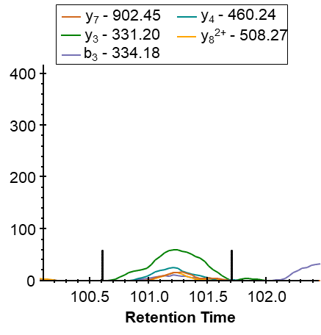
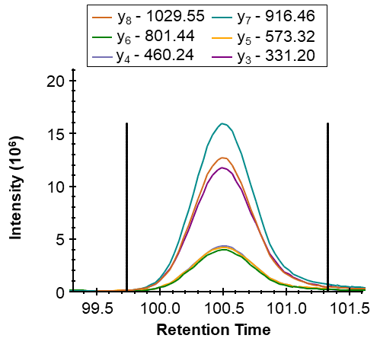
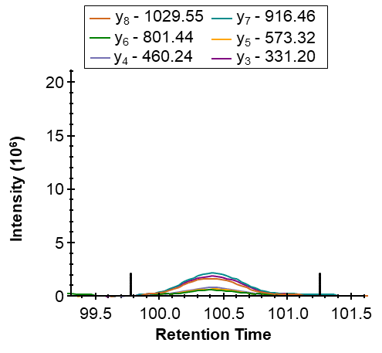
Supplementary Figure S9 C-D
C. XIC MS2 of GYLD⁴⁹⁸KmaLEPSK of the mitochondrial ATP synthase subunit alpha (ATPA)
SIRT5-KO
WT
GYLD⁴⁹⁸KmaLEPSK
(ATPA)
D. XIC MS2 of GYLD⁴⁹⁸KsuccLEPSK of the mitochondrial ATP synthase subunit alpha (ATPA)
SIRT5-KO
WT
GYLD⁴⁹⁸KsuccLEPSK
(ATPA)

Slide 3
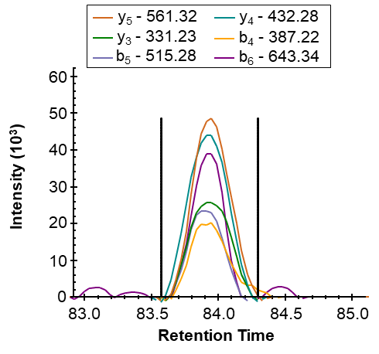
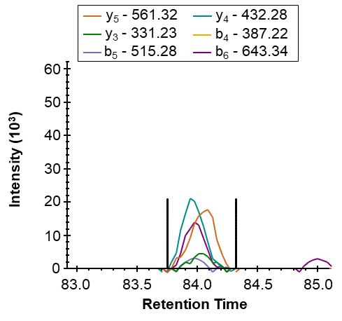
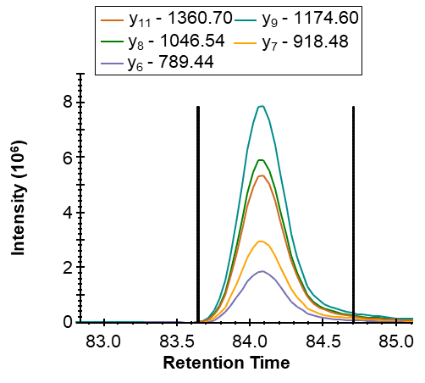
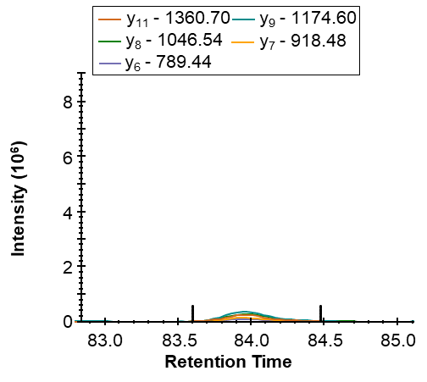
Supplementary Figure S9 E-F
E. XIC MS2 of SISVQQE²³³KmaETIAK of the mitochondrial ATP synthase F(0) complex subunit B1 (AT5F1)
SIRT5-KO
WT
SISVQQE²³³KmaETIAK
(AT5F1)
F. XIC MS2 of SISVQQE²³³KsuccETIAK of the mitochondrial ATP synthase F(0) complex subunit B1 (AT5F1)
SIRT5-KO
WT
SISVQQE²³³KsuccETIAK
(AT5F1)

Slide 4
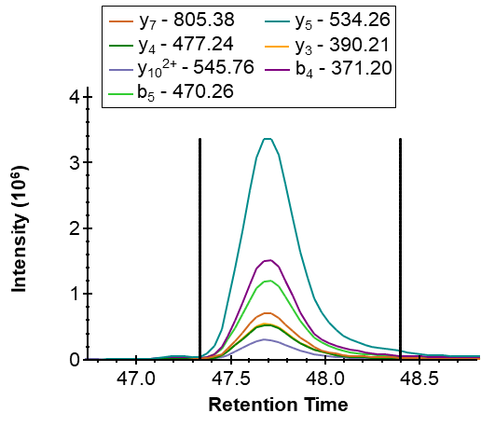
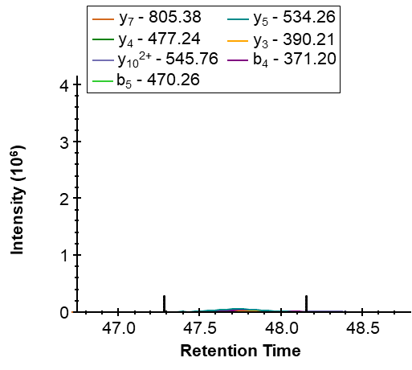
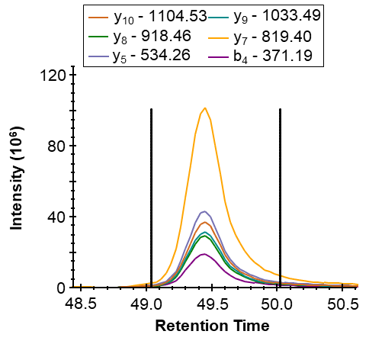
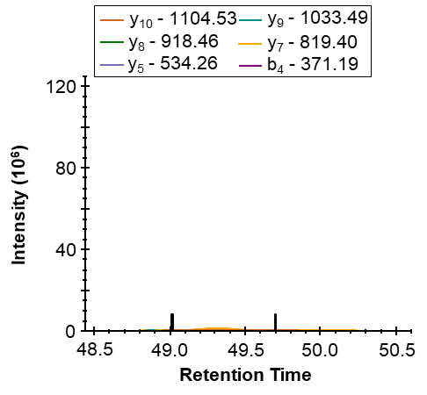
Supplementary Figure S9 G-H
G. XIC MS2 of LAADVG¹⁴⁷KmaGSSQR of the ADP/ATP translocase 1 (ADT1/ANT1)
SIRT5-KO
WT
LAADVG¹⁴⁷KmaGSSQR
(ANT1)
H. XIC MS2 of LAADVG¹⁴⁷KsuccGSSQR of the ADP/ATP translocase 1 (ADT1/ANT1)
SIRT5-KO
WT
LAADVG¹⁴⁷KsuccGSSQR
(ANT1)

Slide 5
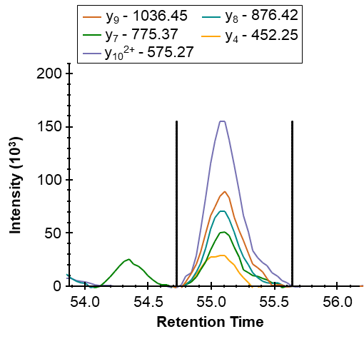
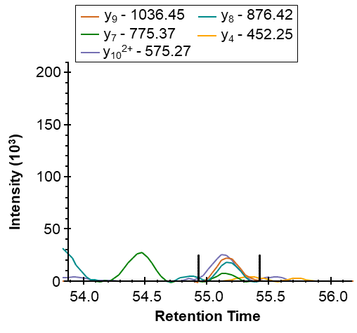
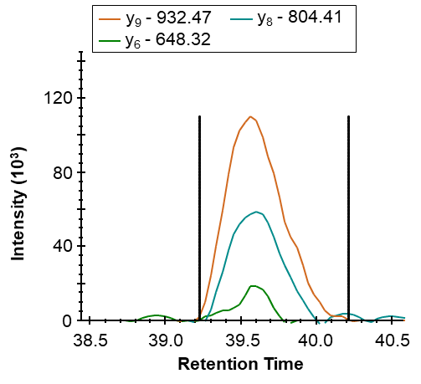
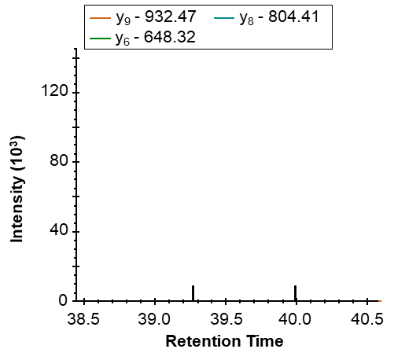
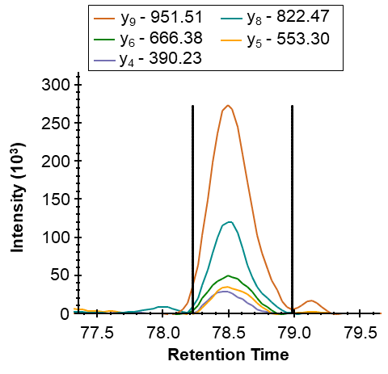
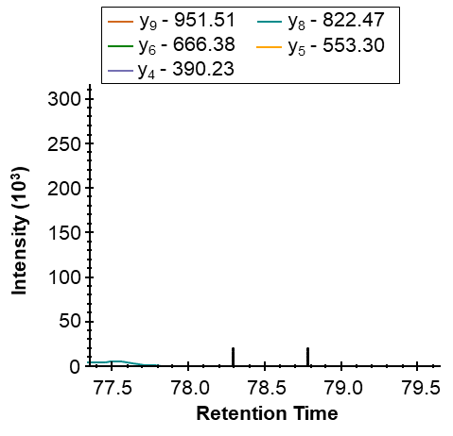
Supplementary Figure S9 I-K
I. XIC MS2 of CV³³KmaLCTGHEYAAK of the calcium/calmodulin-dependent protein kinase type II subunit beta (KCC2B)
SIRT5-KO
WT
CV³³KmaLCTGHEYAAK
(KCC2B)
J. XIC MS2 of T²³KmaQGVTEAAEK of the beta-synuclein (SYUB)
SIRT5-KO
WT
T²³KmaQGVTEAAEK
(SYUB)
K. XIC MS2 of T³⁴KmaEGVLYVGSK of the beta-synuclein (SYUB)
SIRT5-KO
WT
T³⁴KmaEGVLYVGSK
(SYUB)

Slide 6
Supplementary Figure S9. Additional SIRT5-targeted proteins involved in Parkinson’s disease. Extracted ion chromatograms of TQPPP⁴⁰KmaLPVGPSHK (A) (m/z 523.62, z = 3+) and TQPPP⁴⁰KsuccLPVGPSHK (B) (m/z 528.29, z = 3+) of the NADH dehydrogenase [ubiquinone] 1 alpha subcomplex subunit 7 (NDUA7), GYLD⁴⁹⁸KmaLEPSK (C) (m/z 618.31, z = 2+) and GYLD⁴⁹⁸KsuccLEPSK (D) (m/z 625.32, z = 2+) of the mitochondrial ATP synthase subunit alpha (ATPA), SISVQQE²³³KmaETIAK (E) (m/z 773.90, z = 2+) and SISVQQE²³³KsuccETIAK (F) (m/z 780.91, z = 2+) of the mitochondrial ATP synthase F(0) complex subunit B1 (AT5F1), LAADVG¹⁴⁷KmaGSSQR (G) (m/z 637.82, z = 2+) and LAADVG¹⁴⁷KsuccGSSQR (H) (m/z 644.83, z = 2+) of the ADP/ATP translocase 1 (ADT1/ANT1), CV³³KmaLCTGHEYAAK (I) (m/z 541.58, z = 3+) of the calcium/calmodulin-dependent protein kinase type II subunit beta (KCC2B), and T²³KmaQGVTEAAEK (J) (m/z 624.31, z = 2+) and T³⁴KmaEGVLYVGSK (K) (m/z 633.83, z = 2+) of the beta-synuclein (SYUB) in a SIRT5-KO and WT replicate.

