Slide 1





Left-ventricular volumes and ejection fraction from cardiac ECG-gated ¹⁵O-water positron emission tomography compared to cardiac magnetic resonance imaging using simultaneous hybrid PET/MR
Journal of Nuclear Cardiology | Official Journal of the American Society of Nuclear Cardiology
Jonny Nordström*^{1, 2}, Sofia Kvernby*^{1,4}, Tanja Kero^{1,3}, Jens Sörensen^{1,3}, Hendrik J Harms¹, Mark Lubberink^{1,4}
1.Department of Surgical Sciences / Nuclear Medicine & PET, Uppsala University, Uppsala, Sweden
2.Centre for Research and Development, Uppsala/Gävleborg County, Gävle, Sweden
3.Medical Imaging Centre, Uppsala University Hospital, Uppsala, Sweden
4.Medical Physics, Uppsala University Hospital, Uppsala, Sweden
*Shared first authorship
Copyright American Society of Nuclear Cardiology

Slide 2
BACKGROUND
Journal of Nuclear Cardiology | Official Journal of the American Society of Nuclear Cardiology
¹⁵O-water PET is the gold standard for quantification of myocardial blood flow, while cardiac magnetic resonance is considered the gold standard for LV volumes and EF estimation.
Since ¹⁵O-water is freely diffusible, EF and LV volumes can not be calculated from late-uptake ¹⁵O-water PET images.
Calculating LV volumes and EF have in two previous studies shown to be feasible using ECG-gated first-pass images.
The aim of this study was to verify a method for measurement of LV volumes and EF calculations from ¹⁵O-water PET with CMR, simultaneously in a hybrid 3T PET/MR scanner.
Copyright American Society of Nuclear Cardiology

Slide 3
METHODS
Journal of Nuclear Cardiology | Official Journal of the American Society of Nuclear Cardiology
Prospective cohort study.
Twenty-four (24) patients with known or suspected CAD were included. Patients with known history of ST-elevation myocardial infarction were excluded.
Patients underwent a simultaneous ECG-gated cardiac PET/MR scan. The first-pass ¹⁵O-water PET images and the functional CMR images were analyzed using the CarPET software respectively the Segment software, for LV volumes and EF.
LV volumes and EF were compared using correlation analysis and Bland-Altman analysis. Inter- and intra-observer variability were assessed for both modalities.
Copyright American Society of Nuclear Cardiology

Slide 4
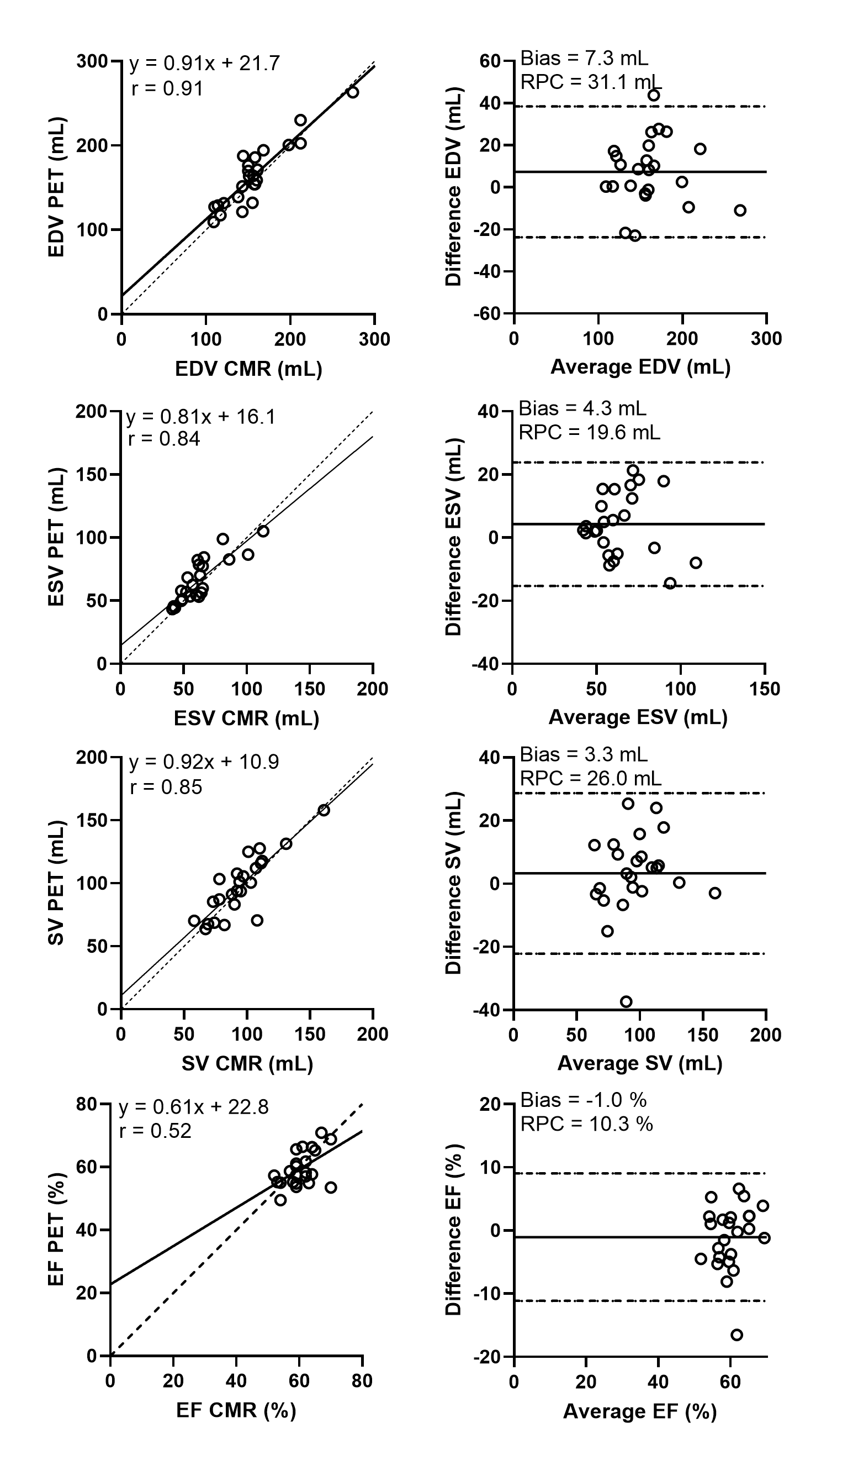
RESULTS
Journal of Nuclear Cardiology | Official Journal of the American Society of Nuclear Cardiology
Linear regression between PET and CMR for EDV, ESV, SV and EF
Copyright American Society of Nuclear Cardiology

Slide 5
RESULTS
Journal of Nuclear Cardiology | Official Journal of the American Society of Nuclear Cardiology
Relative mean bias, ICC, and r² between PET and CMR for all measured parameters.
 | Average PET | Average CMR | Bias (%) | ICC | r
EDV | 164 ± 37 mL | 156 ± 37 mL | 5.2 ± 10.5* | 0.90 | 0.91
ESV | 66 ± 17 mL | 61 ± 18 mL | 8.3 ± 15.5 | 0.82 | 0.84
SV | 98 ± 24 mL | 95 ± 22 mL | 4.0 ± 14.1 | 0.84 | 0.85
EF | 60 ± 6 % | 61 ± 5 % | -1.5 ± 8.1 | 0.51 | 0.52
EDV: end-diastolic volume, ESV: end-systolic volume, SV: stroke volume,
EF: ejection fraction, ICC: intra-class correlation coefficient. *p<0.05.
Intraclass correlation coefficient (ICC) for inter- and intra-observer variability for PET respectively CMR.
 | Inter-observer PET | Intra-observer PET | Inter-observer CMR | Intra-observer CMR
EDV | 0.93 (0.83-0.97) | 0.94 (0.86-0.97) | 0.97 (0.92-0.99) | 0.99 (0.97-1.0)
ESV | 0.85 (0.69-0.94) | 0.93 (0.85-0.97) | 0.89 (0.25-0.97) | 0.96 (0.70-0.99)
SV | 0.91 (0.79-0.96) | 0.86 (0.70-0.94) | 0.93( 0.84-0.97) | 0.98 (0.95-0.99)
EF | 0.68 (0.39-0.85) | 0.68 (0.68-0.85) | 0.50 (0.04-0.77) | 0.82 (0.40-0.94)
EDV: end-diastolic volume, ESV: end-systolic volume, SV: stroke volume, EF: ejection fraction.
Copyright American Society of Nuclear Cardiology

Slide 6
CONCLUSIONS
Journal of Nuclear Cardiology | Official Journal of the American Society of Nuclear Cardiology
LV volumes and EF can be calculated from a single ¹⁵O-water PET scan with high accuracy and comparable precision as with CMR.
The method is fast, highly automated, requires minimal user intervention and could be implemented as a part of the clinical standard analysis of ¹⁵O-water PET.
Copyright American Society of Nuclear Cardiology

