Slide 1
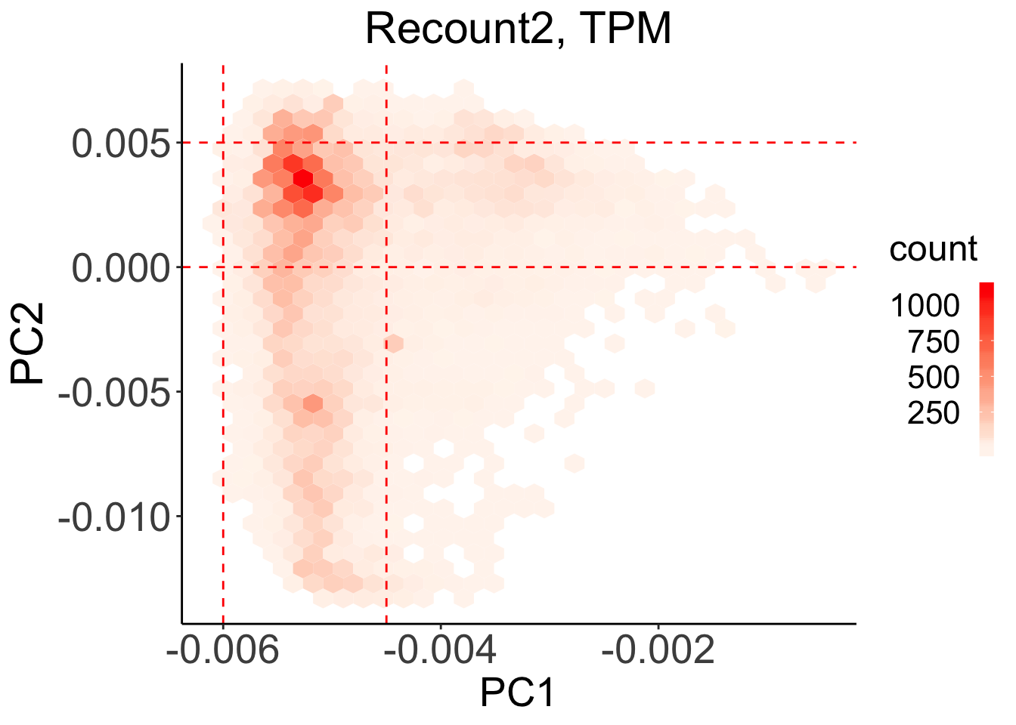
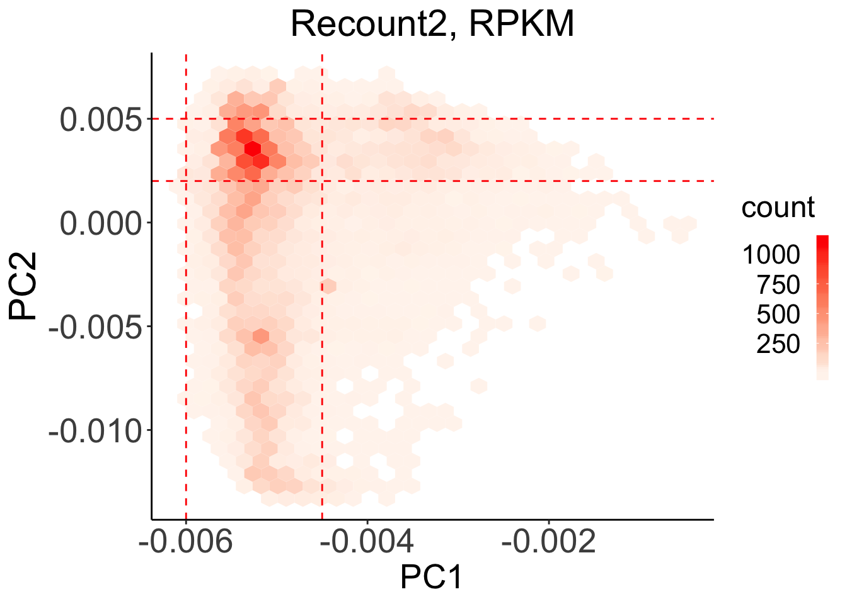
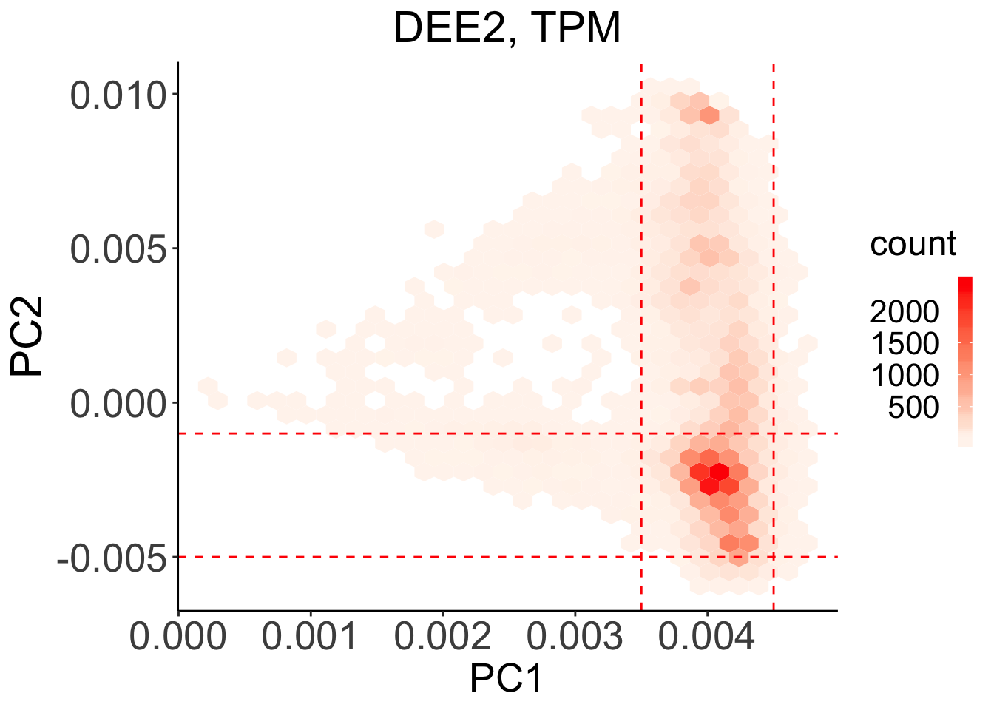
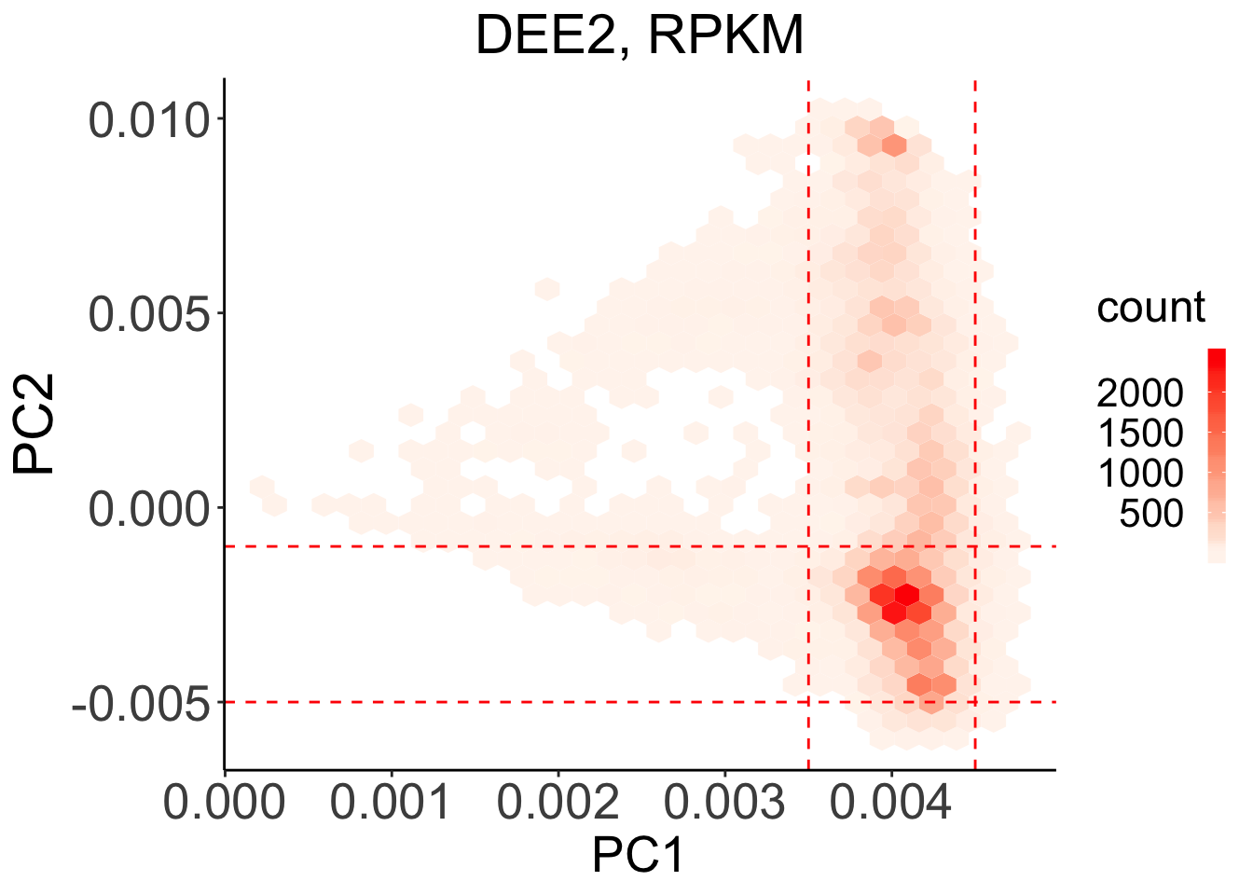
x axis cutoff: [-0.006, -0.0045]
y axis cutoff: [0, 0.005]
x axis cutoff: [-0.006, -0.0045]
y axis cutoff: [0.002, 0.005]
x axis cutoff: [0.0035, 0.0045]
y axis cutoff: [-0.005, -0.001]
x axis cutoff: [0.0035, 0.0045]
y axis cutoff: [-0.005, -0.001]

