Slide 1
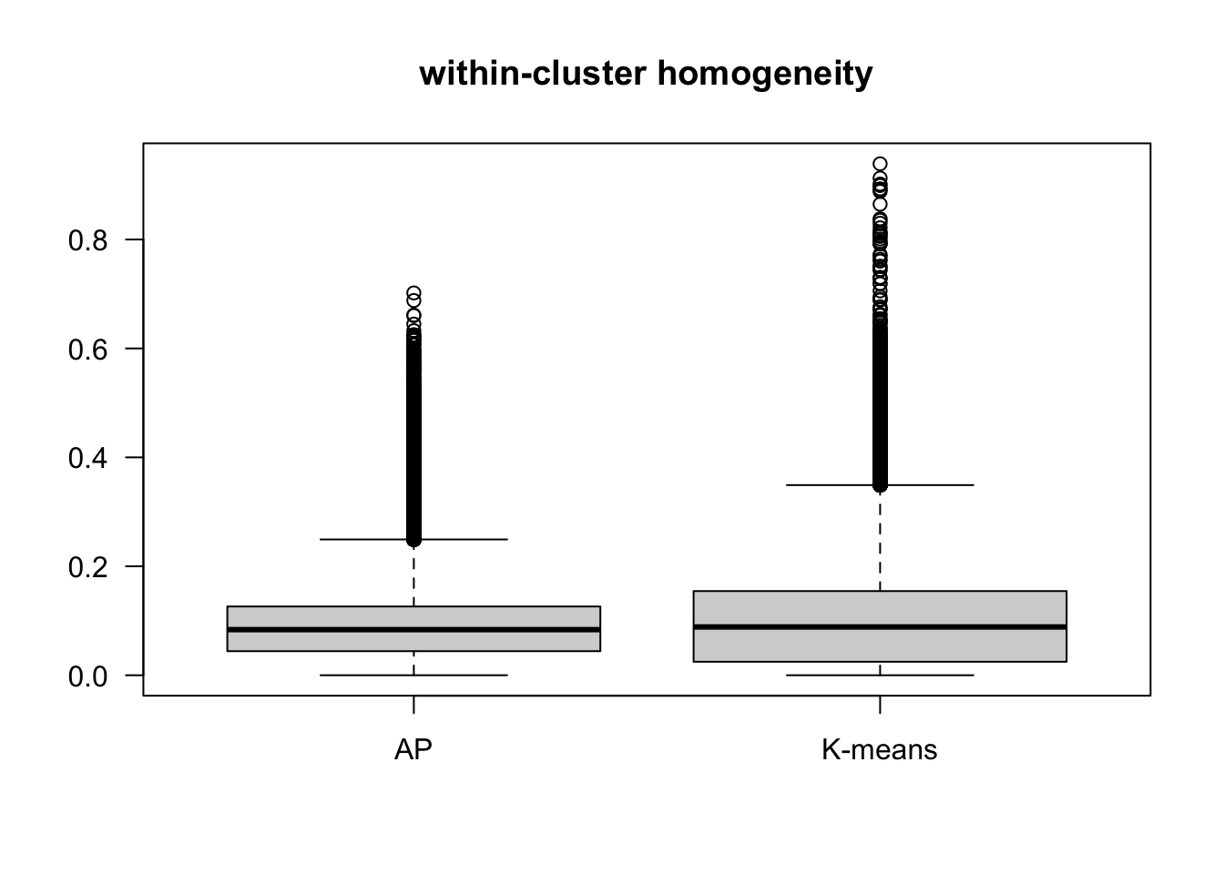
T-test p-value < 0.001

