Slide 1
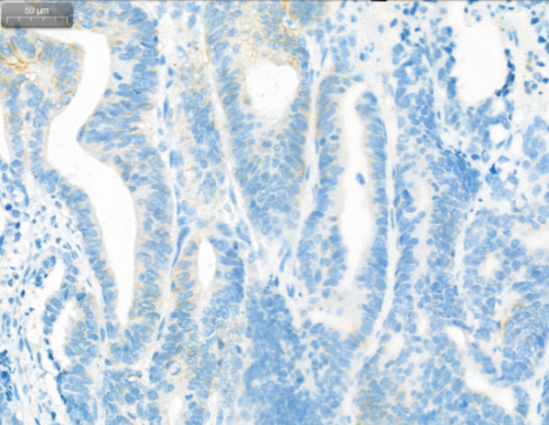
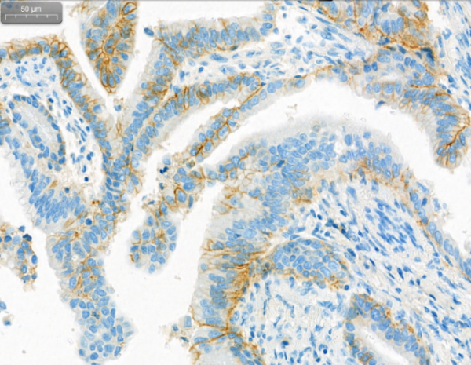
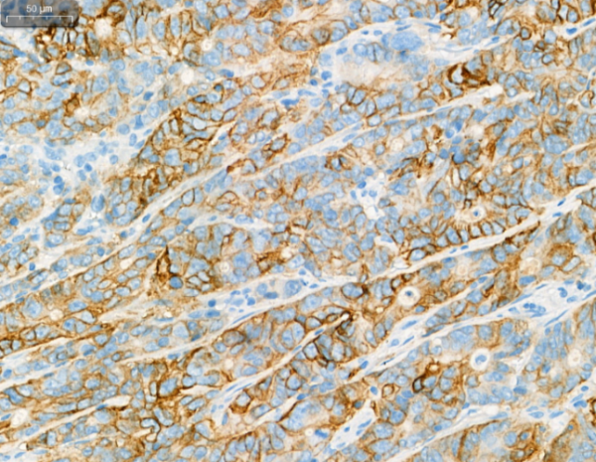
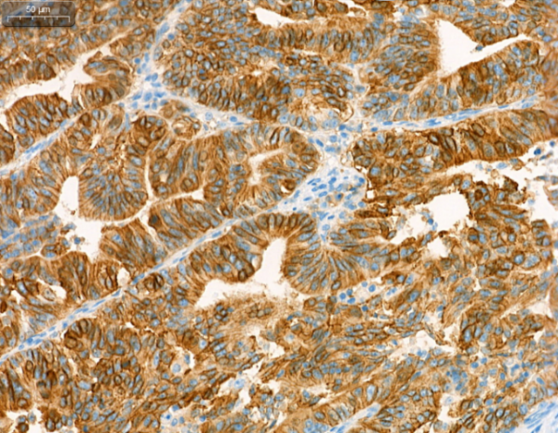
Figure S1
A
B
HER2 Score 0 | Figure
No membranous staining or staining of < 10% of the tumor cells
HER2 Score 1+ | Figure
Staining is weak or detected in only one part of the membrane in ≥ 10% of the tumor cells
50μm
50μm
C
D
HER2 Score 2+ | Figure
Moderate/weak complete or basolateral membranous staining in ≥ 10% of the tumor cells
HER2 Score 3+ | Figure
Strong complete or basolateral membranous staining in ≥ 10% of the tumor cells
50μm
50μm
E
Expression rates of HER2 in three independent sub-cohorts
Center | Total N | HER2 0 % (n) | HER2 1+ % (n) | HER2 2+ % (n) | HER2 3+ % (n)
Center 1 | 3304 | 53.4 (1765) | 25.5 (843) | 13.6 (449) | 7.5 (247)
Center 2 | 1693 | 42.5 (720) | 37.6 (636) | 13.2 (224) | 5.5 (93)
Center 3 | 625 | 64.6 (404) | 15.4 (96) | 13.9 (87) | 6.1 (38)

Slide 2
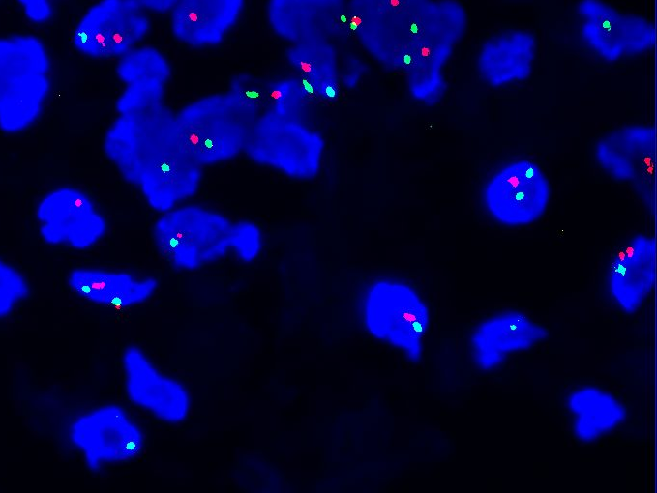
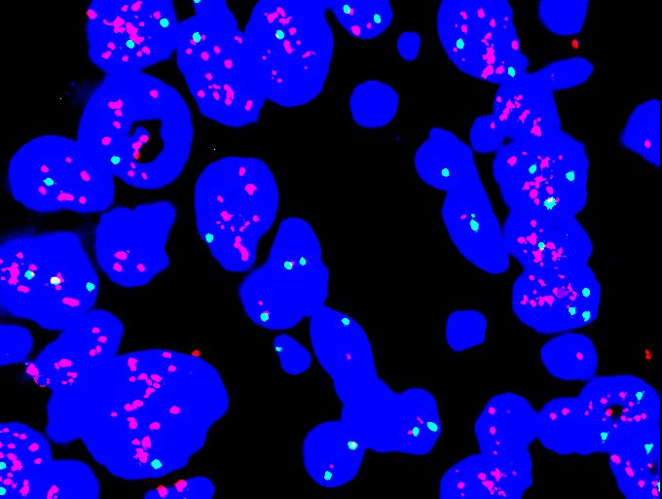
Figure S2
A
B
Absence of HER2 amplification
HER2 amplification

Slide 3
Figure S3
A
Stage II disease HER2 0/1+
B
Stage III disease HER2 0/1+
100
100
Chemotherapy
Disease-free Survival (%)
80
No Chemotherapy
80
60
60
40
Chemotherapy
40
20
No Chemotherapy
20
HR, 0.61 (95% CI, 0.46-0.81); P = 0.001
HR, 0.61 (95% CI, 0.54-0.69); P < 0.001
0
0
1
2
3
4
5
6
7
8
0
0
1
2
3
4
5
6
7
8
No. at risk
Years
Years
Chemotherapy
1248 |  | 1026 |  | 701 |  | 344 |  | 96
199 |  | 156 |  | 105 |  | 40 |  | 8
2601 |  | 1393 |  | 817 |  | 413 |  | 123
416 |  | 173 |  | 82 |  | 29 |  | 12
No Chemotherapy
C
Stage II disease HER2 2/3+
D
Stage III disease HER2 2/3+
100
100
Chemotherapy
Disease-free Survival (%)
80
No Chemotherapy
80
60
60
40
Chemotherapy
40
20
No Chemotherapy
20
HR, 1.12 (95% CI, 0.67-1.88); P = 0.674
HR, 0.52 (95% CI, 0.40-0.67); P < 0.001
0
0
1
2
3
4
5
6
7
8
0
0
1
2
3
4
5
6
7
8
No. at risk
Years
Years
Chemotherapy
339 |  | 268 |  | 182 |  | 92 |  | 18
73 |  | 55 |  | 36 |  | 12 |  | 2
646 |  | 373 |  | 242 |  | 117 |  | 20
100 |  | 37 |  | 21 |  | 9 |  | 2
No Chemotherapy

Slide 4
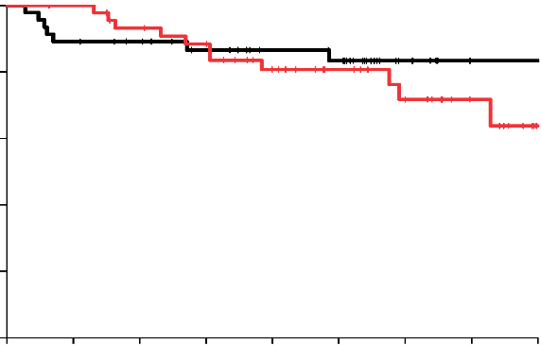
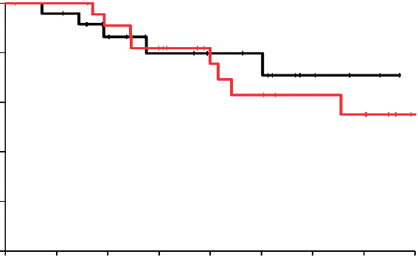
Figure S4
A
Stage II Disease HER2 2+
B
Stage II Disease HER2 3+
100
100
Overall Survival (%)
80
Overall Survival (%)
80
60
60
40
Chemotherapy
40
Chemotherapy
No Chemotherapy
No Chemotherapy
20
HR, 1.10 (95% CI, 0.40-3.03);
P = 0.859
20
HR, 1.46 (95% CI, 0.43-4.99);
P = 0.549
0
1
0
0
2
3
4
5
6
7
8
0
1
2
3
4
5
6
7
8
No. at risk
Years
No. at risk
Years
Chemotherapy
46 |  | 40 |  | 28 |  | 16 |  | 1
46 |  | 38 |  | 28 |  | 9 |  | 2
Chemotherapy
24 |  | 20 |  | 13 |  | 8 |  | 2
24 |  | 17 |  | 10 |  | 4 |  | 0
No Chemotherapy
No Chemotherapy

Slide 5
Figure S5
A
Stage II Disease HER2 2+
Stage II Disease HER2 2+ FISH No-amplified
Stage II Disease HER2 2+ FISH Amplified
B
C
100
100
100
Overall Survival (%)
80
80
80
60
60
60
40
Chemotherapy
40
Chemotherapy
40
Chemotherapy
20
No Chemotherapy
20
No Chemotherapy
20
No Chemotherapy
HR, 0.70 (95% CI, 0.21-2.39); P = 0.570
HR, 1.15 (95% CI, 0.26-5.08); P = 0.854
HR, 0.10 (95% CI, 0.01-1.53); P = 0.097
0
0
0
0
1
2
3
4
5
6
7
8
0
1
2
3
4
5
6
7
8
0
1
2
3
4
5
6
7
8
No. at risk
Years
Years
Years
Chemotherapy
48 | 46 | 41 | 40 | 38 | 33 | 29 | 25 | 8
7 | 7 | 5 | 4 | 4 | 4 | 2 | 1 | 1
37 | 36 | 31 | 31 | 29 | 25 | 22 | 18 | 5
6 | 6 | 5 | 4 | 4 | 4 | 2 | 1 | 1
11 | 10 | 10 | 9 | 9 | 8 | 7 | 7 | 3
1 | 1 | 0 | 0 | 0 | 0 | 0 | 0 | 0
No Chemotherapy
D
Stage III Disease HER2 2+
Stage III Disease HER2 2+ FISH No-amplified
Stage III Disease HER2 2+ FISH Amplified
E
F
100
Chemotherapy
100
Chemotherapy
100
Overall Survival (%)
80
No Chemotherapy
80
No Chemotherapy
80
60
60
60
40
40
40
Chemotherapy
20
20
20
No Chemotherapy
HR, 0.42 (95% CI, 0.21-0.84); P = 0.013
HR, 0.51 (95% CI, 0.24-1.09); P = 0.083
HR, 0.04 (95% CI, 0.004-0.45); P = 0.009
0
0
0
0
1
2
3
4
5
6
7
8
0
1
2
3
4
5
6
7
8
0
1
2
3
4
5
6
7
8
No. at risk
Years
Years
Years
Chemotherapy
61 | 56 | 47 | 34 | 24 | 22 | 16 | 13 | 2
14 | 9 | 5 | 4 | 3 | 2 | 1 | 1
45 | 41 | 34 | 25 | 18 | 16 | 11 | 8
12 | 9 | 5 | 4 | 3 | 2 | 1 | 1
16 | 15 | 13 | 9 | 6 | 6 | 5 | 5 | 2
2 | 0 | 0 | 0 | 0 | 0 | 0 | 0 | 0
No Chemotherapy

Slide 6
Figure S6
A
Stage II Disease T1/T2 HER2 0/1+
B
Stage II Disease T1/T2 HER2 2/3+
100
100
Overall Survival (%)
80
Overall Survival (%)
80
60
60
40
Chemotherapy
40
Chemotherapy
No Chemotherapy
No Chemotherapy
20
HR, 0.39 (95% CI, 0.17-0.88);
P = 0.024
20
HR, 0.74 (95% CI, 0.25-2.18);
P = 0.581
0
1
0
0
2
3
4
5
6
7
8
0
1
2
3
4
5
6
7
8
No. at risk
Years
No. at risk
Years
Chemotherapy
322 |  | 286 |  | 200 |  | 96 |  | 28
32 |  | 26 |  | 16 |  | 7 |  | 3
Chemotherapy
95 |  | 83 |  | 57 |  | 25 |  | 7
17 |  | 13 |  | 8 |  | 1 |  | 0
No Chemotherapy
No Chemotherapy
C
Stage II Disease T3/T4 HER2 0/1+
D
Stage II Disease T3/T4 HER2 2/3+
100
100
Overall Survival (%)
80
Overall Survival (%)
80
60
60
40
Chemotherapy
40
Chemotherapy
No Chemotherapy
No Chemotherapy
20
HR, 0.56 (95% CI, 0.40-0.78);
P = 0.001
20
HR, 1.34 (95% CI, 0.64-2.83);
P = 0.443
0
0
0
1
2
3
4
5
6
7
8
0
1
2
3
4
5
6
7
8
No. at risk
Years
No. at risk
Years
Chemotherapy
926 |  | 799 |  | 545 |  | 270 |  | 69
167 |  | 137 |  | 95 |  | 35 |  | 5
Chemotherapy
244 |  | 210 |  | 147 |  | 81 |  | 13
56 |  | 44 |  | 31 |  | 12 |  | 2
No Chemotherapy
No Chemotherapy

Slide 7
Figure S7
A
Stage II Disease N0/N1 HER2 0/1+
B
Stage II Disease N0/N1 HER2 2/3+
100
100
Overall Survival (%)
80
Overall Survival (%)
80
60
60
40
Chemotherapy
40
Chemotherapy
No Chemotherapy
No Chemotherapy
20
HR, 0.55 (95% CI, 0.40-0.76);
P < 0.001
20
HR, 1.05 (95% CI, 0.55-2.00);
P = 0.890
0
0
0
1
2
3
4
5
6
7
8
0
1
2
3
4
5
6
7
8
No. at risk
Years
No. at risk
Years
Chemotherapy
1063 |  | 922 |  | 627 |  | 308 |  | 82
180 |  | 150 |  | 103 |  | 38 |  | 6
Chemotherapy
282 |  | 243 |  | 169 |  | 90 |  | 16
65 |  | 49 |  | 34 |  | 12 |  | 2
No Chemotherapy
No Chemotherapy
C
Stage II Disease N2/N3 HER2 0/1+
D
Stage II Disease N2/N3 HER2 2/3+
100
100
Overall Survival (%)
80
Overall Survival (%)
80
60
60
40
Chemotherapy
40
Chemotherapy
No Chemotherapy
No Chemotherapy
20
HR, 0.30 (95% CI, 0.11-0.81);
P = 0.017
20
HR, 2.10 (95% CI, 0.28-16.08);
P = 0.474
0
0
0
1
2
3
4
5
6
7
8
0
1
2
3
4
5
6
7
8
No. at risk
Years
No. at risk
Years
Chemotherapy
185 |  | 163 |  | 118 |  | 58 |  | 15
19 |  | 13 |  | 8 |  | 4 |  | 2
Chemotherapy
57 |  | 50 |  | 35 |  | 16 |  | 4
8 |  | 8 |  | 5 |  | 1 |  | 0
No Chemotherapy
No Chemotherapy

Slide 8
Figure S8
A
Stage II Disease GEJ HER2 0/1+
B
Stage II Disease GEJ HER2 2/3+
100
100
Overall Survival (%)
80
Overall Survival (%)
80
60
60
40
Chemotherapy
40
Chemotherapy
No Chemotherapy
No Chemotherapy
20
HR, 0.56 (95% CI, 0.33-0.93);
P = 0.026
20
HR, 2.38 (95% CI, 0.72-7.79);
P = 0.153
0
0
0
1
2
3
4
5
6
7
8
0
1
2
3
4
5
6
7
8
No. at risk
Years
No. at risk
Years
Chemotherapy
346 |  | 307 |  | 207 |  | 102 |  | 28
80 |  | 67 |  | 45 |  | 16 |  | 2
Chemotherapy
125 |  | 108 |  | 71 |  | 37 |  | 4
34 |  | 26 |  | 14 |  | 6
No Chemotherapy
No Chemotherapy
C
Stage II Disease Gastric HER2 0/1+
D
Stage II Disease Gastric HER2 2/3+
100
100
Overall Survival (%)
80
Overall Survival (%)
80
60
60
40
Chemotherapy
40
Chemotherapy
No Chemotherapy
No Chemotherapy
20
HR, 0.49 (95% CI, 0.33-0.72);
P < 0.001
20
HR, 0.73 (95% CI, 0.35-1.50);
P = 0.389
0
0
0
1
2
3
4
5
6
7
8
0
1
2
3
4
5
6
7
8
No. at risk
Years
No. at risk
Years
Chemotherapy
902 |  | 778 |  | 538 |  | 264 |  | 69
119 |  | 96 |  | 66 |  | 26 |  | 6
Chemotherapy
214 |  | 185 |  | 133 |  | 69 |  | 16
39 |  | 31 |  | 25 |  | 7 |  | 2
No Chemotherapy
No Chemotherapy

