Slide 1
Assessment | Prednisolone (N) | Placebo (N) | Reference
Imaging | 12 |  | Figure 2
Suction blisters |  |  | Figure 3 + 4
- Pre tape stripping | 12 | 12
- Post tape striping | 6 | 6
24h 48h 72h | 6 6 6 | 6 5 6
Biopsy |  |  | Figure 5
- Pre tape stripping | 12 | 12
- Post tape striping | 6 | 6
24h 48h 72h | 6 6 6 | 6 6 6
Whole blood stimulation |  |  | Figure 6
Pre- dose | 12 | 12
48h | 12 | 12
52h | 12 | 10
96h | 12 | 12

Slide 2
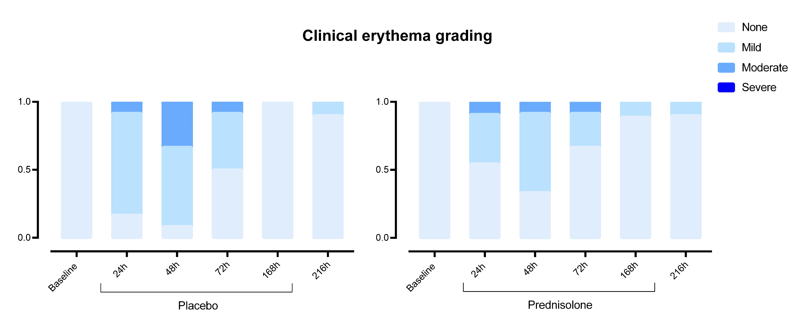

Slide 3
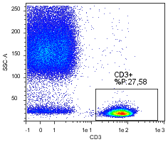
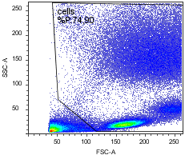
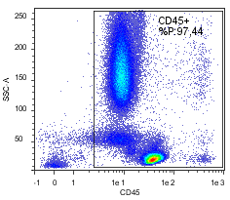
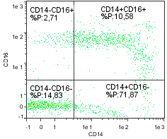
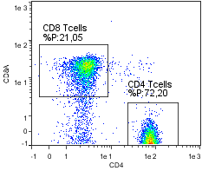
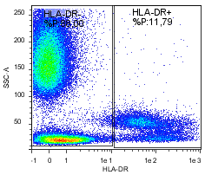
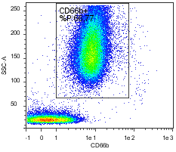
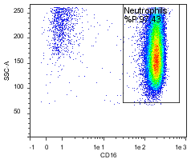
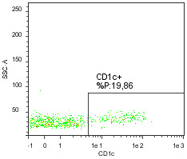
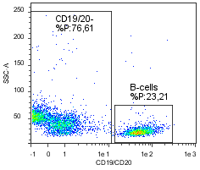

Slide 4
 |  | IFN-γ |  | IL-1β |  | IP-10 |  | IL-6 |  | Mx-A
 |  | Stimulated with IMQ | Unstimulated | Stimulated with IMQ | Unstimulated | Stimulated with IMQ | Unstimulated | Stimulated with IMQ | Unstimulated | Stimulated with IMQ | Unstimulated
 |  | Mean ± SD (pg/mL)
Placebo
 | Pre- dose | 14426 ±18648 | 38 ± 39 | 806 ± 712 | 2 ± 1.7 | 97133 ± 24778 | 900 ± 1536 | 13780 ± 10395 | 7.0 ± 6.6 | 15885 ± 32982 | 14219 ± 33578
 | 48h | 22984 ± 21880 | 37 ± 41 | 1016 ± 888 | 1.6 ± 1.0 | 941912 ± 29086 | 1037 ± 1813 | 17669. ± 13116 | 6.1 ± 5.0 | 15705 ± 33037 | 14006 ± 33669
 | 52h | 28545 ± 26669 | 55 ± 106 | 1052 ± 1611 | 1.8 ± 1.3 | 89270 ± 24812 | 1529 ± 3561 | 13727 ± 10750 | 6.9 ± 7.2 | 17144 ± 36339 | 16256 ± 36808
 | 96h | 25919 ± 23784 | 49 ± 58 | 1220 ± 1191 | 1.7 ± 1.0 | 97108 ± 25927 | 1079 ± 1445 | 17050 ± 13378 | 11.6 ± 17.9 | 15686 ± 33042 | 13658 ± 33757
Prednisolone
 | Pre- dose | 10801 ± 6778 | 24 ± 9 | 1083 ± 865 | 1.6 ± 0.8 | 94683 ± 25500 | 344 ± 378 | 14147 ± 11184 | 16 ± 4 | 5576 ± 3871 | 2674 ± 1914
 | 48h | 12362 ± 6030 | 23 ± 7 | 853 ± 700 | 2.1 ± 1.2 | 102675 ± 17272 | 388 ± 675 | 16422 ± 13266 | 10.7 ± 13.0 | 5619 ± 3911 | 2802 ± 2186
 | 52h | 317 ± 193 | 21 ± 0 | 90 ± 99 | 1.6 ± 0.9 | 40970 ± 30494 | 115 ± 111 | 2293 ± 1558 | 2.8 ± 0 | 5051 ± 3928 | 2772 ± 2195
 | 96h | 3346 ± 1509 | 21 ± 0 | 499 ± 330 | 1.9 ± 1.3 | 91975 ± 28295 | 166 ± 169 | 11130 ± 9302 | 5.6 ± 9.9 | 5004 ± 3867 | 2768 ± 2154

