Slide 1
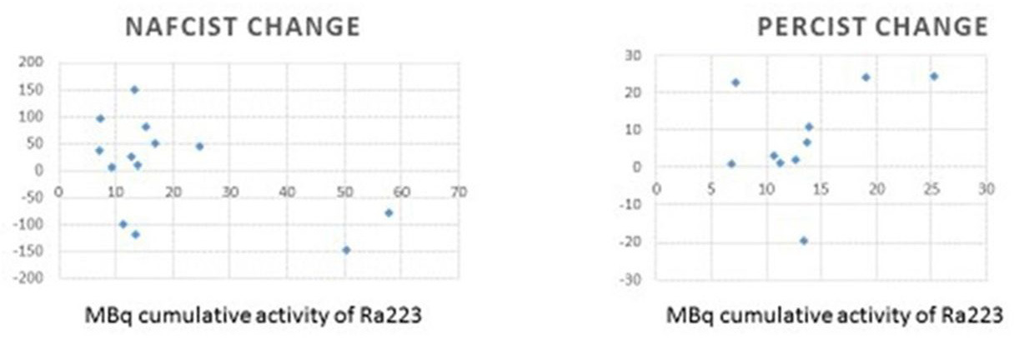
Supplementary Figure: Comparison between NAFCIST and PERCIST. Figure by Kairemo K et al. 2019. ESMO Open. 4(1).

