Slide 1
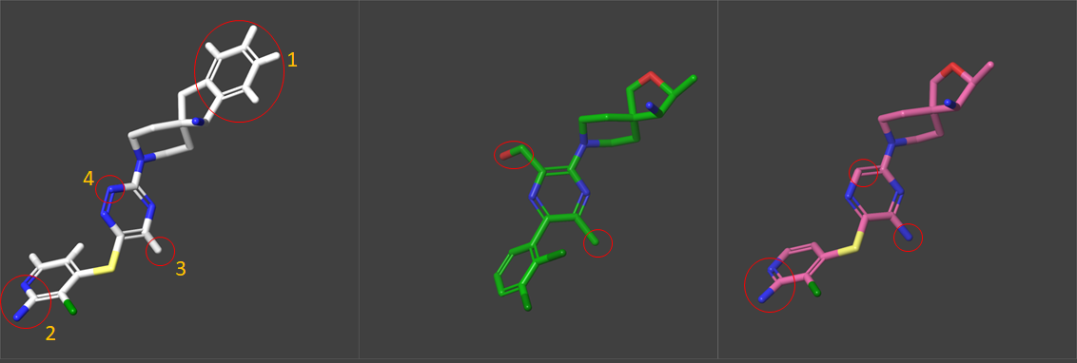
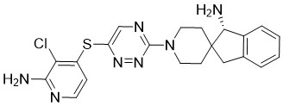
SUPPLEMENTARY FIGURE 1. Comparison of the structures of PF-07284892, RMC445507, TNO155 bound to SHP2
A
PF-07284892
ARRY-558
RMC45507
TNO155
B
(A) The most notable difference for PF-07284892 is the fused phenyl of the dihydroindene, which fits deeper into the interface tunnel and makes enhanced contact to the main chain of several residues, especially an edge-face contact to Phe113 (Feature 1). Other notable differences include: the aminopyridine shared by PF-07284892 and TNO155 is solvent exposed and interacting with several waters (Feature 2); the methyl that is shared by PF-07284892 and RMC45507 lacks the H-bond to Glu250 that is present for the amine of TNO155 (Feature 3); the 1,2,4-triazine of PF-07284892 mimics the hydroxymethyl of RMC45507 via water-mediated contacts to the carbonyls of Arg111 and Leu216, as well as the sidechain of Arg111; these contacts are absent in the complex for TNO155 and diminished for RMC45507 (Feature 4). PDB codes are 7RCT for RMC45507 and 7JVM for TNO155. (B) Chemical structure of PF-07284892.

