Slide 1
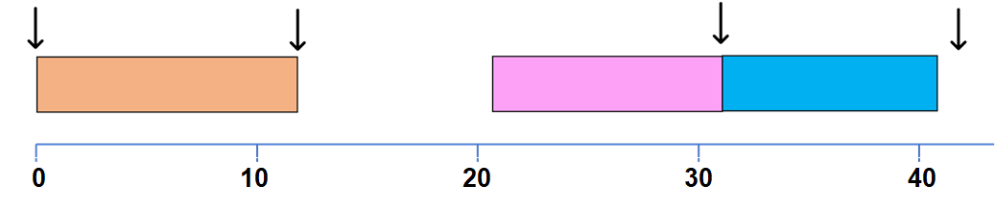

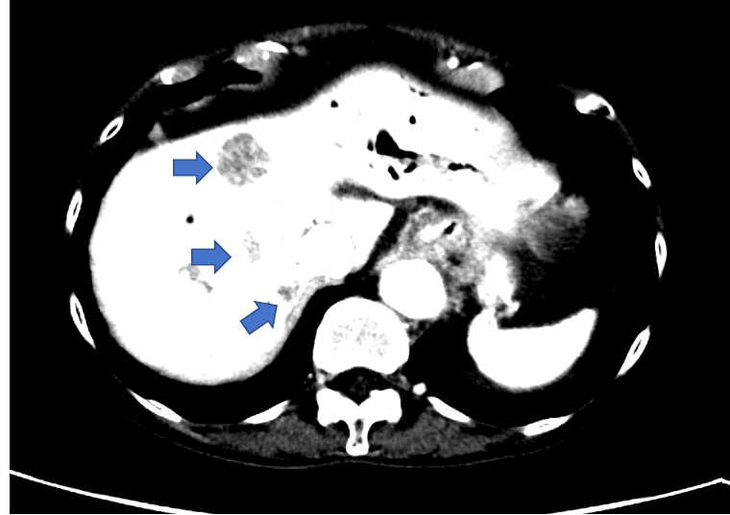
SUPPLEMENTARY FIGURE 7. PF-07284892 sensitizes a patient with GOPC-ROS1 fusion-positive pancreatic cancer to lorlatinib
A
GOPC-ROS1 fusion+ Pancreatic Cancer
Diagnosis
AE
PD
PD
PD
Gemcitabine + Abraxane + Nivolumab (PR)
Repotrectinib (SD)
PF-072848492 (PD) →
PF-072848924892 + lorla (PR)
B
C
lorlatinib 100 mg QD
lorlarinib 75 mg
lorlatinib 100 mg
PF-4892 20 mg D1,D4
PF-4892 40 mgz
D
Screening
Week 6
Week 12
Before PF-08284892
After PF-07284892 mono
PF-07284892+ lorla

Slide 2
Supplementary Figure 7 (cont). (A) Prior treatments included chemotherapy plus an anti-PD1 antibody discontinued due to a treatment-related AE and repotrectinib (investigational ROS1 inhibitor) discontinued for PD. (B) Levels of PF-07284892 (red squares) in plasma as in Figure 2D; blood samples for pERK were not available. (C) Changes in the sum of the longest tumor diameters of target lesions (blue circles) and in levels of GOPC-ROS1 (green triangles) and CTNNB1S45F (grey squares) in ctDNA, as in Figure 2E. (D) Imaging of the liver showing three metastatic lesions at screening, prior to PF-07284892 treatment (left), after 6 weeks of PF-07284892 monotherapy (middle), and after 6 weeks of combined treatment with PF-07284892 and lorlatinib (right). Treatment-related AEs were diarrhea (grade 1-2), edema (grade 1), amylase/lipase elevation (grade 2), and ascites (grade 2); none were considered DLTs. Abbreviations are as in Figure 2.

