Slide 1
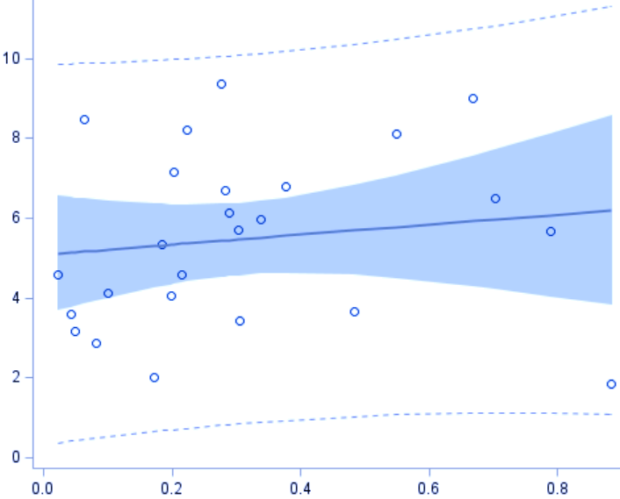
Supplemental Fig. I
Carnosine nmoles/mg tissue
r²=0.0061
ns
RBC carnosine nmoles/mg protein

