Slide 1
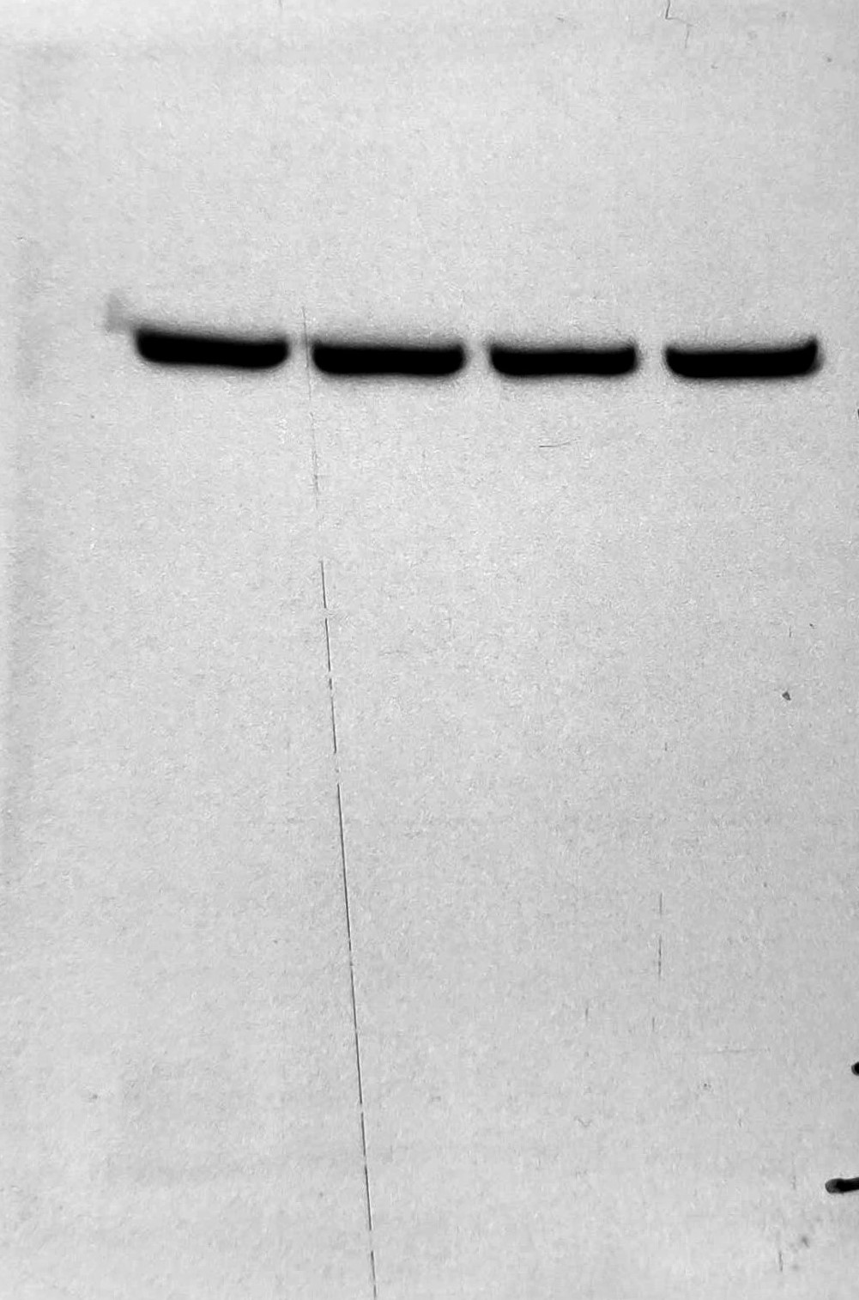
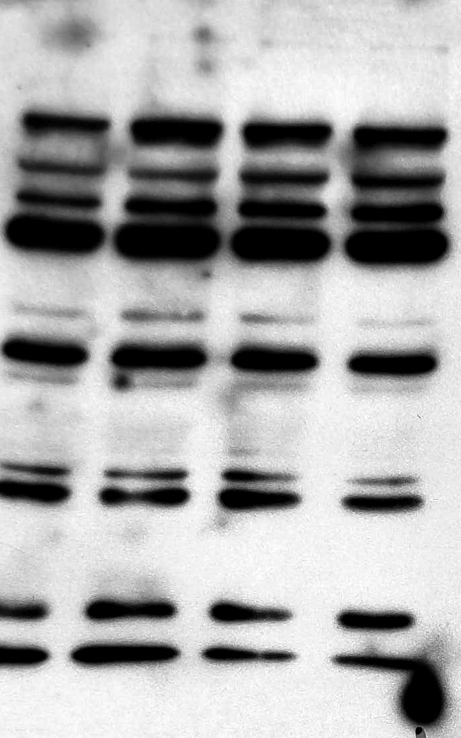
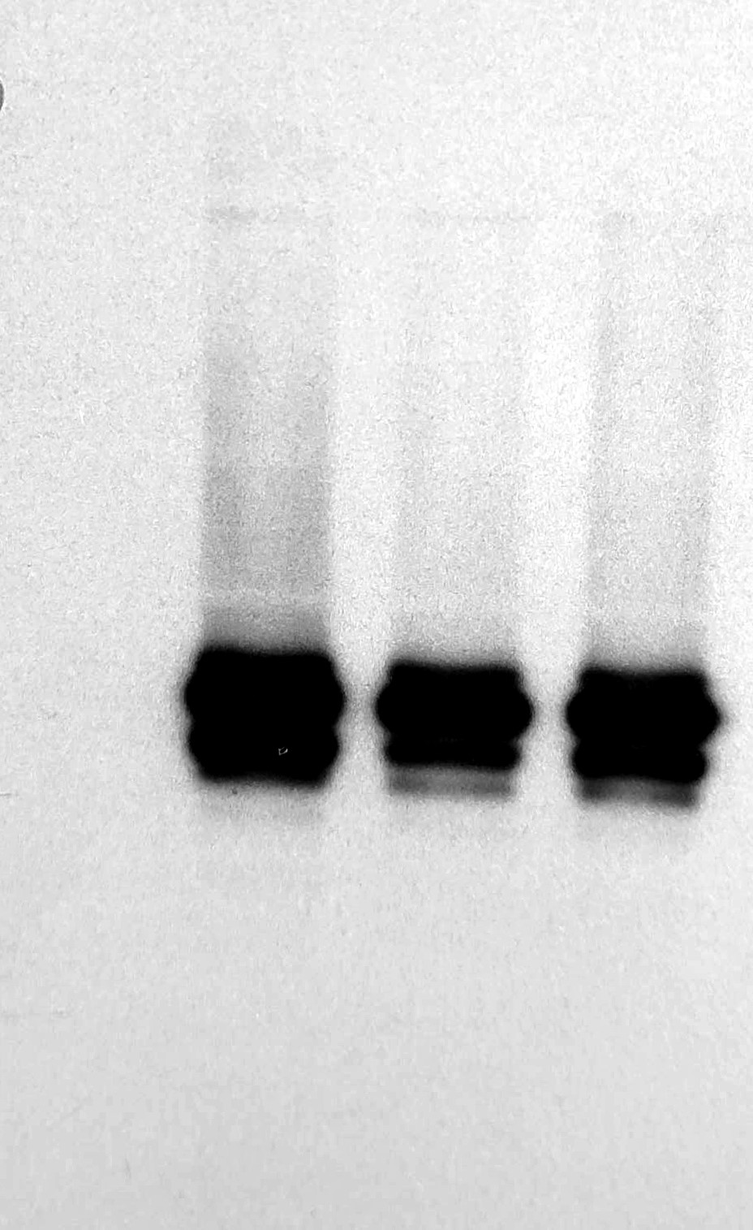
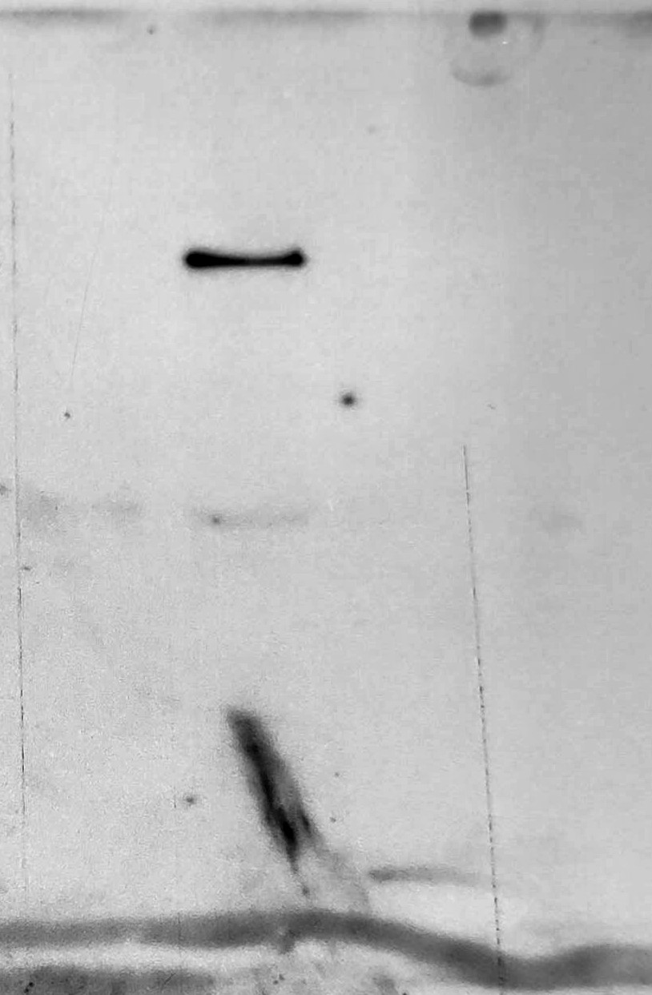
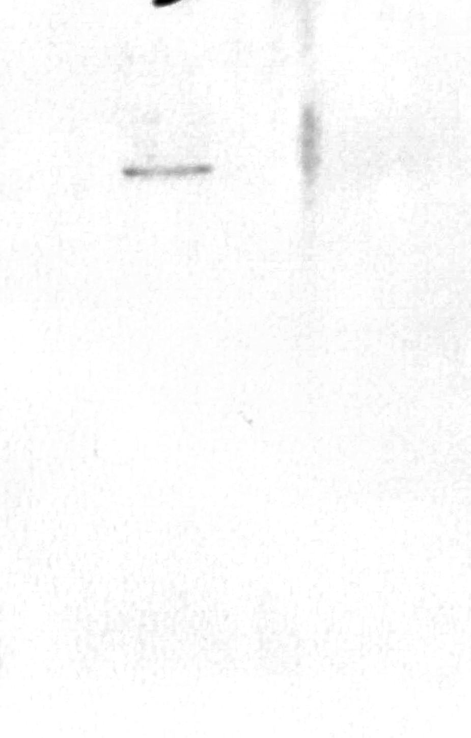
Succoio_supplementary_materials – Uncropped images for Figure 1
XPO1
TNPO1
CA IX
XPO1
TNPO1

Slide 2
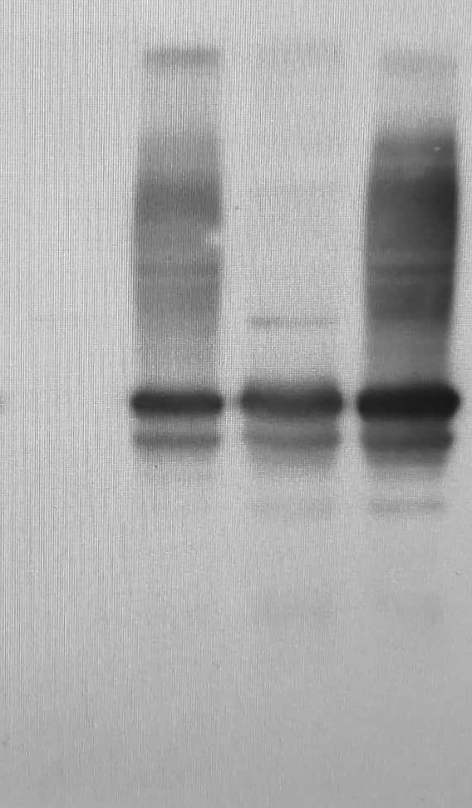
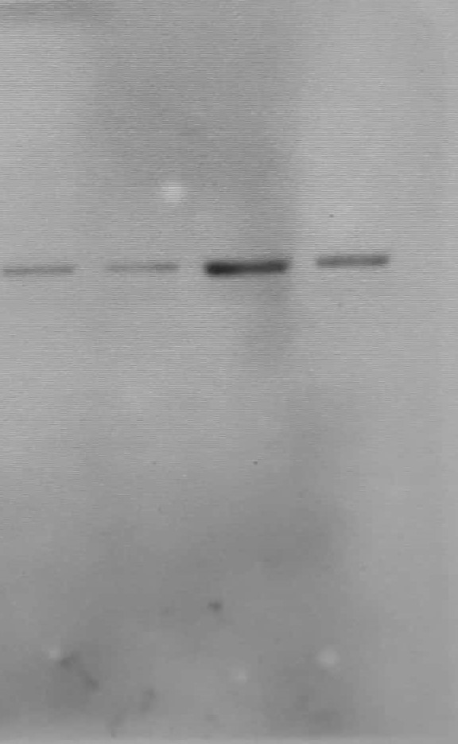
Succoio_supplementary_materials – Uncropped images for Figure 3
CA IX
GRP78

Slide 3
Succoio_supplementary_materials – Uncropped images for Figure4
MUT1
WT
MUT4
MUT1
WT
MUT4
EndoH
MUT1
WT
MUT4
O-Glycosydase
Neuraminidase + O-Glycosydase

