Slide 1
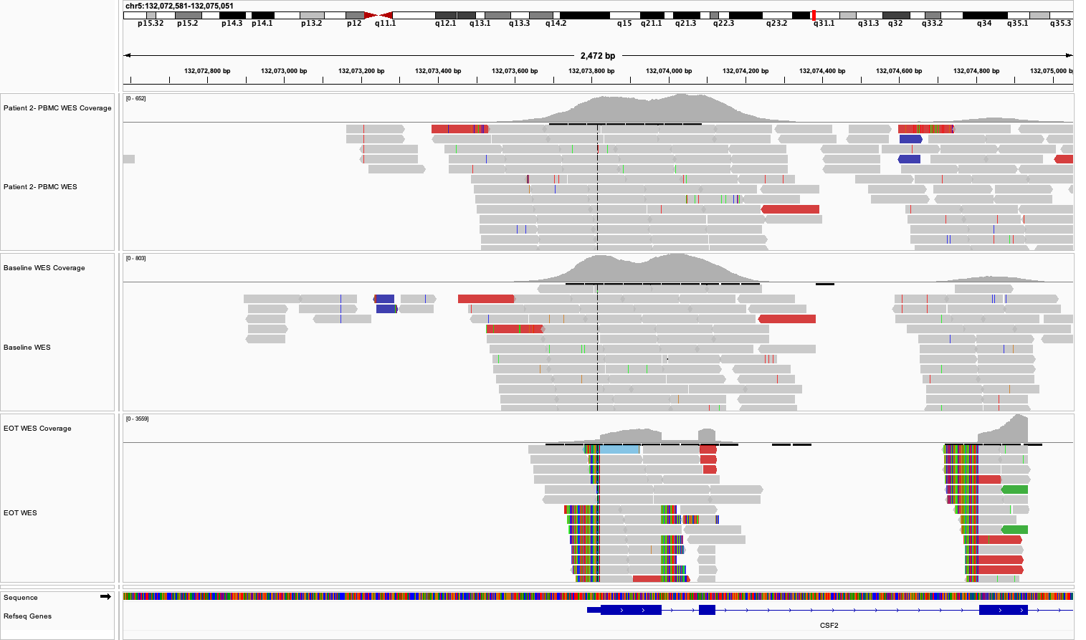
WES reads clipped at edges of exons
Short-clipped reads with CMV promoter sequence

Slide 2
Supplementary Figure S3. Detection of talimogene laherparepvec (T-VEC) vector reads in case #2. This screenshot from the integrated genomics viewer shows reads aligning to CSF2 (GM-CSF) from the peripheral blood, baseline, and end-of-treatment (EOT) whole exome sequencing (WES) data from the surgical specimen of case #2. The short-clipped ends of the reads at the 5’ end of CSF2 contained the T-VEC cytomegalovirus (CMV) promoter sequence, and reads spanned the exon-exon junctions of the CSF2 transcript. This pattern was not observed in the surgical (EOT) specimens from the other patients or in baseline samples.

