Slide 1
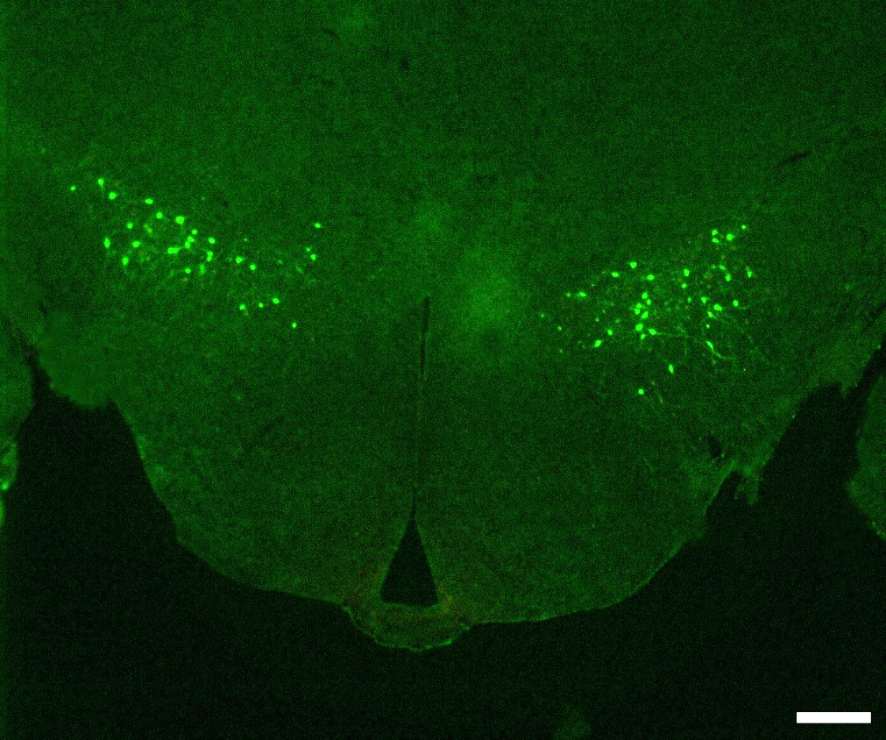
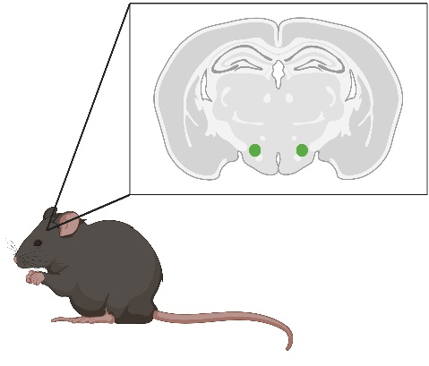
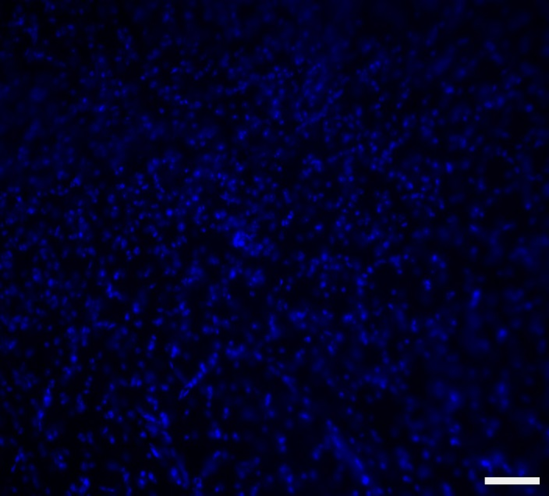
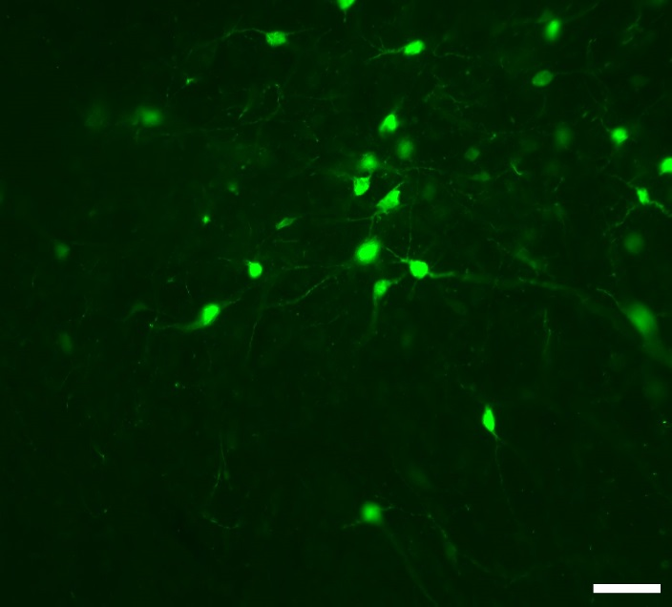
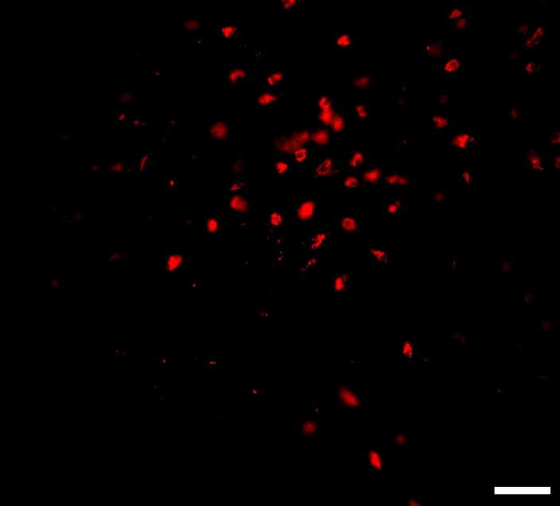
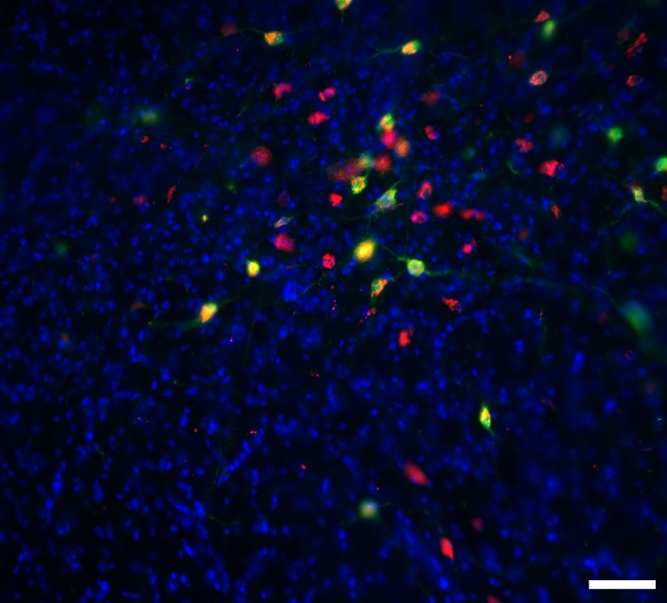
Figure S1.
A.
EGFP
LH
LH
fornix
fornix
Hcrt/ox-GFP
3V
B.
ME
DAPI
EGFP
Hcrt/ox
Merge

Slide 2
Figure S2.
8
20
6
15
4
% change R
% change MP
10
2
5
Control
BIS
Control
BIS

Slide 3
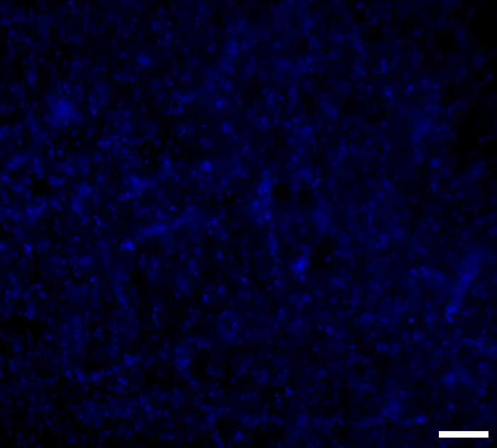
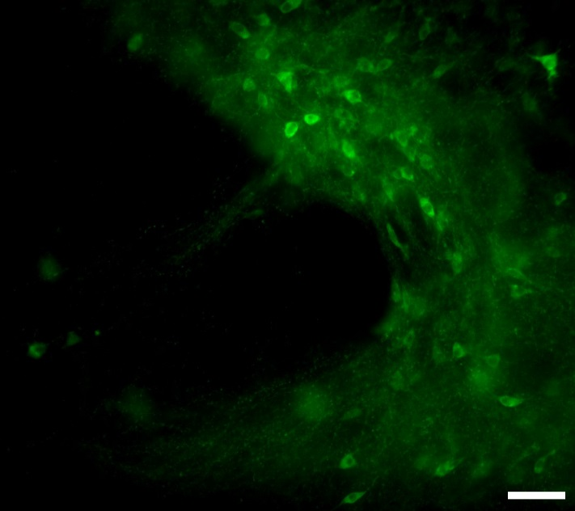
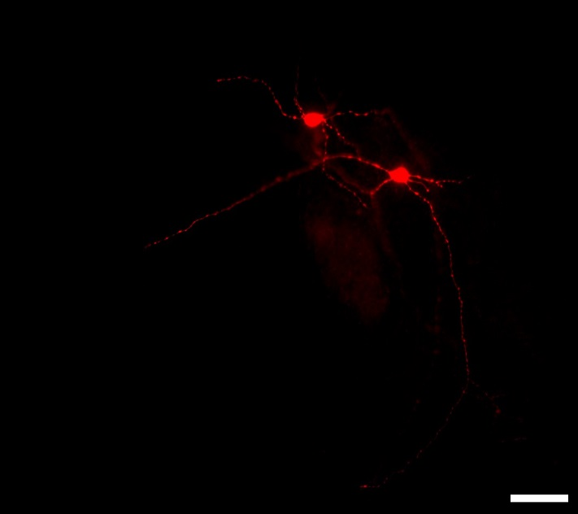
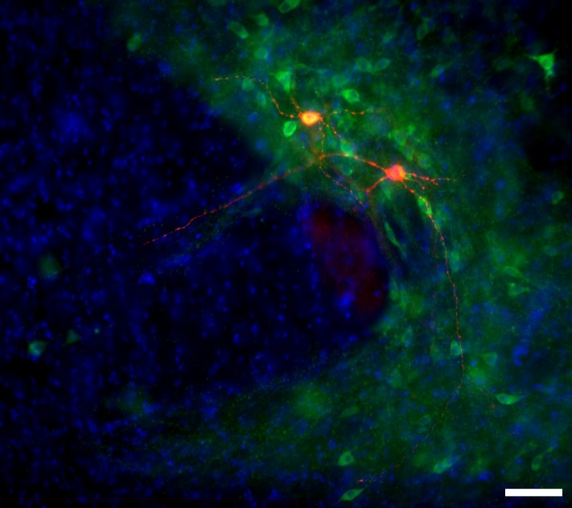
Figure S3.
A.
50pA
25ms
-60mV
-80mV
-100mV
-120mV
Ih
-140mV
B.
DAPI
TH
Biocytin
Merge

Slide 4
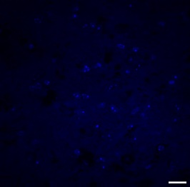
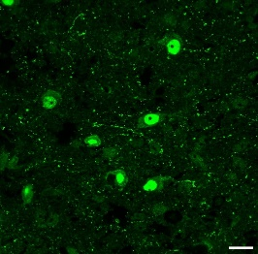
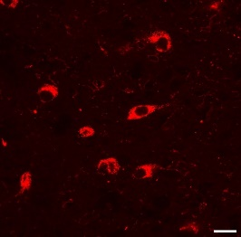
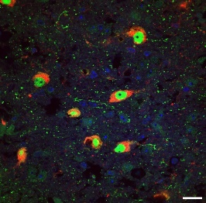
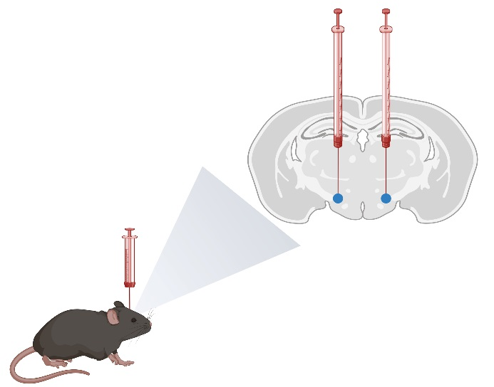
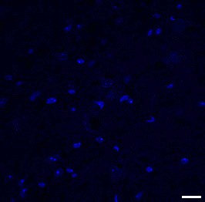
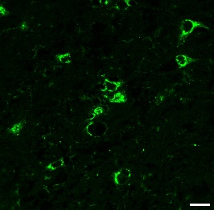
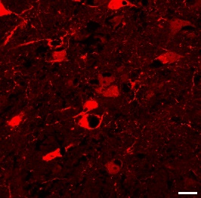
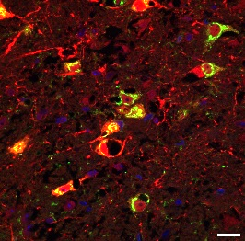
Figure S4.
A.
DAPI
Cre
Hcrt/ox
Merge
B.
pAAV-hSyn-DIO-mCherry
or
pAAV-hSyn-DIO-hM4D(Gi)-mCherry
Orexin-Cre mice: 6-Week-old
C.
DAPI
Hcrt/ox
mCherry
Merge

Slide 5
Figure S5.
pAAV-hSyn-DIO-mCherry
Control
C21
10mV
500ms
pAAV-hSyn-DIO-hM4D(Gi)-mCherry
Control
C21
10mV
500ms

