Slide 1
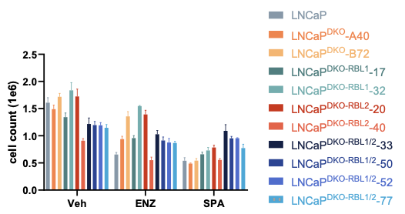
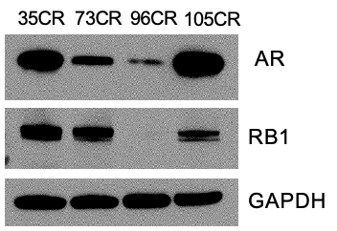
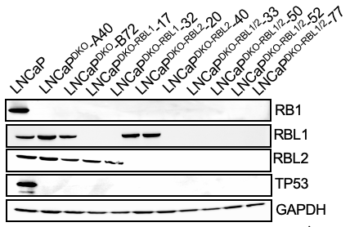
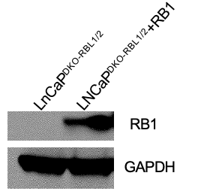
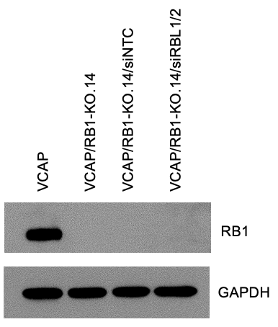
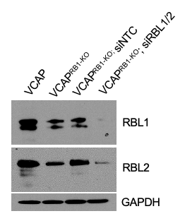
SUPPLEMENTARY FIGURE 1
a
c
b
d
e
f
LNCaP
LNCaP^{DKO-RBL1/2}
LNCaP^{DKO-RBL1/2} + RB1
g
h
Supplementary Figure 1. Characterization of prostate cancer models.
a) Immunoblots for AR and RB1 in LuCaP PDX lines. Note: whole genome sequencing of the 96CR line indicates monoallelic copy loss and no evident mutation in the second allele. The immunoblot detects a very weak band. This line may have functional RB1 loss.
b) Immunoblots for RB1, RBL1, and RBL2 of RB-family knockout clones derived from LNCaP TP53/RB1 double knockout cells (LNCaP^{DKO}). TP53/RB1/RBL1 knockout = LNCaP^{DKO-L1}; TP53/RB1/RBL2 knockout = LNCaP^{DKO-L2}; TP53/RB1/RBL1/RBL2 knockout = LNCaP^{DKO-L1;L2}.
c) Absolute growth of knockout clones with treatment with ENZ or SPA.
d) Immunoblot of RB1 rescue in LNCaP^{DKO-RBL1/2}.
e) Growth assay of LNCaP, LNCaP^{DKO-RBL1/2}, and LNCaP^{DKO-RBL1/2}-RB1 rescue cells.
f) Immunoblot of RB1 in VCaP cells with CRISPR/Cas9 RB1 gene deletion.
g) Dose-response assay of VCAP-RB1 KO cells. Suffix numbers refer to individual clone IDs.
h) Immunoblot confirming knockdown of RBL1 and RBL2 on VCAP/RB1-KO cells

Slide 2
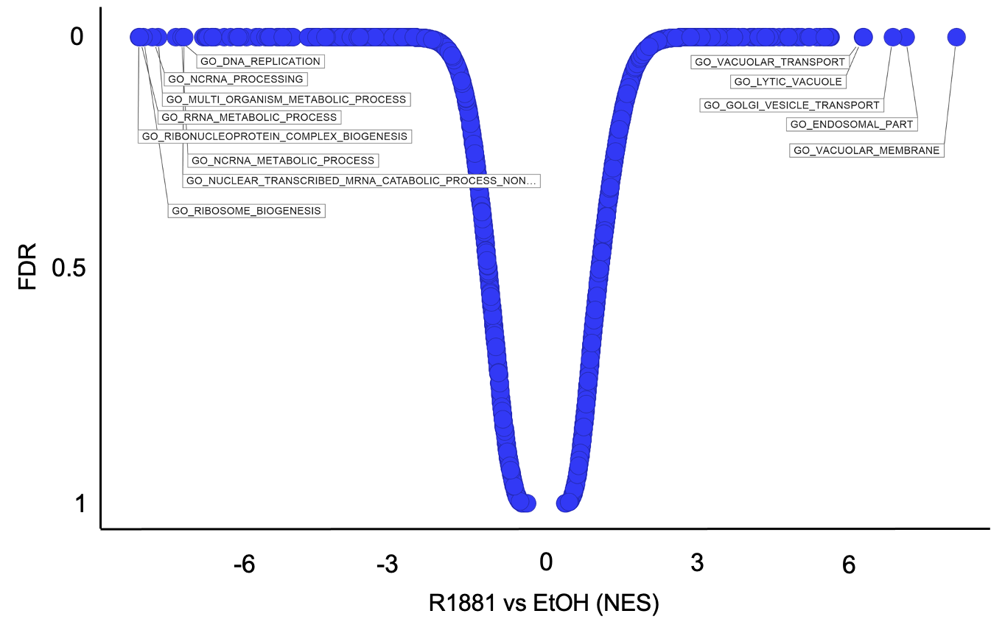
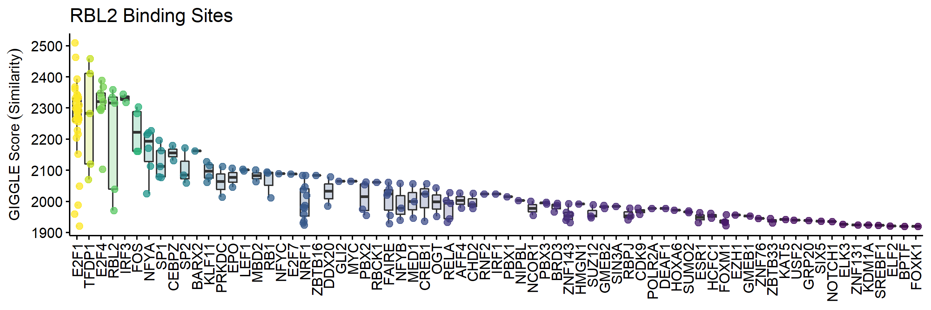
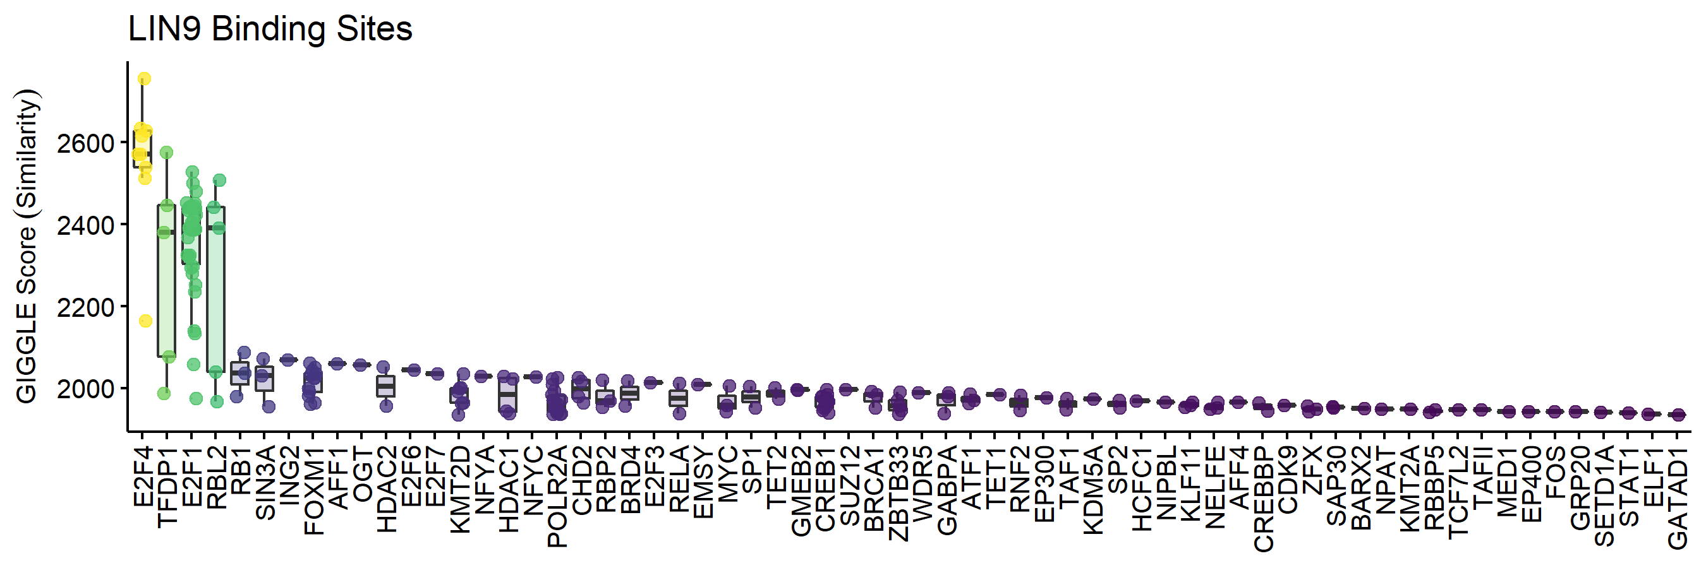
SUPPLEMENTARY FIGURE 2
a
b
150
FDR > 0.05
FDR < 0.05
-log10(FDR)
100
50
0
-2.5
0
-2.5
5
7.5
Fold Change log2(LNCaP) – log2(LNCaP^{DKO-L1;L2})
c
d
Supplementary Figure 2. RB1 and DREAM Component Chromatin Localization
(a) Gene Ontology Gene Sets enriched and depleted by supraphysiological androgen treatment (10nM R1881) in LNCaP^{DKO} (TP53-/-; RB1-/-) cells.
(b) Volcano Plot of differentially enriched RB1 antibody bound chromatin sites between LNCaP and LNCaP^{DKO-L1;L2} cells treated with 10nM R1881.
(c) Motif analysis for RBL2 bound sites determined by Cut&Run,
(d) Motif analysis for LIN9 bound sites determined by ChIP-seq.

Slide 3
SUPPLEMENTARY FIGURE 3
a
b
Supplementary Figure 3. Chromatin modifying proteins and predicted regulators of SPA induced transcription.
(a) Log2-protein abundance scores of proteins enriched with LIN37-bound chromatin in LNCaP^{DKO} cells treated with SPA (10nM R1881) or EtOH control for chromatin modifying proteins. All proteins shown were significantly enriched (FDR < 0.05) over the IgG pulldown control.
(b) Top motifs of SPA-activated genes in DKO RNA-seq datasets as predicted by Lisa analysis.

Slide 4
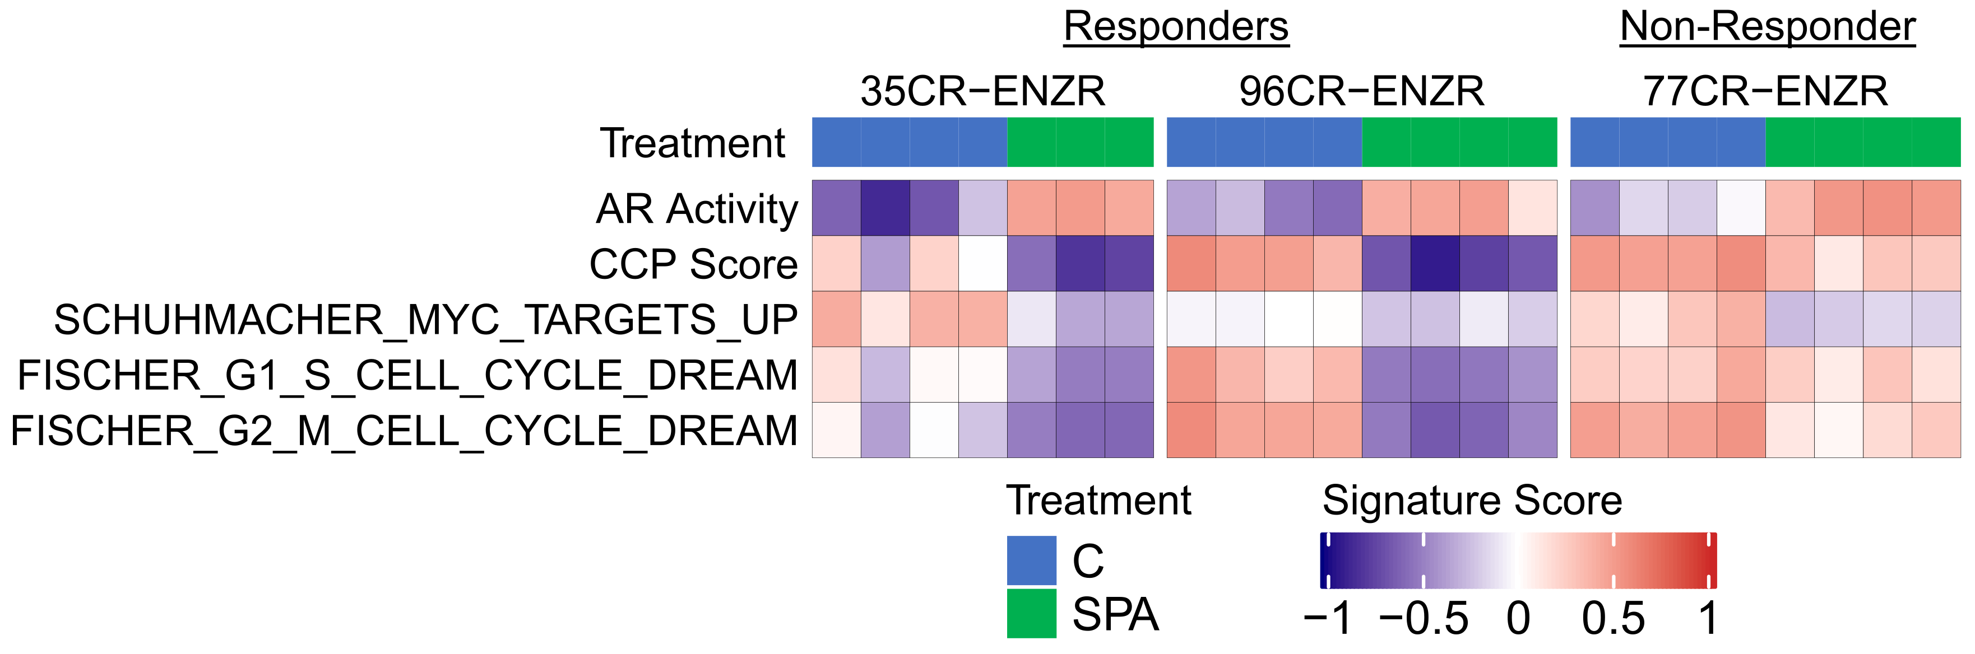
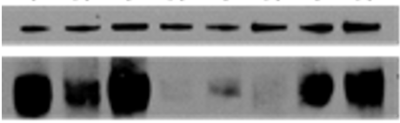

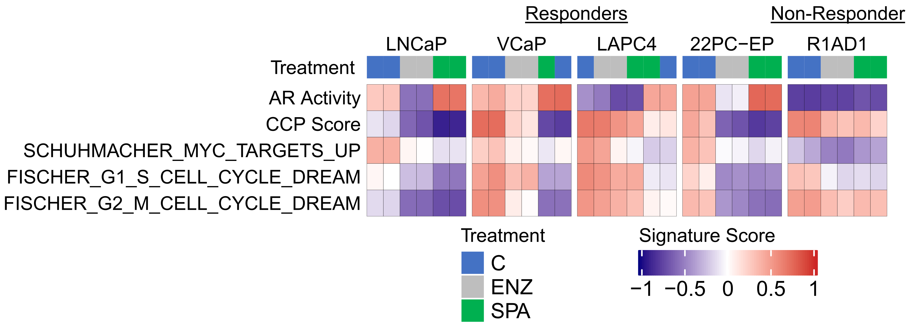
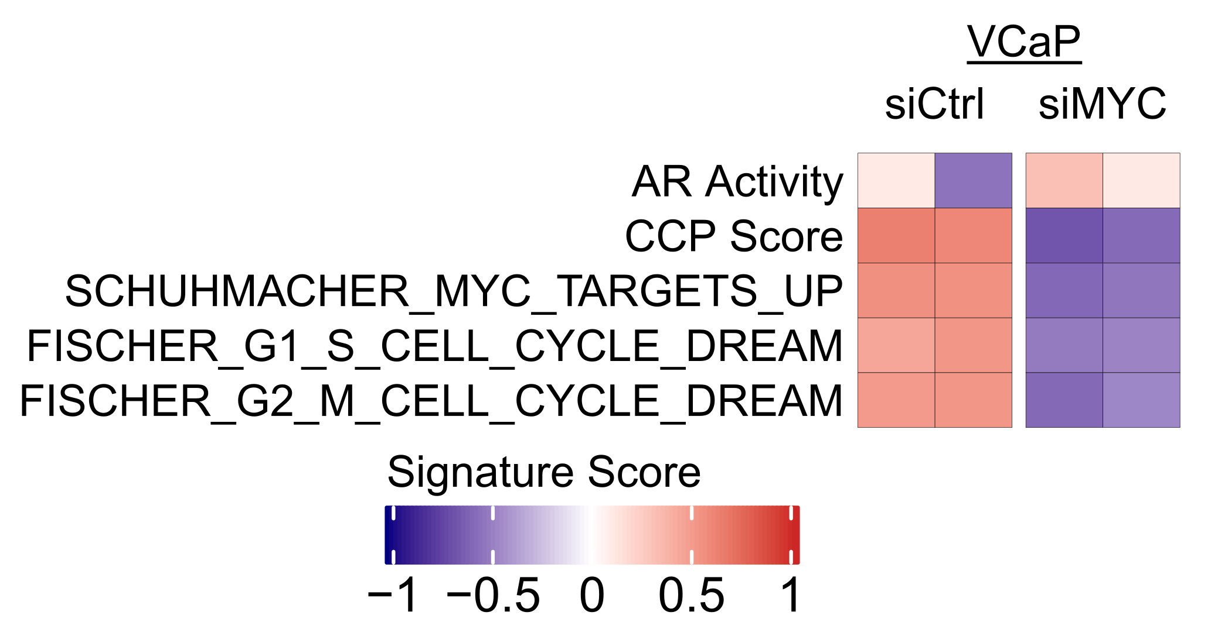
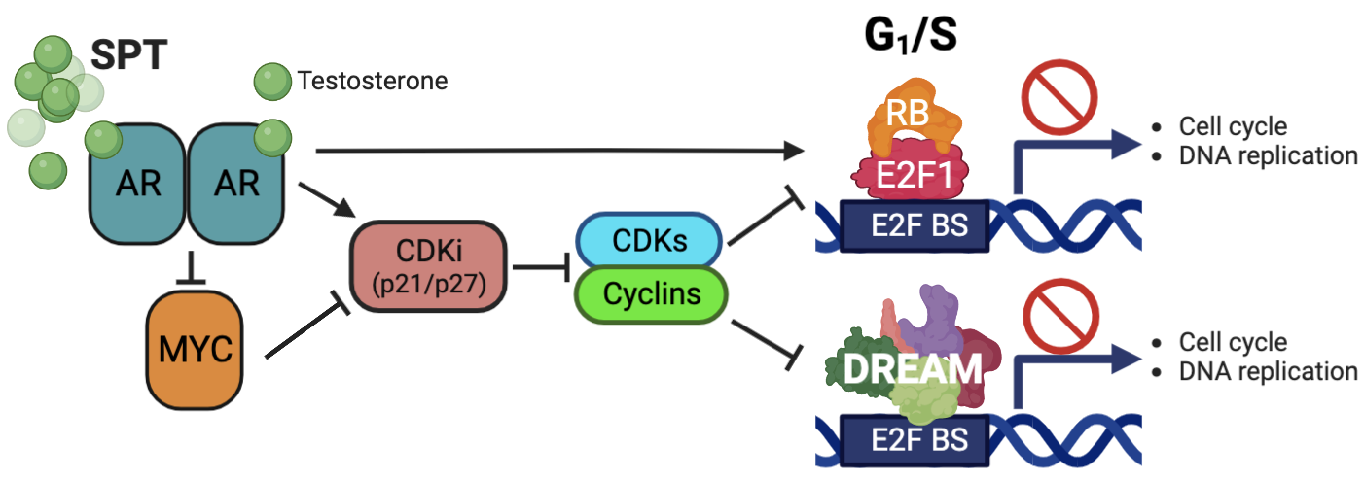
SUPPLEMENTARY FIGURE 4
a
b
LNCaP^{DKO-RBL1/2}-50
LNCaP
LNCaP^{DKO}
LNCaP^{DKO-RBL1/2}-52
AR
GAPDH
c
d
LNCaP-
DKO-GFP
LNCaP-
DKO-MYC
MYC
GAPDH
R1881
e
f
Supplementary Figure 4. DREAM Gene Signature Expression.
a) Immunoblot for AR protein expression. Two replicates for each sample type are shown.
Suffix designations for LNCaPDKO-RBL1/2 are clone identifiers.
b) Immunoblot of LNCaP^{DKO} GFP and LNCaP^{DKO}-MYC after treatment with 10nM R1881 for 48hrs
c) Molecular signature (GSVA) score heatmaps of SPA responder vs non-responder PDX lines.
C = control treatment; SPA = supraphysiological androgens
d) GSVA of SPA responder vs non-responder cell lines.
C = control treatment; SPA = supraphysiological androgens; ENZ = enazalutamide.
e) GSVA results of MYC knockdown in VCAP cells. Columns are replicate experiments (GSM4969720).
f) Schematic of supraphysiological testosterone (SPT) mediated prostate cancer growth arrest. SPT, supraphysiological testosterone or other androgens; AR, androgen receptor; CDKi, cyclin dependent kinase inhibitors; CDKs, cyclin dependent kinases; E2F BS, genomic binding sites for E2F.

