Slide 1
Figure S1
Descriptive flow-chart of NIPT results.

Slide 2
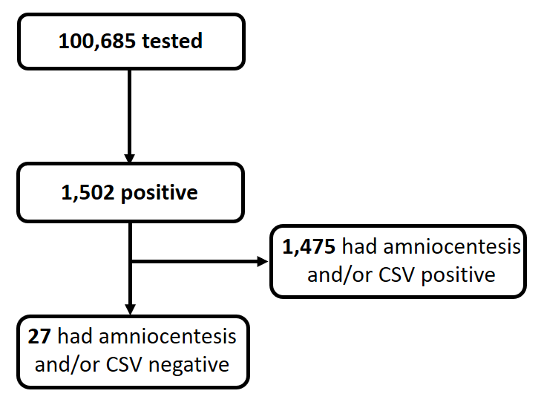
Figure S1

