Slide 1
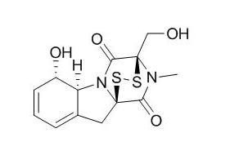
1
Gliotoxin (1)
Nfi
Avi
Aud
Ale
Gliotoxin
Afu
Std.
Figure S2

