Slide 1
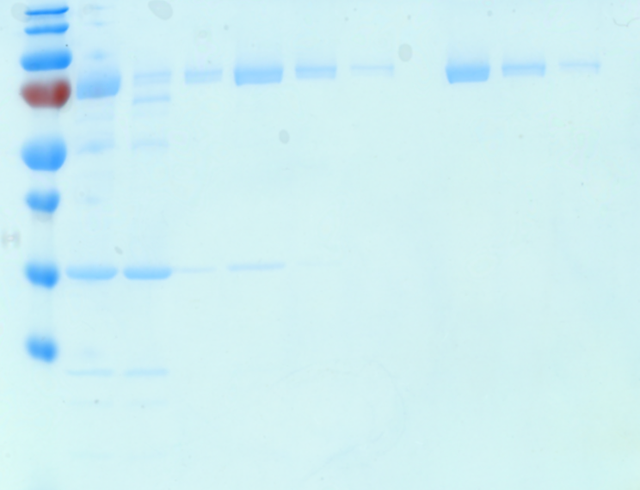
Figures 4a and S2c
Figures 4b and S2e
70kDa-
70kDa-
40kDa-
25kDa-
15kDa-
10kDa-
Figure 4c
70kDa-
Figure S2a
Figure S2d
70kDa-
70kDa-
70kDa-
40kDa-
40kDa-
70kDa-
40kDa-
Figure S2c
25kDa-
10kDa-
10kDa-
10kDa-
10kDa-
Source Data. Original, unspliced images for gels. The figures associated with each image were indicated above the images, molecular weight markers are indicated on the left.

