Slide 1
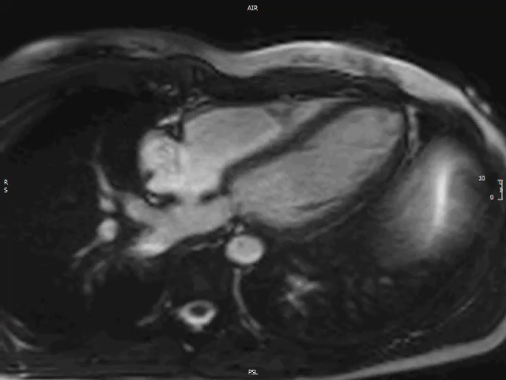
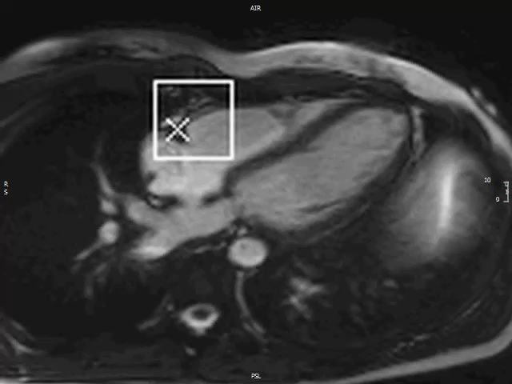
A
B
Video 01: Video showing A) video of the free-breathing 4 chamber cine scan used for right coronary artery (RCA) tracking to determine cardiac motion and 2) overlay of the same image to illustrate the motion of the RCA.

