Slide 1
Table S1:Ten gene edits and their function
Genetic Modifications in donor pig for Cardiac Xenotransplantation
Genetic Modification | Mechanisms | Properties
Xenogenic Carbohydrate Knockout
Galactose-α-1,3-galactose KO (GTKO) | Deletion of immunogenic Galactose-α-1,3-galactose (Gal) glycan through knockout of the synthetic enzyme alpha1,3-galactosyltransferase (GT) | Anti-Immunogenic
β1,4-N-acetylgalactosyltransferase KO (B4GalKO) | Deletion of immunogenic blood group SDa antigen through knockout of the synthetic enzyme (B4GalNT2)
CMP-N-acetylneuraminic acid hydroxylase KO (CMAHKO) | Deletion of immunogenic glycan N-glycolylneuraminic acid (Neu5Gc) through knockout of the synthetic enzyme CMP-N-acetylneuraminic acid hydroxylase (CMAH)
Growth Hormone Receptor Knockout (GHRKO) | Reduction of downstream insulin growth factor-1 (IGF-1) signaling | Reduce intrinsic graft growth
Human Transgene Expression
CD46 | Suppress human complement activity by mediating cleavage of C3b and C4b complement deposition | Complement Regulation
Decay Accelerating Factor (DAF) | Inhibits C3 and C5 convertase enzymes and downstream complement activation
Epithelial Cell Protein C Receptor (EPCR) | Activates Protein C | Anti-Coagulation
Thrombomodulin (TBM) | Binds human thrombin and activates Protein C via activated thrombin
Heme oxygenase-1 (HO-1) | Decreases oxidative products | Anti-Inflammatory
CD47 | Interacts with macrophage signal regulatory protein (SIRP)α to prevent opsonization and phagocytosis of xenogeneic tissue

Slide 2
Table S2: Immunosuppression (IS) regimen comparison: IS for non-human primates (NHPs) vs. Cardiac xenograft recipient

Slide 3
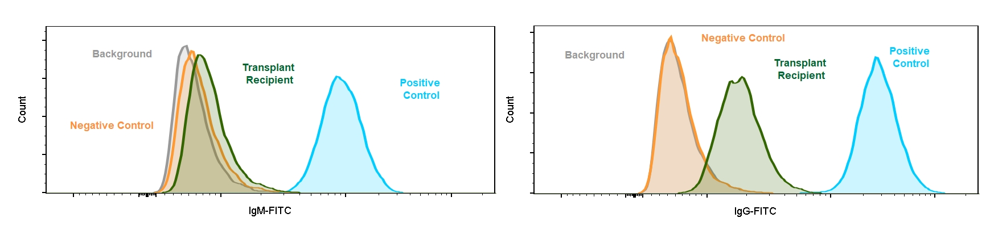
Figure 1 (i): (a) Antibody Binding

Slide 4
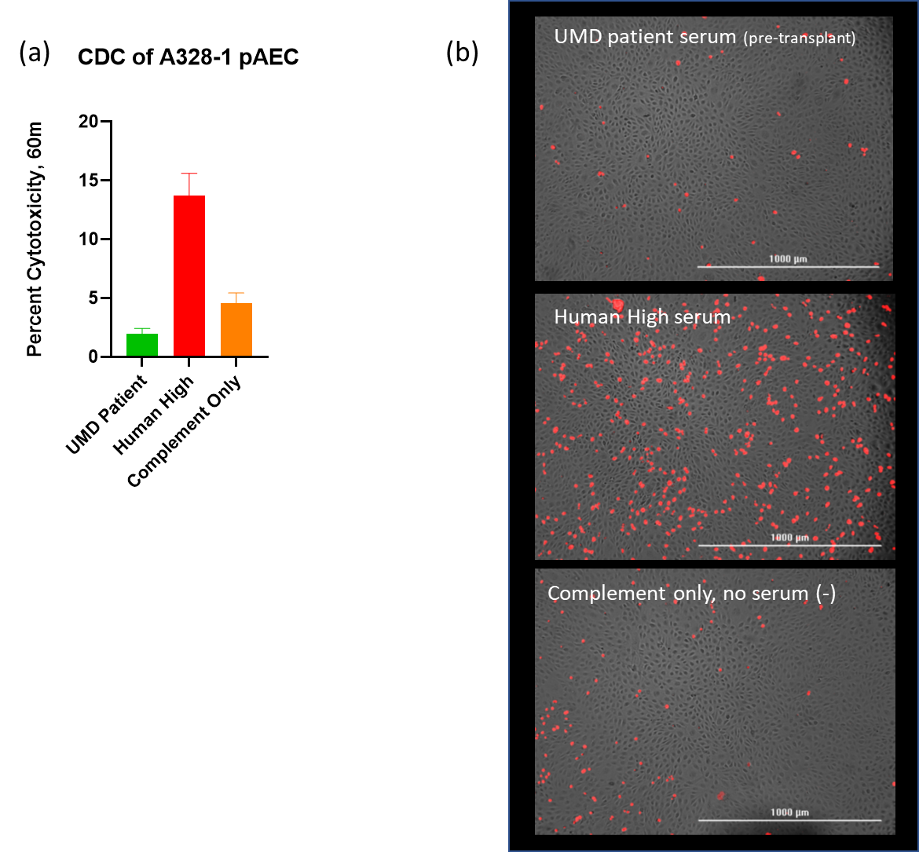
Figure 1 (ii): Antibody Cytotoxicity

Slide 5
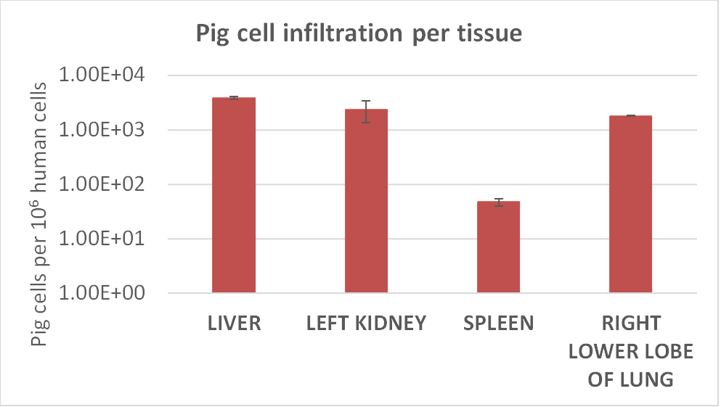
Figure S2: Microchimerism in the recipients

Slide 6
Table S3: Assessment of PCMV transcription
Recipient Tissue | U41 | U57 | U100 | 18s
Liver | UD | UD | UD | 15.68
Spleen | UD | UD | UD | 16.31
Kidney | UD | UD | UD | 15.64

Slide 7
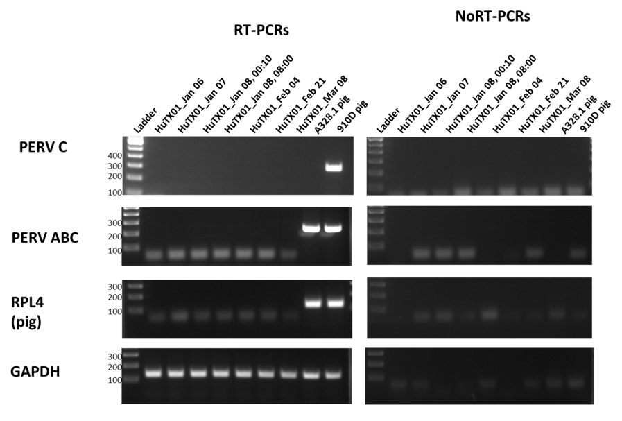
Figures S3: PERV analysis of transplant recipient's PBMC at different intervals

Slide 8
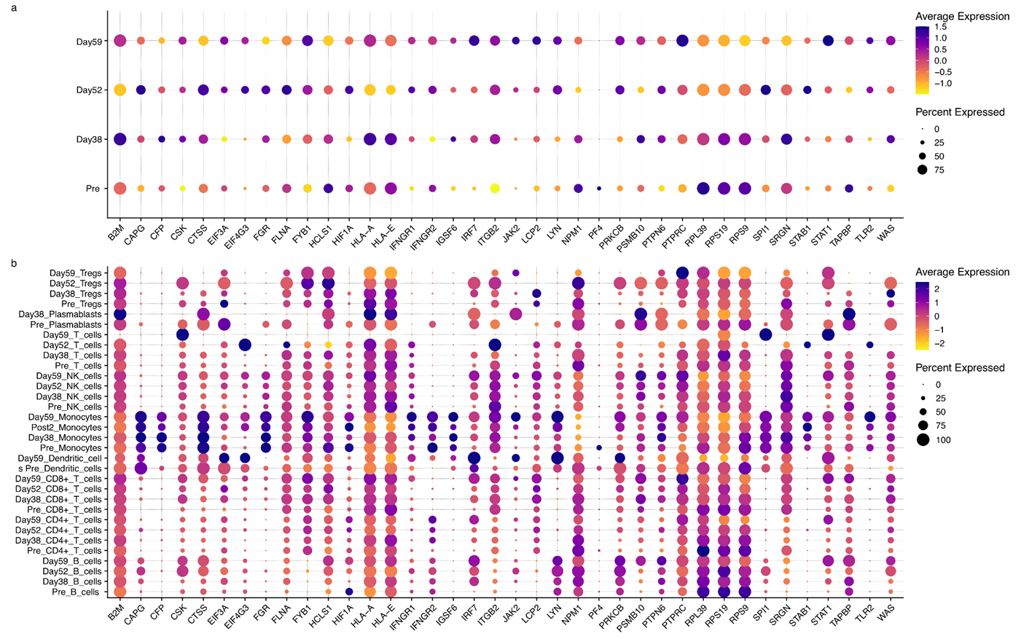
Figures S4. a-b. Post− vs. pre−transplant differentially expressed allograft rejection signature genes

Slide 9
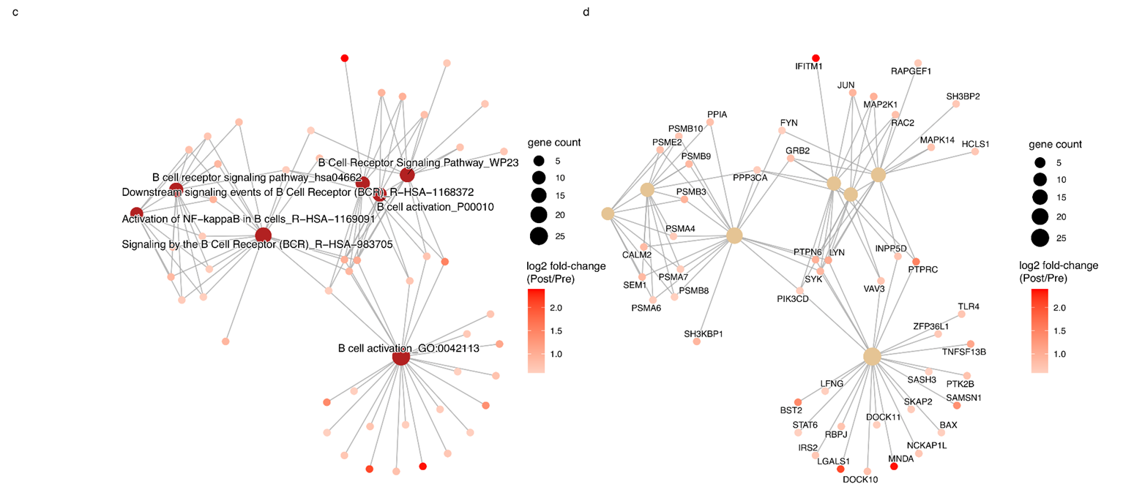
Figures S4. Enrichment profile associated with BCR signaling

Slide 10
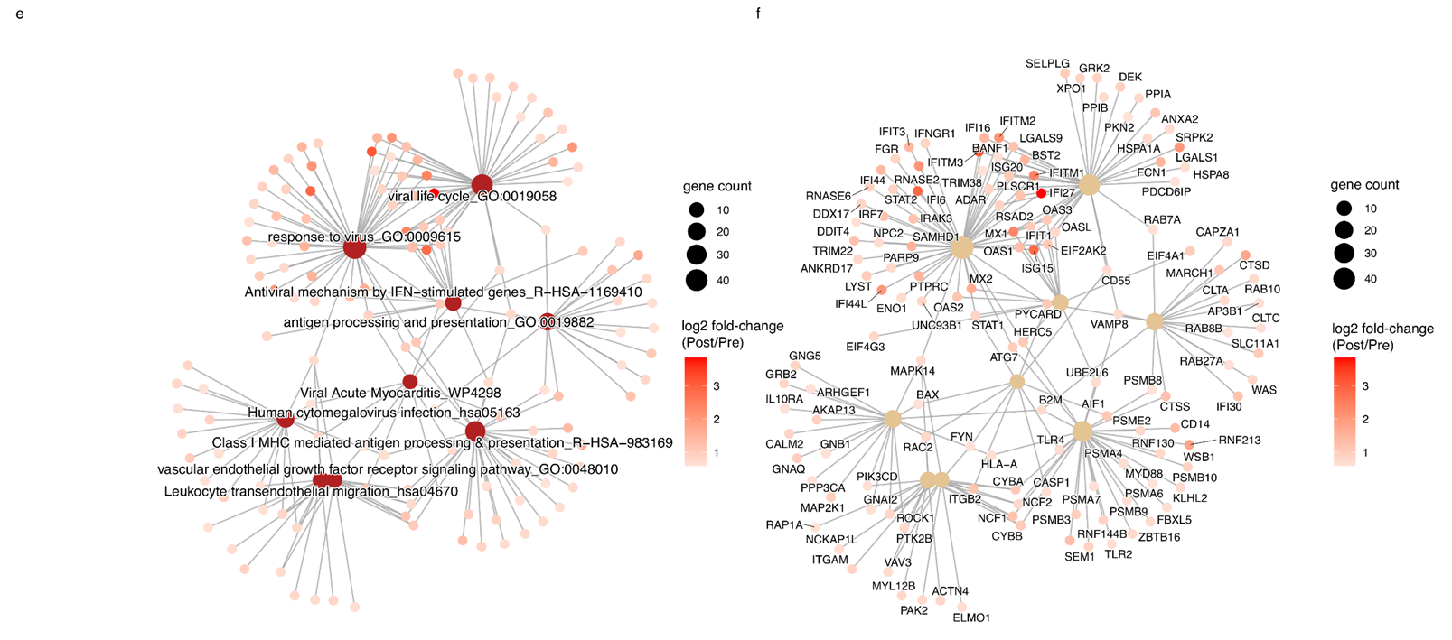
Figures S4. Enrichment profile associated with a viral infection and endothelial damage

