Slide 1
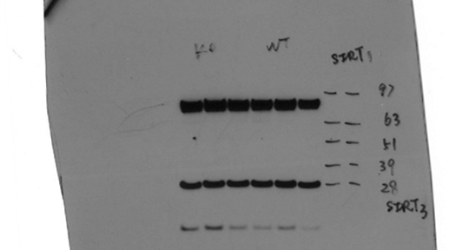
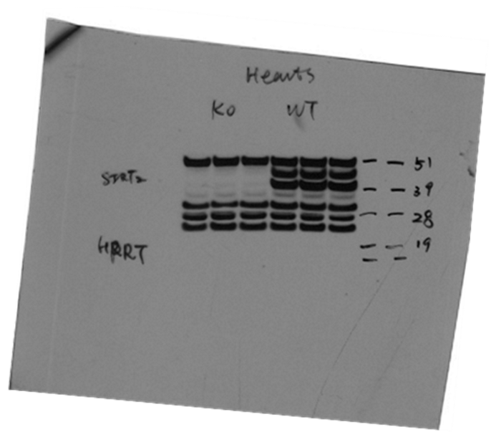
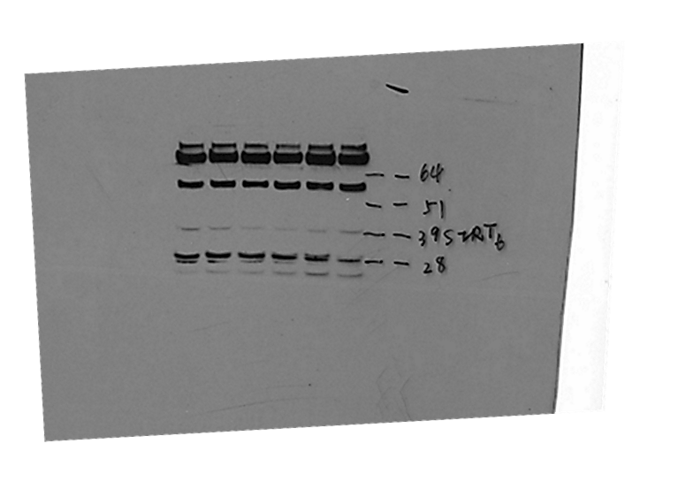
Figure 2-Supplemental Figure 1
WT
Sirt2^{-/-}
WT
Sirt2^{-/-}
SIRT1
SIRT2
SIRT3
HPRT
SIRT6

