Slide 1
Supplemental Figures

Slide 2
A
B
Veh
20
40
100
100x2
Suppl. Fig. 1. Effect of BCLA on liver ALT activity in vivo. (A) WT mice were treated with 20 mg/kg BCLA or vehicle control and total ALT activity was measured in liver tissue lysates 4 (left) and 24 (right) hours later. (B) WT mice were treated with the indicated doses (20 – 100 mg/kg) of BCLA for 24 hours and total ALT activity was measured in liver tissue lysates. Data are expressed as mean±SE. *p<0.05.

Slide 3
mRNA
Mpc2
Gpt2
Suppl. Fig. 2. Expression of MPC2 and GPT2 (ALT2) in liver tissue from WT and DKO mice. mRNA for MPC2 and ALT2 was measured by qPCR in RNA isolated from liver tissue and converted to cDNA. Data are expressed as mean±SE. *p<0.05.

Slide 4
A
B
Suppl. Fig. 3. Expression of Gclc and Gsr in liver tissue from WT, MPC2 KO, ALT2 KO, and DKO mice. mRNA for Gclc and Gsr was measured by qPCR in RNA isolated from liver tissue and converted to cDNA. Data are expressed as mean±SE. *p<0.05.

Slide 5
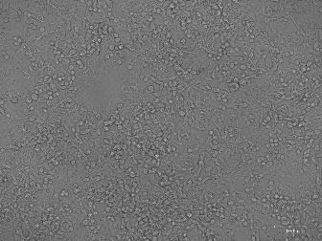
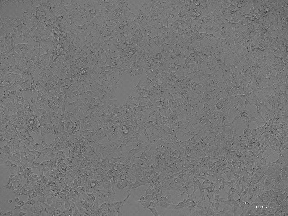
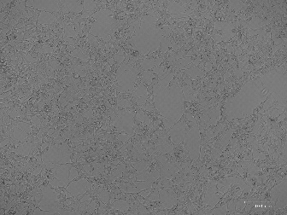
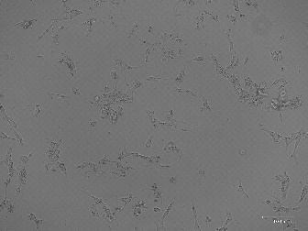
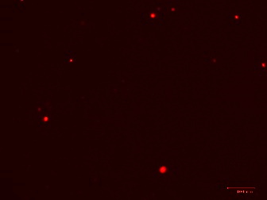
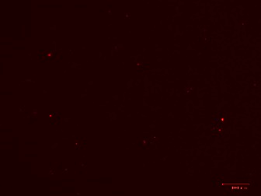
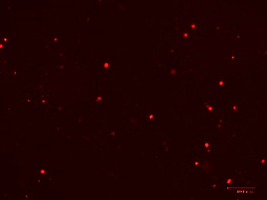
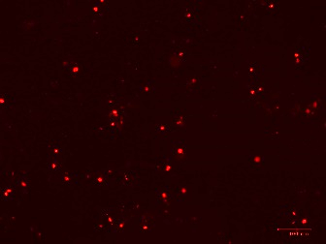
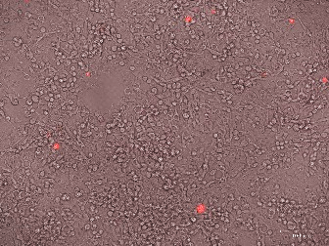
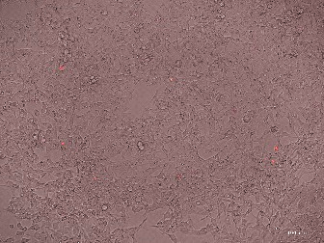
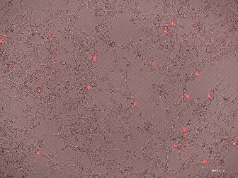
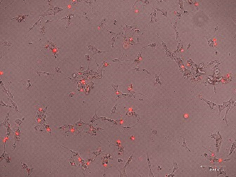
A
B
C
0
6
24
48
PC
PI
Merge
Suppl. Fig. 4. Characterization of APAP toxicity in HepG2 cells overexpressing CYP2E1. (A) Cells were treated with the 20 mM APAP for the indicated time points and LDH release into medium was measured. (B) Cells were treated with the indicated concentrations of APAP for 48 hours and LDH release was measured. (C) Cells were treated with 20 mM APAP for the indicated time points and stained with propidium iodide (PI). Data are expressed as mean±SE for 3 independent experiments run on different days. *p<0.05 vs. Veh control.

Slide 6
Suppl. Fig. 5. Serum ketones after APAP overdose. β-hydroxybutyrate was measured in serum from vehicle-treated WT mice and from WT and DKO mice after APAP overdose. Data are expressed as mean±SE for 3 independent experiments run on different days. *p<0.05. **p<0.01. ***p<0.001.

