Slide 1

Lineage Plasticity in SCLC Generates Non-Neuroendocrine Cells Primed for Vasculogenic Mimicry
Sarah M. Pearsall, PhD, Stuart C. Williamson, PhD, Sam Humphrey, PhD, Ellyn Hughes, PhD, Derrick Morgan, BSc, Fernando J. García Marqués, PhD, Griselda Awanis, PhD, Rebecca Carroll, MSc, Laura Burks, PhD, Yan Ting Shue, PhD, Abel Bermudez, BS, Kristopher K. Frese, PhD, Melanie Galvin, MSc, Mathew Carter, BSc, Lynsey Priest, MSc, Alastair Kerr, PhD, Cong Zhou, PhD, Trudy G. Oliver, PhD, Jonathan D. Humphries, PhD, Martin J. Humphries, PhD, Fiona Blackhall, MD, PhD, Ian G. Cannell, PhD, Sharon J. Pitteri, PhD, Gregory J. Hannon, PhD, Julien Sage, PhD, Caroline Dive, PhD, Kathryn L. Simpson, PhD
Journal of Thoracic Oncology
Volume 18 Issue 10 Pages 1362-1385 (October 2023)
DOI: 10.1016/j.jtho.2023.07.012
Copyright © 2023 International Association for the Study of Lung Cancer Terms and Conditions

Slide 2
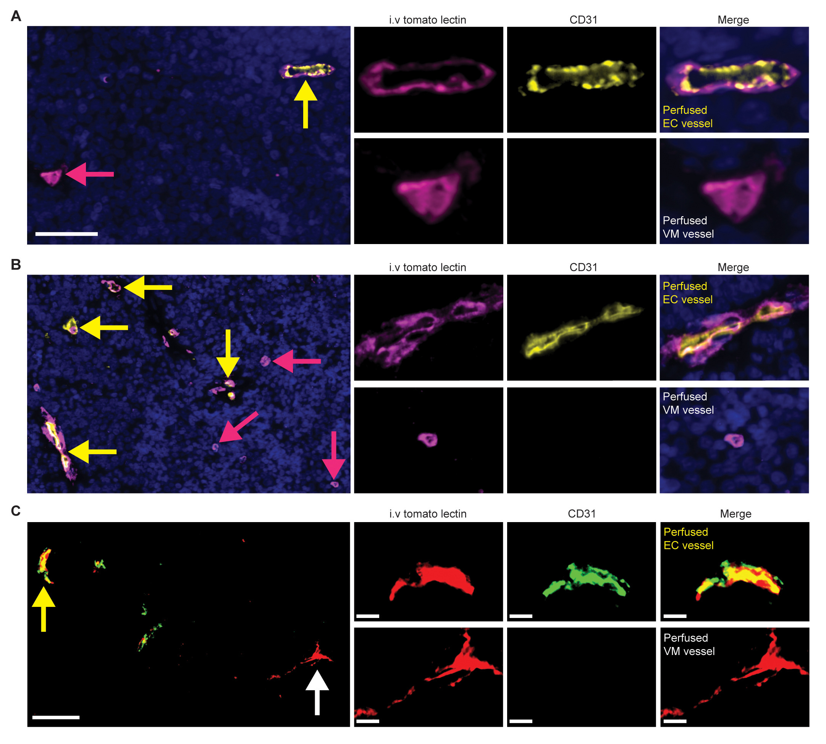
Supplementary Figure 2
Journal of Thoracic Oncology 2023 181362-1385DOI: (10.1016/j.jtho.2023.07.012)
Copyright © 2023 International Association for the Study of Lung Cancer Terms and Conditions
Notes:
Perfused VM and endothelial vessels are present in SCLC CDX. (A, B) Representative IF image of a perfused endothelial (EC) vessel (CD31⁺/intravenous tomato lectin⁺, yellow arrow) and a perfused VM vessel (CD31⁻/ intravenous tomato lectin⁺, pink arrow) within a CDX09 tumor that was harvested after intravenous tomato lectin injection. Single channel IF for CD31 (yellow) and intravenous tomato lectin (pink) illustrated with merged multiplex on the right in which nuclei are blue (DAPI stain). Scale bars 50 µm (left panel) and 10 µm (right panels). (C) Representative IF image of a perfused endothelial (EC) vessel (CD31⁺/intravenous tomato lectin⁺, human mitochondria‑) and a perfused VM vessel (CD31⁻/intravenous tomato lectin⁺, human mitochondria⁺) within a cryosectioned CDX09 tumor that was harvested after intravenous tomato lectin injection. Single channel IF for CD31 (green), intravenous tomato lectin (red) and human mitochondria (white) shown with merged multiplex on the right where CD31 and lectin overlay is yellow. Scale bars 10 µm. CDX, circulating tumor cell–derived explant; DAPI, 4',6-diamidino-2-phenylindole; EC, endothelial cell; IF, immunofluorescence; VM, vasculogenic mimicry.

