Slide 1

Lineage Plasticity in SCLC Generates Non-Neuroendocrine Cells Primed for Vasculogenic Mimicry
Sarah M. Pearsall, PhD, Stuart C. Williamson, PhD, Sam Humphrey, PhD, Ellyn Hughes, PhD, Derrick Morgan, BSc, Fernando J. García Marqués, PhD, Griselda Awanis, PhD, Rebecca Carroll, MSc, Laura Burks, PhD, Yan Ting Shue, PhD, Abel Bermudez, BS, Kristopher K. Frese, PhD, Melanie Galvin, MSc, Mathew Carter, BSc, Lynsey Priest, MSc, Alastair Kerr, PhD, Cong Zhou, PhD, Trudy G. Oliver, PhD, Jonathan D. Humphries, PhD, Martin J. Humphries, PhD, Fiona Blackhall, MD, PhD, Ian G. Cannell, PhD, Sharon J. Pitteri, PhD, Gregory J. Hannon, PhD, Julien Sage, PhD, Caroline Dive, PhD, Kathryn L. Simpson, PhD
Journal of Thoracic Oncology
Volume 18 Issue 10 Pages 1362-1385 (October 2023)
DOI: 10.1016/j.jtho.2023.07.012
Copyright © 2023 International Association for the Study of Lung Cancer Terms and Conditions

Slide 2
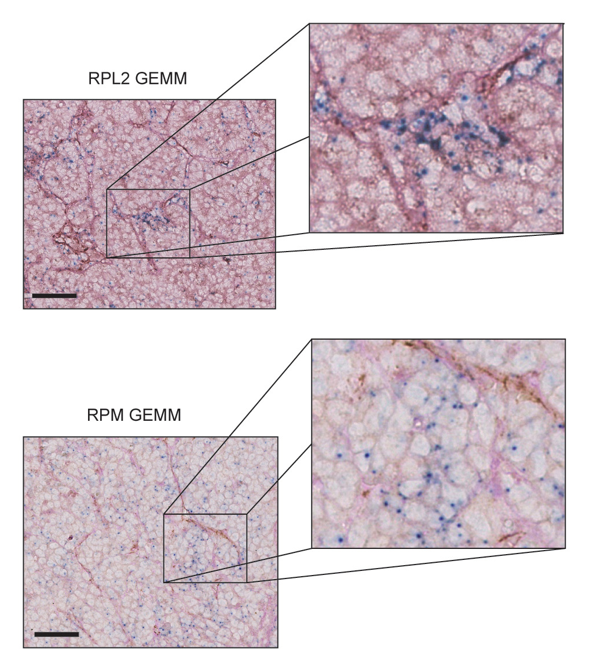
Supplementary Figure 3
Journal of Thoracic Oncology 2023 181362-1385DOI: (10.1016/j.jtho.2023.07.012)
Copyright © 2023 International Association for the Study of Lung Cancer Terms and Conditions
Notes:
VM co-localizes with REST in SCLC GEMMs. Multiplex IHC and ISH assay showing images of VM vessels (PAS⁺/CD31⁻, pink), endothelial vessels (PAS⁺/CD31⁺, brown) and REST ISH (blue). Scale bars, 50 µm. Representative images from three independent tumor replicates in SCLC GEMMs; RBL2 GEMM (Trp53fl^{/fl}/Rb1^{fl/fl}/Rbl2fl/fl)²² and RPM GEMM (Trp53fl/fl/Rb1fl/fl/MycLSL^{/LSL}).²³ GEMM, genetically engineered mouse model; IHC, immunohistochemistry; ISH, in situ hybridization; PAS, Periodic Acid Schiff stain; VM, vasculogenic mimicry.

