Slide 1

Lineage Plasticity in SCLC Generates Non-Neuroendocrine Cells Primed for Vasculogenic Mimicry
Sarah M. Pearsall, PhD, Stuart C. Williamson, PhD, Sam Humphrey, PhD, Ellyn Hughes, PhD, Derrick Morgan, BSc, Fernando J. García Marqués, PhD, Griselda Awanis, PhD, Rebecca Carroll, MSc, Laura Burks, PhD, Yan Ting Shue, PhD, Abel Bermudez, BS, Kristopher K. Frese, PhD, Melanie Galvin, MSc, Mathew Carter, BSc, Lynsey Priest, MSc, Alastair Kerr, PhD, Cong Zhou, PhD, Trudy G. Oliver, PhD, Jonathan D. Humphries, PhD, Martin J. Humphries, PhD, Fiona Blackhall, MD, PhD, Ian G. Cannell, PhD, Sharon J. Pitteri, PhD, Gregory J. Hannon, PhD, Julien Sage, PhD, Caroline Dive, PhD, Kathryn L. Simpson, PhD
Journal of Thoracic Oncology
Volume 18 Issue 10 Pages 1362-1385 (October 2023)
DOI: 10.1016/j.jtho.2023.07.012
Copyright © 2023 International Association for the Study of Lung Cancer Terms and Conditions

Slide 2
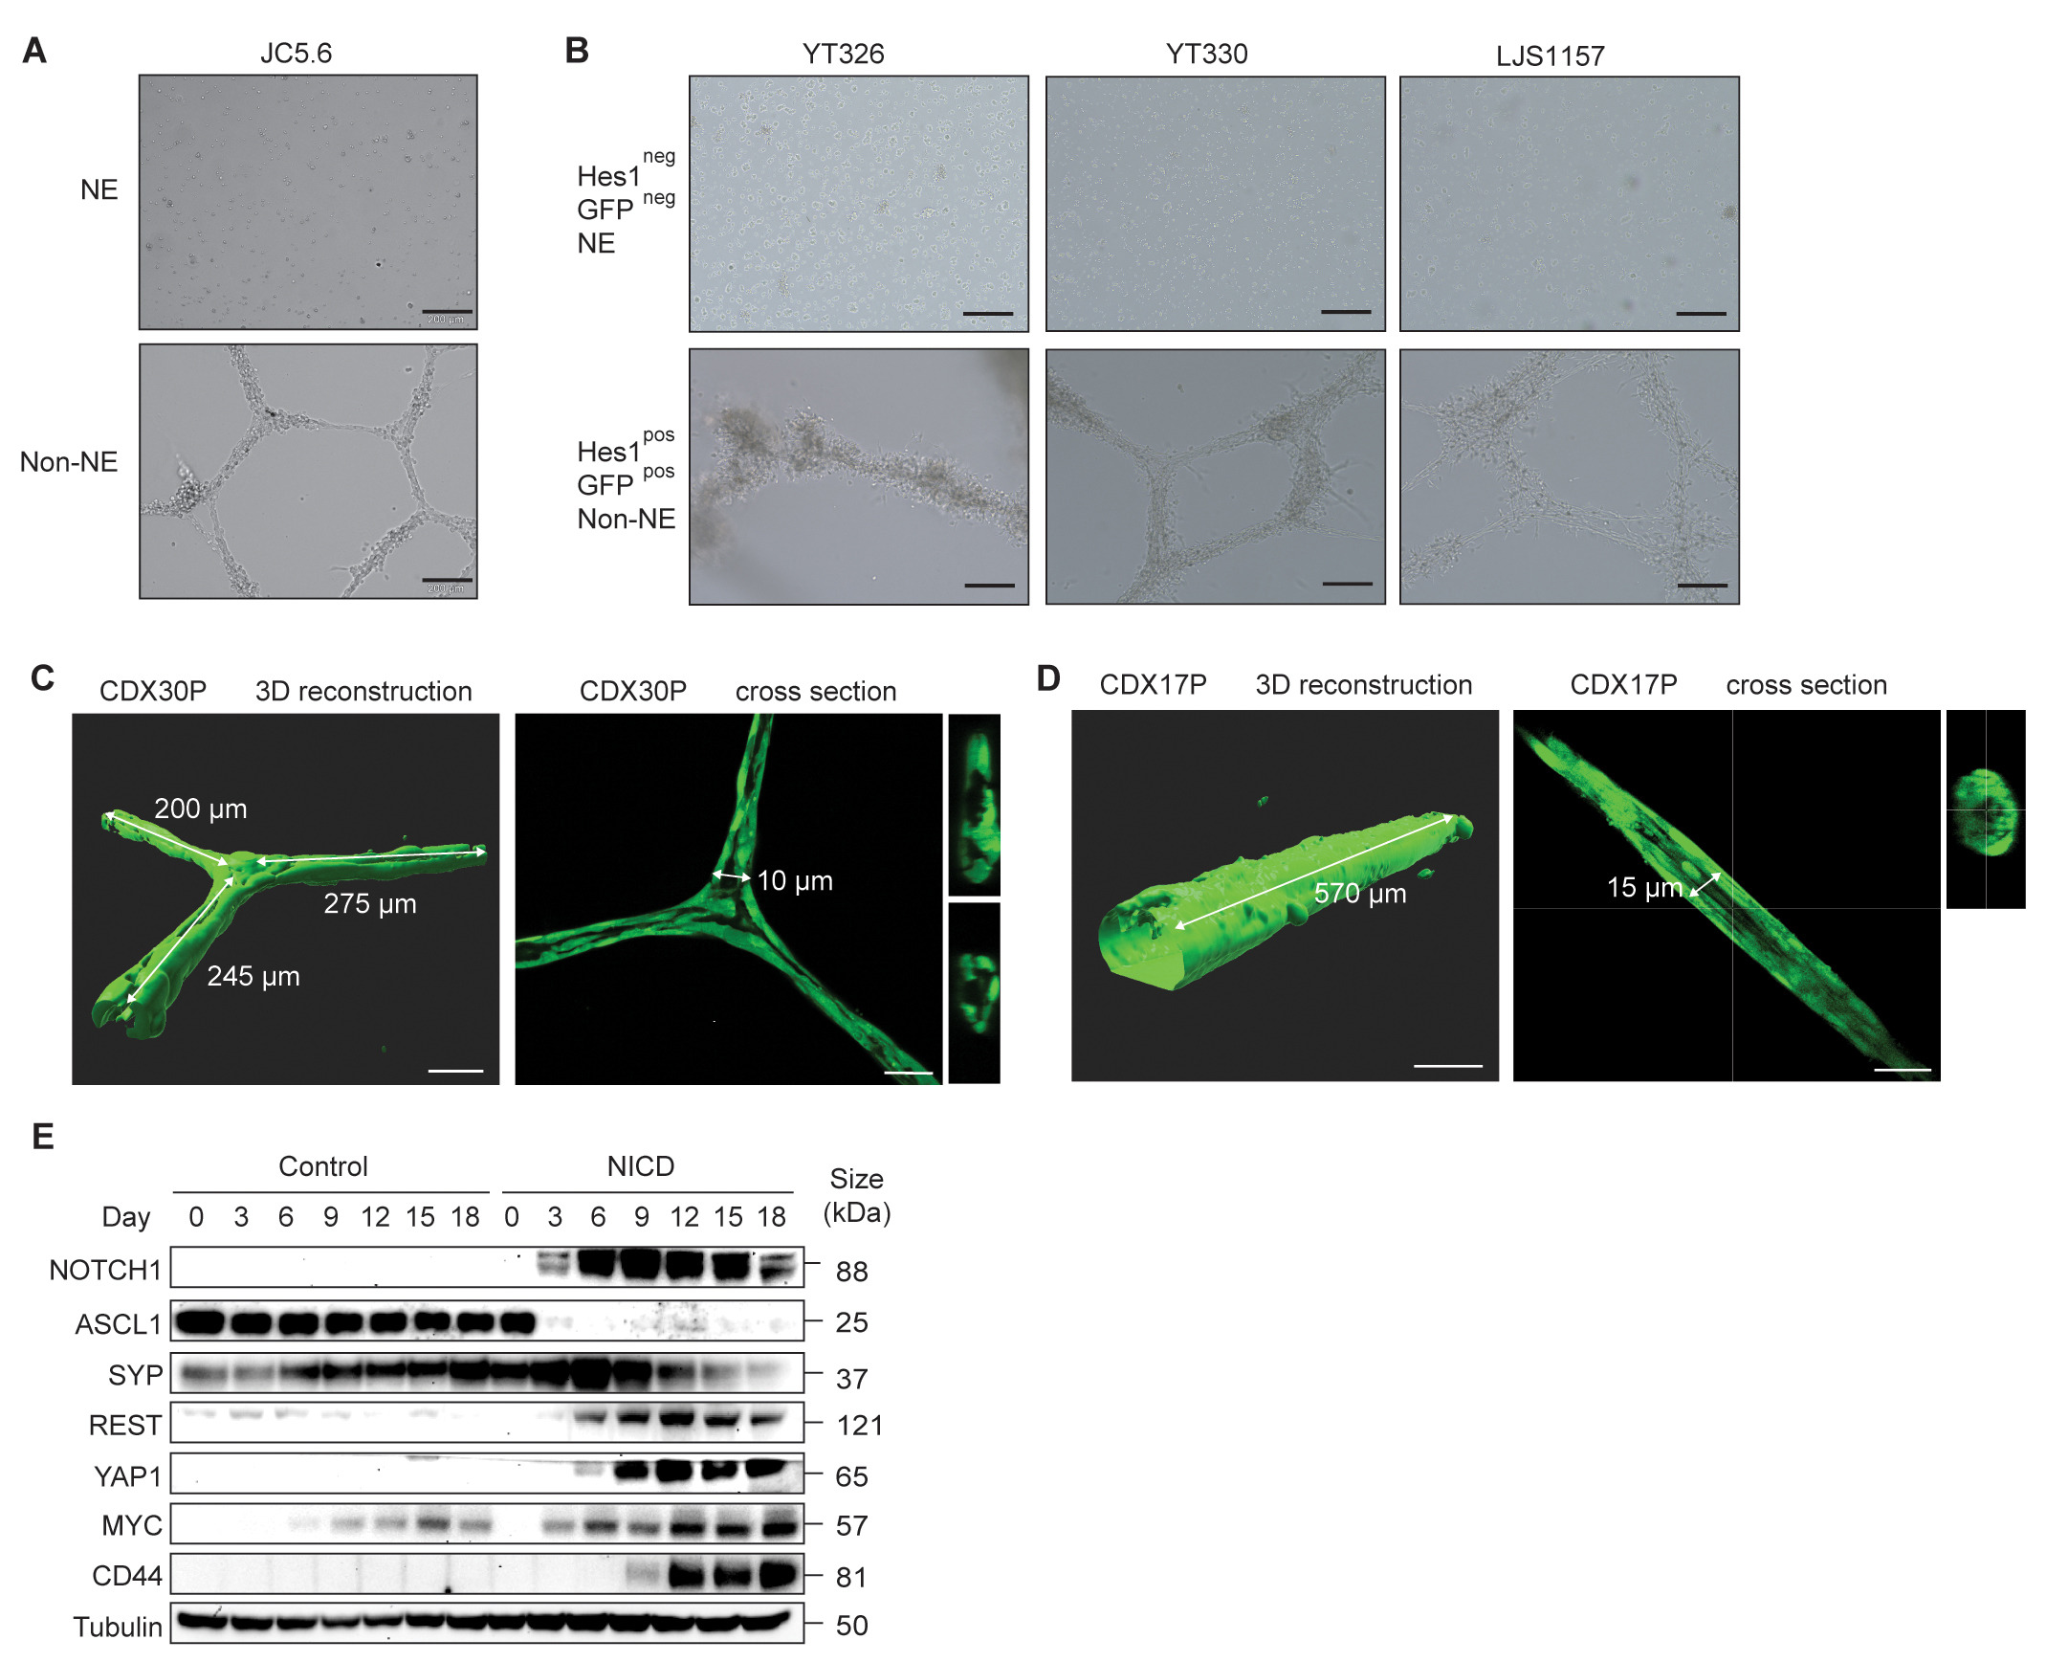
Supplementary Figure 4
Journal of Thoracic Oncology 2023 181362-1385DOI: (10.1016/j.jtho.2023.07.012)
Copyright © 2023 International Association for the Study of Lung Cancer Terms and Conditions
Notes:
Tubule formation assays in CDX and GEMM tumors ex vivo (A) Representative brightfield images of tubule forming assays in RPM GEMM (Trp53fl/fl/Rb1fl/fl/MycLSL^{/LSL})²³ NE and non-NE cells ex vivo. n = 3 independent replicate tumors were analyzed. Scale bars 200 µm. (B) Representative brightfield images of tubule forming assays in RBL2 GEMM (Trp53fl^{/fl}/Rb1^{fl/fl}/Rbl2^{fl/fl})²² NE (HES1^{neg}/GFP^{neg}) and non-NE cells (HES1^{pos}/GFP^{pos}) previously separated by flow cytometry based on Hes1-GFP reporter expression and cultured ex vivo. n = 3 independent replicate cell lines (YT326, YT330 and LJS1157) were analyzed. Scale bars 200 µm. (C, D) CDX30P non-NE cells (C) and CDX17P non-NE cells (D) labelled with Cell Tracker Green form hollow tubules when grown on Matrigel. Representative confocal microscopy images followed by Z-stack software reconstruction (Imaris) after 72 hours on Matrigel. Tubule length and diameter dimensions are shown, scale bars 50 µm. CDX30P cross section is the same image as in Figure 3F. (E) Representative immunoblots of CDX31P empty-vector control cells and NICD-expressing cells at day 0 pre-dox induction and every 3 days post-dox induction. CDX, circulating tumor cell–derived explant; GEMM, genetically engineered mouse model; NE, neuroendocrine.

