Slide 1

Lineage Plasticity in SCLC Generates Non-Neuroendocrine Cells Primed for Vasculogenic Mimicry
Sarah M. Pearsall, PhD, Stuart C. Williamson, PhD, Sam Humphrey, PhD, Ellyn Hughes, PhD, Derrick Morgan, BSc, Fernando J. García Marqués, PhD, Griselda Awanis, PhD, Rebecca Carroll, MSc, Laura Burks, PhD, Yan Ting Shue, PhD, Abel Bermudez, BS, Kristopher K. Frese, PhD, Melanie Galvin, MSc, Mathew Carter, BSc, Lynsey Priest, MSc, Alastair Kerr, PhD, Cong Zhou, PhD, Trudy G. Oliver, PhD, Jonathan D. Humphries, PhD, Martin J. Humphries, PhD, Fiona Blackhall, MD, PhD, Ian G. Cannell, PhD, Sharon J. Pitteri, PhD, Gregory J. Hannon, PhD, Julien Sage, PhD, Caroline Dive, PhD, Kathryn L. Simpson, PhD
Journal of Thoracic Oncology
Volume 18 Issue 10 Pages 1362-1385 (October 2023)
DOI: 10.1016/j.jtho.2023.07.012
Copyright © 2023 International Association for the Study of Lung Cancer Terms and Conditions

Slide 2
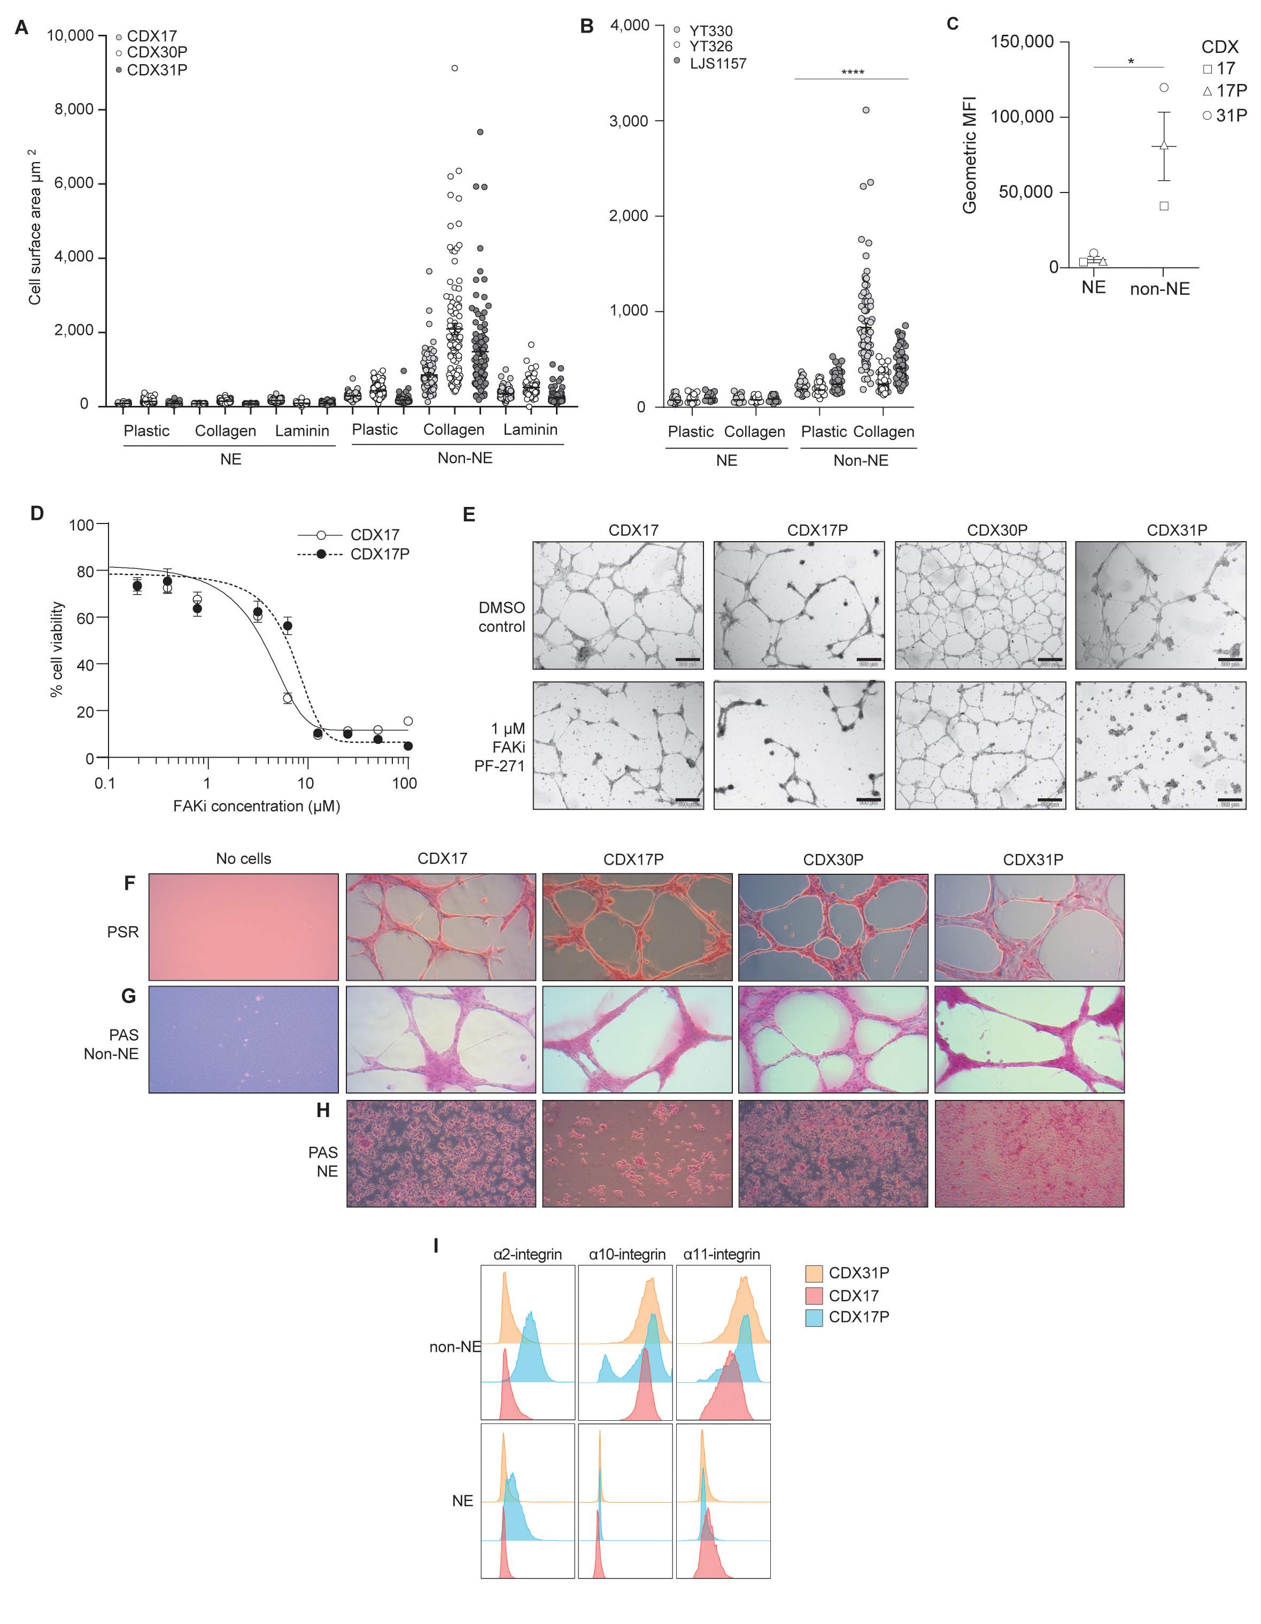
Supplementary Figure 6
Journal of Thoracic Oncology 2023 181362-1385DOI: (10.1016/j.jtho.2023.07.012)
Copyright © 2023 International Association for the Study of Lung Cancer Terms and Conditions
Notes:
RBL2 GEMM ECM adherence assays and CDX PAS/PSR collagen and glycoprotein staining. (A) CSA of CDX (light gray circles, CDX17, open circles, CDX30P, gray circles, CDX31P) NE and non-NE cells on plastic, collagen, or laminin. Data are mean (± SEM) 200 cells analyzed from a CDX tumor. (B) CSA of RBL2 GEMM (Trp53fl/fl/Rb1fl/fl/Rbl2fl/fl)²² NE (HES1^{neg}/GFP^{neg}) and non-NE cells (HES1^{pos}/GFP^{pos}) previously separated by flow cytometry based on Hes1-GFP reporter expression and cultured ex vivo (YT330, light gray circles, YT326, open circles, LJS1157, gray circles) on plastic or collagen. Data are mean (± SEM) 200 cells analyzed from a GEMM tumor. (∗∗∗∗p < 0.0001 two-tailed unpaired Student’s t test). (C) Flow cytometry analysis of paired CDX NE and non-NE cells isolated ex vivo from CDX17, CDX17P and CDX31P showing cell surface protein expression of total β1 integrin represented as the geometric MFI. Data are mean (± SEM). n = 3 CDX tumors (CDX17, CDX17P and CDX31P) analysed. (∗p = 0.03 two-tailed unpaired Student’s t test). (D) Dose-response curves of CDX non-NE cells treated with 0-100 μM FAK inhibitor (FAKi) PF-271 for 72 hours (CDX17, open circles; CDX17P, black circles, dashed line). Data are mean (± SEM) (E) Representative brightfield images of CDX non-NE cell tubule-forming assay treated with 1 μM FAKi PF-271 or DMSO vehicle control for 24 hours. Scale bars, 500 µm. n = 3 replicates per CDX tumor. (F) PSR IHC to detect collagens (red stain) in CDX17, CDX17P, CDX30P and CDX31P non-NE cells (plus acellular control) in ex vivo tubule formation assay. (G) PAS IHC to detect glycoproteins (pink stain) in CDX17, CDX17P, CDX30P and CDX31P non-NE cells (plus acellular control) in ex vivo tubule formation assay. Representative images shown, n = 2-3 samples analyzed. (H) PAS IHC to detect glycoproteins (pink stain) in CDX17, CDX17P, CDX30P and CDX31P NE cells VM in ex vivo tubule formation assay. Representative images shown, n = 2-3 samples analyzed per CDX. (I) Flow cytometry analysis of paired CDX NE and non-NE cells isolated ex vivo from CDX17, CDX17P and CDX31P reveals differential surface expression of collagen-binding β1-integrin α-subunits. CDX, circulating tumor cell–derived explant; CSA, cell surface area; GEMM, genetically engineered mouse model; IHC, immunohistochemistry; MFI, mean fluorescence intensity; NE, neuroendocrine; PAS, Periodic Acid Schiff stain; PSR, picrosirius red; SEM, standard error of the mean.

