Slide 1
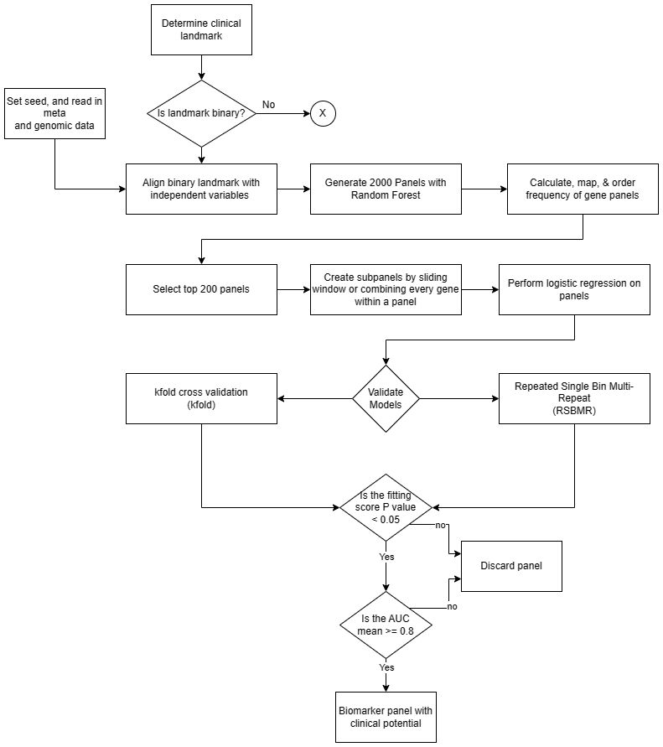
Figure 1A.
See 1B for details
See 1D for details
See 1C for details

Slide 2
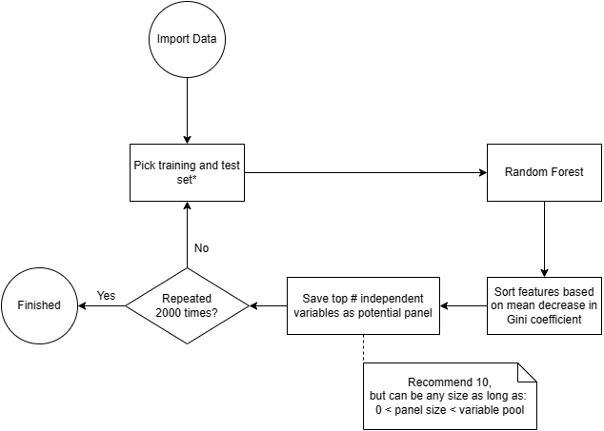
Figure 1B.

Slide 3
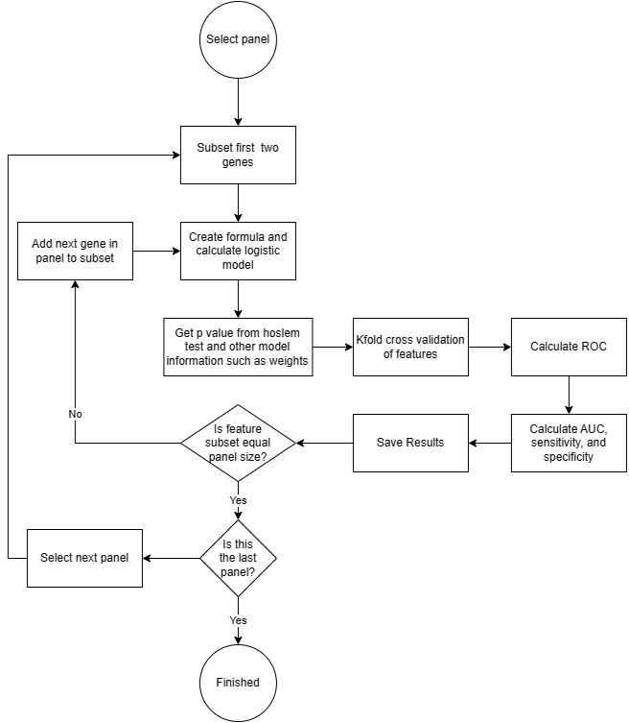
Figure 1C.

Slide 4
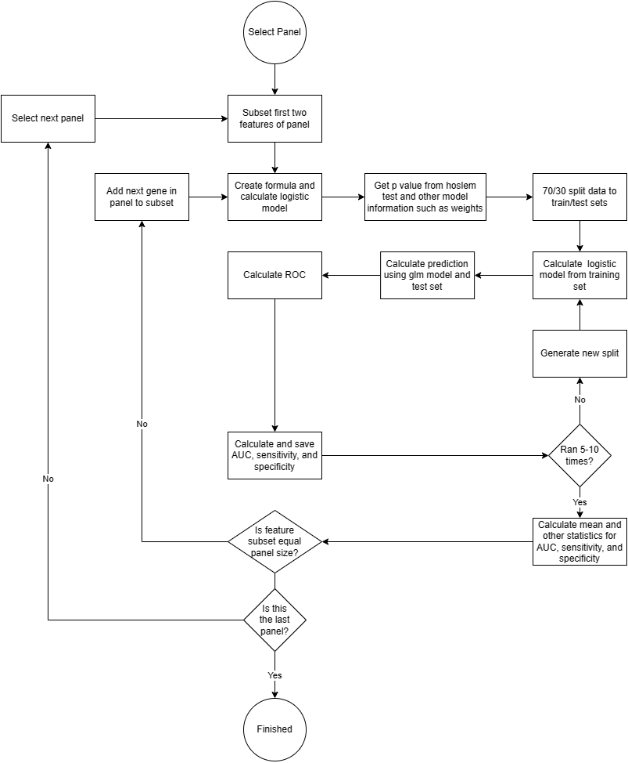
Figure 1D.

Slide 5
Figure 2.
Disease stages
Under the Cutoff (Braak stage ≤ Ω)
Sample size
Above the Cutoff (Braak stage > Ω)
Ω = I or II or III
Braak stage cutoff at I II III IV V
Cohorts used for present study defined as assortments 1, 2 and 3

Slide 6
Figure 3A.
Assortment 1, Cutoff at Braak I
Assortment 2, Cutoff at Braak II
Assortment 3, Cutoff at Braak III
Figure 3B.
Assortment 1, Cutoff at Braak I
Assortment 2, Cutoff at Braak II
Assortment 3, Cutoff at Braak III

Slide 7
Figure 4A. AUC plot of best performing panel curated by RSBMR to differentiate Un-I from Ab-I

Slide 8
Figure 4B. AUC plot of best performing panel curated by k-fold to differentiate Un-I from Ab-I

Slide 9
Figure 4C. AUC plot of best performing panel curated by RSBMR to differentiate Un-II from Ab-II

Slide 10
Figure 4D. AUC plot of best performing panel curated by k-fold to differentiate Un-II from Ab-II

Slide 11
Figure 4E. AUC plot of best performing panel curated by RSBMR to differentiate Un-III from Ab-III

Slide 12
Figure 4F. AUC plot of best performing panel curated by k-fold to differentiate Un-III from Ab-III

Slide 13
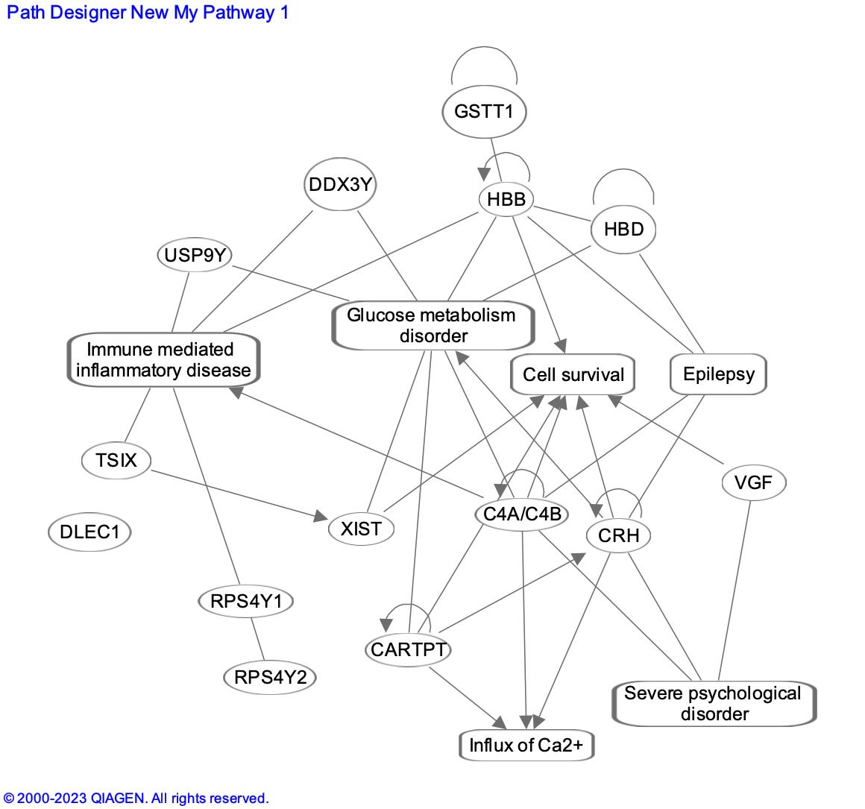
Figure 5. Network

Slide 14
Figure S1.
A.
B.
C.

