Slide 1
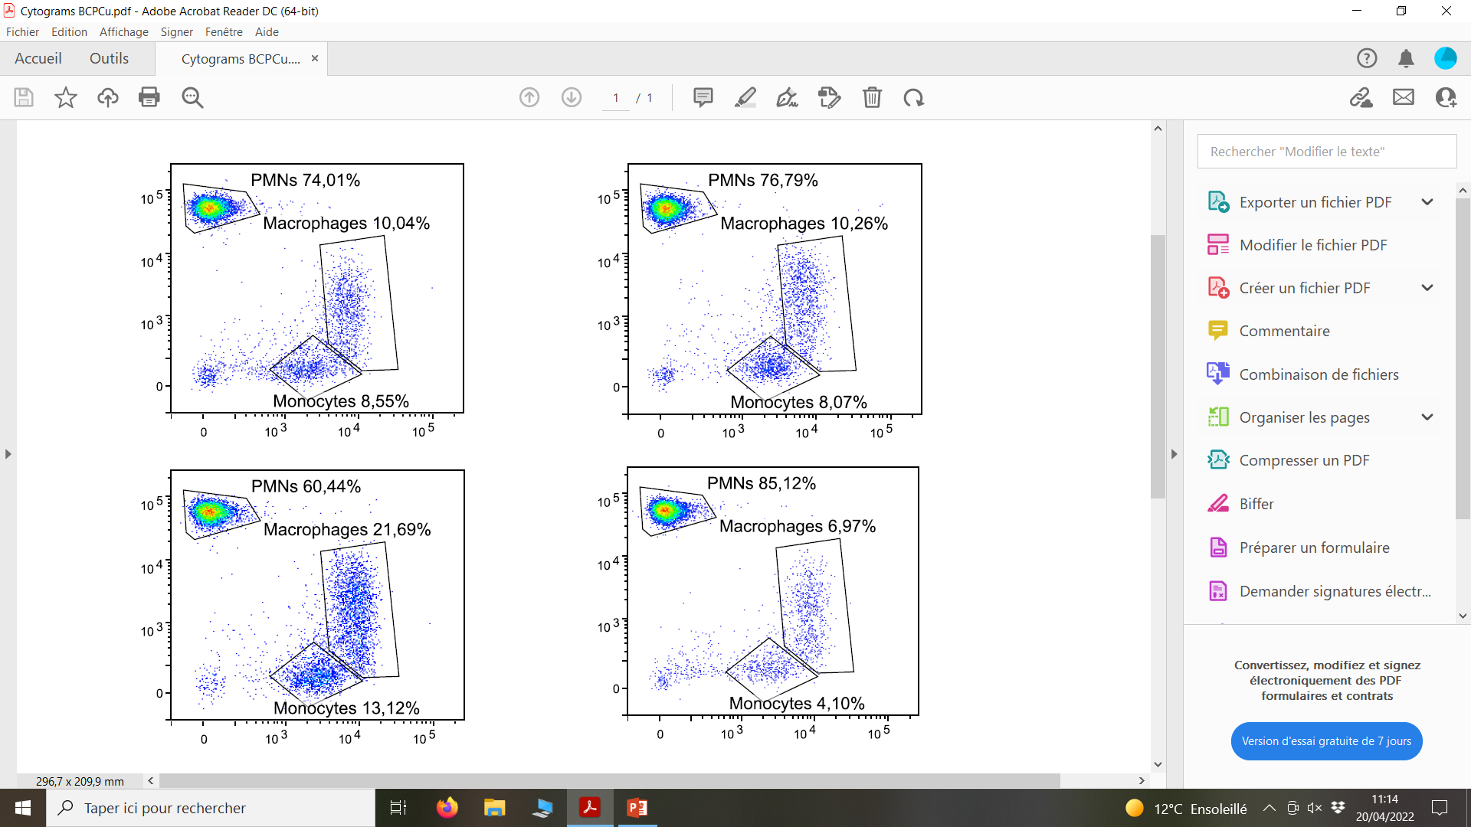
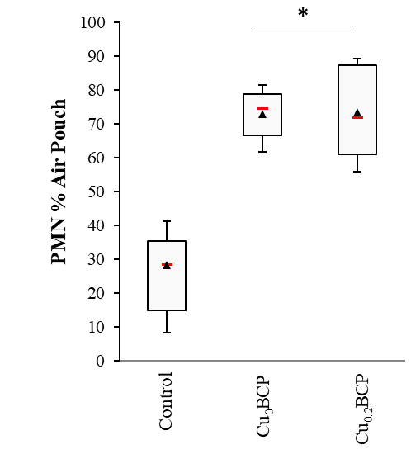
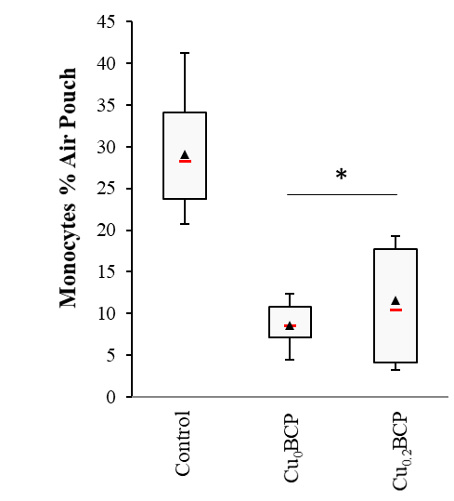
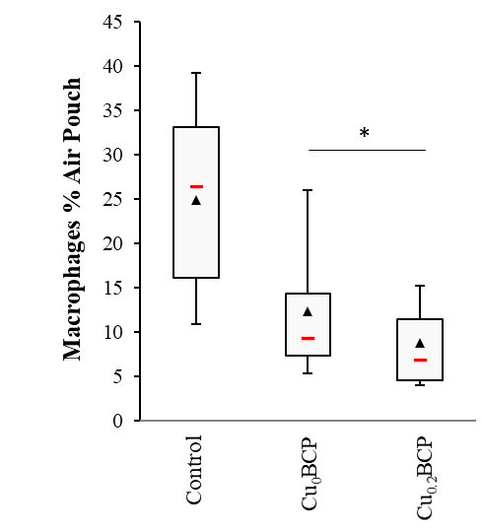
A
B
C
Cu₀BCP
Ly-6G (PE)
Cu_{0.2}BCP
CD11b (BV-421)
D
E
Control
Cu₀BCP
Cu_{0.2}BCP
Back side
Ventral side
F
Back side
Ventral side

