Slide 1
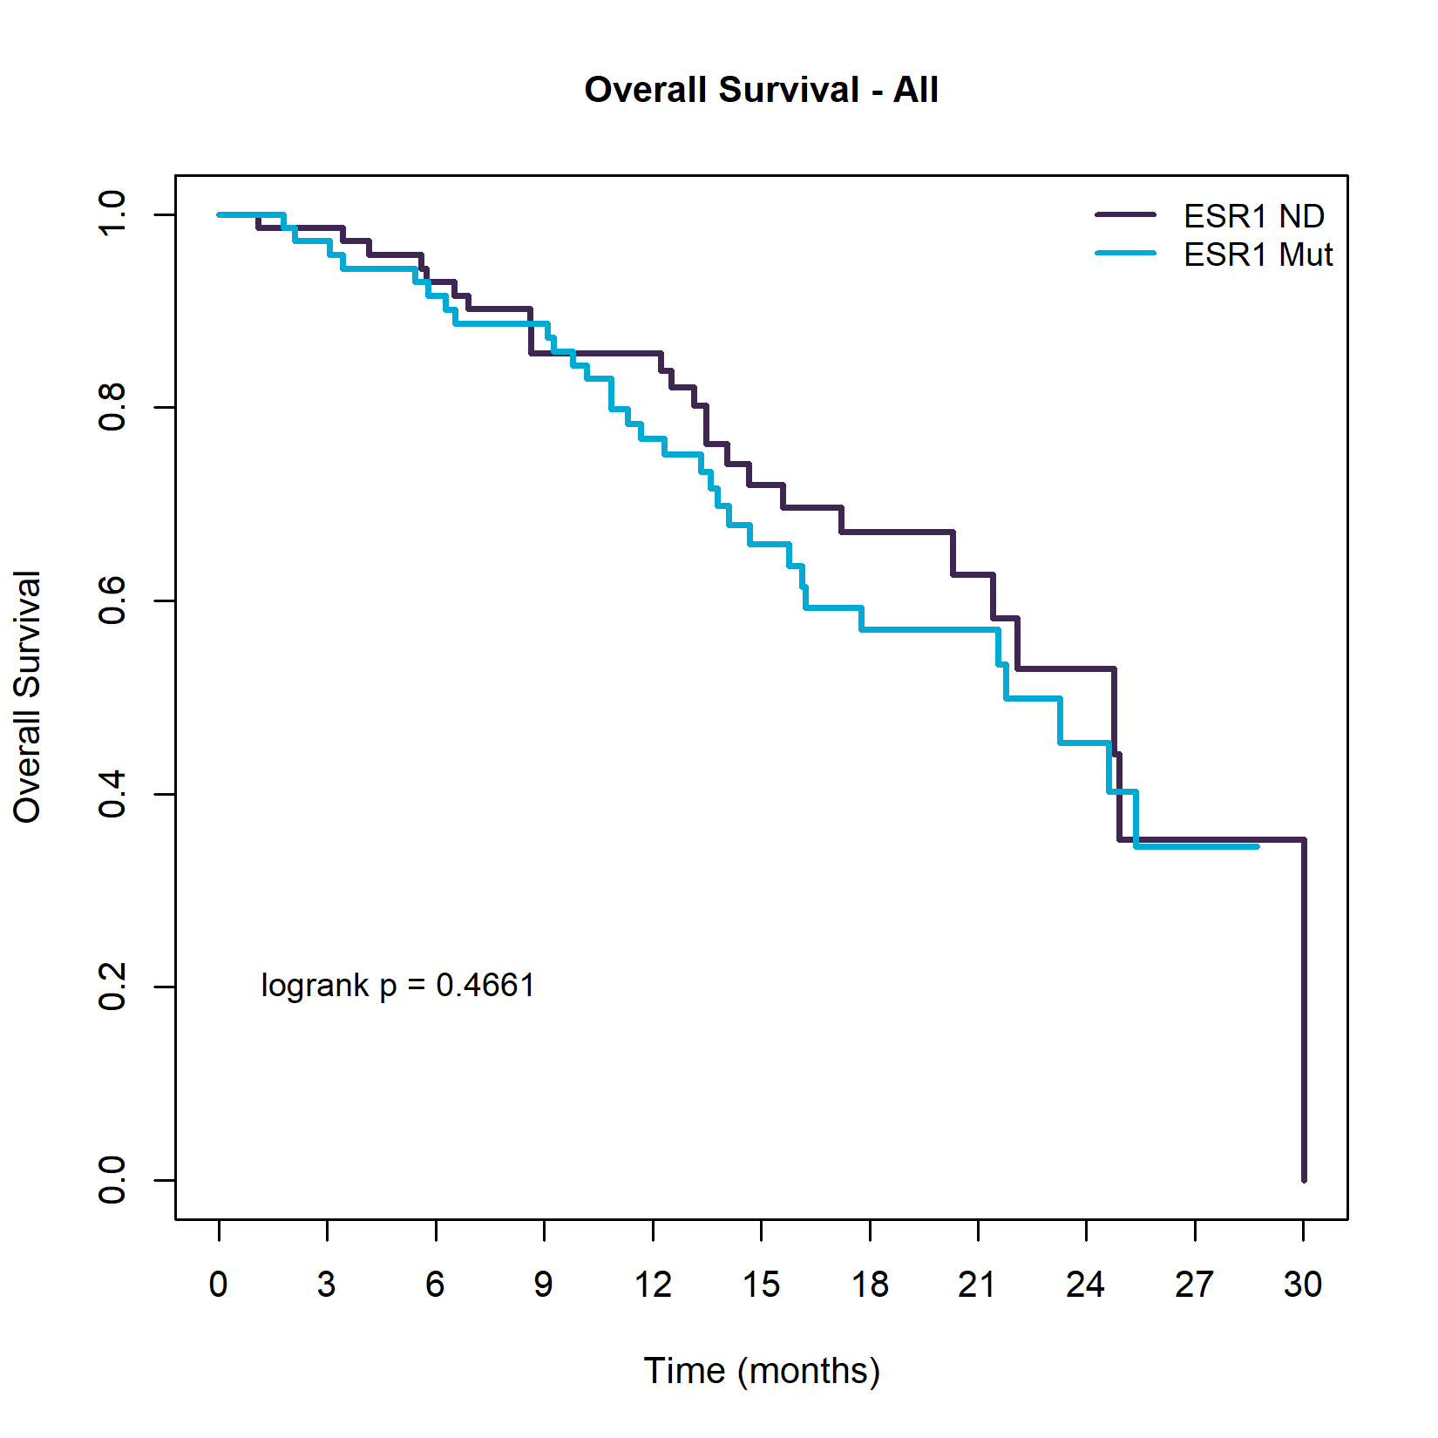
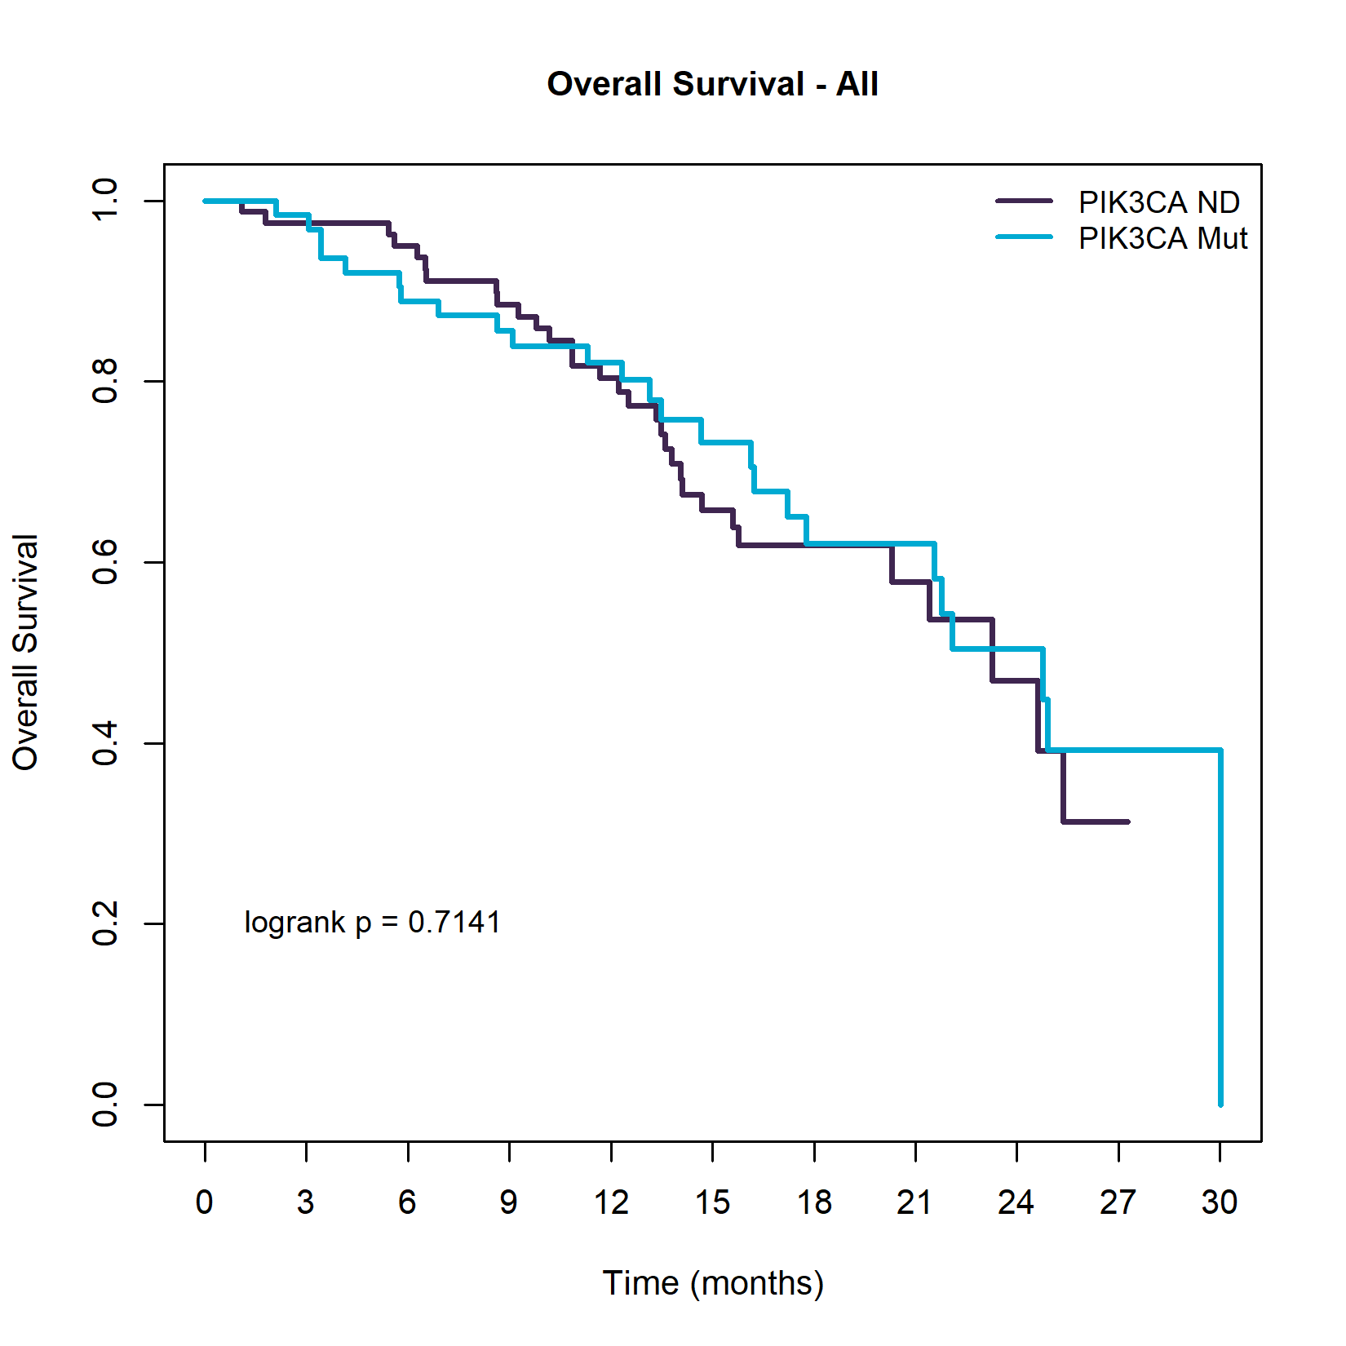
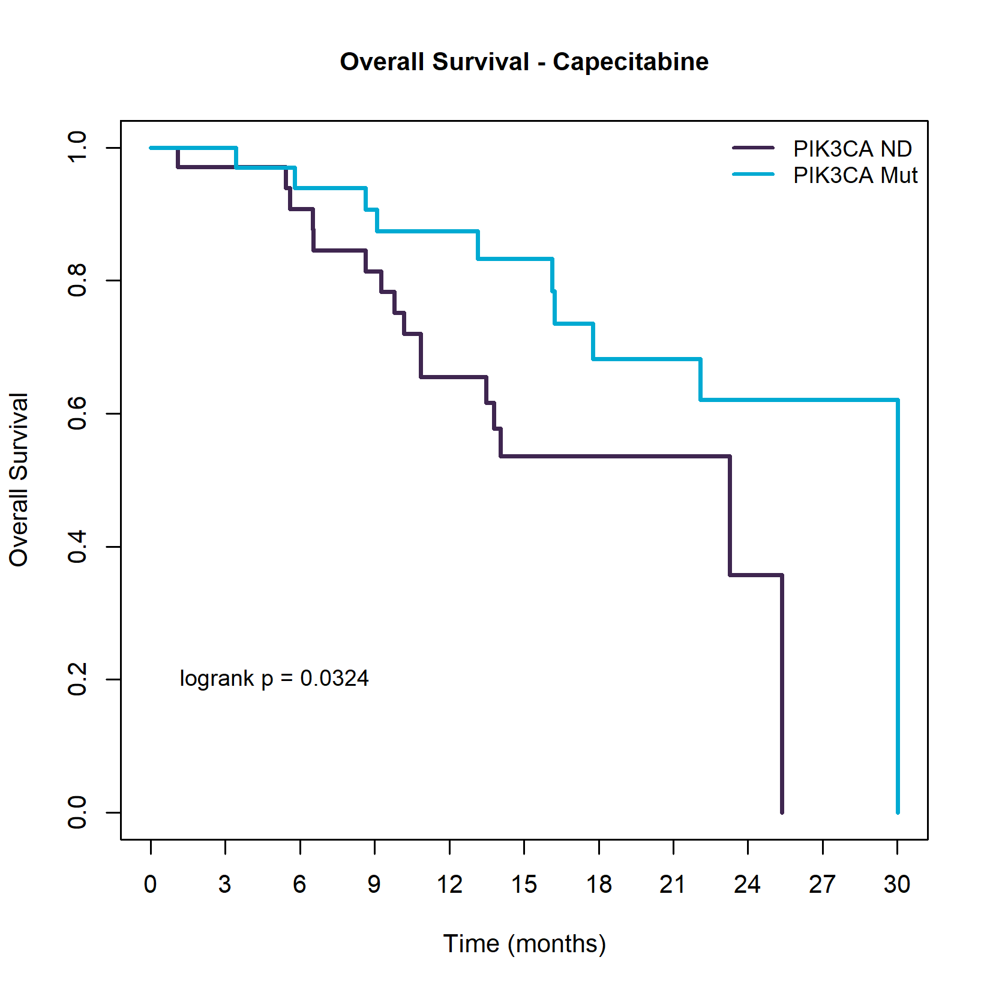
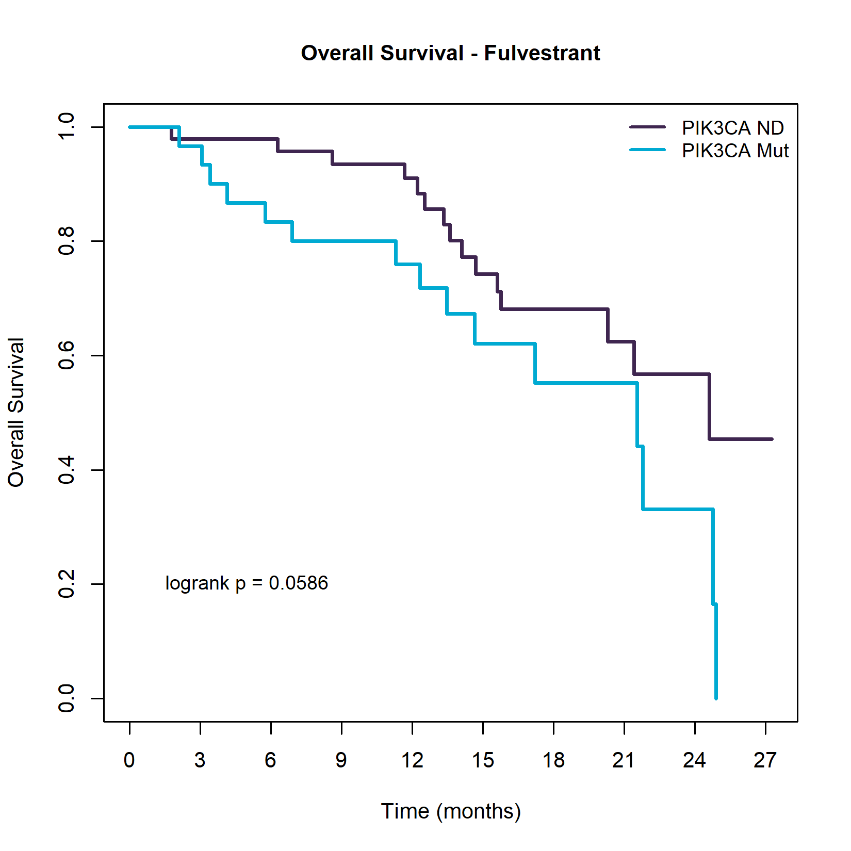
Supplementary Figure 4. OS analysis in baseline population (C1D1) on ESR1 and PIK3CA mutations, within the population with any detectable mutation (N=146).
A
B
ESR1 | Median OS | HR (95%CI) | P-value
ESR1 ND | 24.77 | 1 | 0.4656
ESR1 Mut | 21.78 | 1.22 (0.71-2.08)
PIK3CA | Median OS | HR (95%CI) | P-value
PIK3CA ND | 23.26 | 1 | 0.7139
PIK3CA Mut | 24.77 | 0.9 (0.53-1.55)
C
D
Overall Survival – Palbociclib plus fulvestrant
PIK3CA | Median OS | HR (95%CI) | P-value
PIK3CA ND | 23.26 | 1 | 0.033
PIK3CA Mut | 30.03 | 0.41 (0.18-0.95)
PIK3CA | Median OS | HR (95%CI) | P-value
PIK3CA ND | 24.61 | 1 | 0.0659
PIK3CA Mut | 21.55 | 1.97 (0.96-4.05)
Notes:
Supplementary Figure 4. OS analysis in baseline population (C1D1) on ESR1 and PIK3CA mutations, within the population with any detectable mutation (N=146).
Kaplan-Meier survival curves to measure the effect of number of mutations in survival. (A) OS analysis on ESR1 gene mutations, regardless treatment, by presence/absence of mutations, (B) OS analysis on PIK3CA gene mutations, regardless treatment, by presence/absence of mutations.
Kaplan-Meier survival curves to measure the effect presence/absence of PIK3CA gene mutations in OS, by treatment arms. (C) Capecitabine arm, and (D) Palbociclib plus fulvestrant arm.

