Slide 1
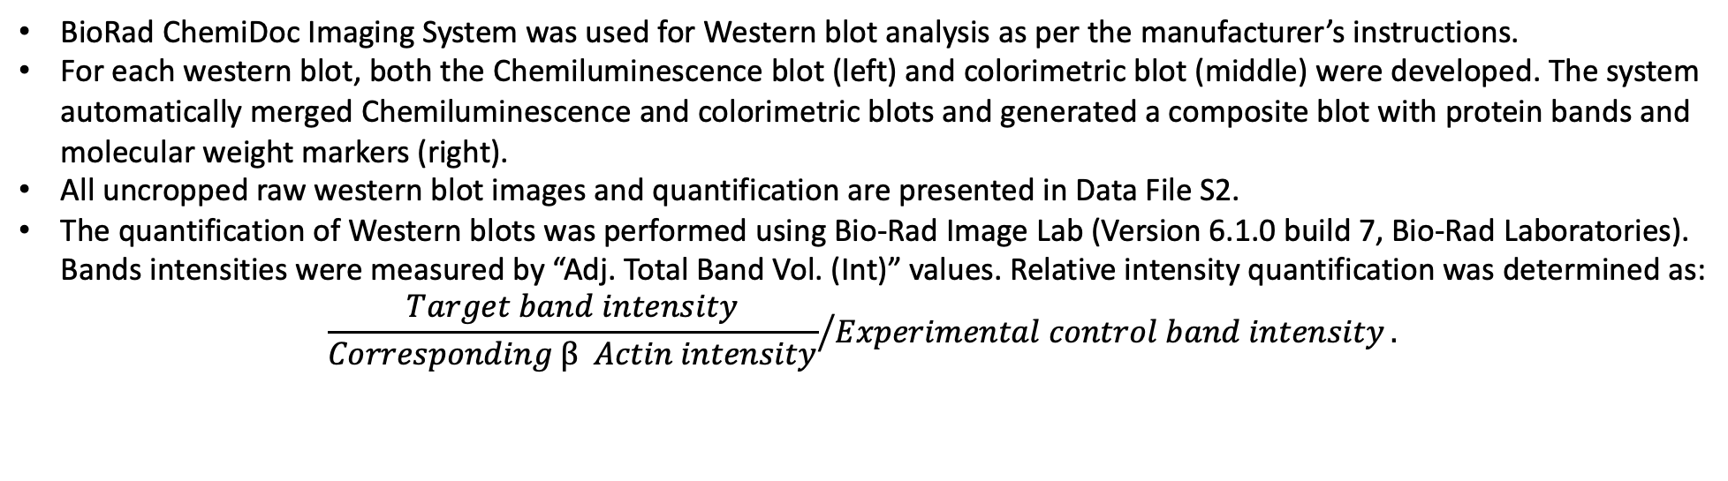
Chemiluminescence Plot:
Colorimetric Plot:
Composite Plot
BioRad ChemiDoc Imaging System was used for Western blot analysis as per the manufacturer’s instructions.
For each western blot, both the Chemiluminescence blot (left) and colorimetric blot (middle) were developed. The system automatically merged Chemiluminescence and colorimetric blots and generated a composite blot with protein bands and molecular weight markers (right).
All uncropped raw western blot images and quantification are presented in Data File S2.
The quantification of Western blots was performed using Bio-Rad Image Lab (Version 6.1.0 build 7, Bio-Rad Laboratories). Bands intensities were measured by “Adj. Total Band Vol. (Int)” values. Relative intensity quantification was determined as:
$${\frac{Target band intensity}{Corresponding β Actin intensity}}/{Experimental control band intensity}.$$

Slide 2
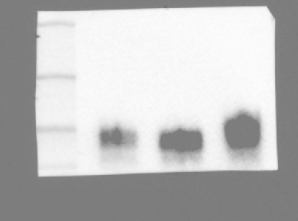
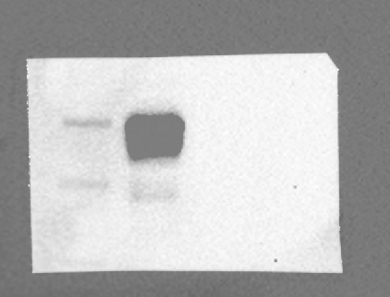
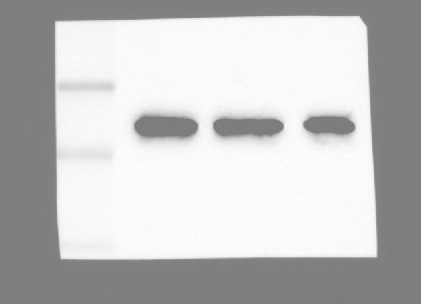
Fig 2A
LNCaP
LNCaP
LNCaP
TP53
WT KO
WT KO
WT KO
50 kDa
50 kDa
1.0 2.9
37 kDa
100 kDa
1.0 0
37 kDa
75 kDa
p53
B7-H3
β-Actin

Slide 3
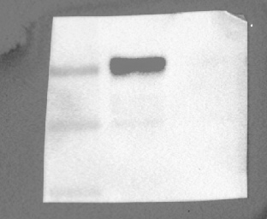
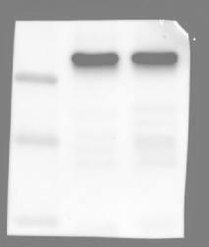
Fig 2C
DU145
DU145
DU145
PTEN
WT KO
WT KO
WT KO
pAKT
1.0 2.9
50 kDa
50 kDa
100 kDa
1.0 312.7
β-Actin
B7-H3
37 kDa
PTEN
50 kDa
1.0 0
50 kDa
AKT
1.0 1.0

Slide 4
Fig 2H
MK2206 (uM)
MK2206 (uM)
0 0.05 0.1 0.5 1
0 0.05 0.1 0.5 1
B7-H3
50 kDa
100 kDa
1.0 0.7 0.6 0.2 0.1
pAKT
75 kDa
B7-H3
1.0 1.0 1.0 0.9 0.6
50 kDa
AKT
1.0 1.0 1.2 1.1 1.0
1.0 1.0 0.9 0.5 0.4
100 kDa
Sp1
50 kDa
37 kDa
β-Actin

Slide 5
Fig 2I
LNCaP
LNCaP
TP53
WT KO
TP53
WT KO
50 kDa
p53
1.0 5.2
37 kDa
1.0 0
100 kDa
B7-H3
50 kDa
β-Actin
37 kDa
1.0 6.3
100 kDa
Sp1

Slide 6
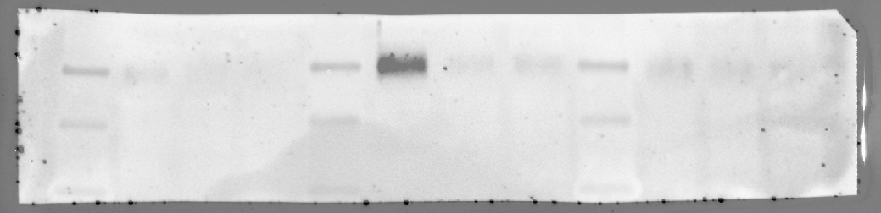
Fig 3A
sgCd276
sgCtrl #2 #3
50 kDa
B7-H3
37 kDa
1.0 0.1 0.2
50 kDa
β-Actin
37 kDa

Slide 7
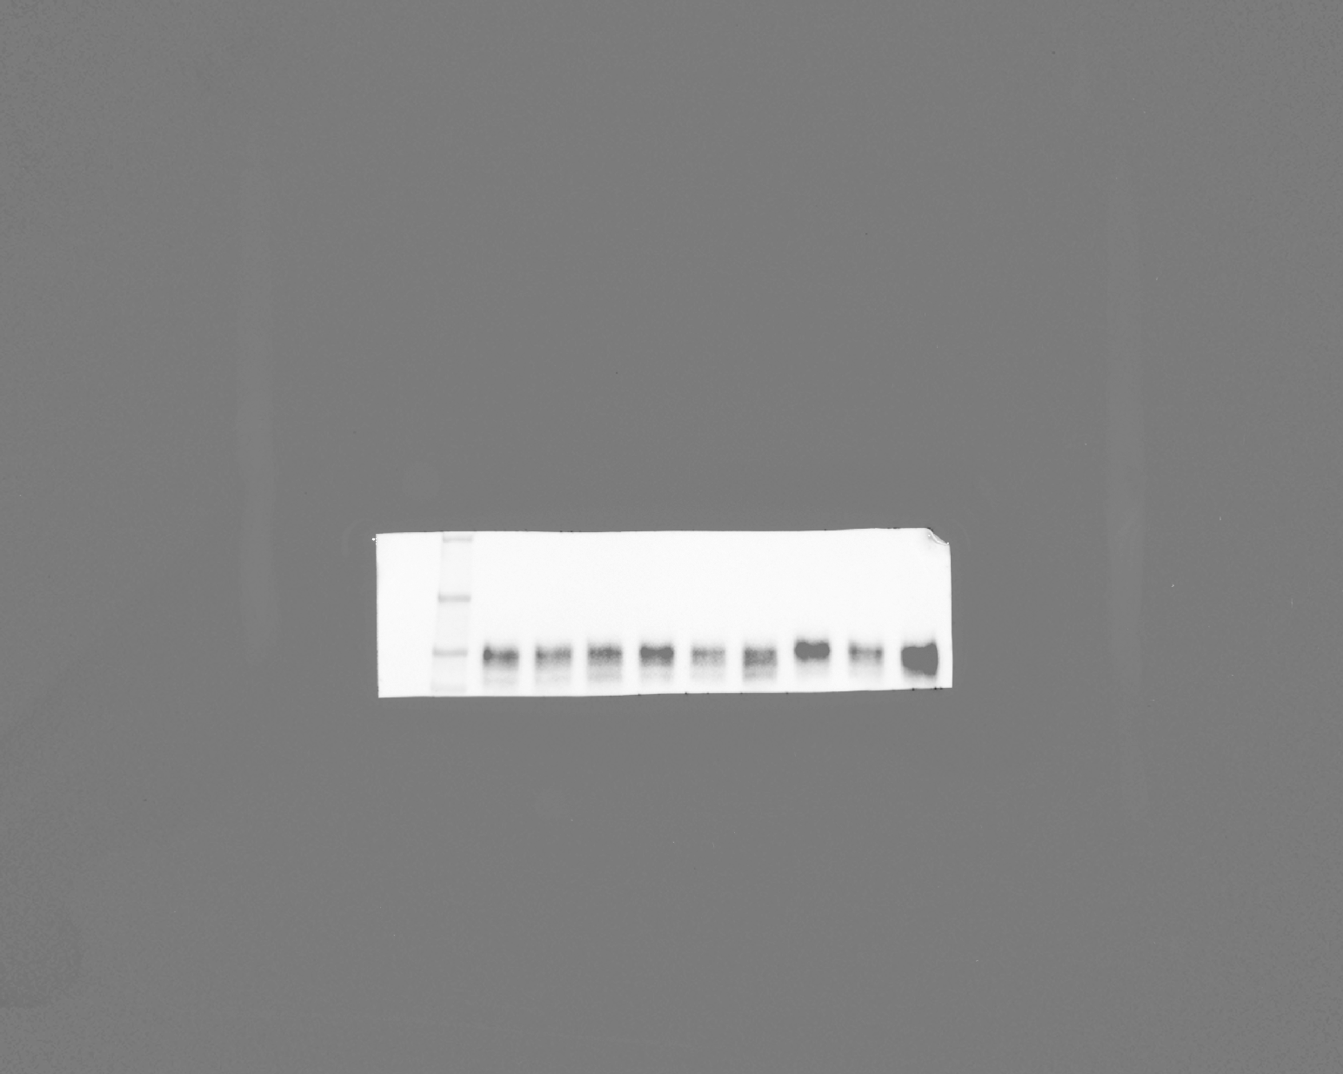
Fig S2B
siCtrl siSP1
1.0 0.6
100 kDa
B7-H3
1.0 0
100 kDa
Sp1
50 kDa
β-Actin
37 kDa

Slide 8
Fig S2C
Mithramycin A
– +
1.0 0.6
100 kDa
B7-H3
1.0 0.4
100 kDa
Sp1
50 kDa
β-Actin
37 kDa

Slide 9
Fig S2D
TP53 KO LNCaP
siCtrl
siSP1
SP1
– + – +
1.0 1.4 0.5 0.9
100 kDa
B7-H3
50 kDa
β-Actin
37 kDa

Slide 10
Fig S2H
LNCaP
22Rv1
SP1
– +
SP1
– +
1.0 1.1
1.0 0.9
100 kDa
B7-H3
100 kDa
B7-H3
50 kDa
β-Actin
37 kDa
DU145
SP1
– +
1.0 1.0
100 kDa
B7-H3
50 kDa
β-Actin
37 kDa

