Slide 1
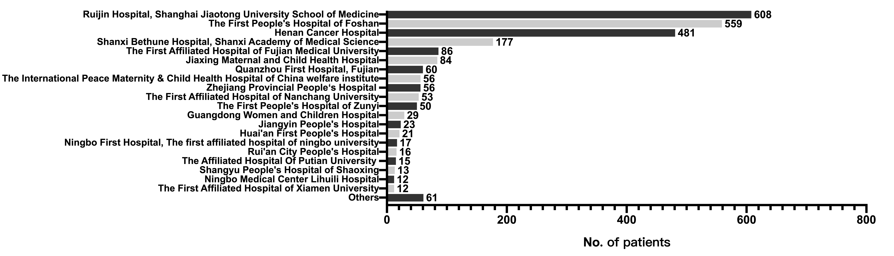
Figure S1. list of hospitals and enrolled cases in the study.
Notes:
Abbreviations: HER2, human epidermal growth factor receptor-2; ER, estrogen receptor.

Slide 2
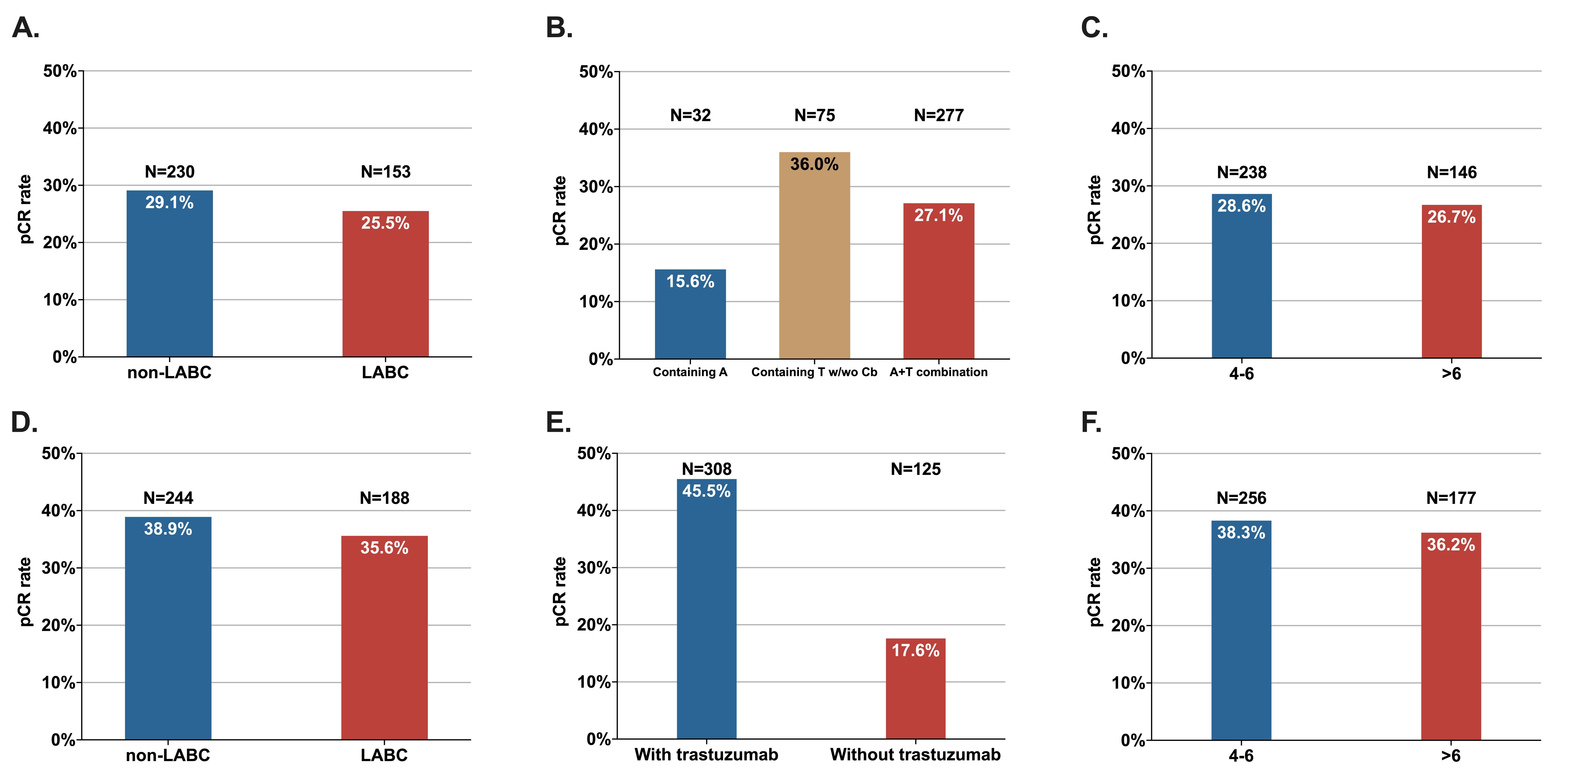
Figure S2. Pathological complete response rate in ER- patients according to tumor stage, neoadjuvant regimens, and neoadjuvant therapy cycles. (A) TNBC, according to different clinical stage. (B) TNBC, according to different NAC regimen. (C) TNBC, according to cycles of NAC. (D) ER-/HER2+, according to different clinical stage. (E) ER-/HER2+, with neoadjuvant trastuzumab or not. (F) ER-/HER2+, according to cycles of NAT.
Notes:
Abbreviations: TNBC, triple-negative breast cancer; NAC, neoadjuvant chemotherapy; ER, estrogen receptor; HER2, human epidermal growth factor receptor-2; NAT, neoadjuvant treatment; pCR, pathological complete response; non-LABC, non-locally advanced breast cancer, refers to clinical stage I and IIA; LABC, locally advanced breast cancer, refers to clinical stage IIB and III; A, anthracycline; T, taxane; Cb, carboplatin.

Slide 3
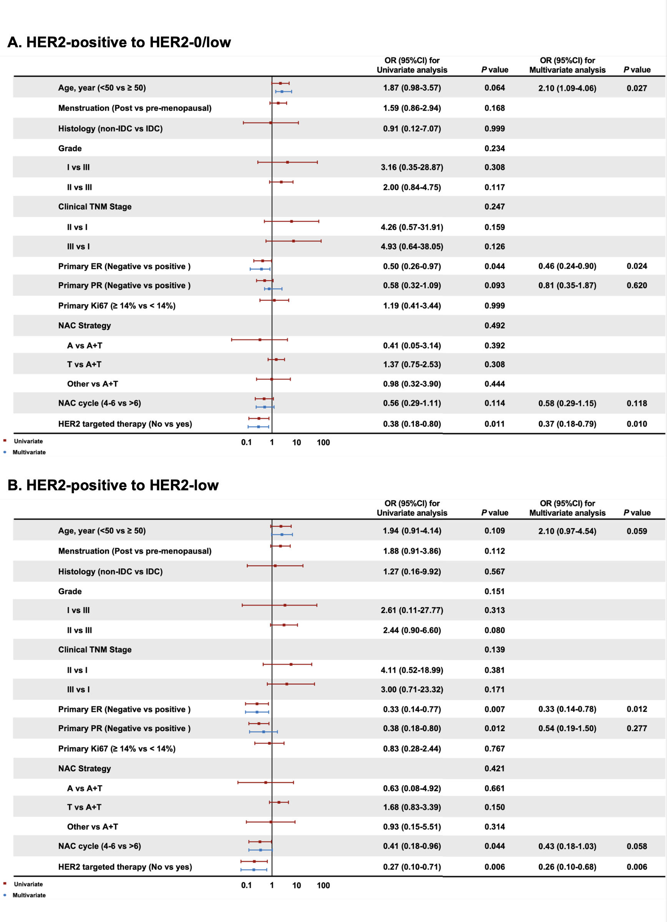
Figure S3. Impact factors of HER2 category change from HER2 positive to (A) HER2-0/low and (B) HER2-low in primary HER2 positive patients.
Notes:
Abbreviations: HER2, human epidermal growth factor receptor-2; OR, odds ratio; CI, confidence interval; IDC, invasive ductal carcinoma; ER, estrogen receptor; PR, progesterone receptor; NAC, neoadjuvant chemotherapy; A, anthracycline; T, taxane.

Slide 4
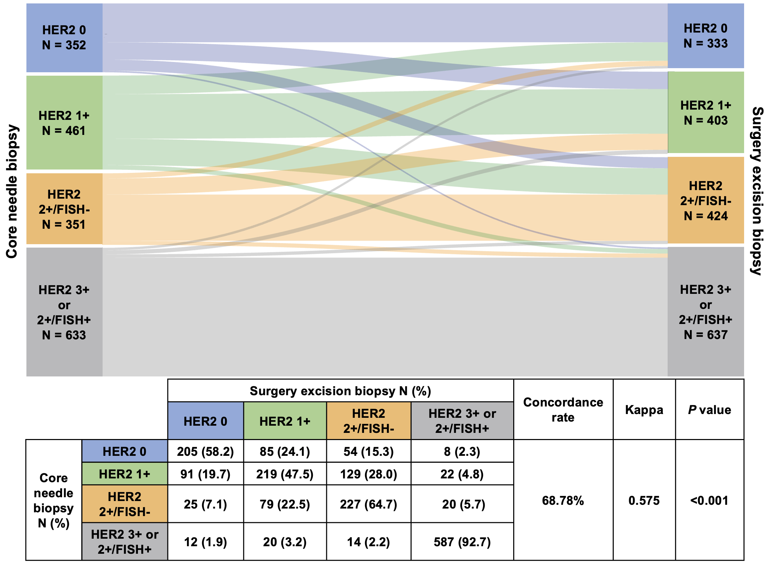
Figure S4. HER2 category change between primary and residual disease according to four subtypes: HER2 0, HER2 1+, HER2 2+/FISH-, and HER2 3+ or 2+/FISH+.
Notes:
Abbreviations: HER2, human epidermal growth factor receptor-2; ER, estrogen receptor; FISH, fluorescence in situ hybridization.

Slide 5
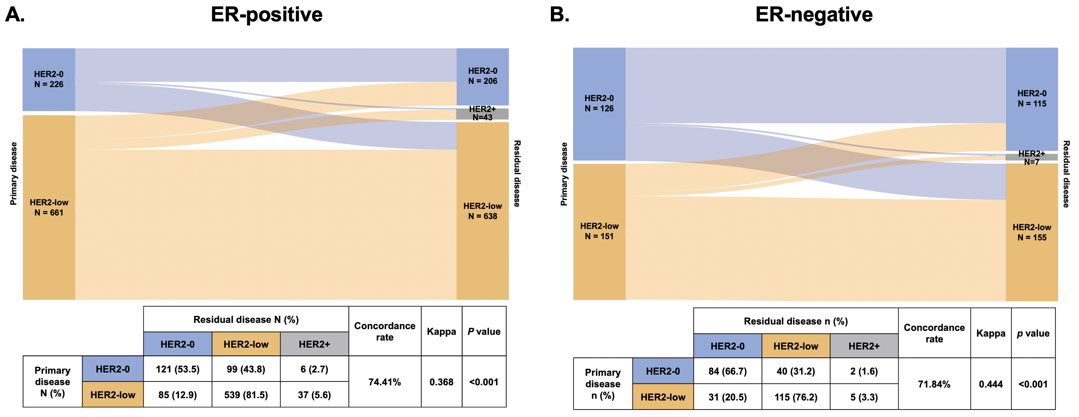
Figure S5. HER2 category change in (A) ER-positive and (B) ER-negative, HER2-negative patients.
Notes:
Abbreviations: HER2, human epidermal growth factor receptor-2; ER, estrogen receptor.

Slide 6
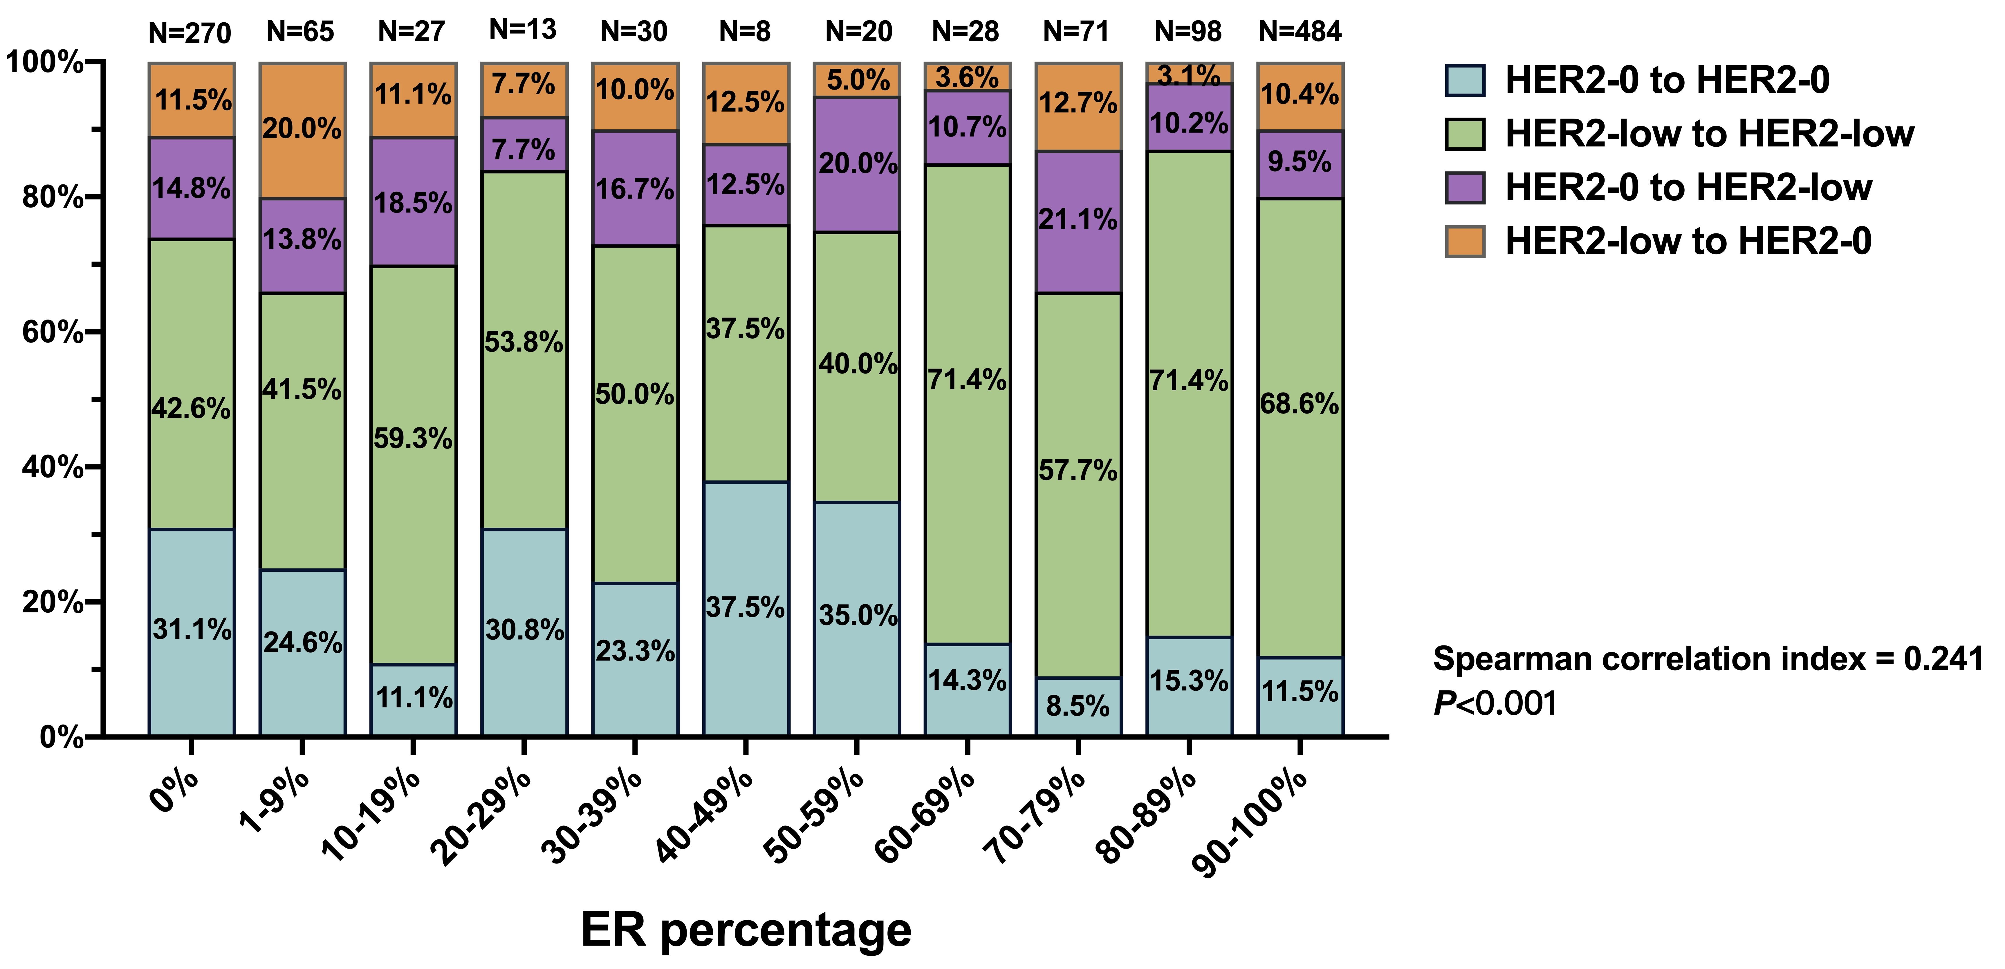
Figure S6. The detail of HER2 category change according to ER expression level.
Notes:
Abbreviations: HER2, human epidermal growth factor receptor-2; ER, estrogen receptor.

Slide 7
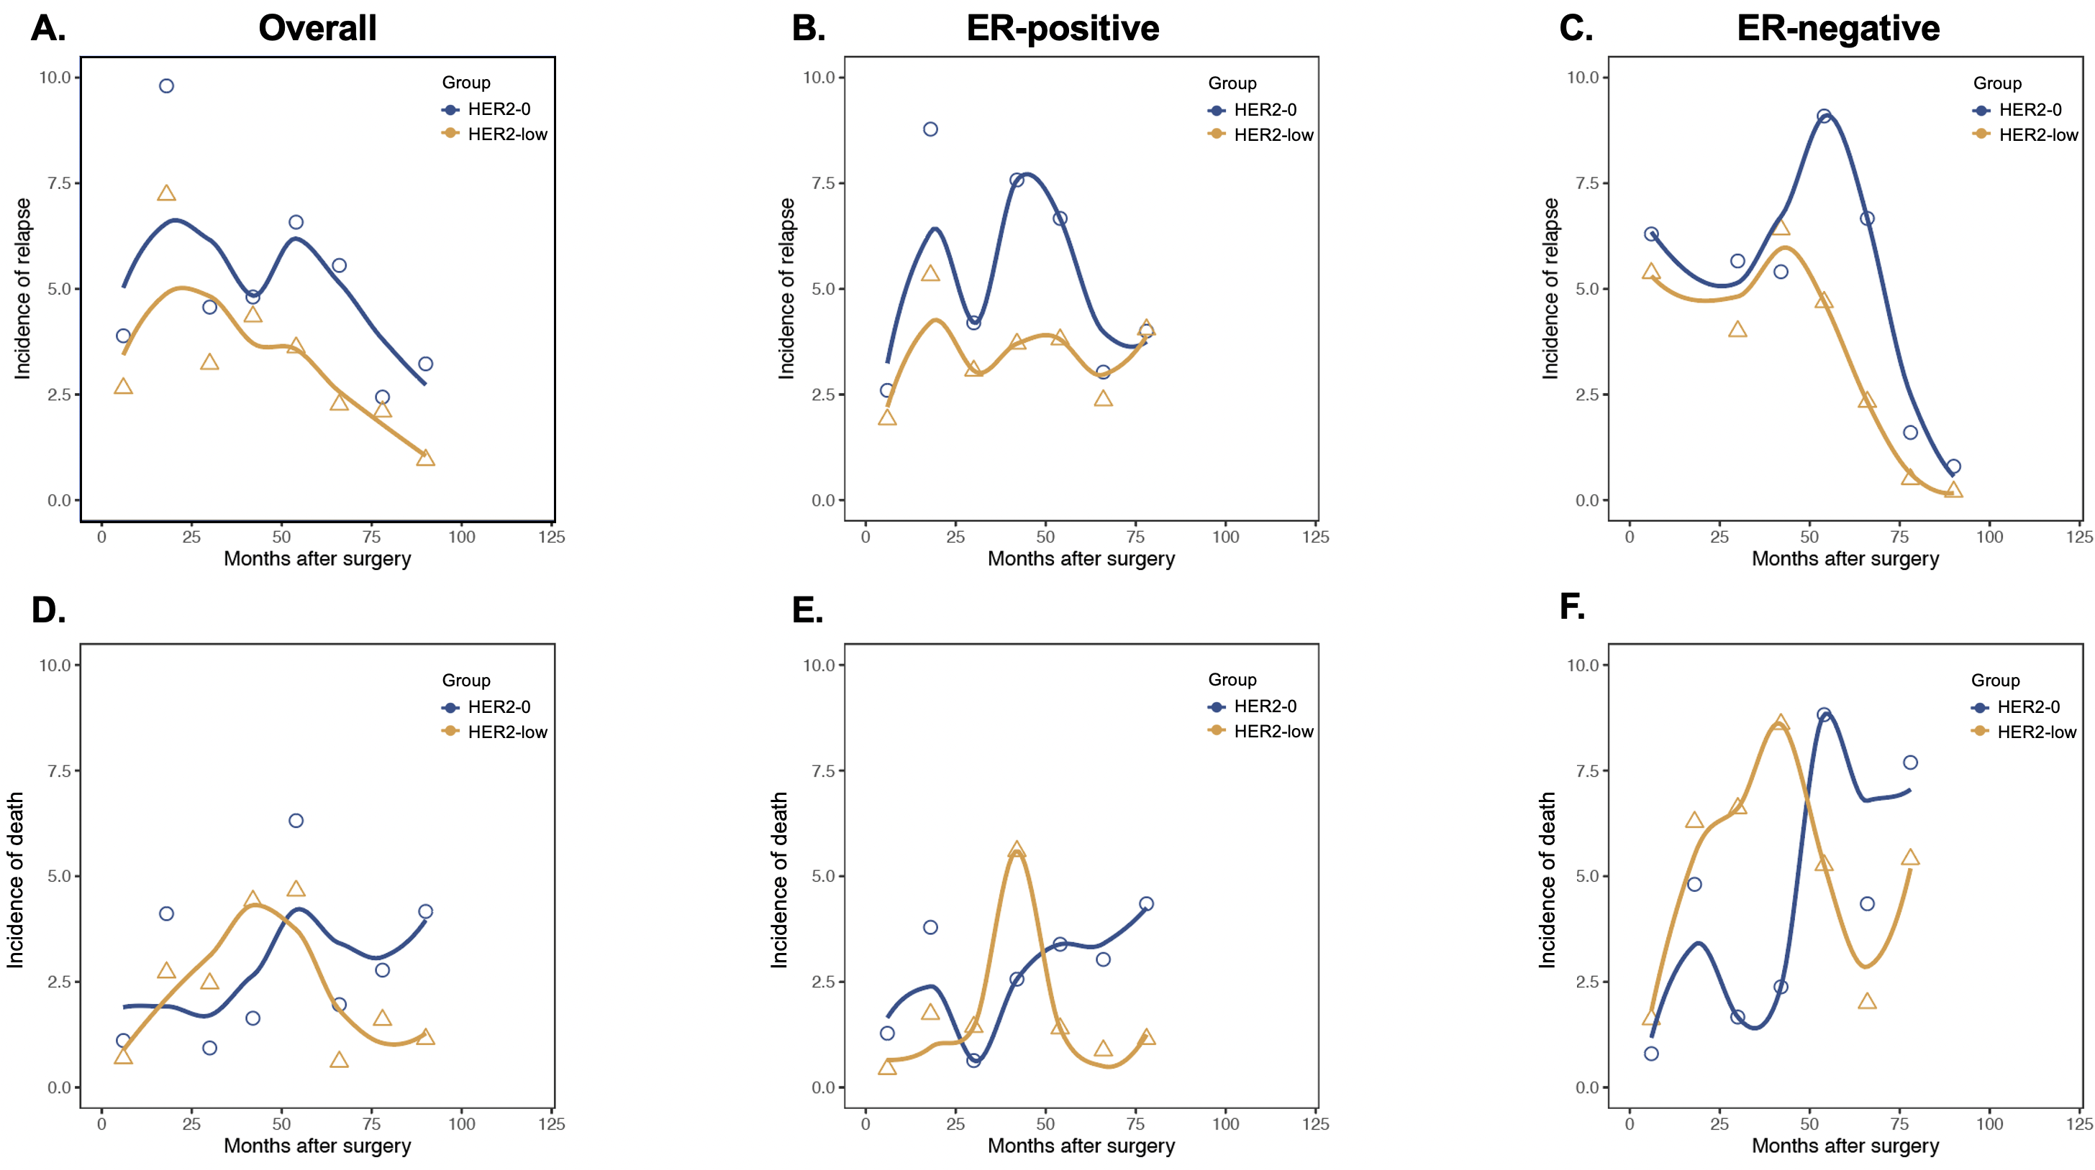
Figure S7. Annual relapse and death risk according to primary HER2-low expression of (A, D) all, (B, E) ER-positive, and (C, F) ER-negative, HER2-negative patients.
Notes:
Abbreviations: HER2, human epidermal growth factor receptor-2; ER, estrogen receptor.

Slide 8
Figure S8. RFI and OS according to primary HER2-low expression of (A, C) ER-positive, and (B, D) ER-negative, HER2-negative patients with residual disease.
Notes:
Abbreviations: RFI, recurrence free interval; OS, overall survival; HER2, human epidermal growth factor receptor-2; ER, estrogen receptor.

Slide 9
Figure S9. RFI and OS according to HER2 category change of (A, D) all, (B, E) ER-positive, and (C, F) ER-negative, HER2-negative patients with residual disease.
Notes:
*Adjusted to age, menstruation, stage, primary ER, primary PR, primary Ki67, and grade.
# Adjusted to age, menstruation, stage, primary PR, primary Ki67, and grade.
Abbreviations: RFI, recurrence free interval; OS, overall survival; HER2, human epidermal growth factor receptor-2; ER, estrogen receptor; PR, progesterone receptor.

Slide 10
Figure S10. CPS-EG score distribution and category according to (A, B) primary HER2-low expression and (C, D) HER2 category change in HER2-negative patients.
Notes:
Abbreviations: HER2, human epidermal growth factor receptor-2.

