Slide 1
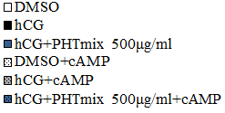
SUPPLEMENTAL FIGURE 1
A
B
d
CYP11A1
c
d
b,c
d
b,c
d
d
d
b
d
d
d
b
b,d
Percent Fold Change Relative to hCG
b
b
b,d
b
Percent Fold Change Relative to hCG
b
b
b
b
b
b
b
b,c
b
c
b
c
b
b
b
b
a
a
c
c
c
c
c
a
a
a
a
a
a
C
b
HSD3B2
b
b
b
b,c
a,b
a
a
b
a,b
b
b
a,b
a,b
a,b
a
b
a
c
c
a,c
a
a
Percent Fold Change Relative to hCG
a

