Slide 1
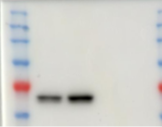
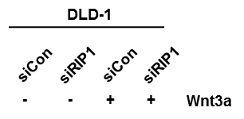
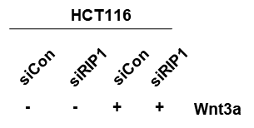


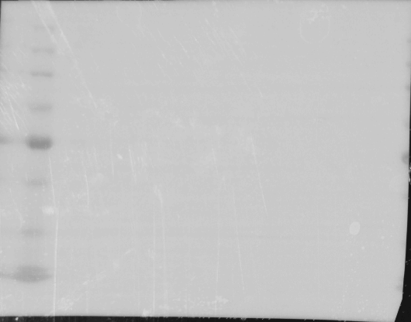
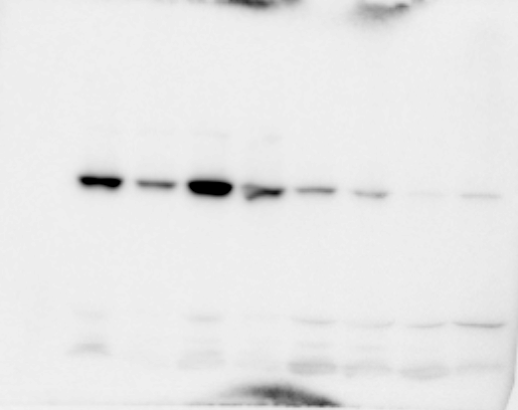
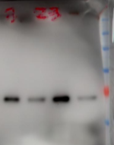
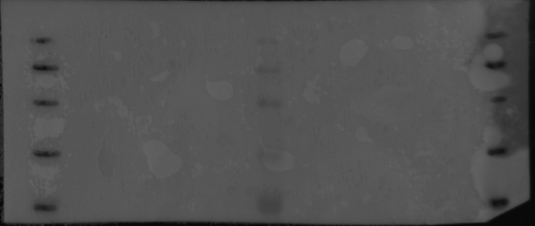
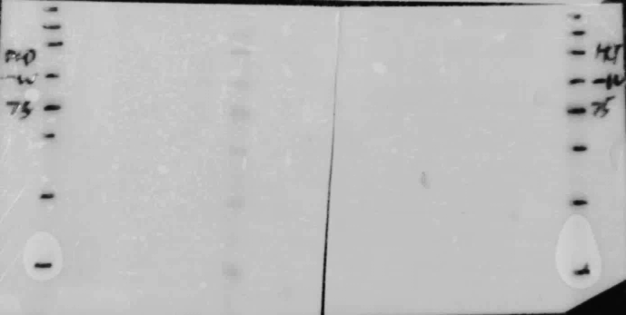
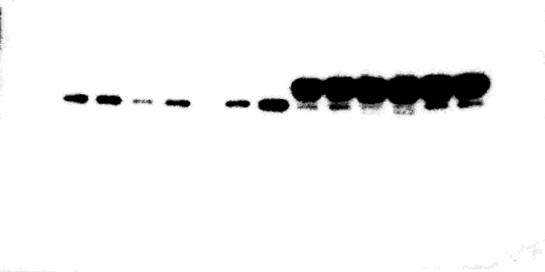
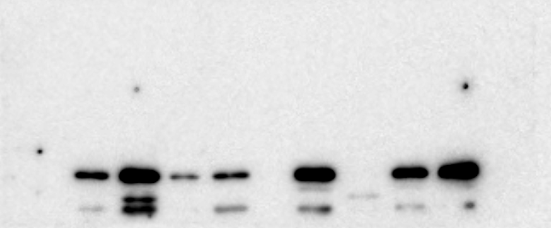
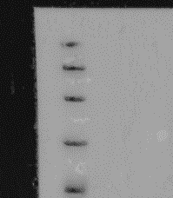
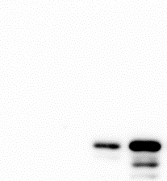
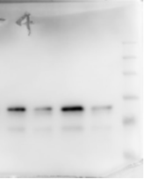
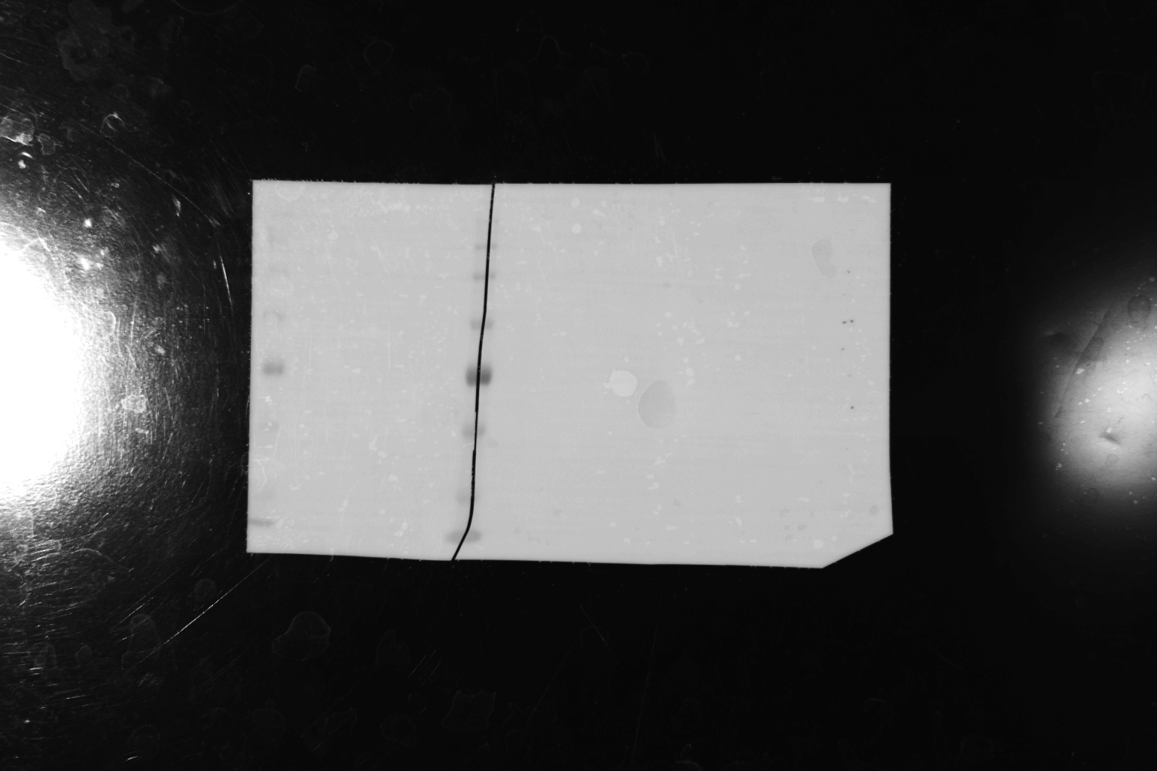

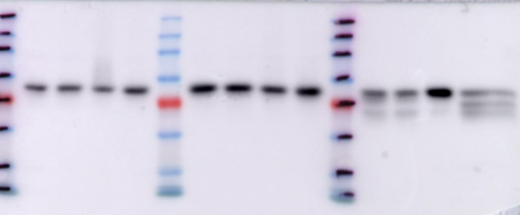
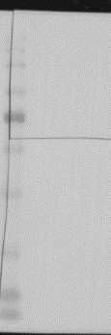
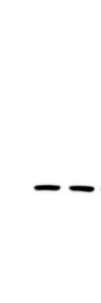
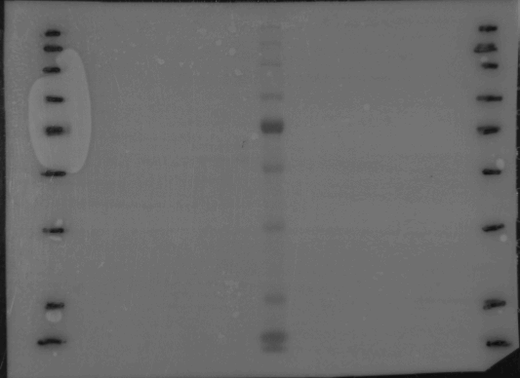


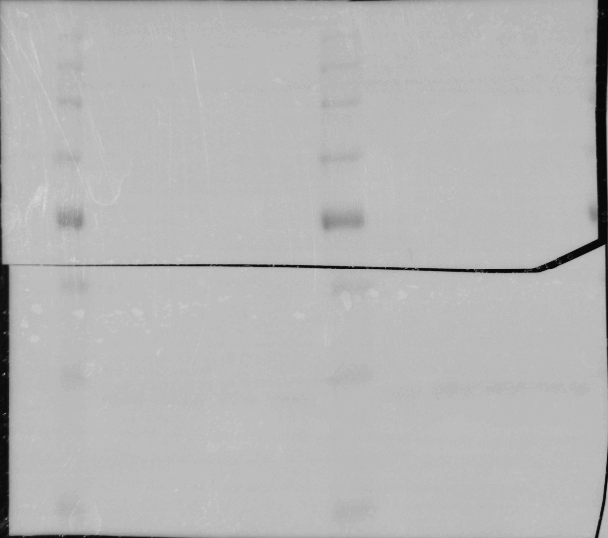
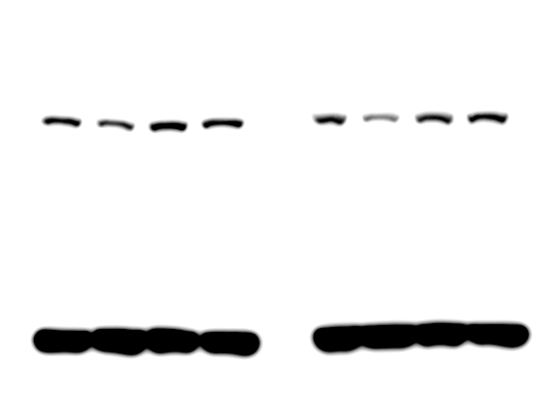
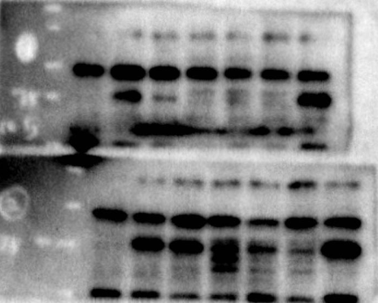
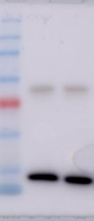
Figure 1A.
Figure 1B.
Figure 1C.
RIP1
β-catenin
RIP1
RIP1
RIP1
β-actin
RIP1
Figure 1F.
β-catenin
β-catenin
β-catenin
β-catenin
β-catenin
β-actin
β-actin
β-actin
Flag
β-actin
β-actin

Slide 2


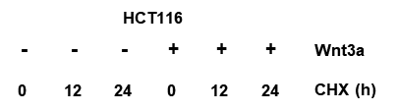


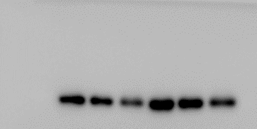
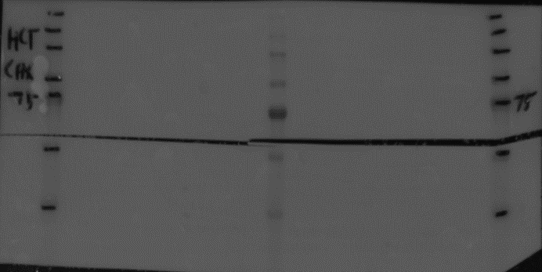
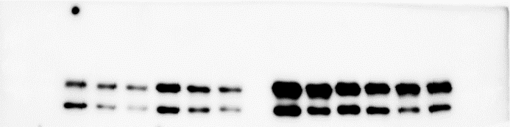
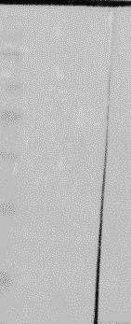
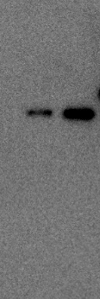
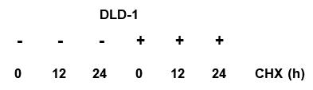
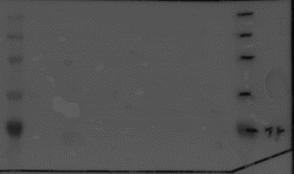
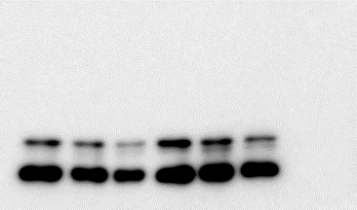
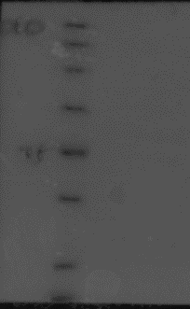

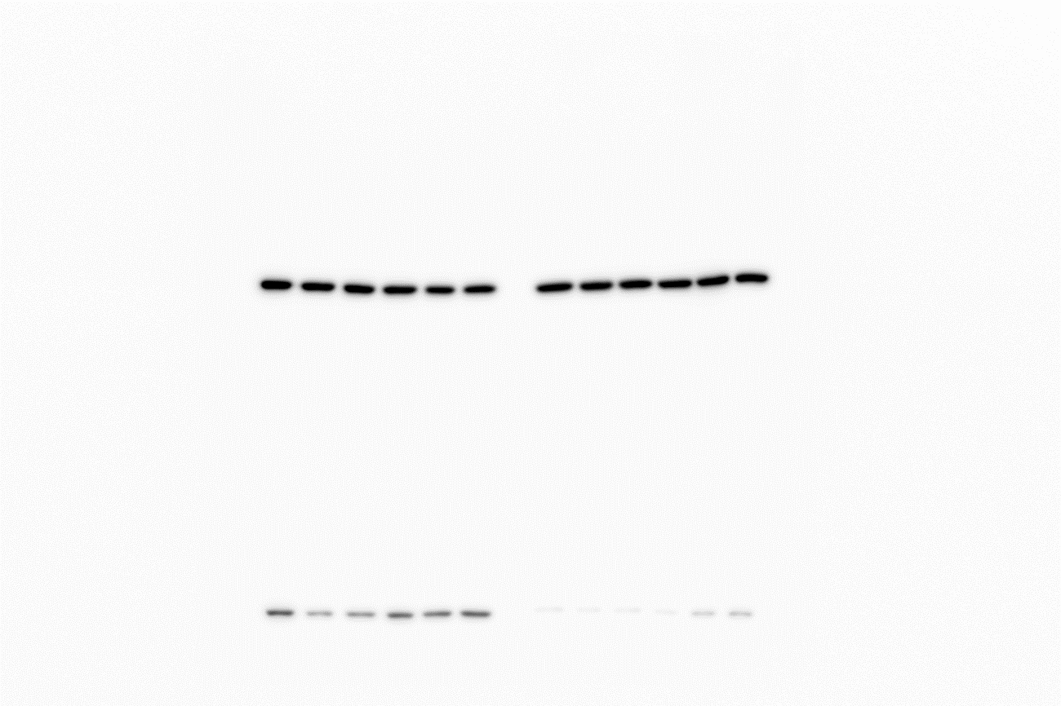
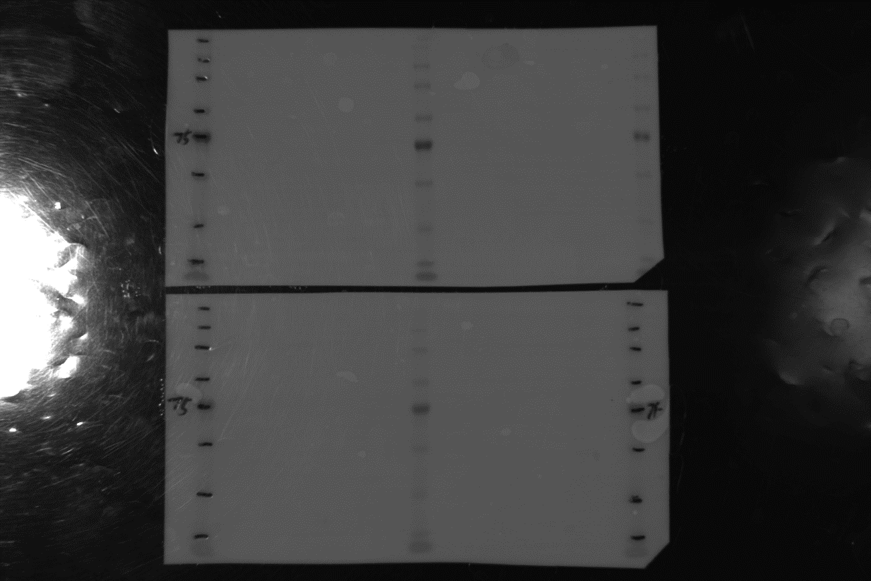
Figure 2A.
Figure 2B.
RIP1
β-catenin
β-catenin
β-catenin
RIP1
β-actin
RIP1
RIP1
β-catenin
β-catenin
β-catenin
β-actin
β-actin
β-actin

Slide 3
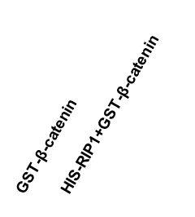
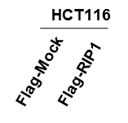
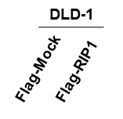


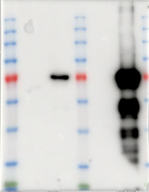
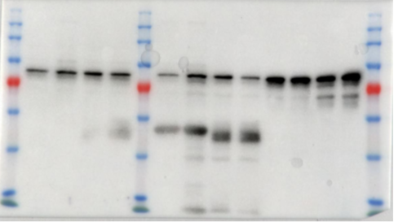
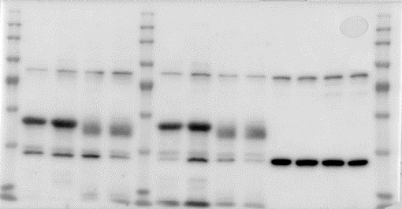
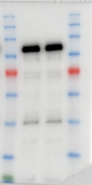
Figure 2C.
Figure 2D.
GST
β-catenin
β-catenin
Flag
Flag
His
β-catenin
β-catenin
β-actin
GST
β-actin

Slide 4
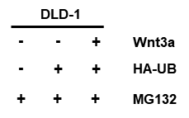
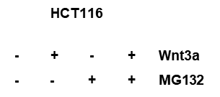
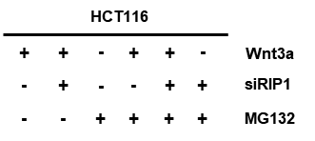
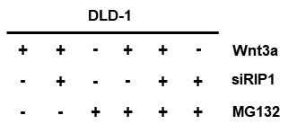
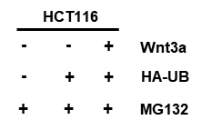
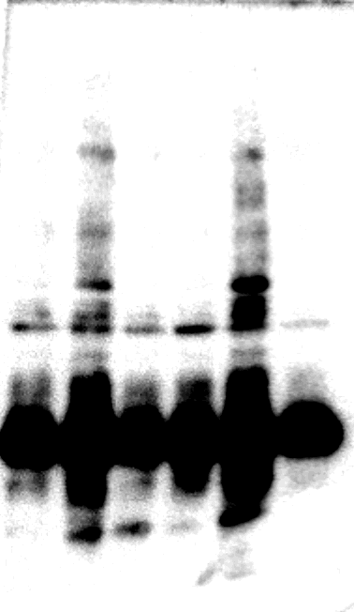
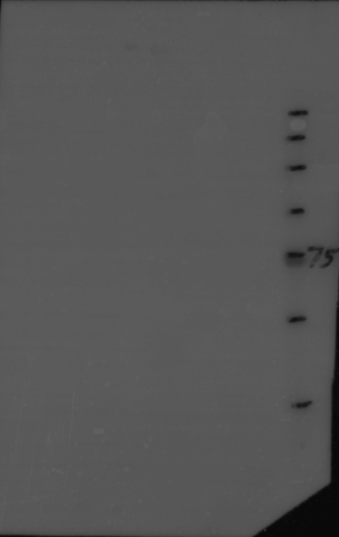
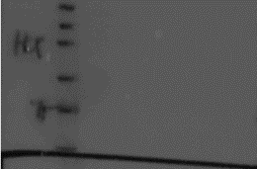
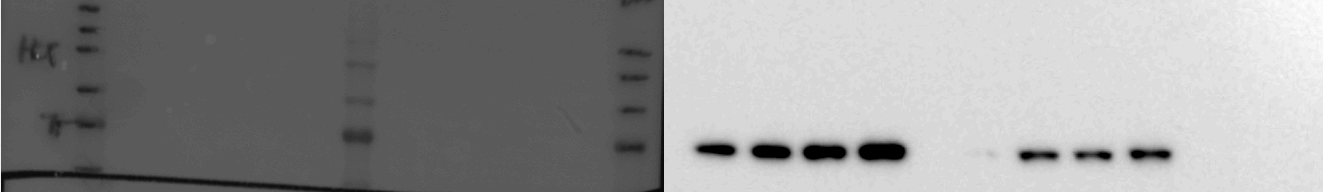


















Figure 3A.
Figure 3B.
Figure 3C.
RIP1
β-catenin
β-actin
RIP1
RIP1
RIP1
RIP1
β-catenin
β-catenin
RIP1
β-catenin
β-actin
β-catenin
β-catenin
β-actin
β-actin
β-actin
β-actin

Slide 5




































Figure 4A.
Figure 4B.
RIP1
RIP1
RIP1
RIP1
β-catenin
cIAP2
β-catenin
β-catenin
β-catenin
β-actin
cIAP2
cIAP1
cIAP1
cIAP2
β-actin
RIP1
cIAP1
β-actin
β-actin
β-catenin
β-actin

Slide 6



















Figure 4C.
Figure 4D.
cIAP2
cIAP2
cIAP1
cIAP1
β-catenin
β-catenin
β-catenin
β-catenin
β-catenin
β-catenin
RIP1
RIP1
cIAP2
cIAP1
cIAP2
cIAP1
cIAP1
cIAP2
β-actin
β-actin
β-actin
β-actin
β-actin
β-actin

Slide 7

































Figure 5A.
Figure 5B.
RIP1
RIP1
E-cadherin
E-cadherin
β-catenin
β-catenin
Vimentin
Vimentin
β-actin
β-actin
E-cadherin
E-cadherin
E-cadherin
E-cadherin
Vimentin
Vimentin
Vimentin
Vimentin
β-actin
β-actin
β-actin
β-actin

Slide 8










Figure 6A.
Figure 6B.
HCT116
Si-RIP1
Si-Con
HCT116
Si-Con
Si-RIP1
Si-Con
Si-RIP1
β-Trcp
IP:β-catenin
IP: IgG
β-catenin
RIP1
β-Trcp
β-Trcp
β-actin
Flag
Flag
DLD-1
DLD-1
DLD-1
Si-Con
DLD-1
DLD-1
Si-RIP1
Si-RIP1
Si-Con
Si-RIP1
β-Trcp
β-Trcp
Si-Con
Si-RIP1
Si-RIP1
Si-RIP1
Si-Con
Si-Con
Si-Con
IP:β-catenin
IP: IgG
β-Trcp
β-catenin
β-catenin
β-catenin
RIP1
β-actin
β-actin
β-actin

Slide 9






Supple-Fig1
Supple-Fig2
HCT116
DLD-1
DLD-1
HCT116
IP: b-ca
IgG
IP: b-ca
IgG
Input
-
-
-
-
-
+
+
+
+
+
WNT3A
DLD-1
0
3
6
12
24
0
3
6
12
24
CHX (h)
-
-
-
-
-
+
+
+
+
+
WNT3A
-
+
-
+
-
+
-
+
-
+
0
3
6
12
24
0
3
6
12
24
CHX (h)
RIP1
RIP1
RIP1
RIP1
HCT116
-
+
Wnt3a
β-catenin
β-catenin
β-catenin
β-catenin
β-actin
RIP1
β-actin
β-actin
β-actin

