Slide 1
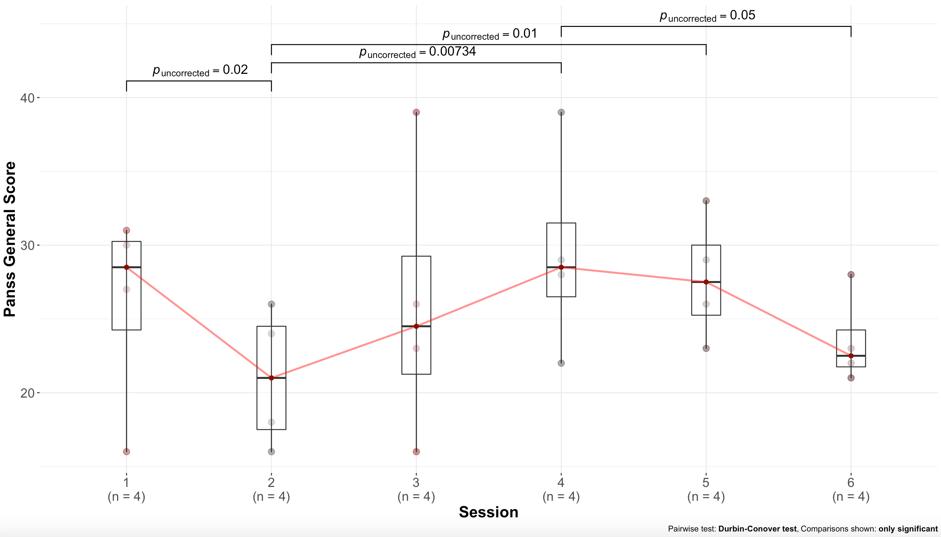
eFigure 1: Supplementary Primary Outcome Results: This figure demonstrates the summary of post-hoc pairwise comparisons by session contrasts for both HD-tDCS and HD-tACS in one graph. The purpose for this analysis is to determine whether there was a see-saw effect for PANSS general symptoms by examining differences between HD-tDCS 1-month compared to HD-tACS baseline or between HD-tDCS baseline compared to HD-tACS 1-month.

