Slide 1
Supplemental Figure 1
Notes:
Somatic mutations in epigenomic modifier genes and cytogenetics
Overview of somatic mutations in epigenomic modifier genes as well as cytogenetics. No association between mutations in epigenetic modifiers and therapy response as well as methylation patterns can be observed. The overall screening sample set harbors no distinct clustering patterns.

Slide 2
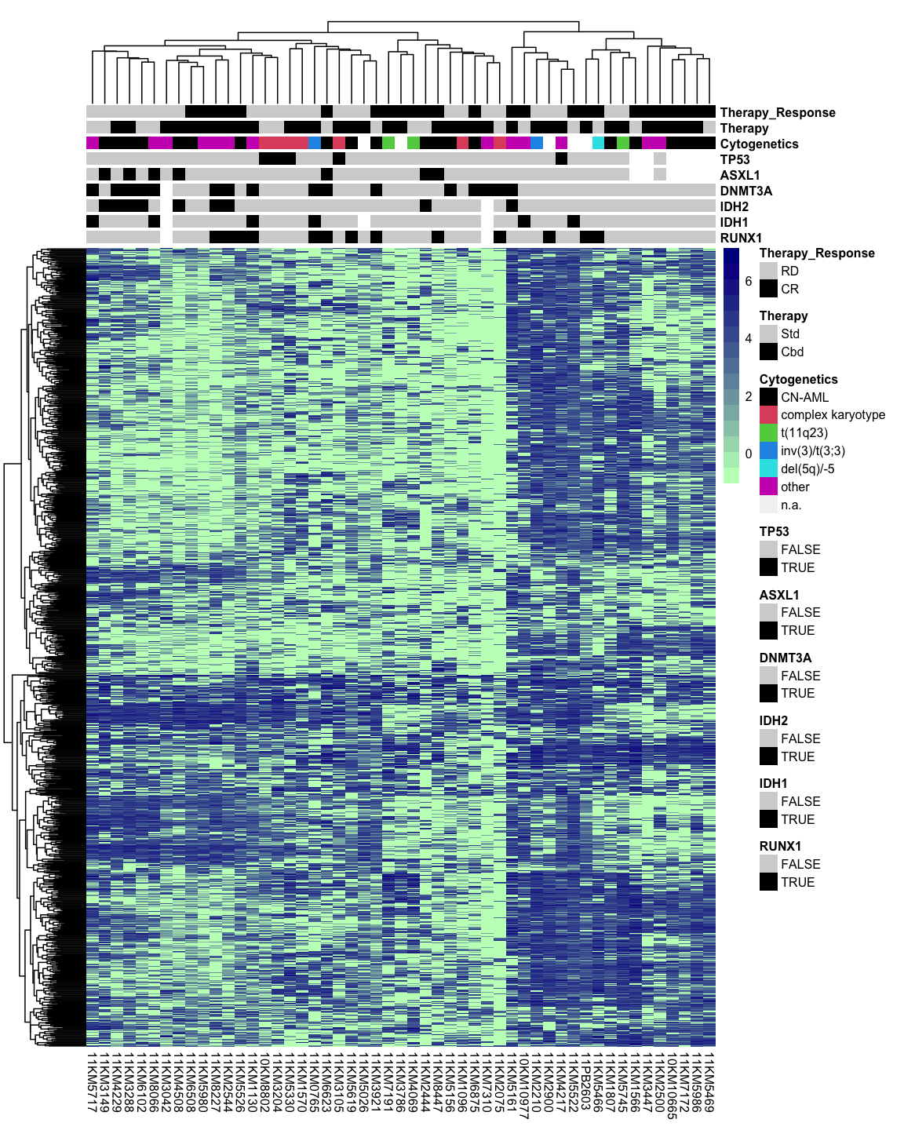
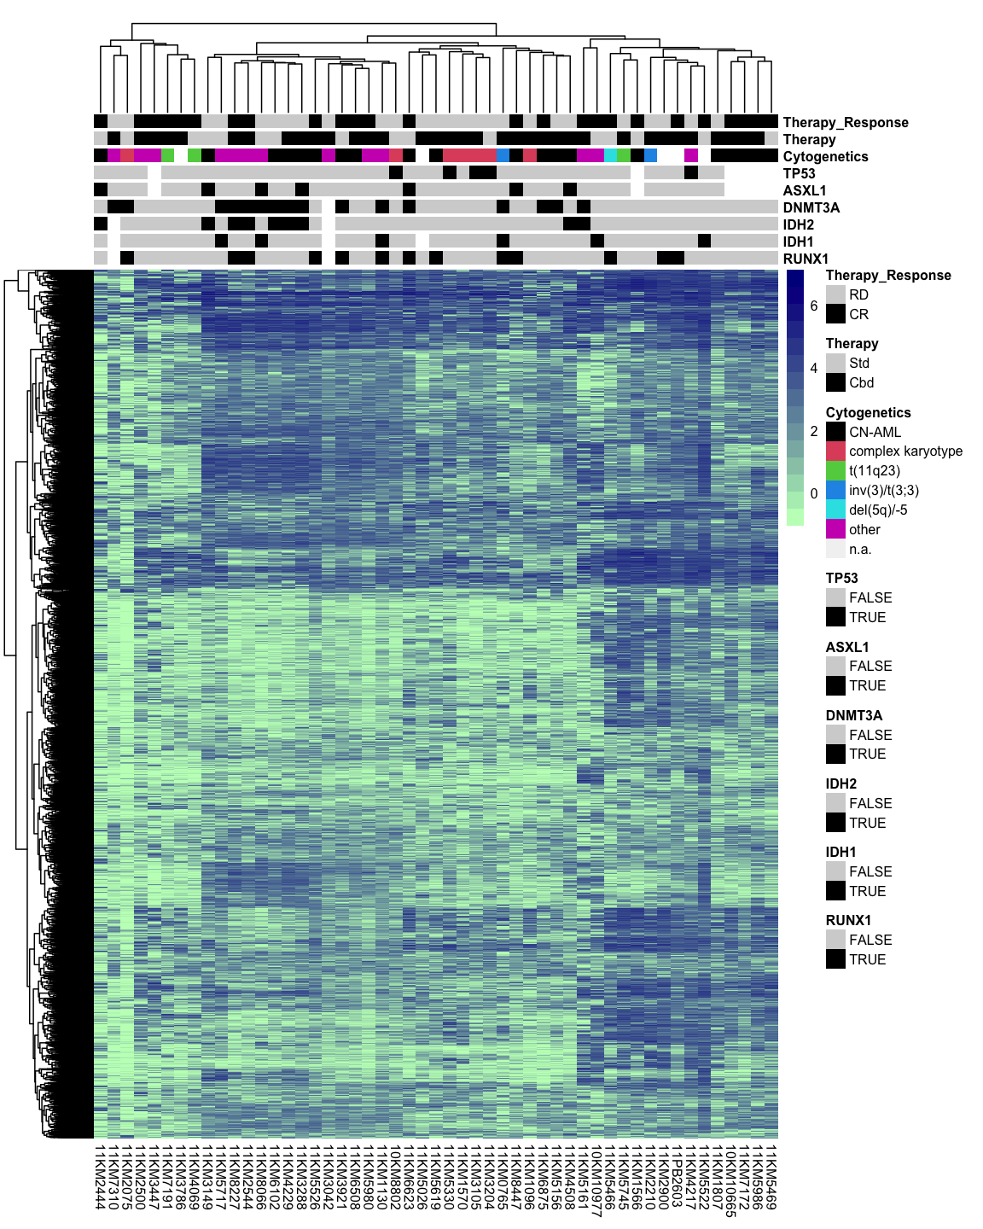
Supplemental Figure 2
A
B
Top 1000 most variable CpG regions
Top 10000 most variable CpG regions
Notes:
Unsupervised hierarchical clustering of top 1000 (A) and 10000 (B) most variable CpG regions
Assessment of the impact of karyotypes and mutations in epigenetic modifier genes by unsupervised hierarchical clustering of the top 1000 and top 10000 most variable CpG regions in the screening cohort.

Slide 3
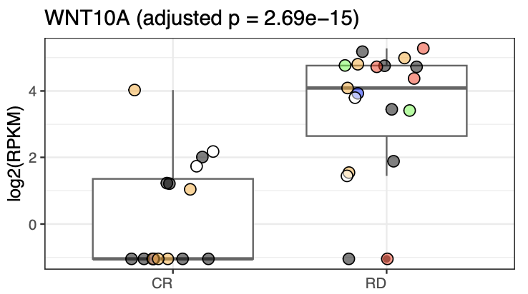
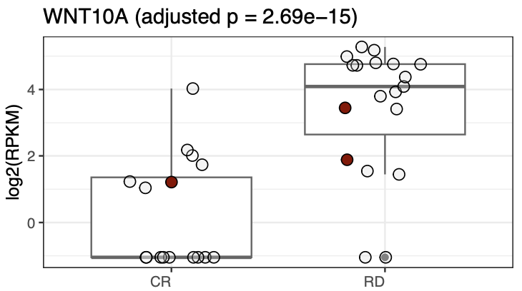
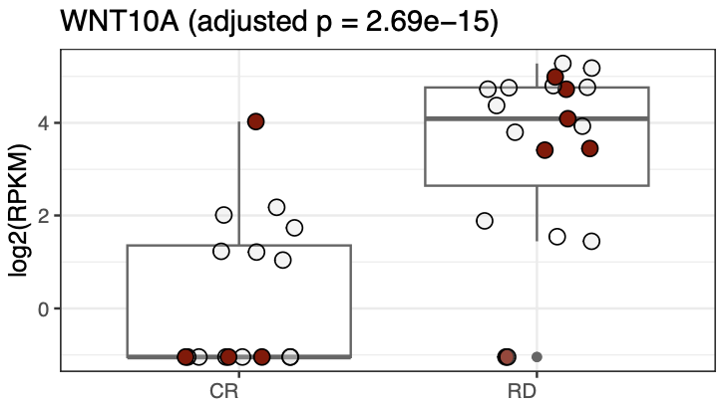
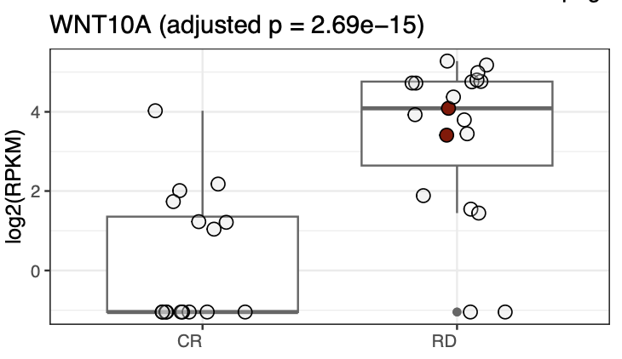
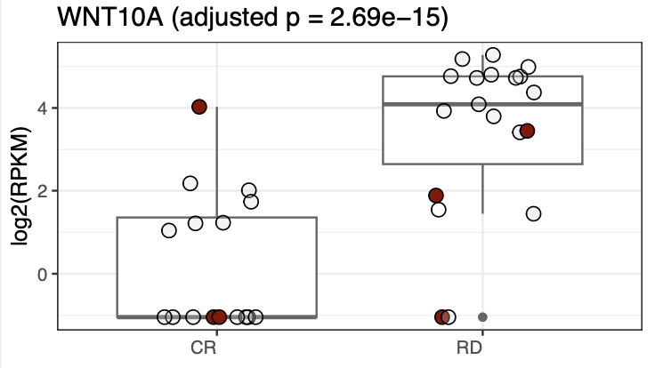
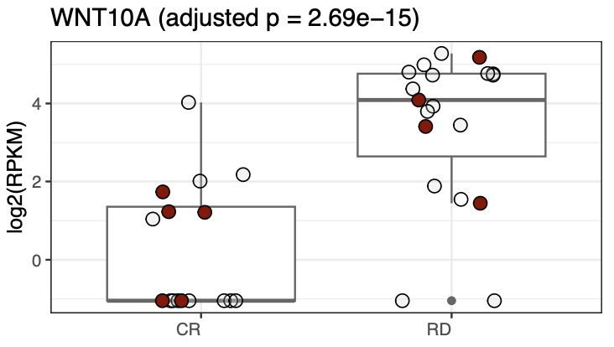
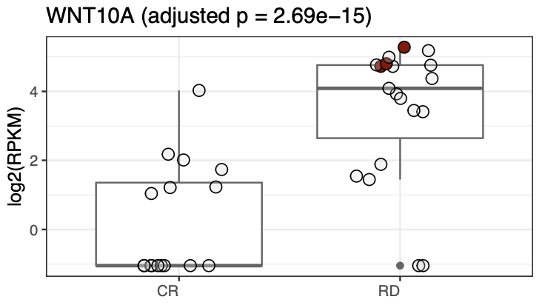
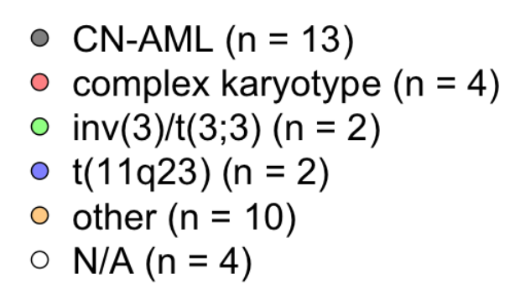
Supplemental Figure 3 – 1/10
ASXL1
DNMT3A
IDH1
IDH2
RUNX1
TP53
Notes:
Distribution of mutations and karyotypes in top 10 DMRs for signature generation
Assessment of the impact of karyotypes and mutations in epigenetic modifier genes by unsupervised hierarchical clustering of the top 1000 and top 10000 most variable CpG regions in the screening cohort.

Slide 4
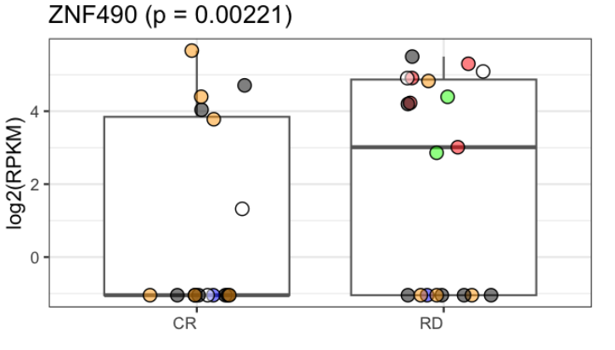
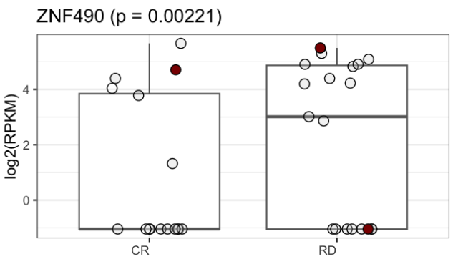
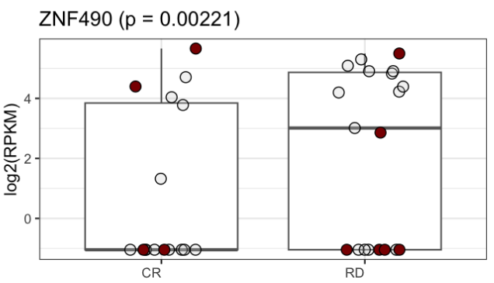
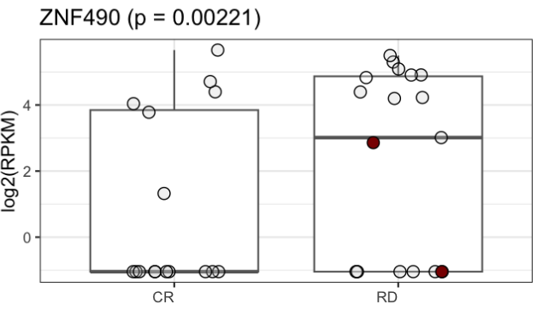
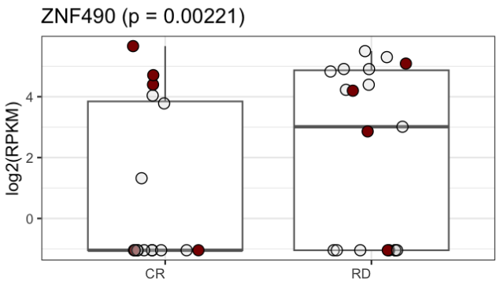
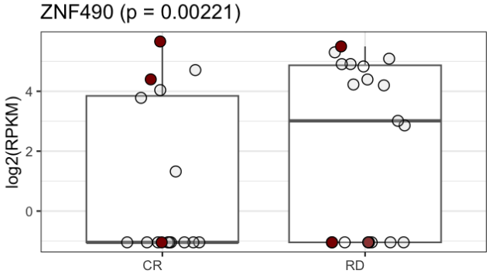
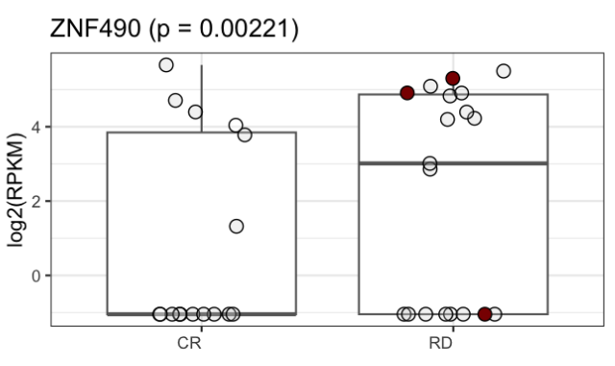
Supplemental Figure 3 – 2/10
ASXL1
DNMT3A
IDH1
IDH2
RUNX1
TP53

Slide 5
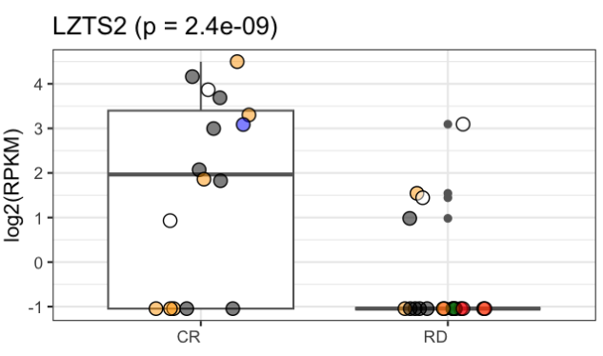
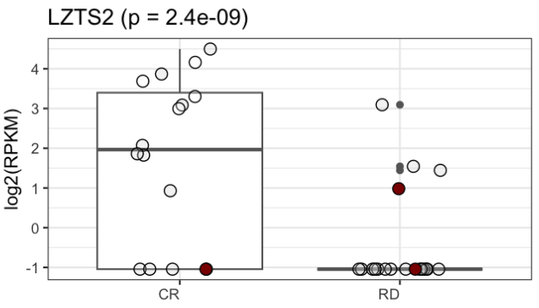
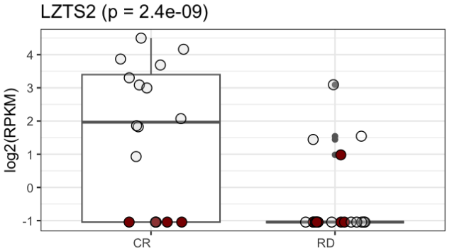
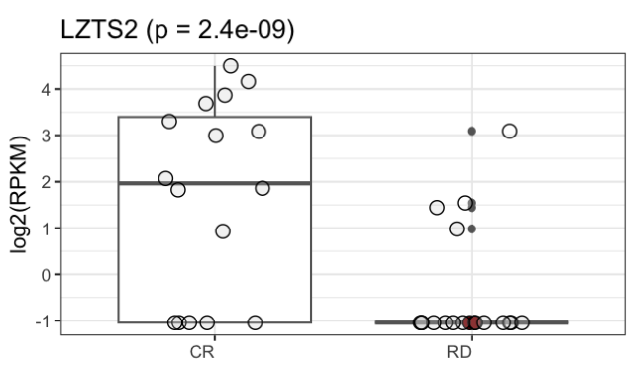
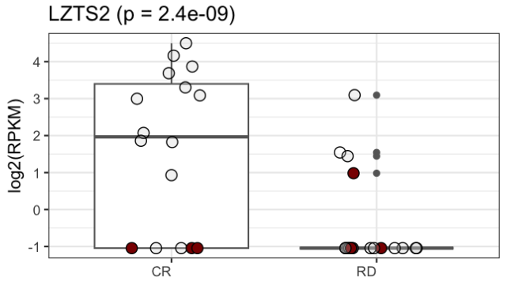
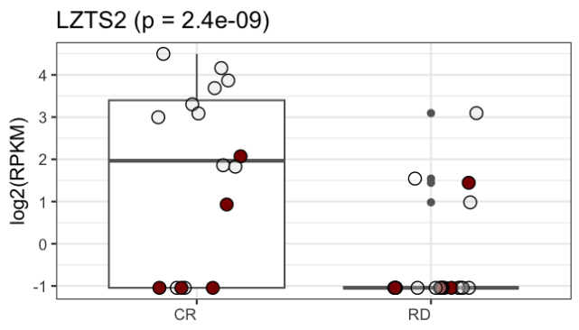
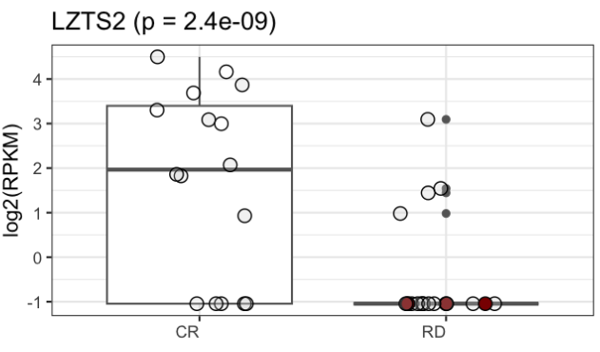
Supplemental Figure 3 – 3/10
ASXL1
DNMT3A
IDH1
IDH2
RUNX1
TP53

Slide 6
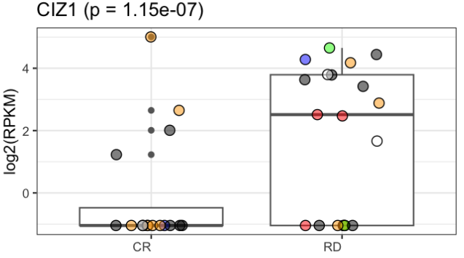
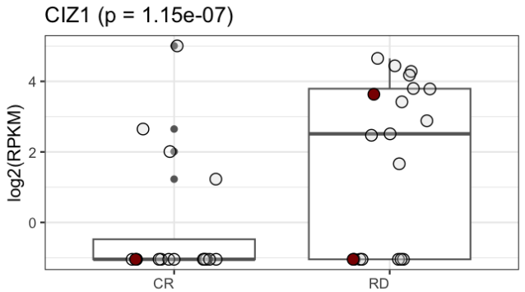
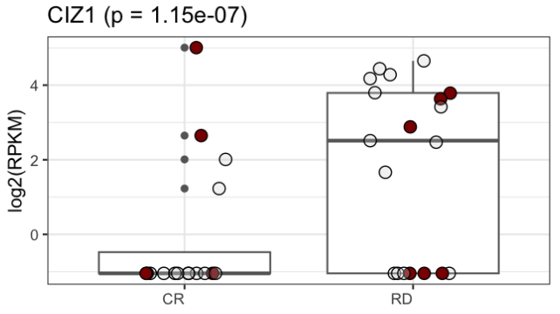
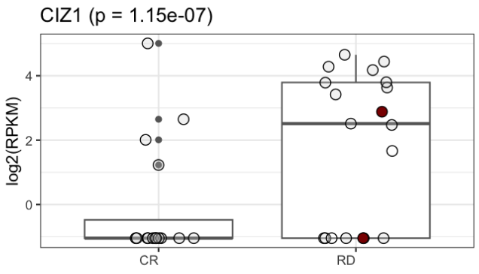
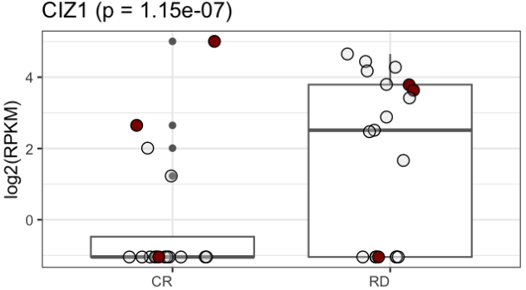
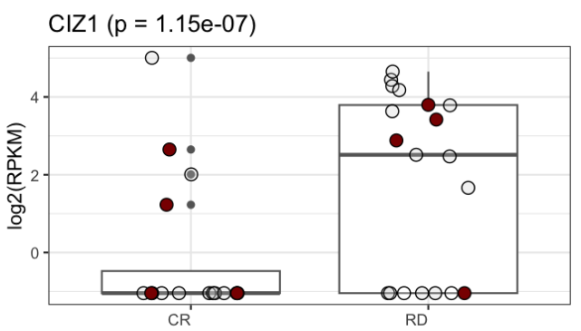
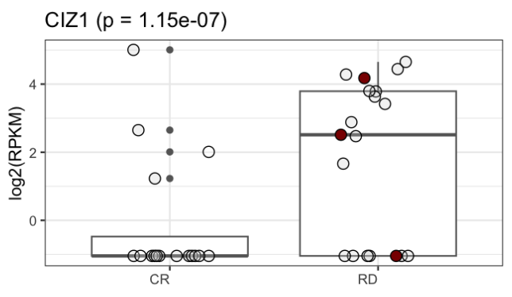
Supplemental Figure 3 – 4/10
ASXL1
DNMT3A
IDH1
IDH2
RUNX1
TP53

Slide 7
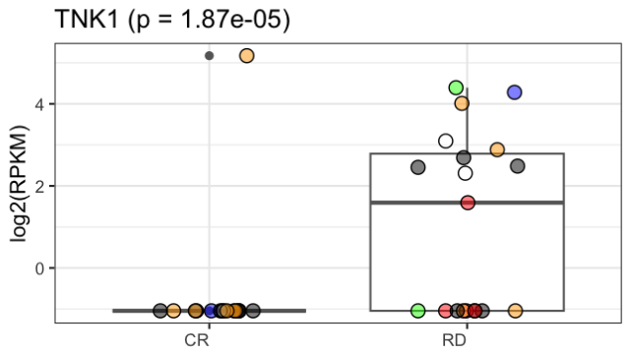
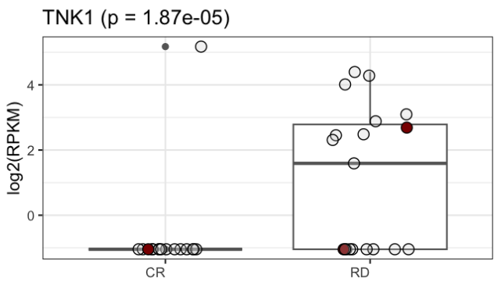
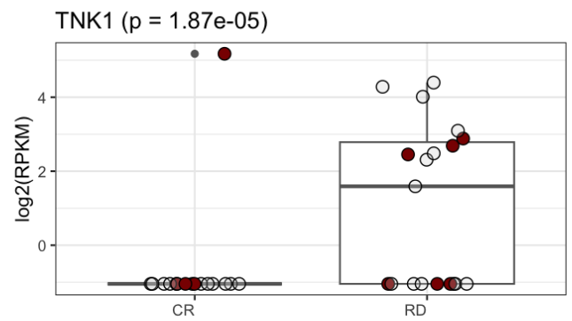
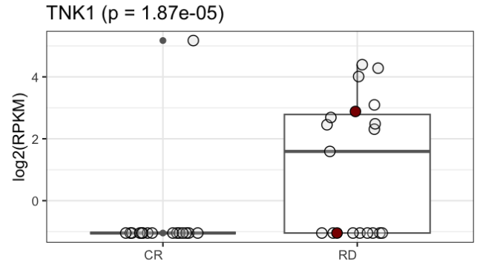
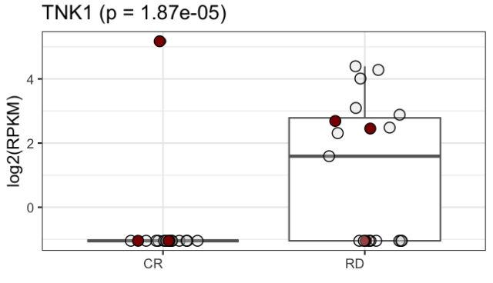
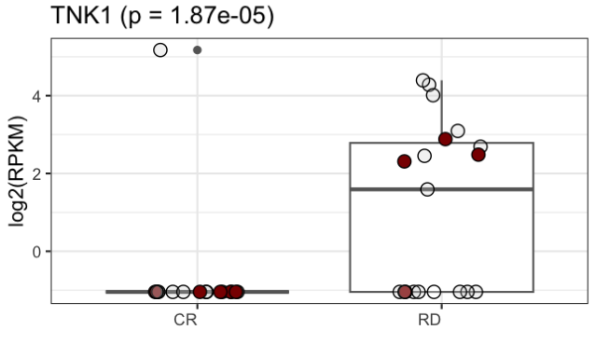
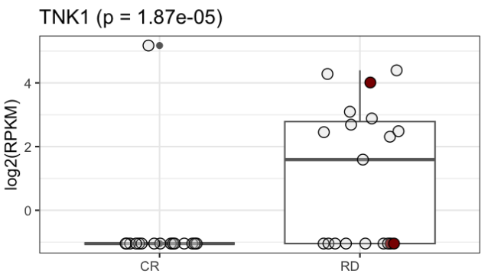
Supplemental Figure 3 – 5/10
ASXL1
DNMT3A
IDH1
IDH2
RUNX1
TP53

Slide 8
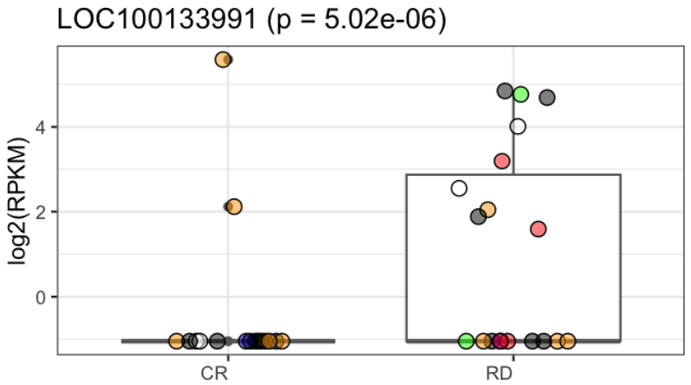
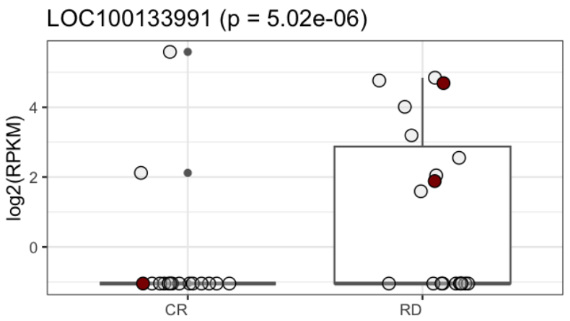
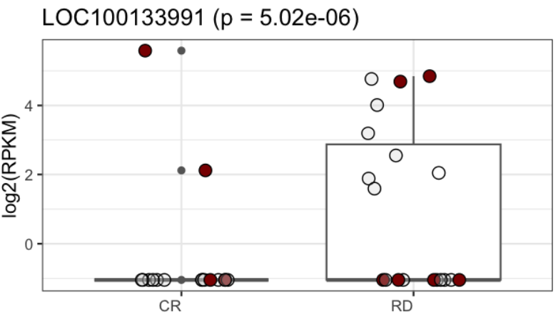
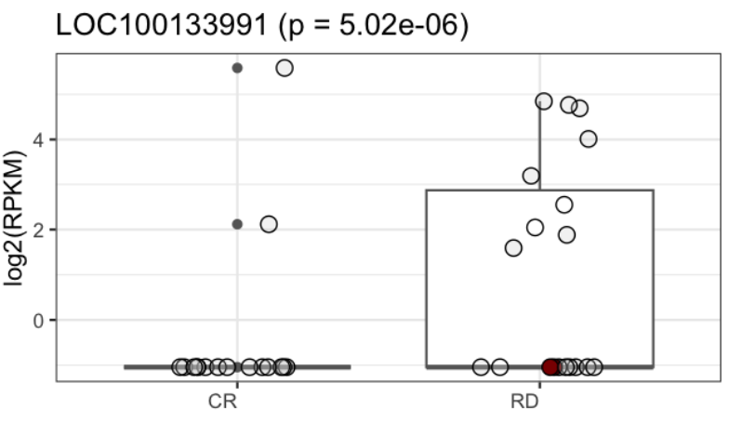
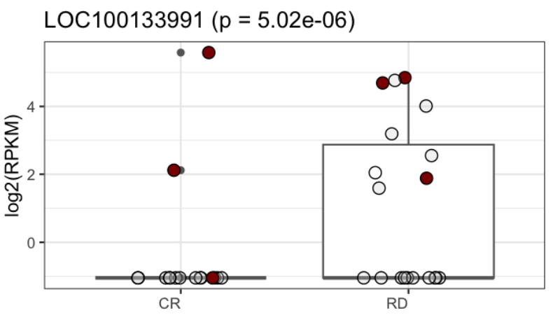
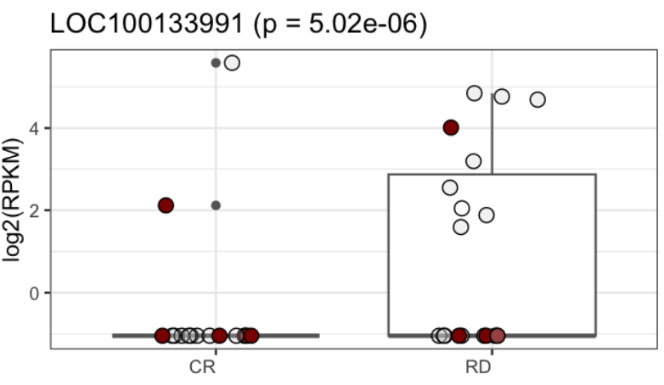
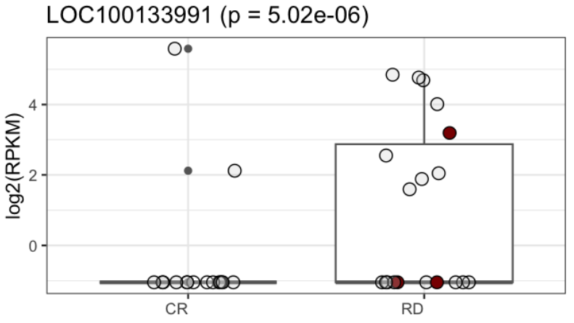
Supplemental Figure 3 – 6/10
ASXL1
DNMT3A
IDH1
IDH2
RUNX1
TP53

Slide 9
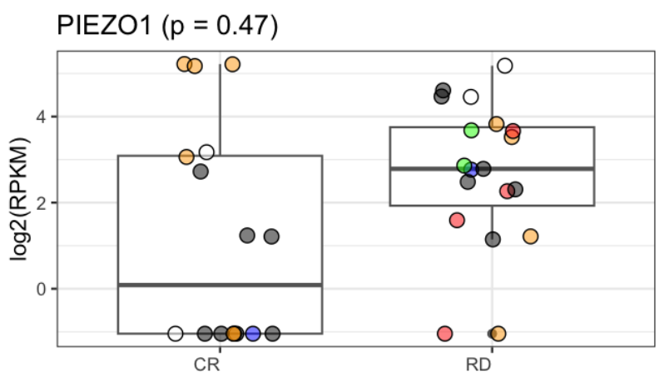
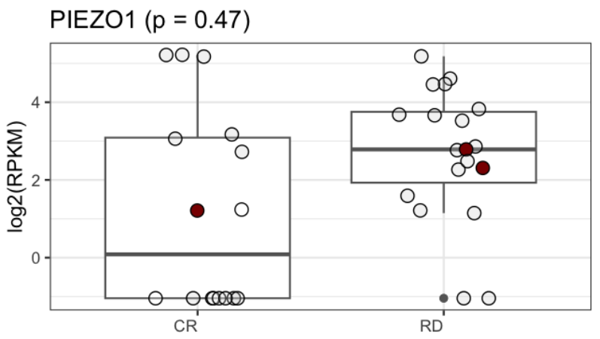
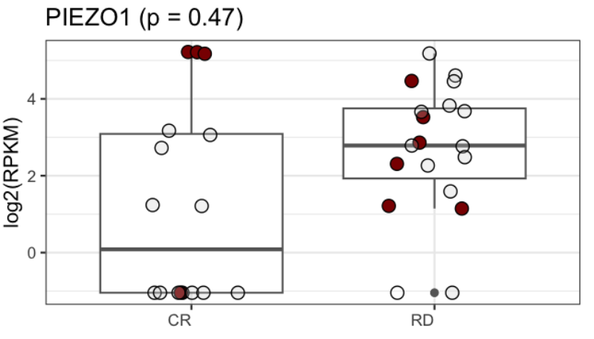
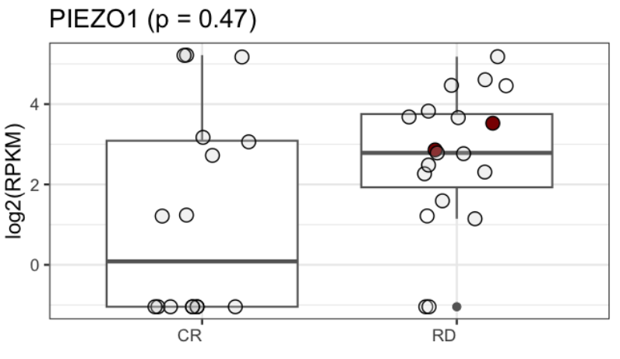
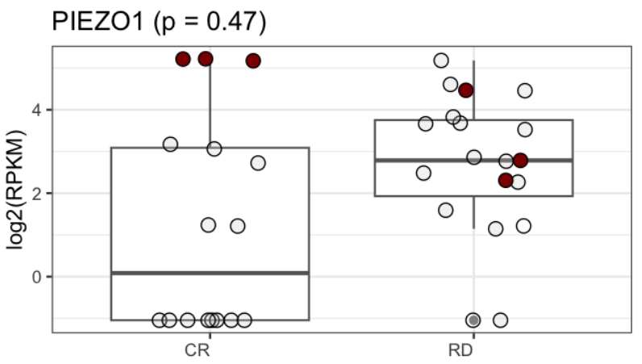


Supplemental Figure 3 – 7/10
ASXL1
DNMT3A
IDH1
IDH2
RUNX1
TP53

Slide 10







Supplemental Figure 3 – 8/10
ASXL1
DNMT3A
IDH1
IDH2
RUNX1
TP53

Slide 11







Supplemental Figure 3 – 9/10
ASXL1
DNMT3A
IDH1
IDH2
RUNX1
TP53

Slide 12







Supplemental Figure 3 – 10/10
ASXL1
DNMT3A
IDH1
IDH2
RUNX1
TP53

Slide 13


Supplemental Figure 4
A
B
Principal Component Analysis
screening set (overall)
screening set (exp arm)
Notes:
Principal Component Analysis on 500-bp bins after primary filtering on all samples (A) and on the EXP arm (B)
Principal component analysis based on 664,227 bins for the overall sample set and the experimental therapy arm. Labeled samples indicate extreme values in read count numbers, i.e. the top and bottom 5% read count values. Blue and red dots represent data points that were identified as potential outliers based on either extremely low total read counts, as shown in blue, or extremely high total read counts, as shown in red. For subsequent steps of differential methylation analysis, blue samples i.e. unsaturated samples with low total read counts were ignored.

Slide 14


Supplemental Figure 5
DMR distribution
A
Overall DMRs
B
Top DMRs
propportion of read counts > 0 (across samples)
Absolute frequencies
Notes:
Distribution of Differentially Methylated Regions
A Box-Whiskers plot indicating distribution of DMRs within the total set of DMRs filtered for bins with positive read counts across all samples.
B Bar plots indicate the distribution of genomic annotations in the set of top candidates.
DMR – differentially methylated region
3‘UTR - three prime untranslated region
5‘UTR - five prime untranslated region
TTS - transcription termination site
Promoter-TSS - promoter transcritption start site

Slide 15


Supplemental Figure 6
GC content distribution
A
B
Notes:
GC content distribution and the relationship of GC content to transcriptional start sites (TSS)
A Regions with higher GC content show an over-representation in the set of top candidates, irrespective of data normalization with CQN.
“Top hits (std)” denominate data not normalized by application of CQN. A graph for CQN normalized data is included.
B Regions in the set of top candidates show close relation to transcriptional start sites. A graph for CQN normalized data is included.
CQN = conditional quantile normalization

Slide 16


Supplemental Figure 7
Primary Classifier
A
B
Notes:
Primary Classifier
A A multivariable signature for therapy response (CR - green color) prediction generated through applying a penalized logistic regression model („elastic-net penalty“) to the 450k M-values within the set of validated candidates. The classifier predicted response perfectly. Y-axis gives the probability for refractory disease (RD - refractory disease).
B A multivariable signature for therapy response prediction containing 17 probes. CpG dinucleotides are associated with 12 genes and two previously undescribed regions.

Slide 17

Supplemental Figure 8
ROC curve for the signature linear predictor
Notes:
ROC curve for the 450k elastic net signature linear predictor
Receiver operating characteristic curve for the 17 CpG containing classifier as assessed within the validation cohort. Both sensitivity and specificity do not allow for prediction of therapy response.

Slide 18


Supplemental Figure 9
A
B
Notes:
Significantly differentially methylated regions … Recomposed classifier with flanking CpGs shows significant DMRs in EXP arm only
A and B Manhattan plots for univariable testing of candidate regions based on MassARRAY data from validation sample set. Individual, specific CpG dinucleotides from the initial predictive signature (n=15 out of 17) are highlighted in green color. Significant hits are limited to patients treated with a combination therapy regimen as shown on the left whereas the group of patients receiving standard therapy showed no significant hits.

Slide 19

Supplemental Figure 10
Fitted probabilities with predictions for CR
Notes:
Probability estimates and misclassifications
Probability estimates for complete response to demethylating therapy based on the CpG units shown in Figure 5B. CR and RD indicate complete response and refractory disease, respectively. Unstained dots indicate samples with correct predictions to therapy, whereas red dots indicate misclassifications.

Slide 20

Supplemental Figure 11
ROC curve for the signature linear predictor in STD
Notes:
ROC curve for the lasso signature linear predictor applied to STD arm
Evaluation for HMA specificity by application of the classifier in the STD arm results in a misclassification error of 0.24 and an AUC of 0.76. The result is comparable to the .632+-bootstrap estimates for misclassification error and AUC for the EXP arm. This finding indicates unspecificity in the EXP arm.

