Slide 1
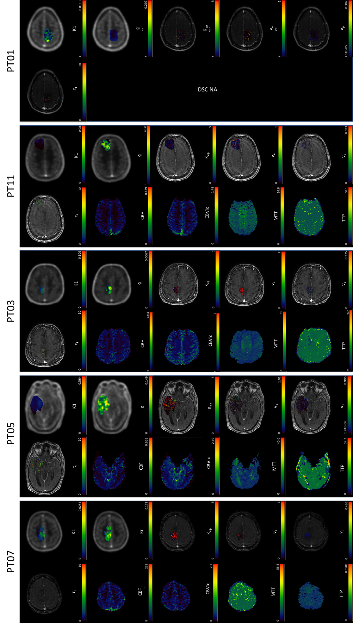
Supplementary Fig. S1

Slide 2
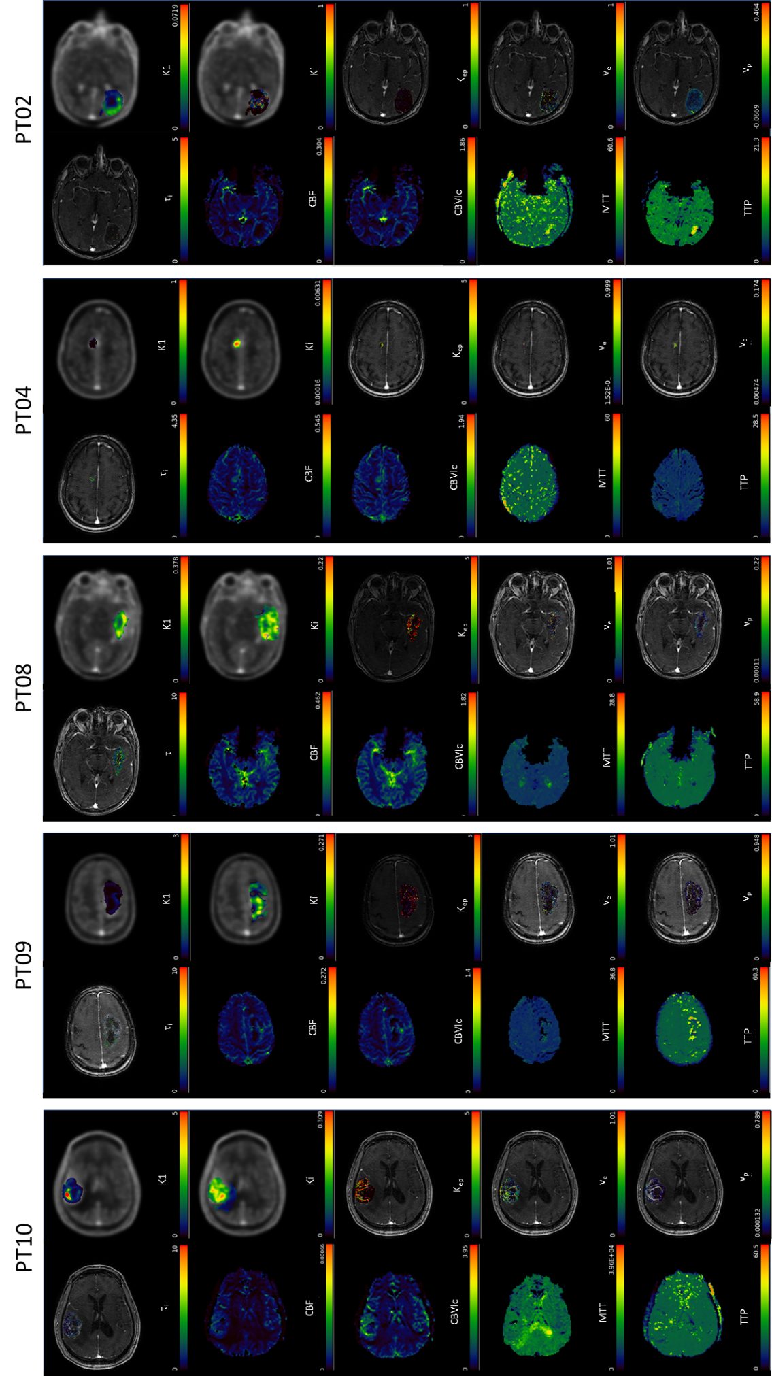
Supplementary Fig. S1. cont-d.

Slide 3
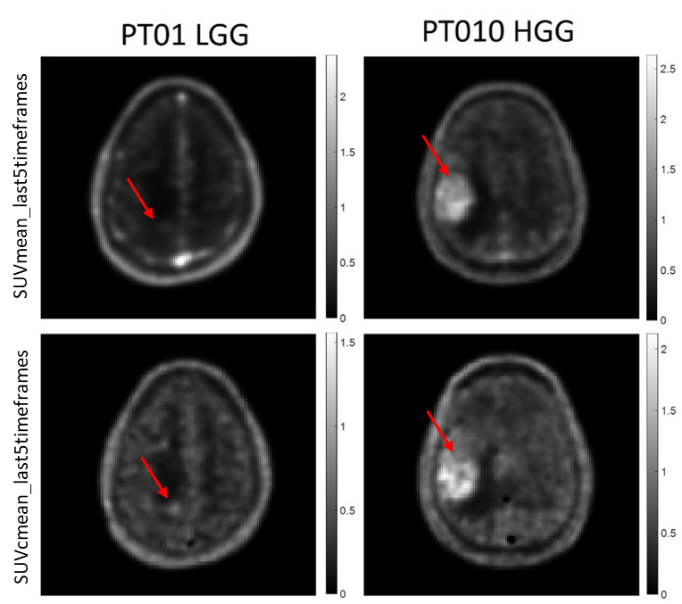
Supplementary Fig. S2

Slide 4
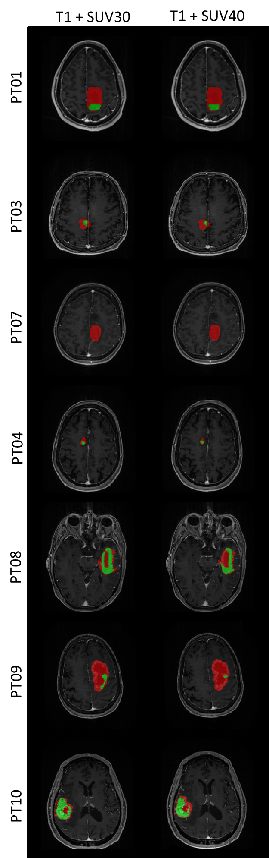
Supplementary Fig. S3

Slide 5
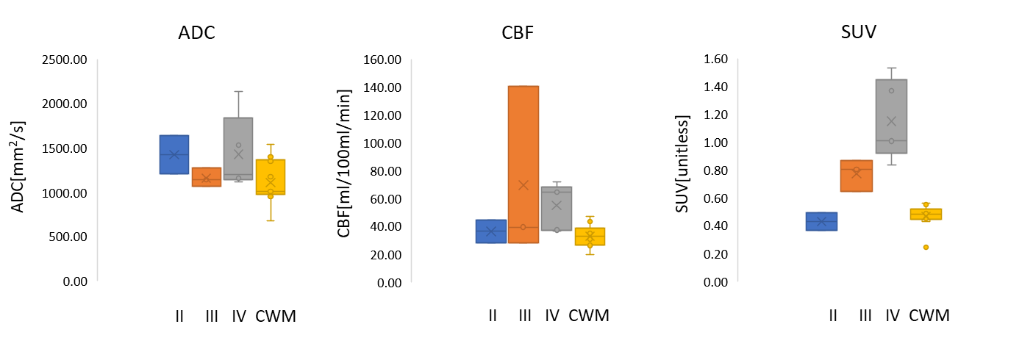
Supplementary Fig. S4

Slide 6
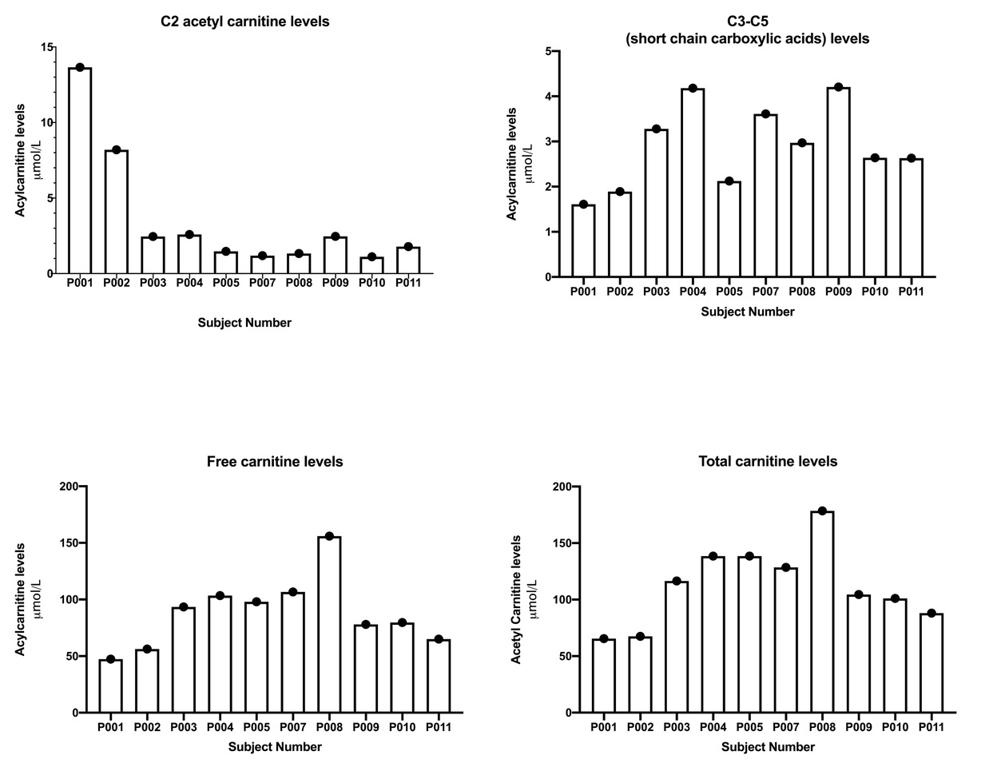
Supplementary Fig. S5
A.
B.

Slide 7
Supplementary Fig. S6
SLC25A20
SLC22A5
Ki-67
ACSS2
ACSS1/2
ACSS3

Slide 8
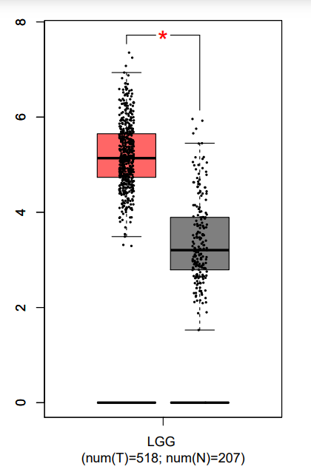
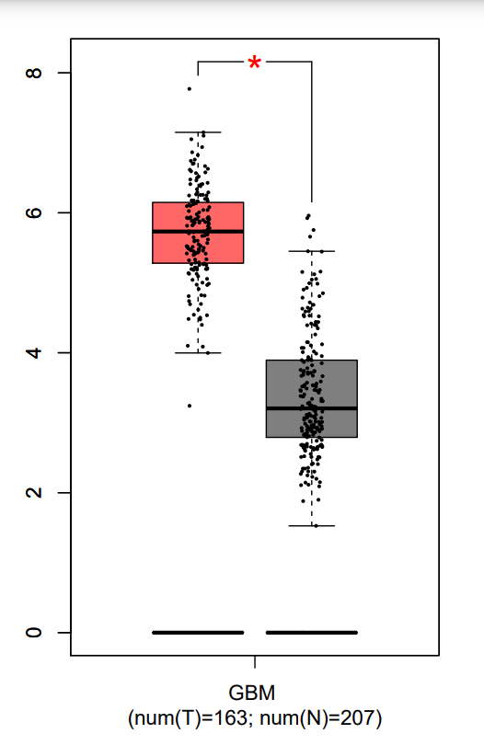
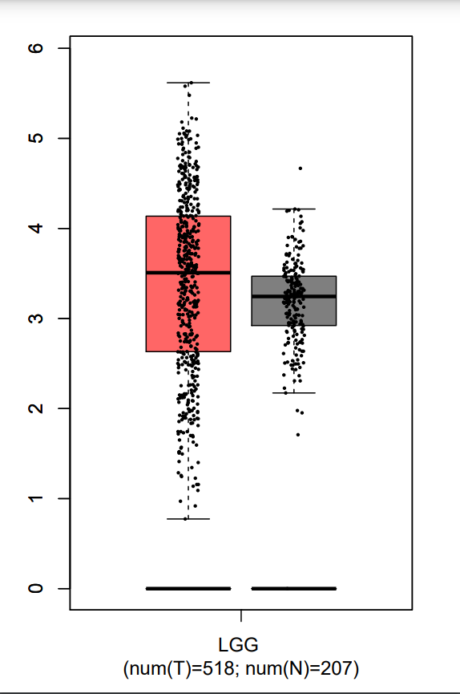
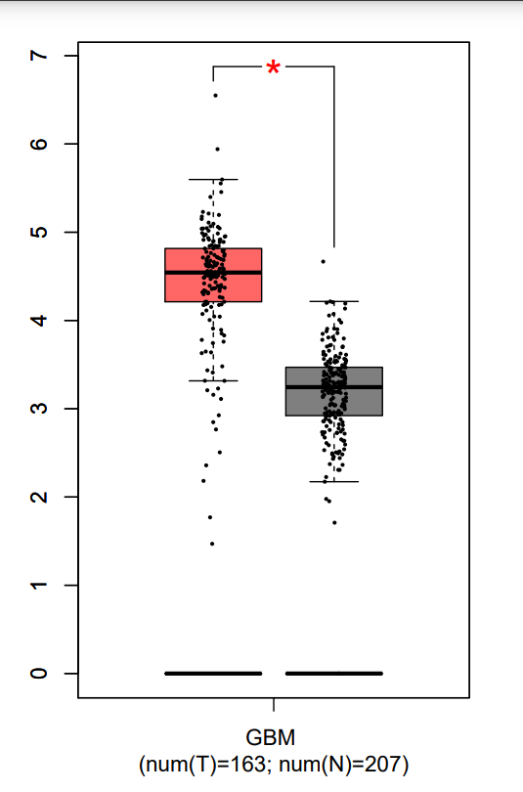
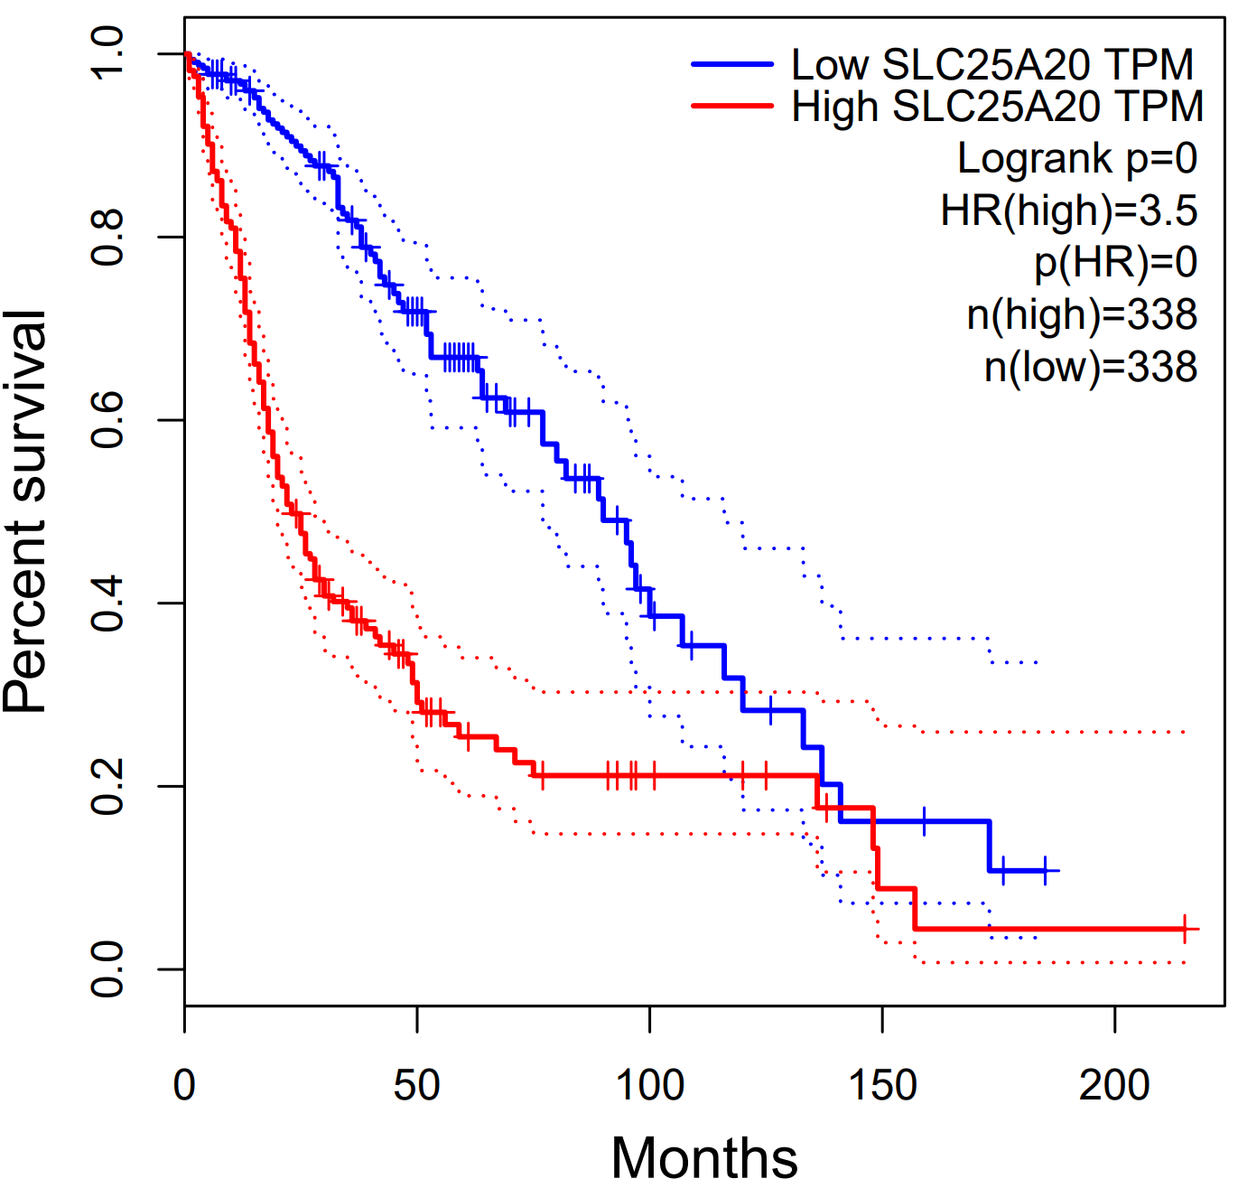
Supplementary Fig. S7
LGG
HGG
A.
SLC16A1 expression
B.
SLC25A20 expression
C.

Slide 9
Supplementary Table 1

