Slide 2
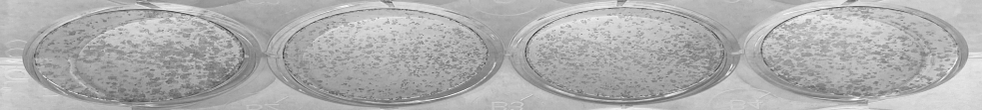
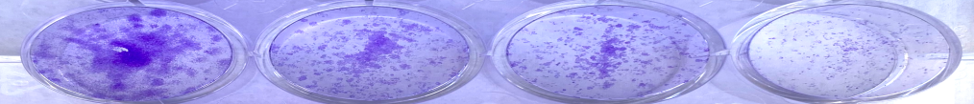
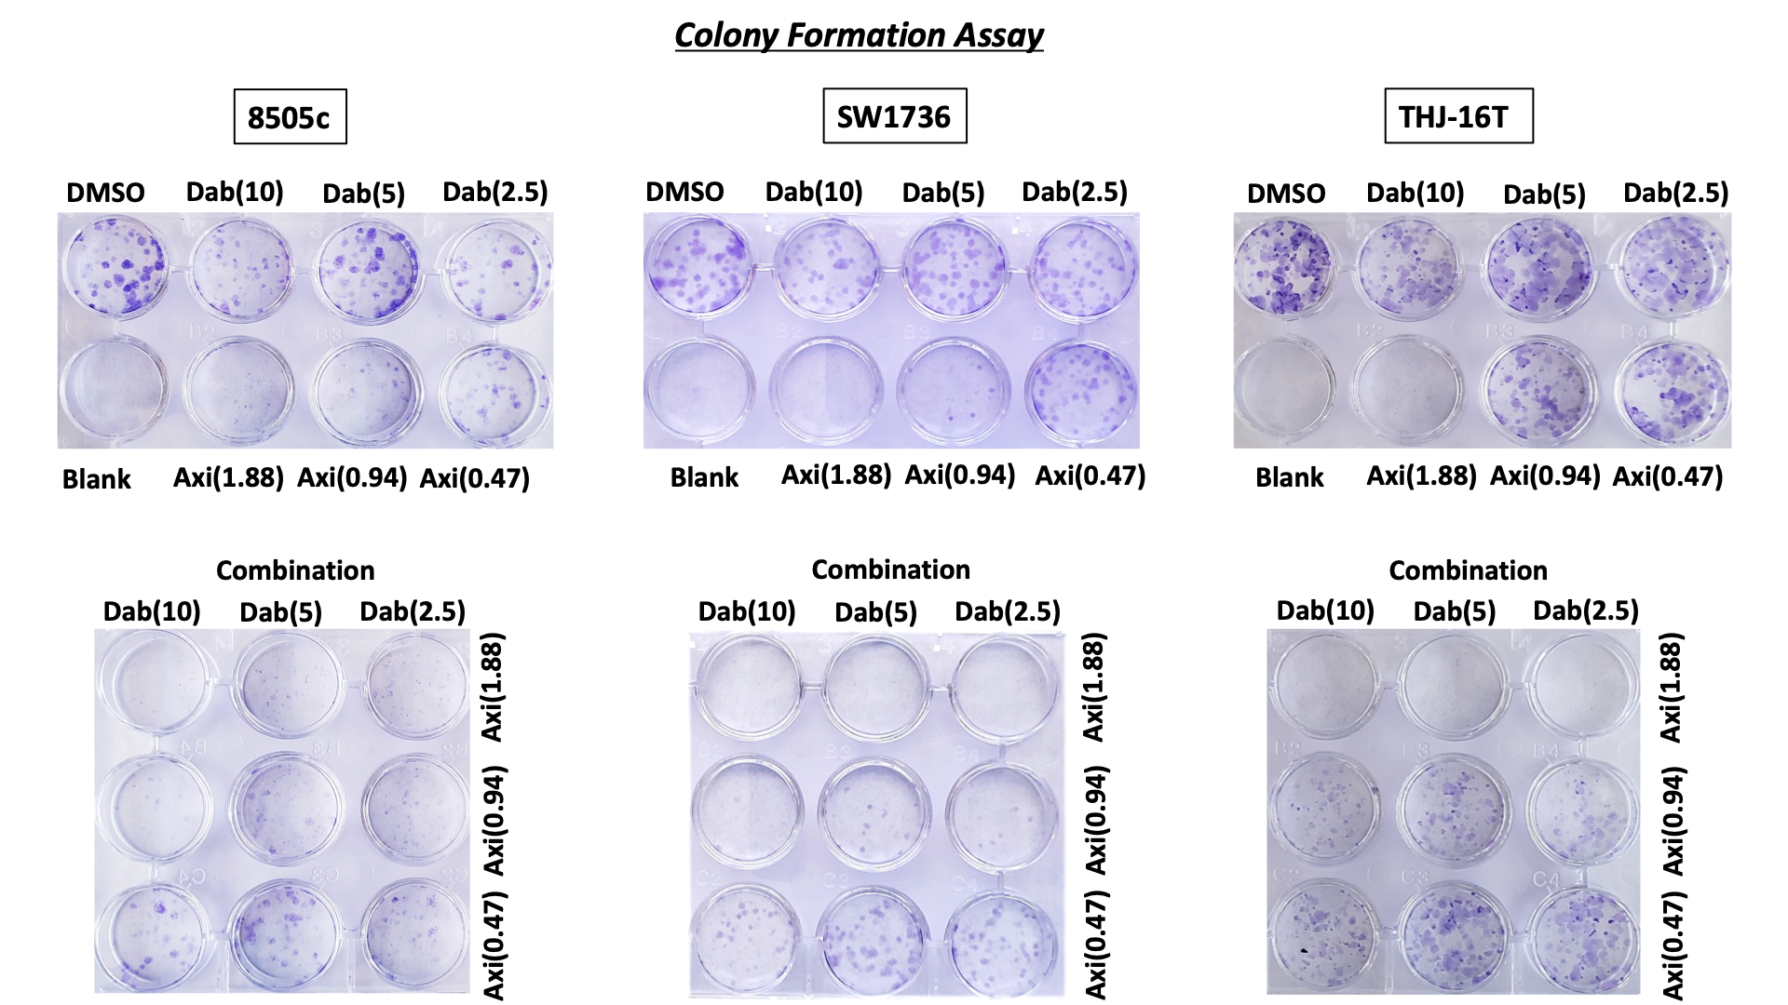
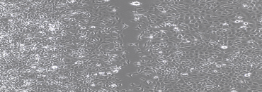
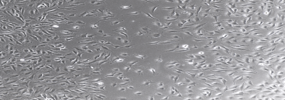
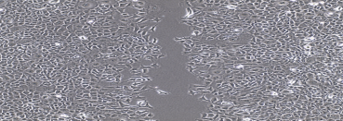
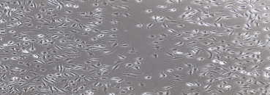
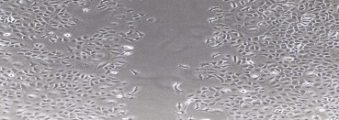
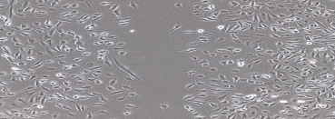
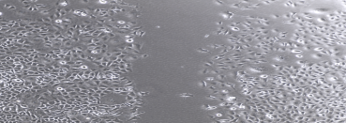
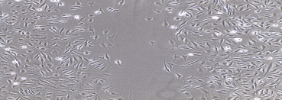
Sup Fig 1.
A)
B)
SW1736
8505C
Dab 10 µM
Dab 5 µM
Dab 2.5 µM
Dab 10 µM
Dab 5 µM
Dab 2.5 µM
Con
Con
Con
Dab 2.5 µM
Dab 5 µM
Dab 10 µM
Con
Dab 2.5 µM
Dab 5 µM
Dab 10 µM
C)
D)
8505C
SW1736
E)
Control
Dabrafenib
2.5 μM
Dabrafenib
5.0 μM
Dabrafenib
10 μM

Slide 3
Supplemental Fig 1. Effect of dabrafenib on proliferation, colony formation and migration in 8505C and SW1736 ATC cell lines.
(A) Effect of increasing doses of dabrafenib on proliferation in 8505C and SW1736. The X-axis represents the elapsed time in hours and the Y-axis represents the relative fluorescence unit (RFU). Data is shown as mean ± SD. (B) Representative images of the effect of increasing doses of dabrafenib on the number and size of the colony in 8505C and SW1736 with short-term treatment and (C)long-term treatment. (D-E) Effect of increasing doses of dabrafenib on migration in 8505C and SW1736. Dabrafenib significantly inhibited the migration with increasing doses in both 8505C and SW1736 (**P< 0.01, ****P<0.0001). The data are shown as the mean ± SD. Con=control, DAB = dabrafenib.

