Slide 2

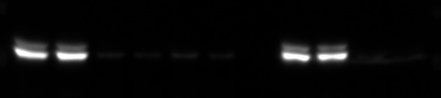
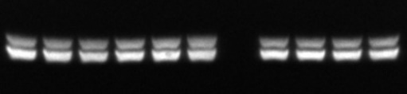


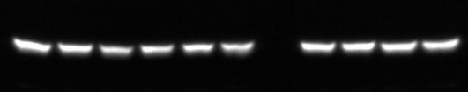
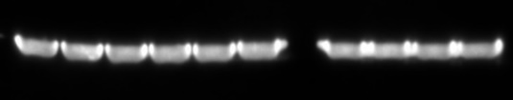
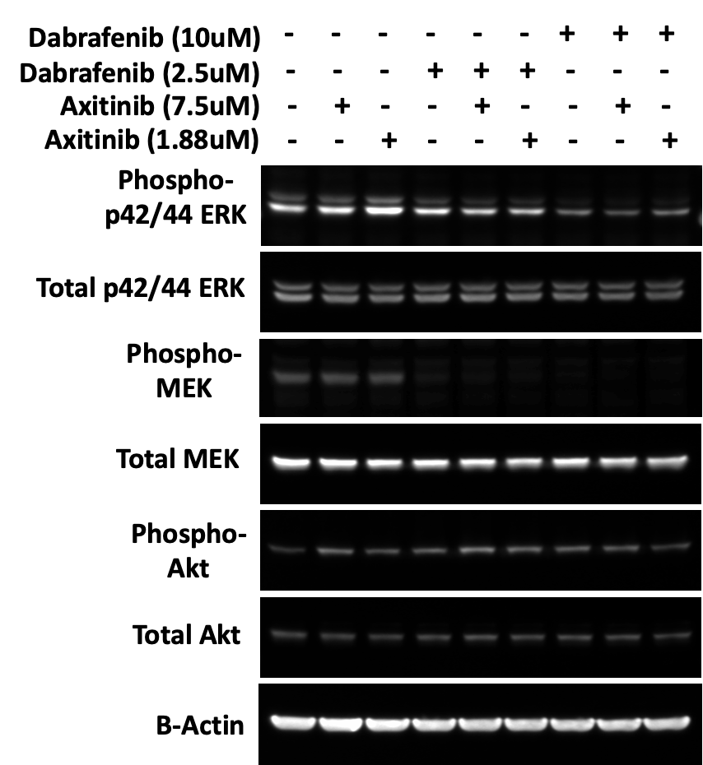
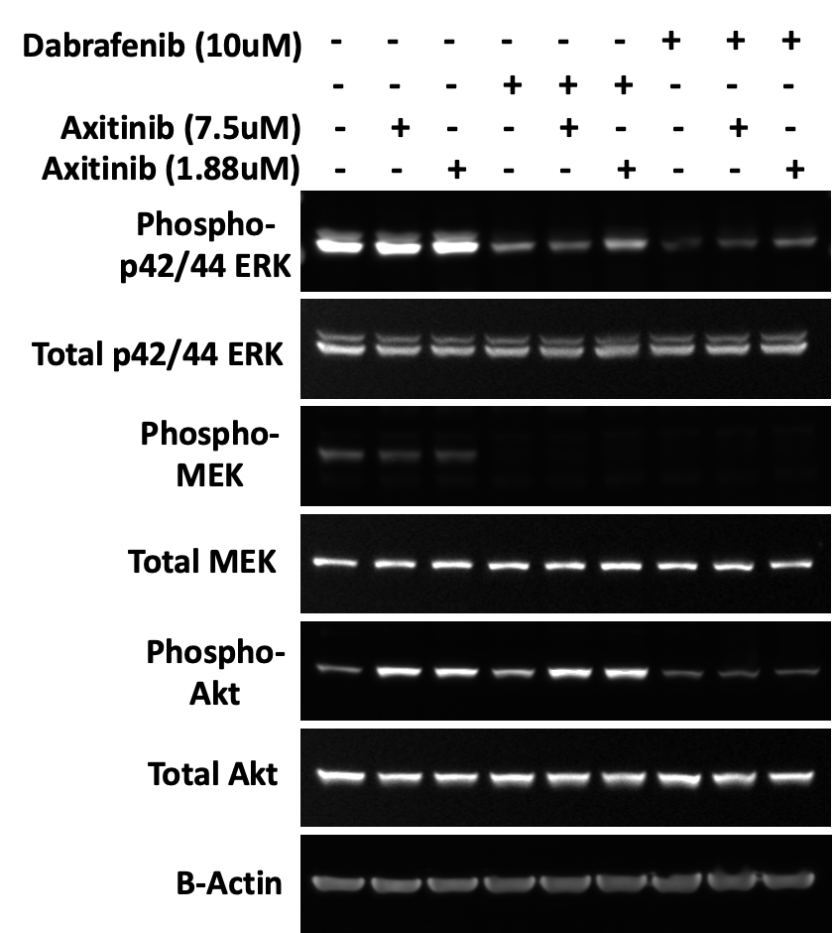
Sup Fig 3.
8505C
SW1736
A.
-
-
-
-
-
-
-
+
+
-
PLX4720 (10 µM)
PLX4720 (10 µM)
+
+
-
-
-
-
-
-
-
-
PLX4720 (5 µM)
+
+
PLX4720 (5 µM)
+
+
-
-
-
-
-
Axitinb (7.5 µM)
-
Axitinb (7.5 µM)
+
+
+
+
+
+
Phospho-
p42/44 ERK
Phospho-
p42/44 ERK
Total p42/44 ERK
Total p42/44 ERK
Phospho-MEK
Phospho-MEK
Total MEK
Total MEK
β-Actin
β-Actin
8505C
Dabrafenib (10 µM)
SW1736
Dabrafenib (10 µM)
Dabrafenib (2.5 µM)
Dabrafenib (2.5 µM)
Axitinb (7.5 µM)
Axitinb (7.5 µM)
Axitinb (1.88 µM)
Axitinb (1.88 µM)
Phospho-
p42/44 ERK
Phospho-
p42/44 ERK
Total p42/44 ERK
Total p42/44 ERK
Phospho-MEK
Phospho-MEK
Total MEK
Total MEK
β-Actin
β-Actin
B.

Slide 3
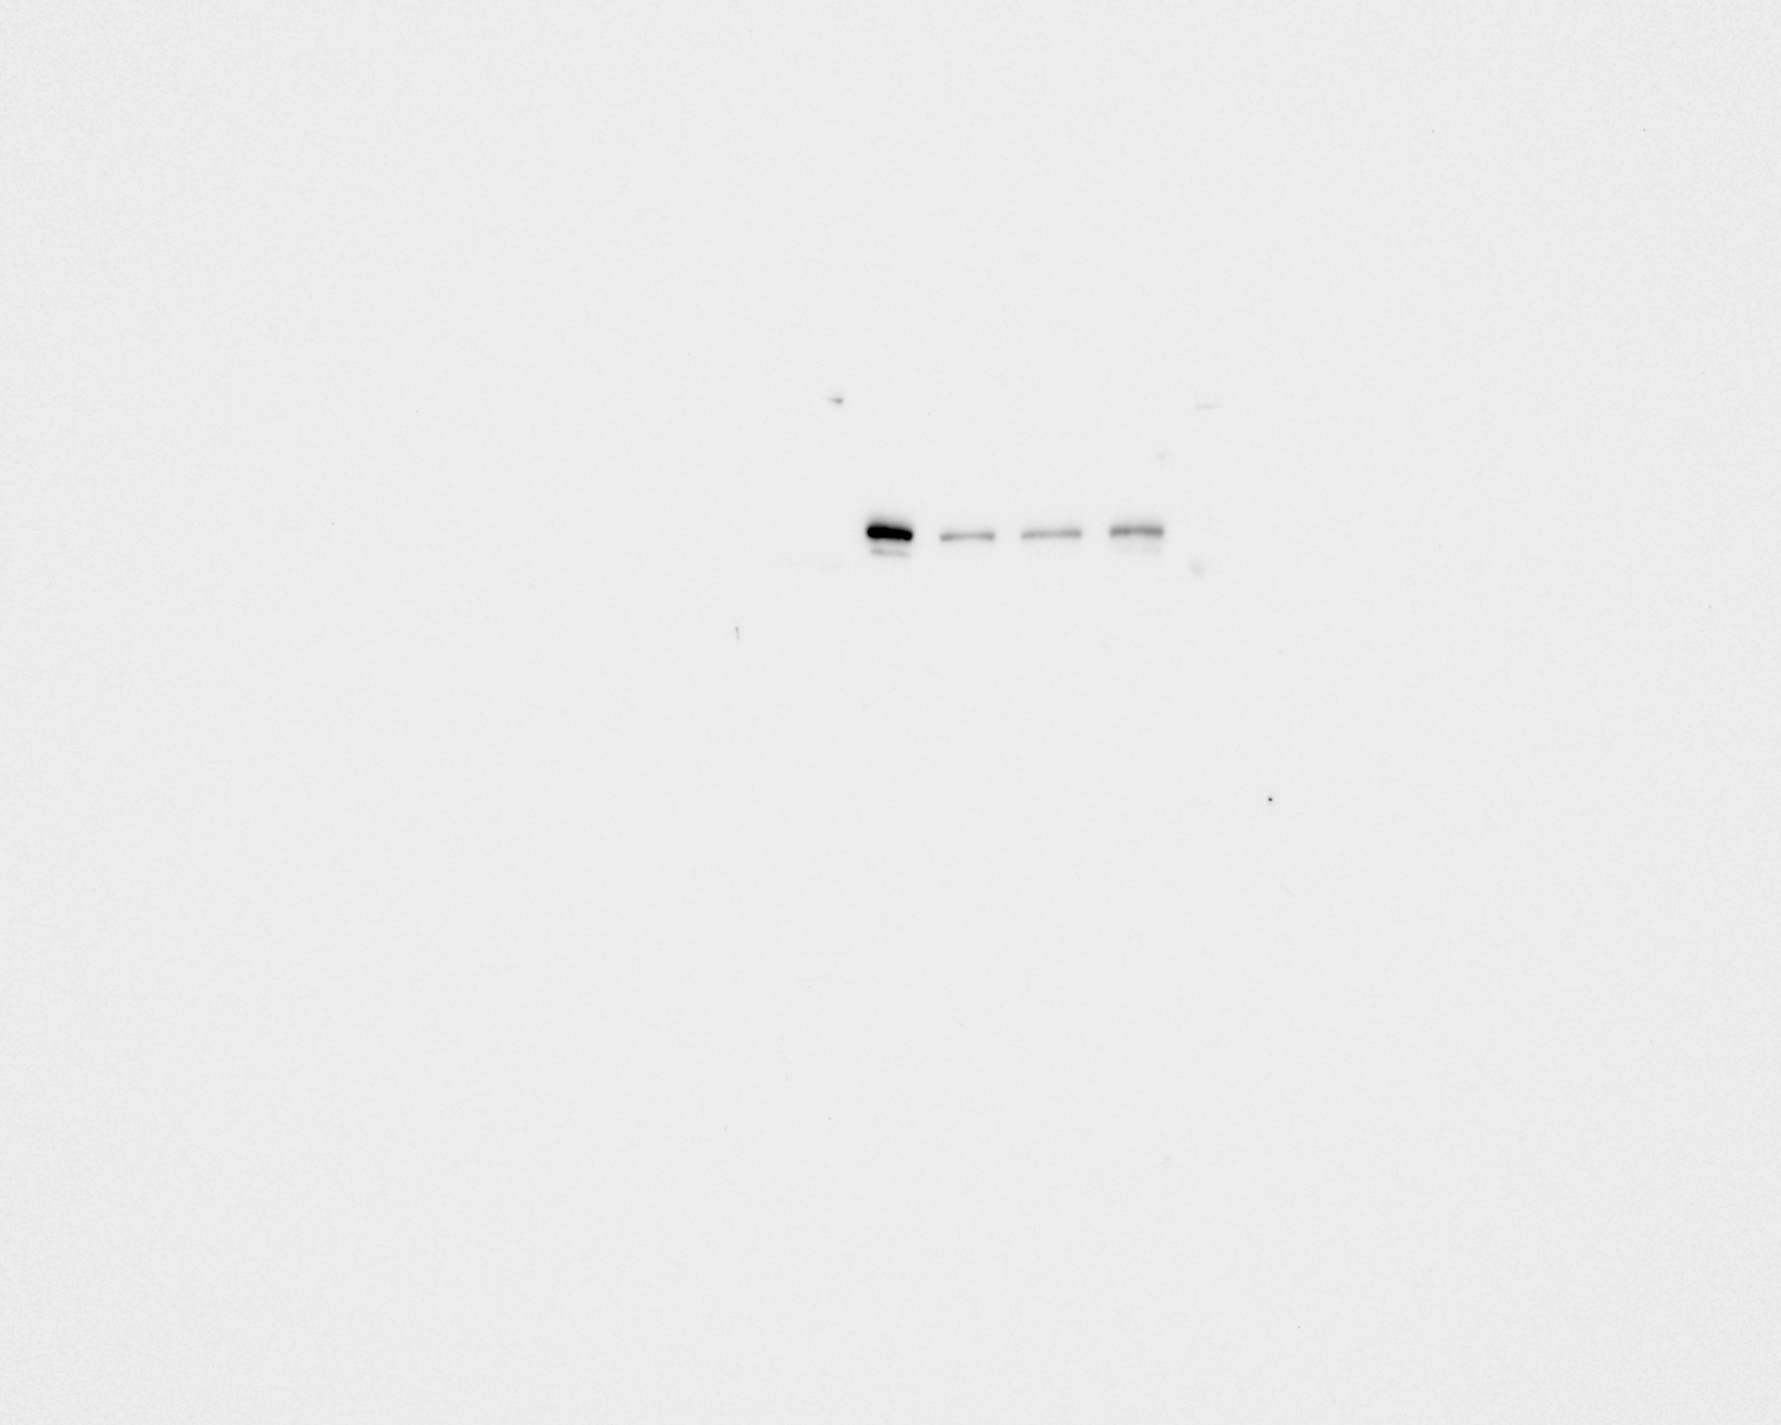
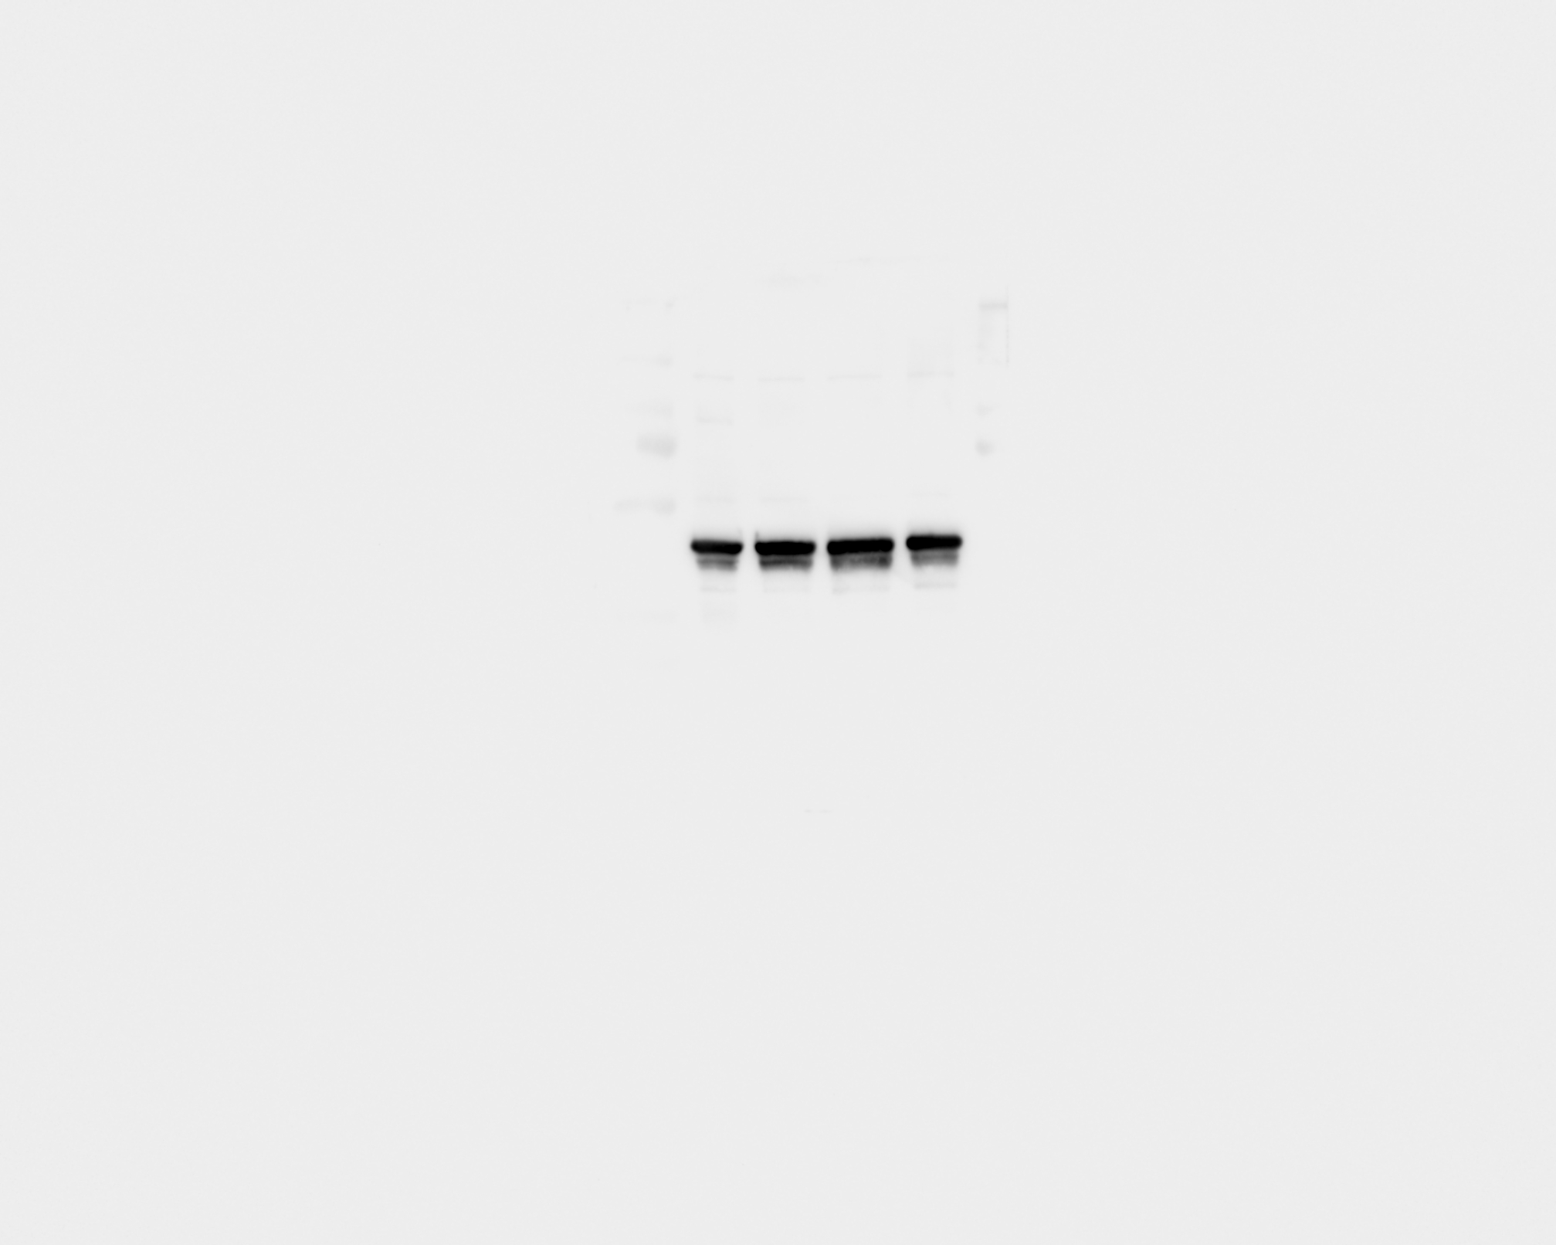
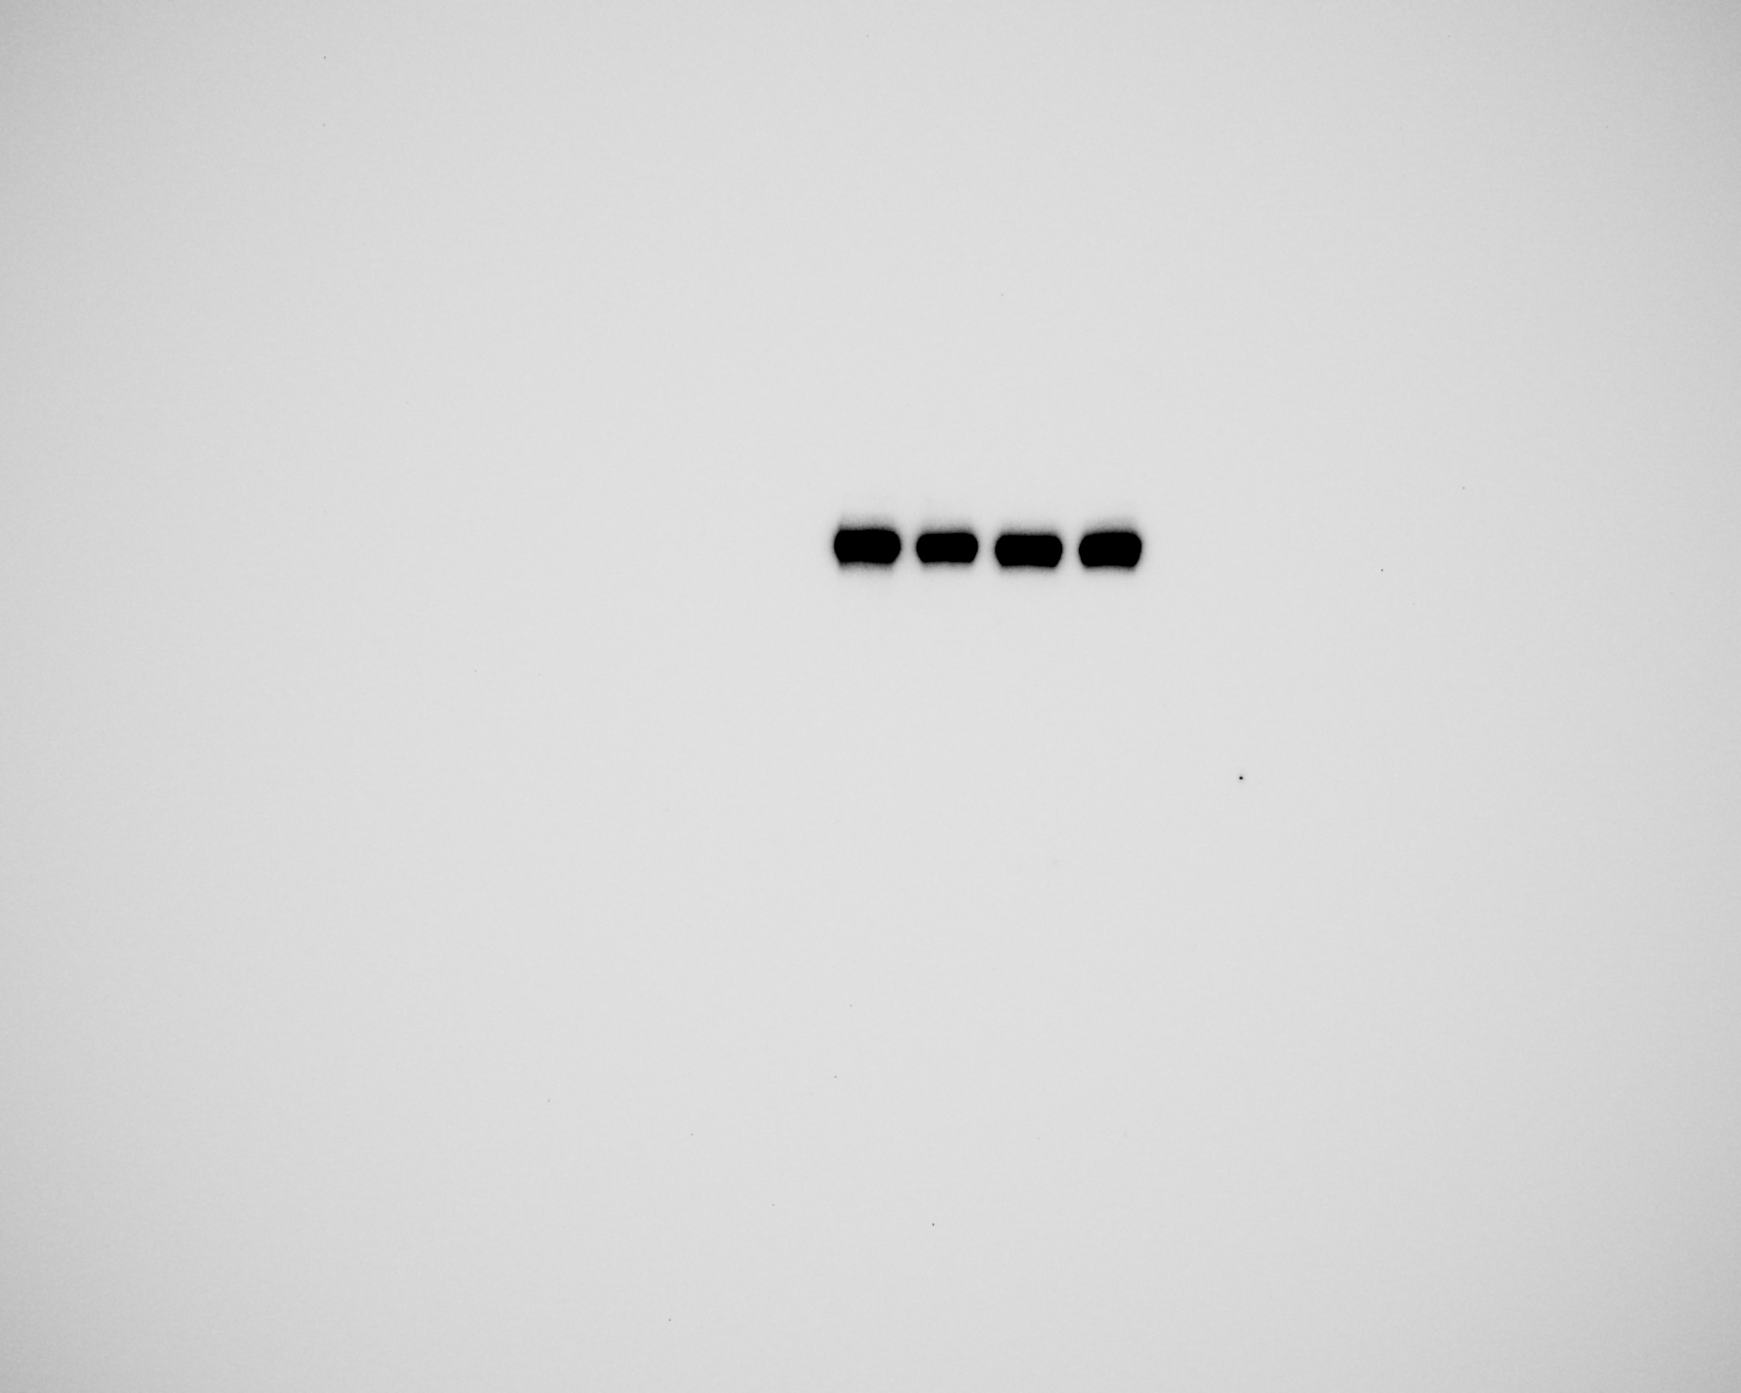
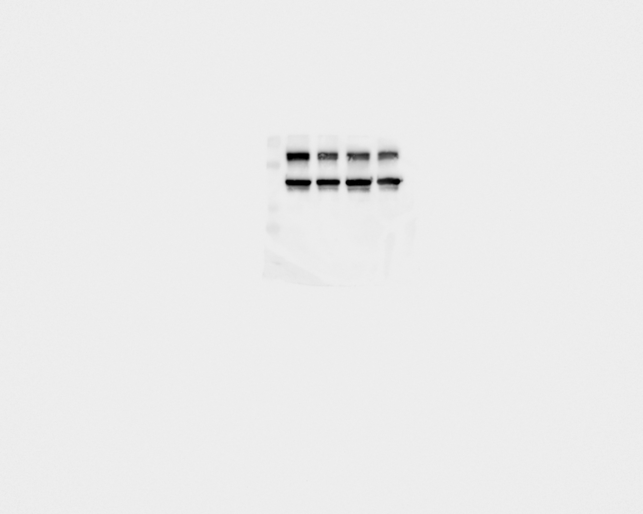
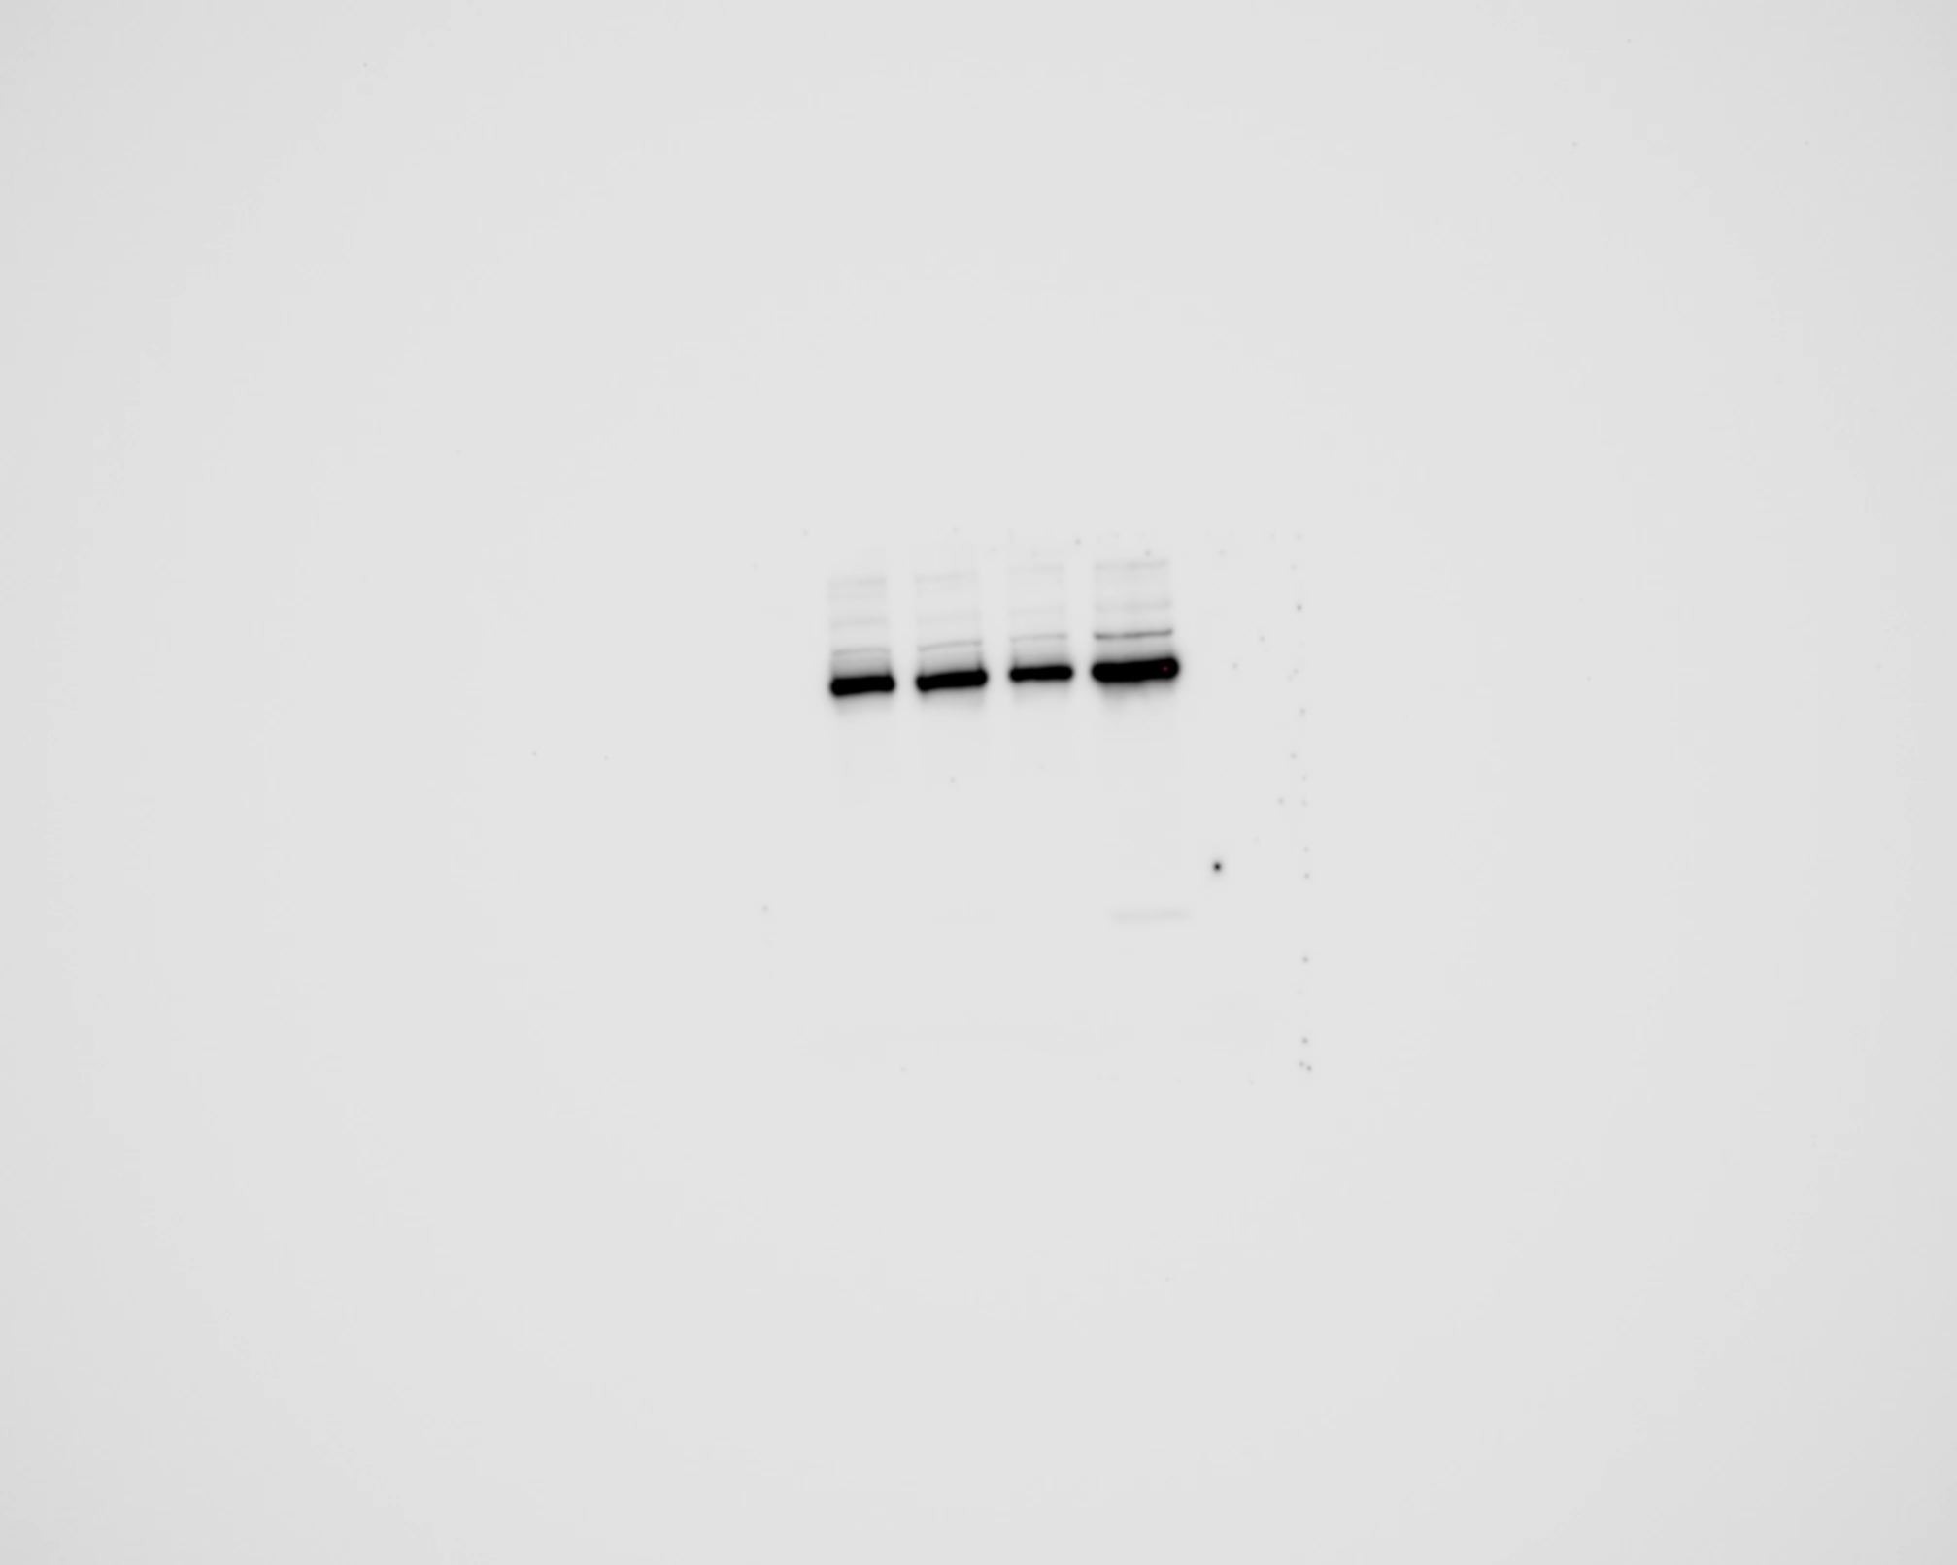
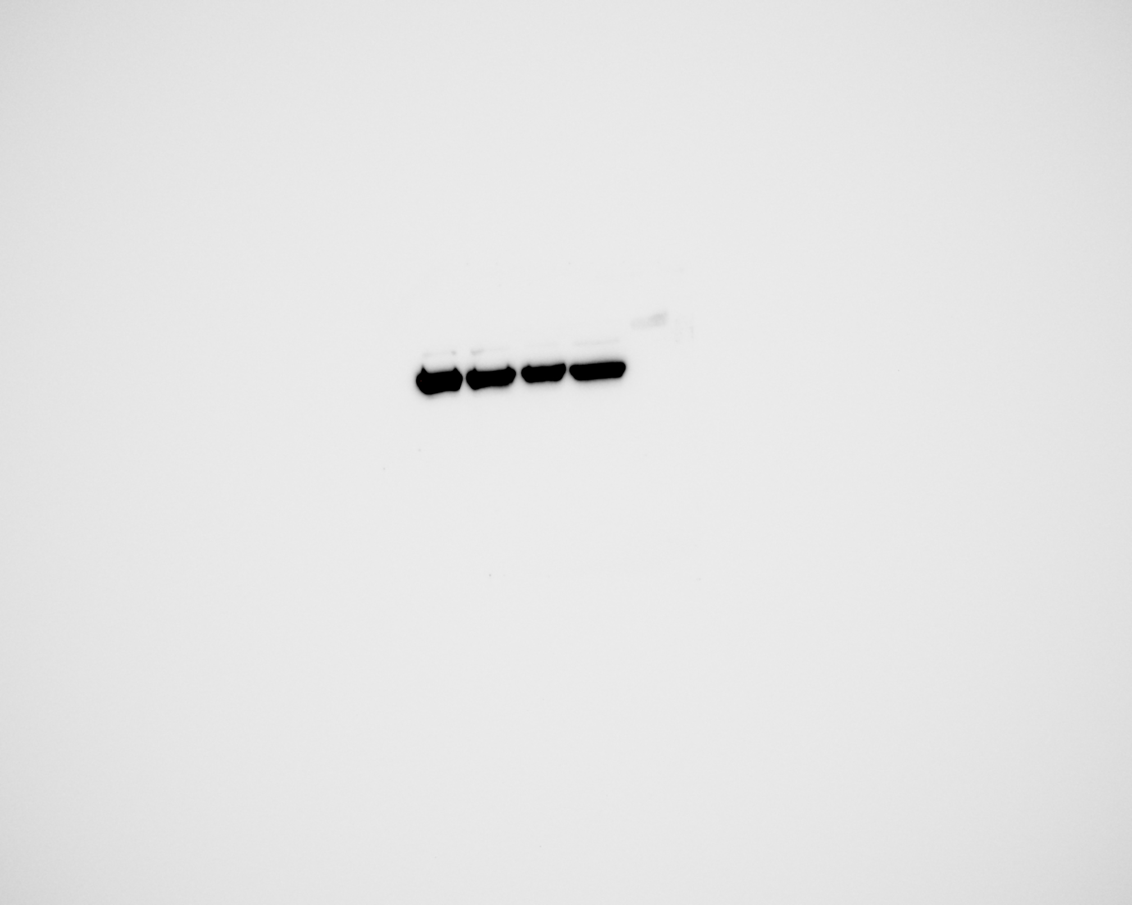

Sup Fig 3.
C.
8505C
D.
Axitinib 1.25 µM
-
+
-
-
Axitinib 2.5 µM
-
-
+
-
Axitinib 5 µM
-
-
-
+
P-Stat3
β-actin
Stat3
β-actin
P-AKT
β-actin
AKT
β-actin
Supplemental Fig 3. Effect of axitinib and BRAF inhibitor combination on ERK pathway and the effect of axitinib on pAKT and pSTAT3 the downstream regulators of VEGFR pathway.
(A) The combination of BRAF inhibitors and axitinib inhibited the ERK pathway by reducing the levels of phospho-ERK and phospho-MEK after 24 hours of treatment in SW1736 and 8505C cells. (B) Densitometry of the western blot showing the ratio of expression of phospho-ERK/total ERK normalized with beta actin. (C)- Axitinib inhibited phosphorylation of STAT3 and AKT in 8505C after 24 hours of treatment. (D)-Densitometry of the western blot showing the ratio of phospho-STAT3/total STAT3 and phosphor AKT/total AKT normalized with beta actin. PLX = PLX4720, DAB = dabrafenib, and Axi = axitinib.

