Slide 2
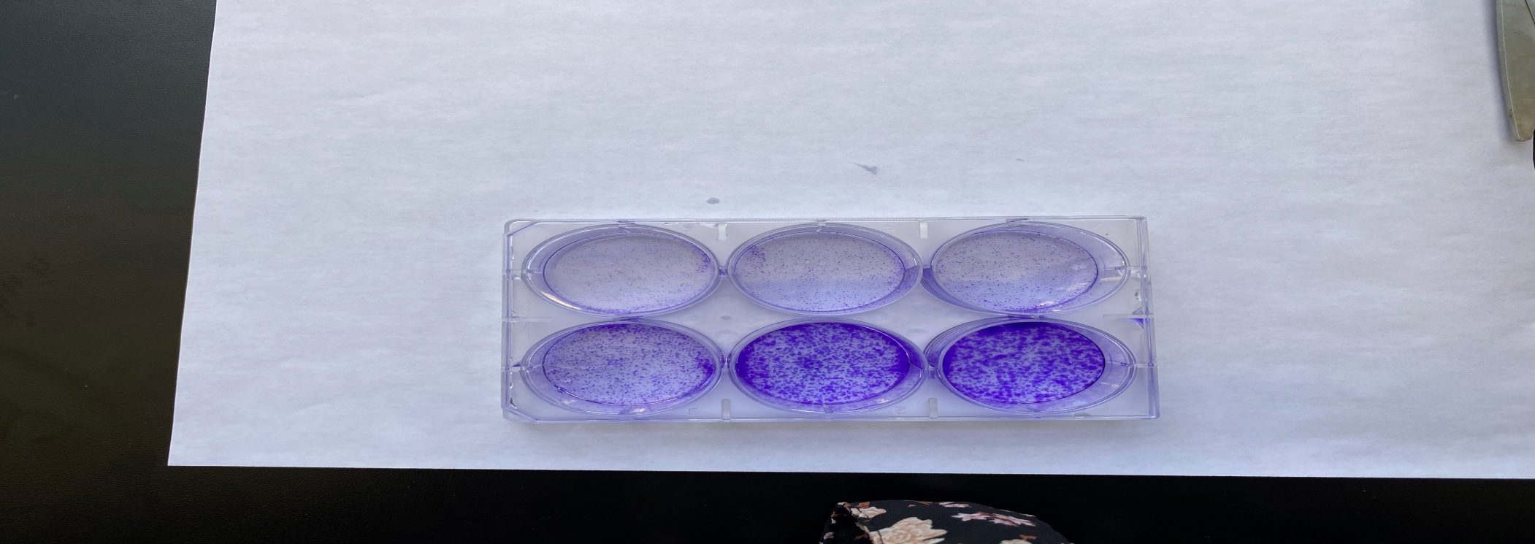
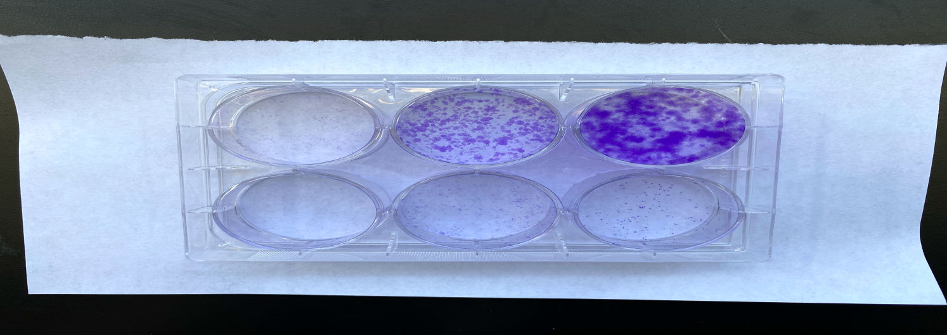
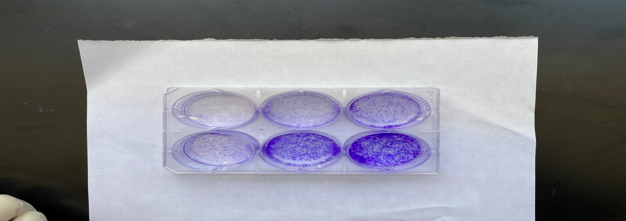
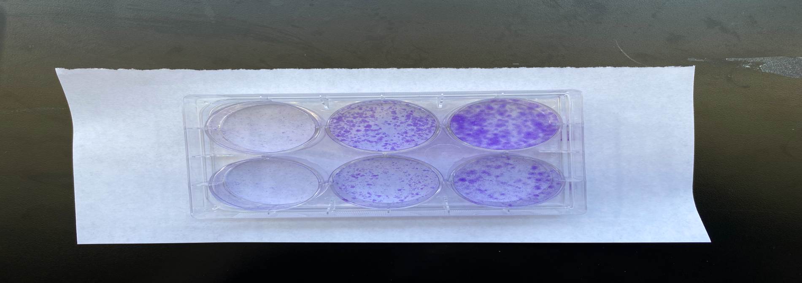
Sup Fig 4.
B.
A.
**
***
****
*
****
****
**
****
*
ns
****
****
****
****
****
****
*
****
C.
8505C
SW1736
Dabrafenib 10 µM
PLX4720 15 µM
DMSO
Dabrafenib 10 µM
PLX4720 15 µM
DMSO
DMSO
DMSO
Axitinib
1.89 µM
Axitinib
1.89 µM
DMSO
DMSO
Axitinib
0.47 µM
Axitinib
0.47 µM

Slide 3
Supplemental Fig 4. Effect of combination of BRAF inhibitors and axitinib on short and long-term treatment on colony formation in 8505C and SW1736 ATC cell line
(A-B) Histograms representing the mean colony counts in 8505C and SW1736 cells after axitinib (0.47 µM), PLX4720 (15 µM) and dabrafenib (10µM) treatment alone and in combination. The data are shown as the mean ± SD. For all panels, the black stars denote combination versus vehicle, the blue stars denote combination versus BRAF inhibitor (PLX4720 and dabrafenib), and the red stars denote combination versus axitinib. (C)- Long term effect of the all the drugs as single and in combination on the number and size of the colonies of 8505C and SW1736. PLX = PLX4720, DAB = dabrafenib, and Axi = axitinib.

