Slide 1
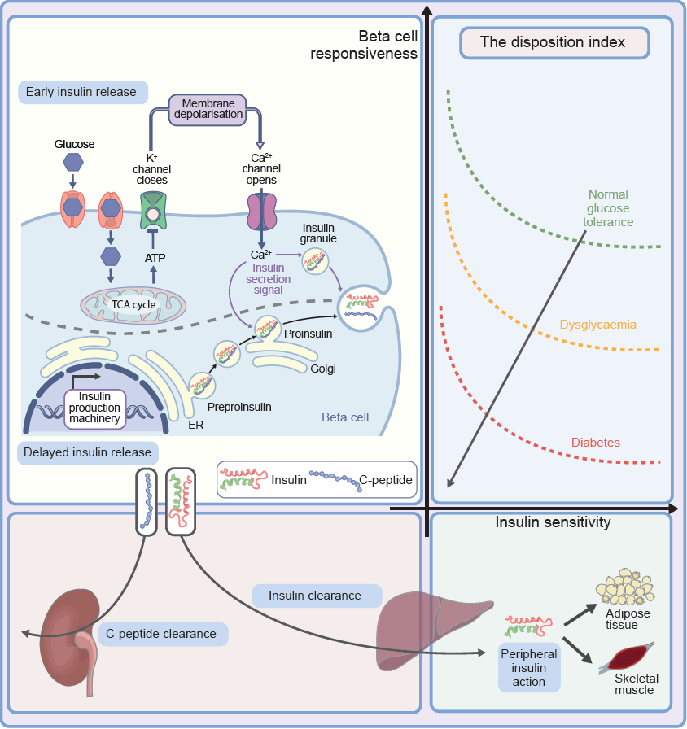
The disposition index results from the hyperbolic interaction of insulin secretion (beta cell responsiveness) and insulin sensitivity
Galderisi et al (2023) Diabetologia DOI 10.1007/s00125-021-06011-5
©The Authors 2023. Distributed under the terms of the CC BY 4.0 Attribution License (http://creativecommons.org/licenses/by/4.0/)

Slide 2
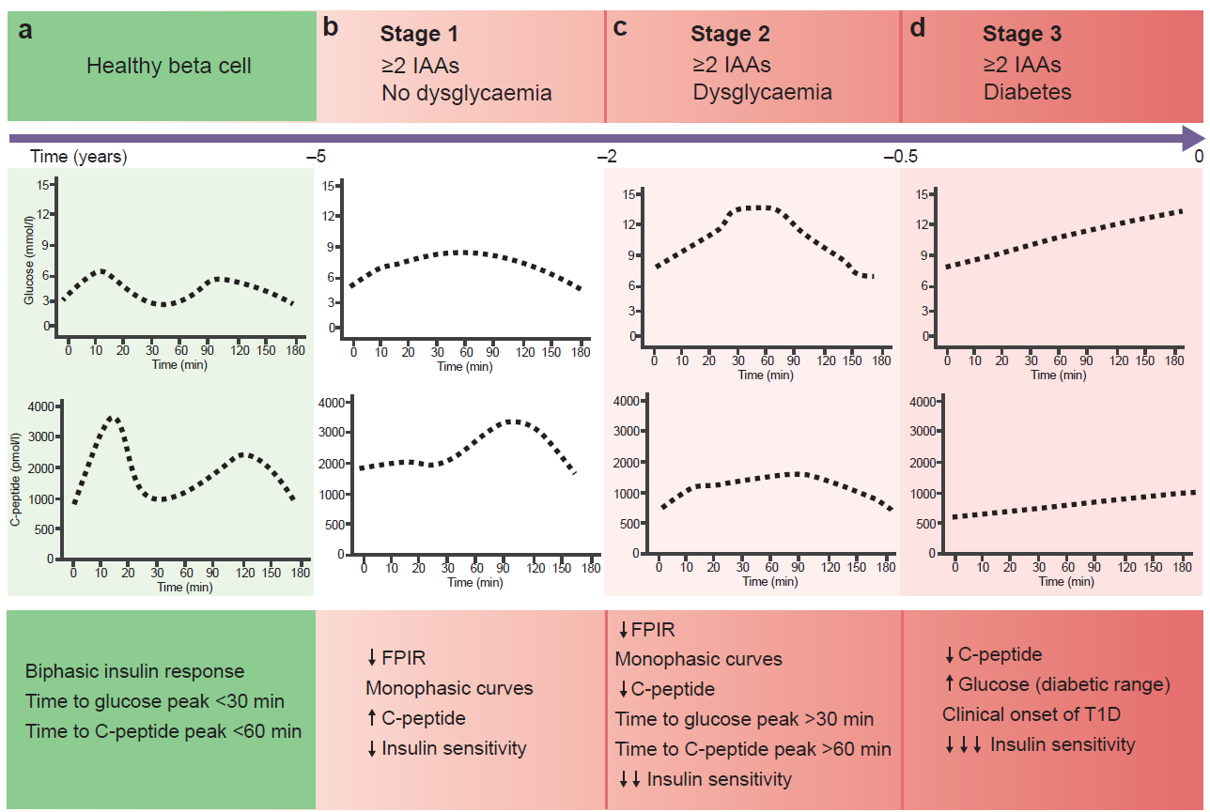
Glucose and C-peptide profiles during an OGTT through progression from healthy beta cells (a) to stage 1 (b), stage 2 (c) and stage 3 (d) type 1 diabetes
Galderisi et al (2023) Diabetologia DOI 10.1007/s00125-021-06011-5
©The Authors 2023. Distributed under the terms of the CC BY 4.0 Attribution License (http://creativecommons.org/licenses/by/4.0/)

