Slide 1
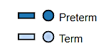
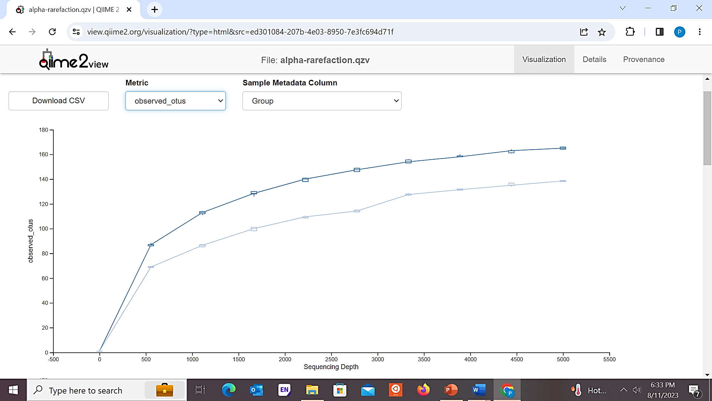
Additional file 1: Figure S1
Rarefaction curves of 16S rRNA gene sequence representing Observed OTUs in Clean and natural breast milk samples . X -axis reports the number of sequences per samples.

Slide 2
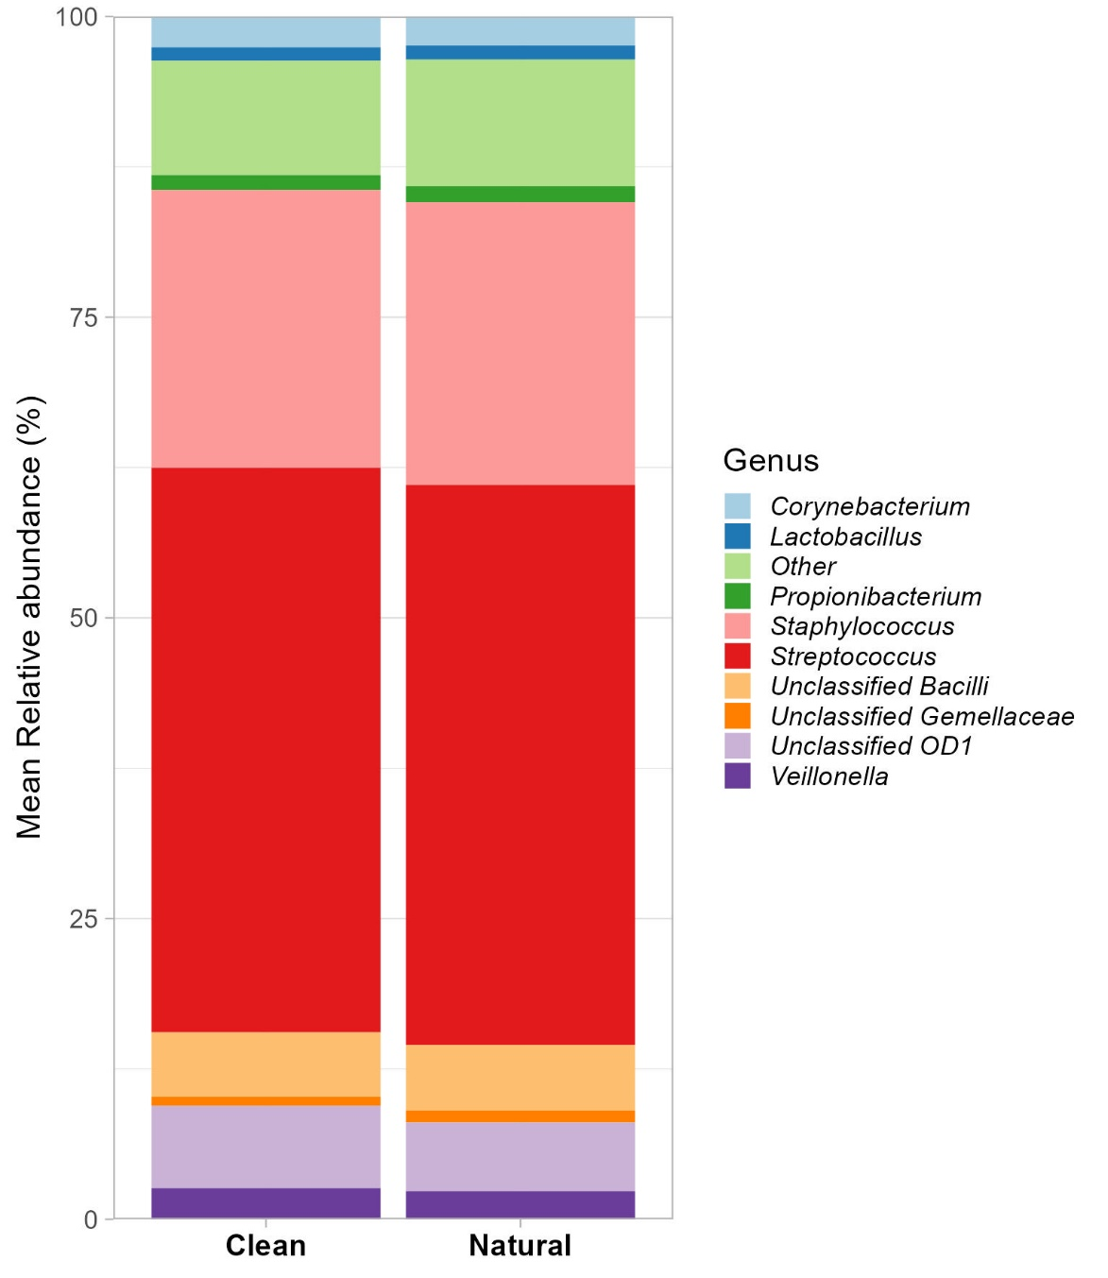
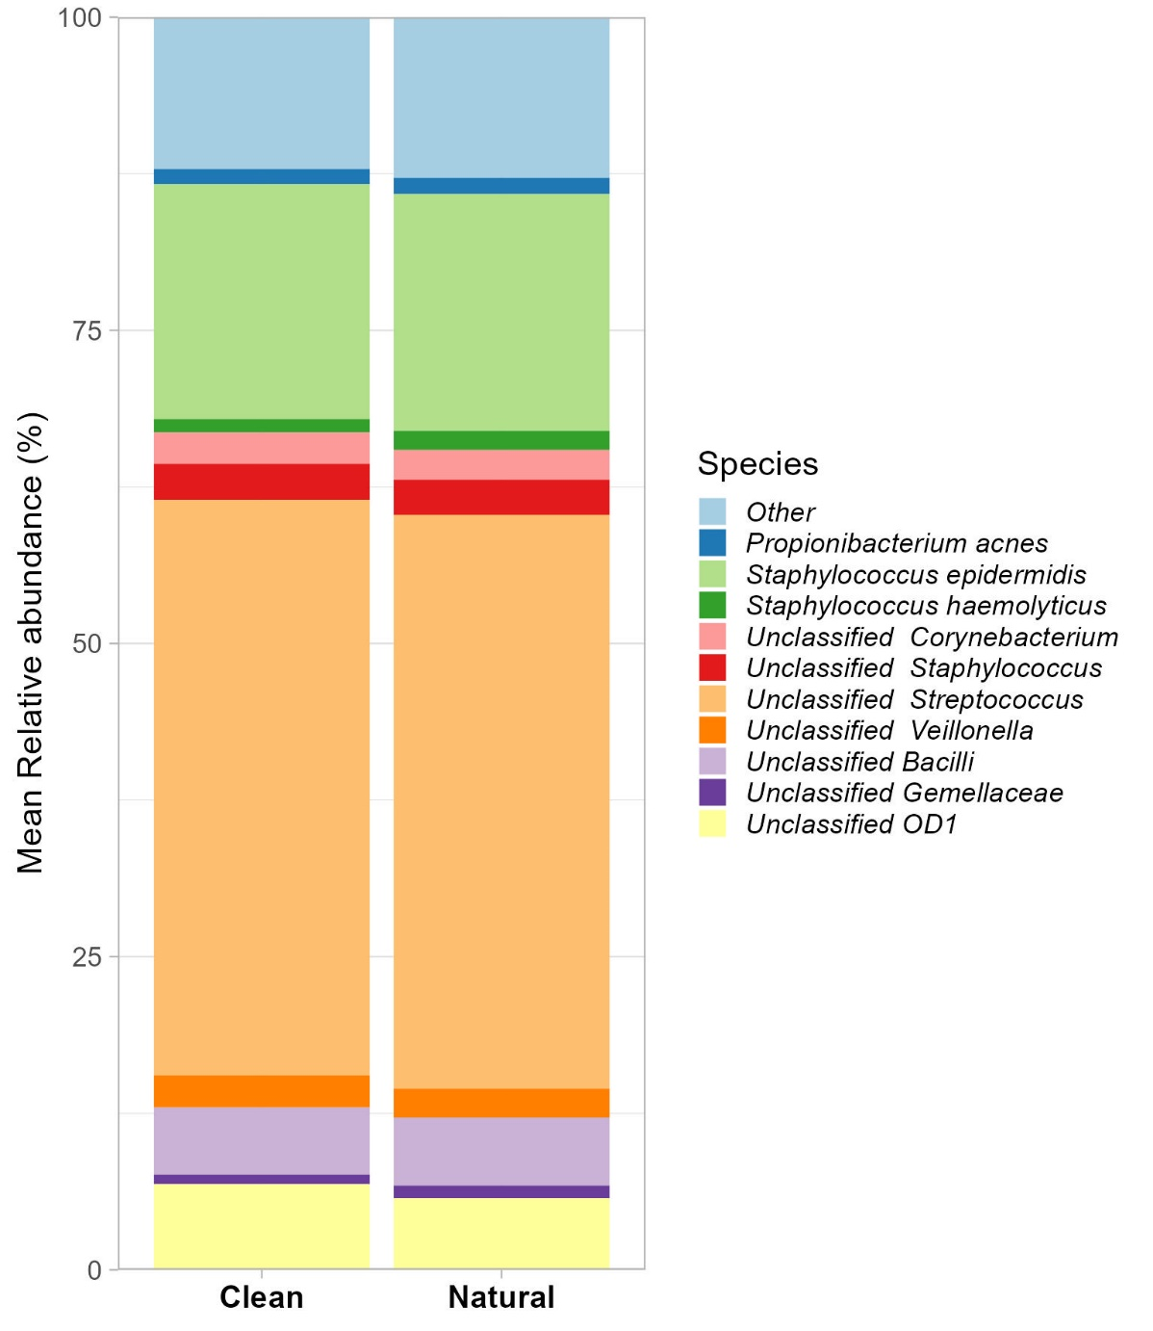
A
B
Additional file 1: Figure S2
The relative abundance of bacteria in the breastmilk sample from the clean and natural groups at A) genus and B) species levels.

Slide 3
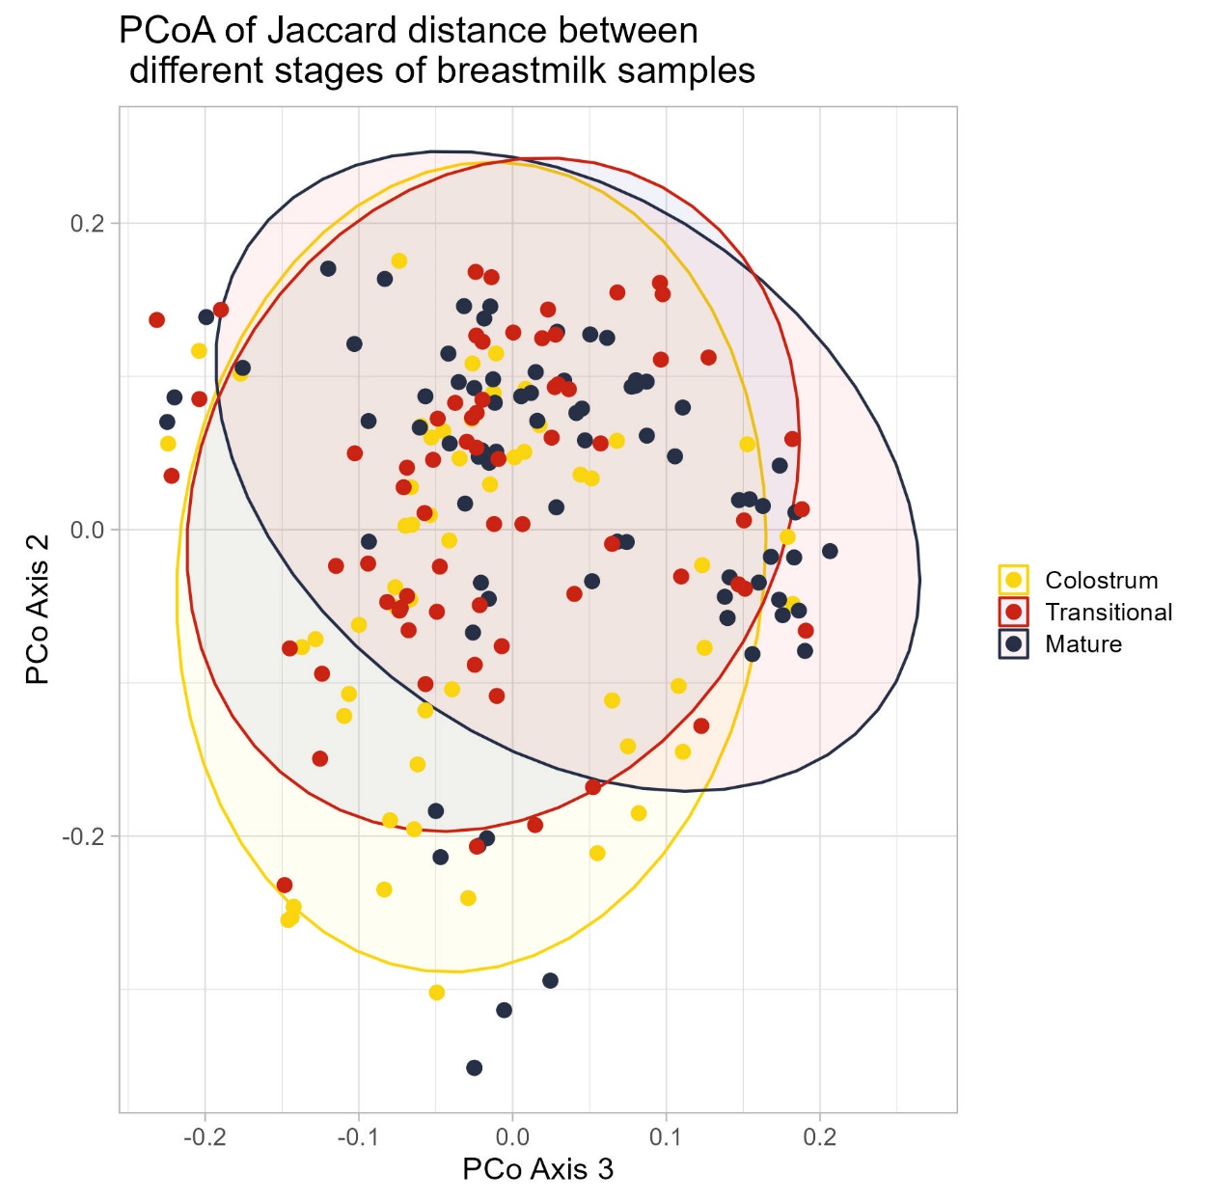
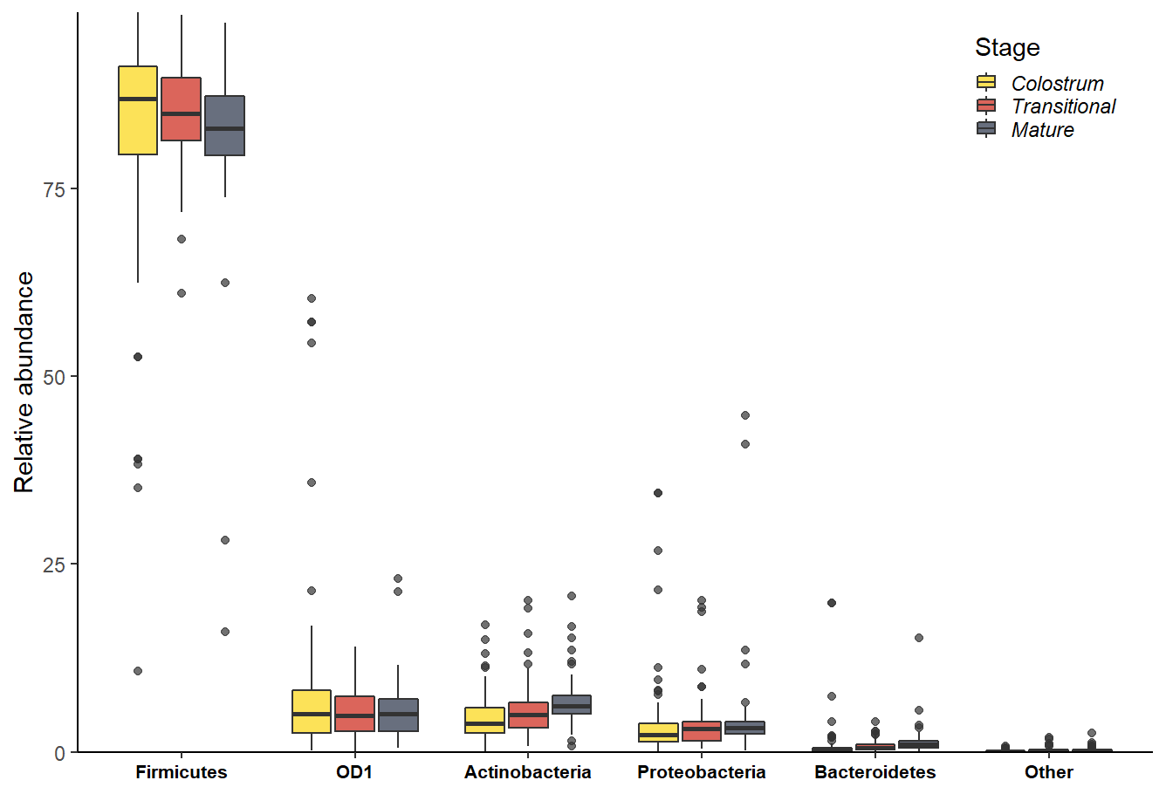
A
B
p=0.001
*
*
***
***
Additional file 1: Figure S3
A) Jaccard distance (p <0.001); p values determined by ADONIS to compare different stages of lactation: colostrum (yellow), transitional (red), mature (royal blue) BM samples. B) The median relative abundance of bacteria in the breastmilk sample at different stages of lactation (colostrum, transitional and mature) BM samples at phylum and species levels.

Slide 4
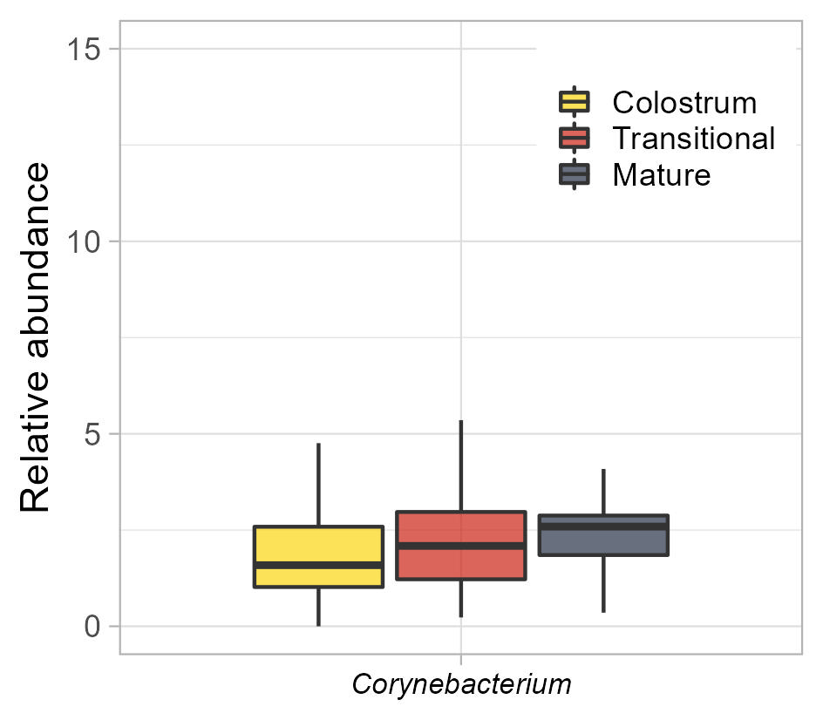
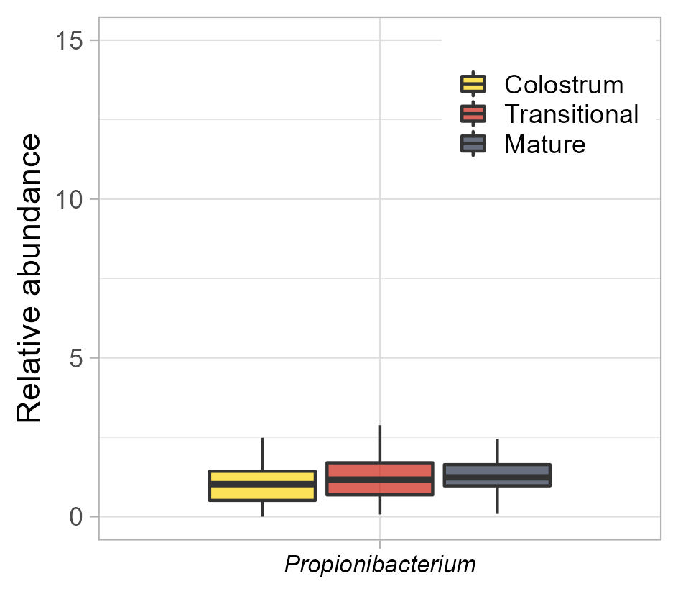
A
B
****
****
Additional file 1: Figure S4
Differences in mean relative abundance of A) Corynebacterium B) Propionibacterium in the BM samples at three stages of lactation, (Colostrum, Transitional and Mature).

Slide 5
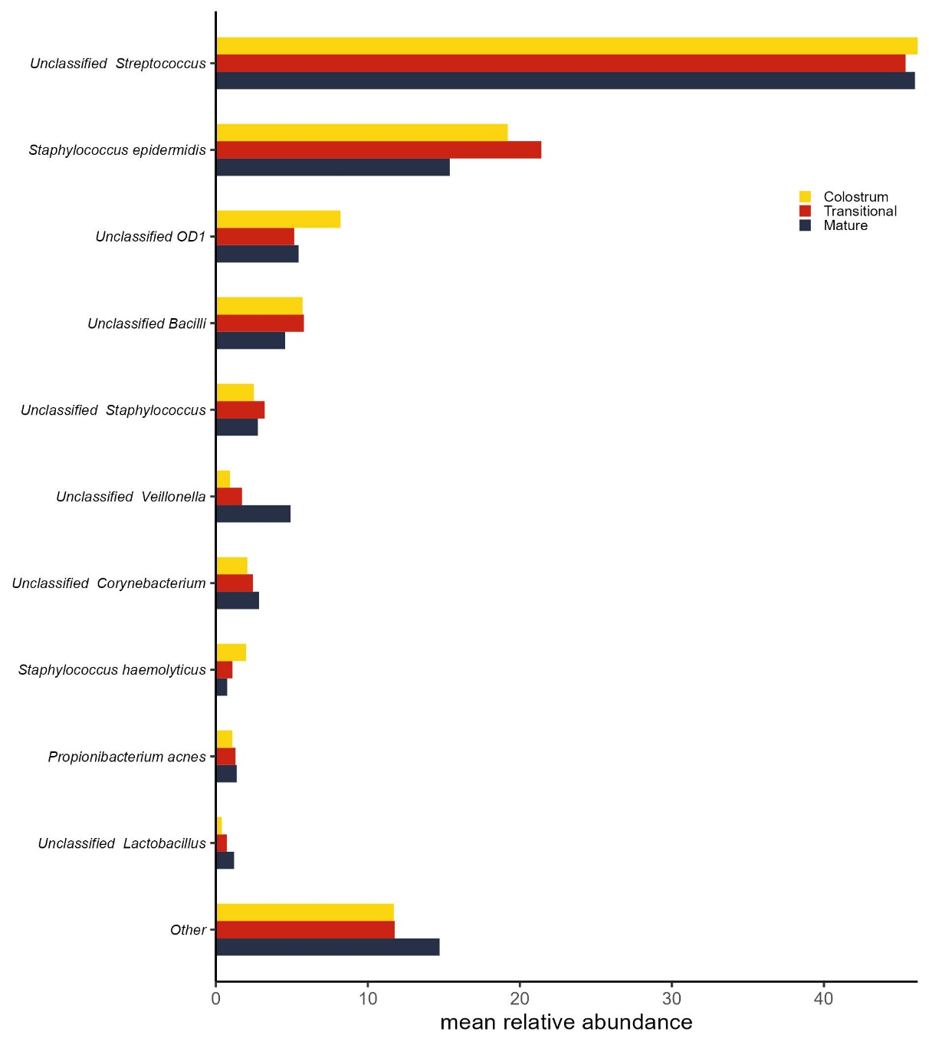
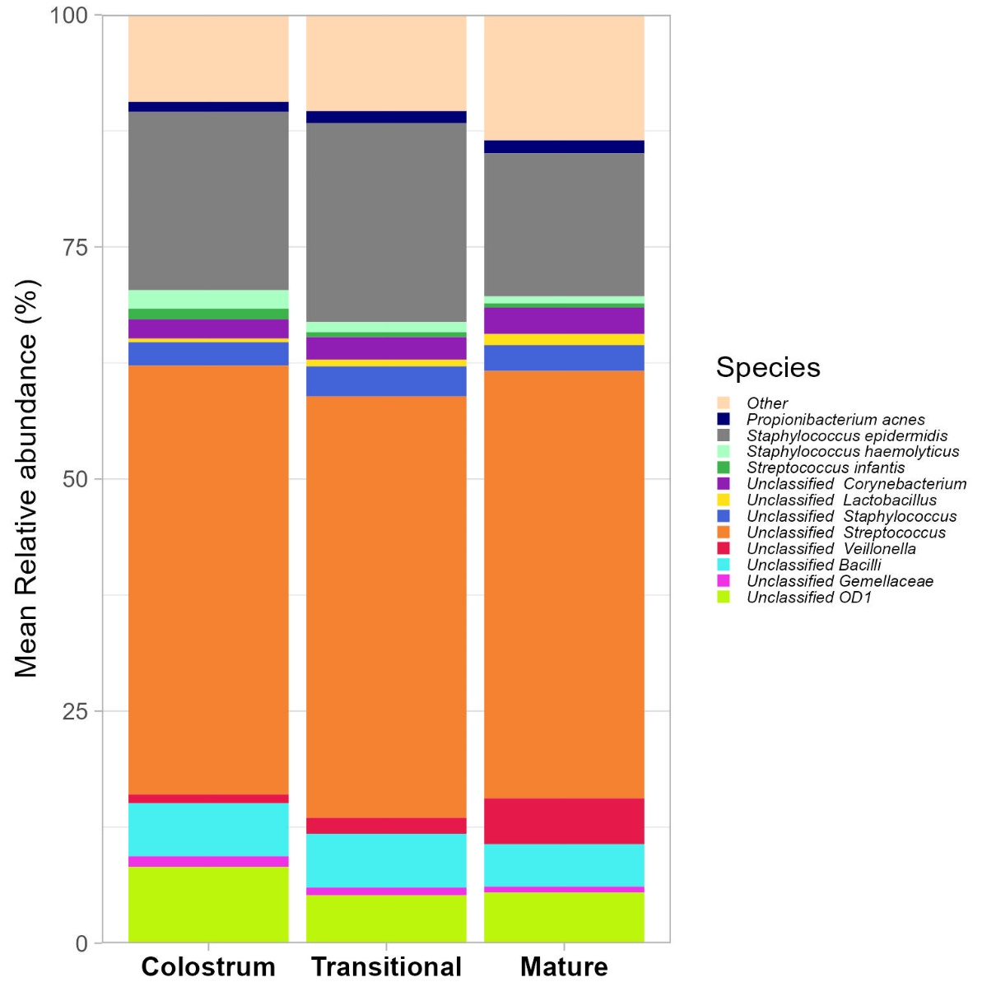
A
B
Additional file 1: Figure S5
Differences in mean relative abundance of top 10 species the BM samples across the three stages of lactation, Colostrum, Transitional and Mature BM sample in A) Individual bar plots B) Stacked bar plots

Slide 6
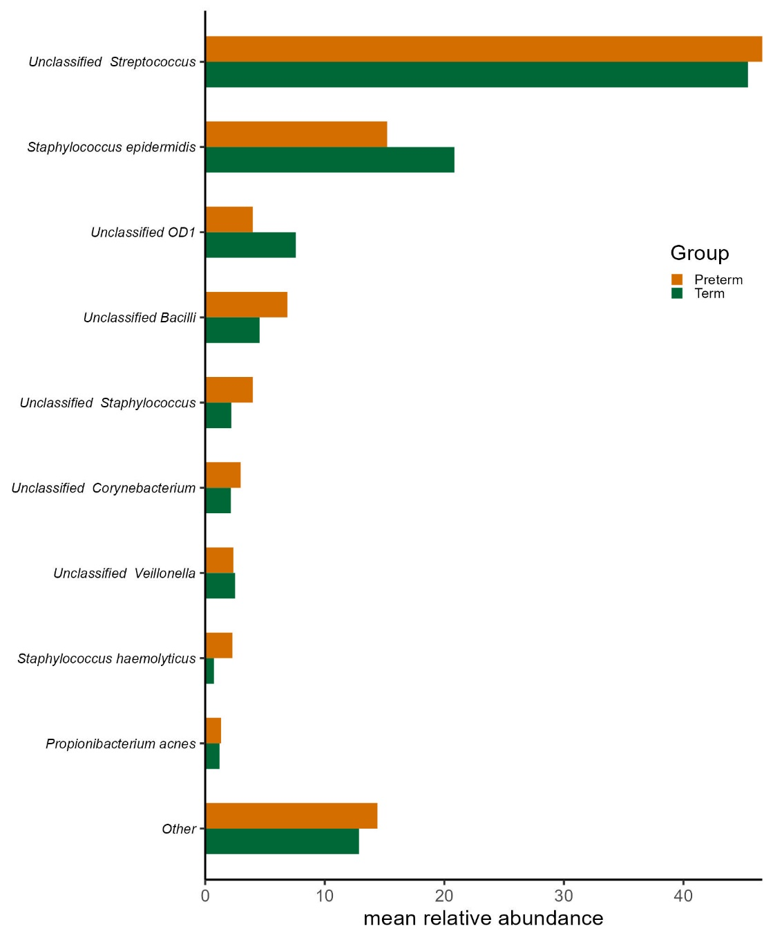
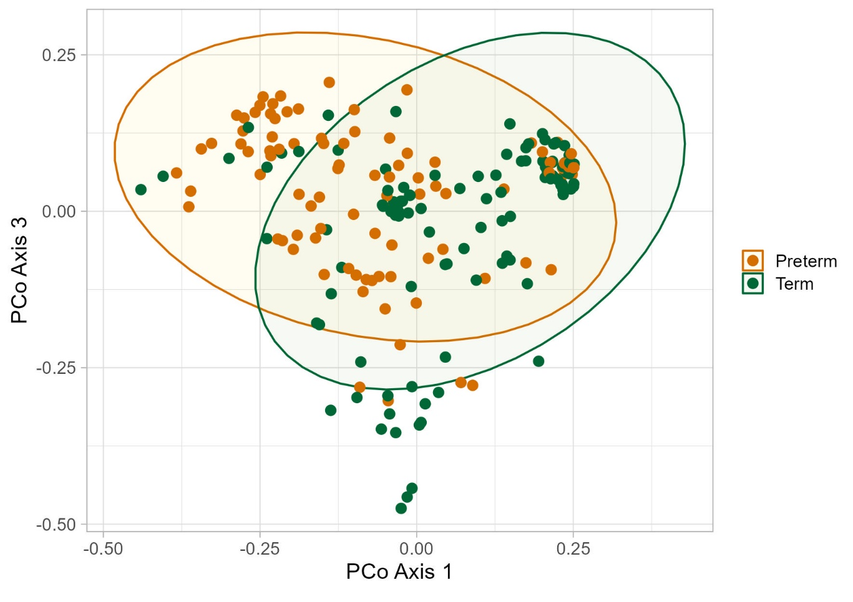
A
B
P=0.001
Additional file 1: Figure S6
A) PCoA plot of Bray-Curtis distances (p =0.001); p values determined by ADONIS to compare Preterm (brown) and Term (green) BM samples. B) The mean relative abundance of top 10 species in the preterm and term groups.

Slide 7
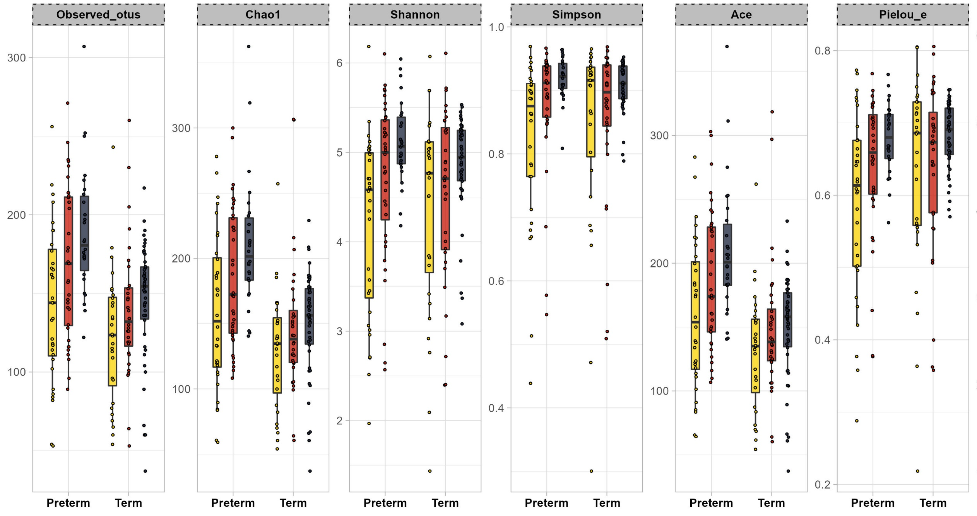

**
**
*
*
**
**
**
Additional file 1: Figure S7
A) Alpha diversity boxplots of Preterm (brown) and Term (green) BM samples across the 3 stages of lactation.

Slide 8
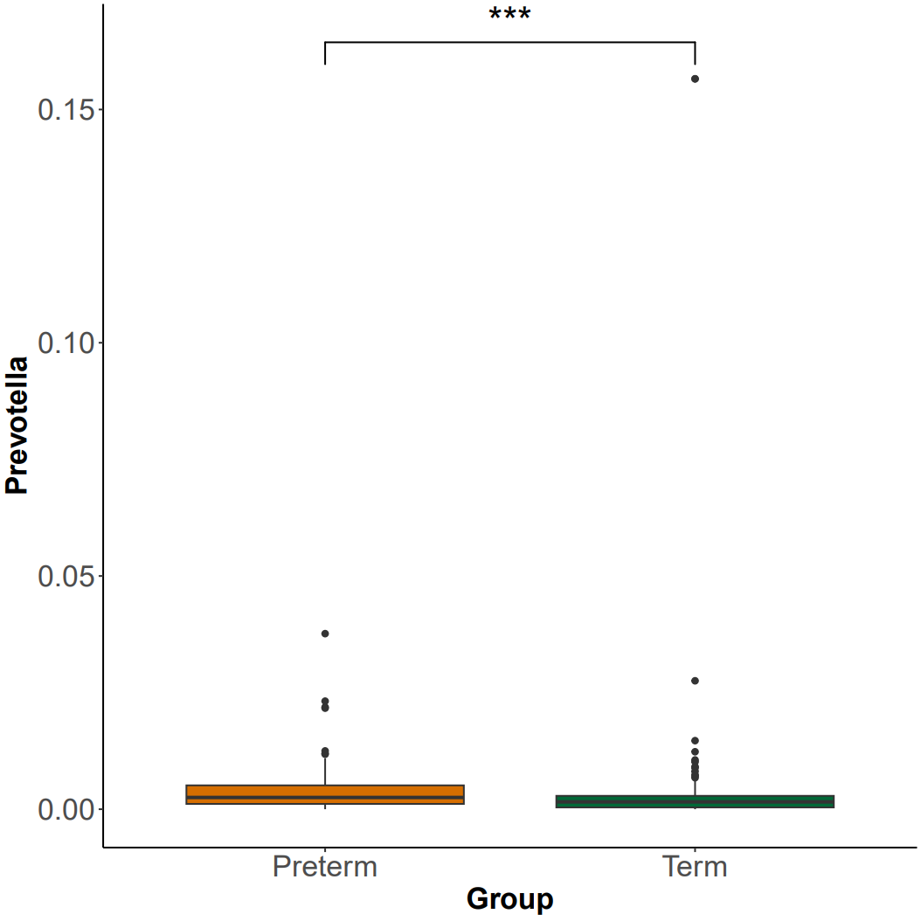
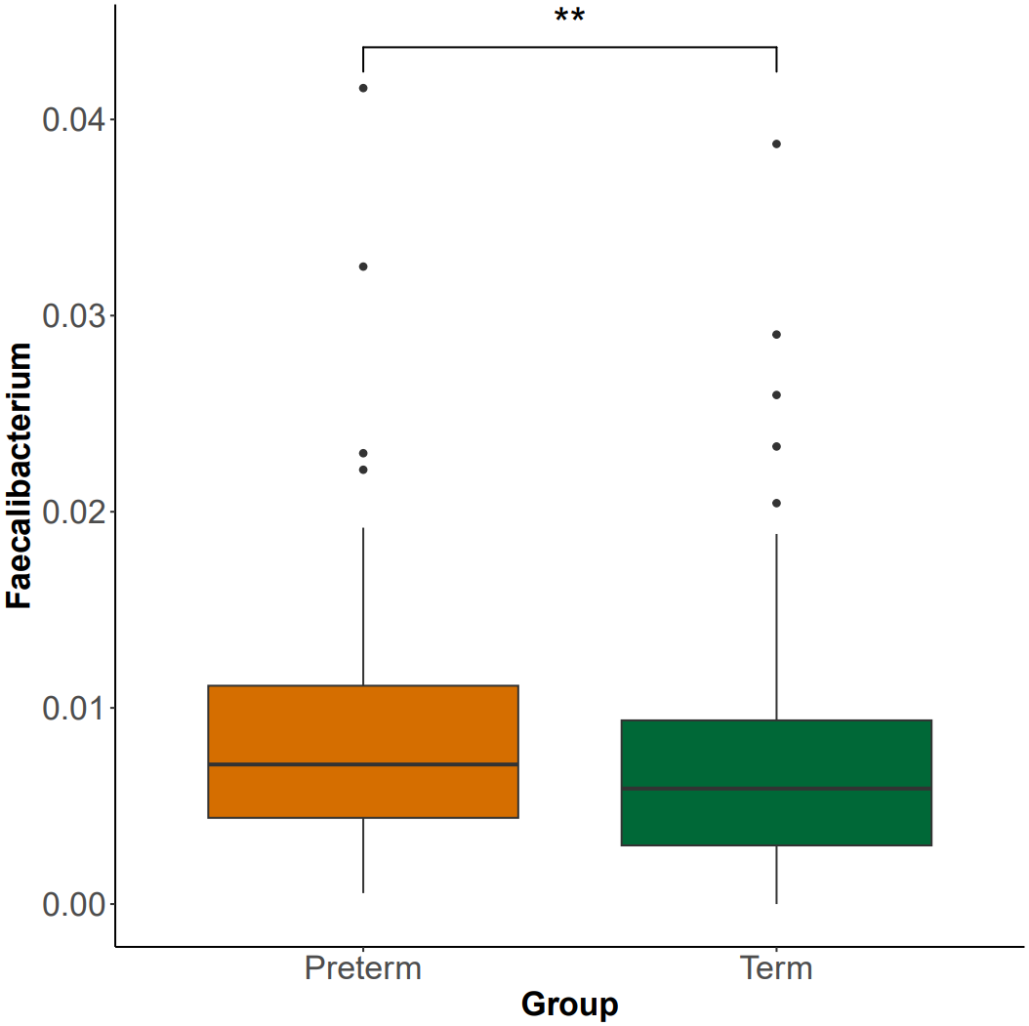
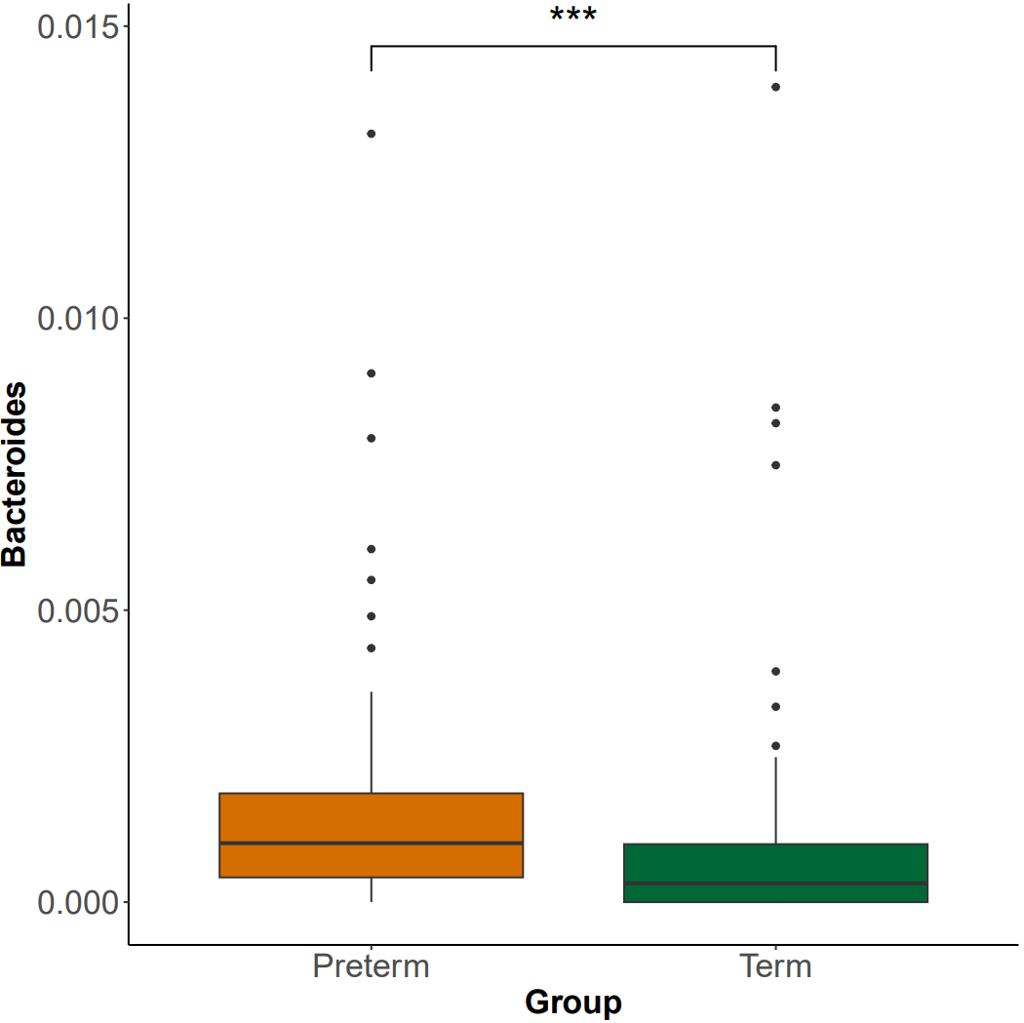
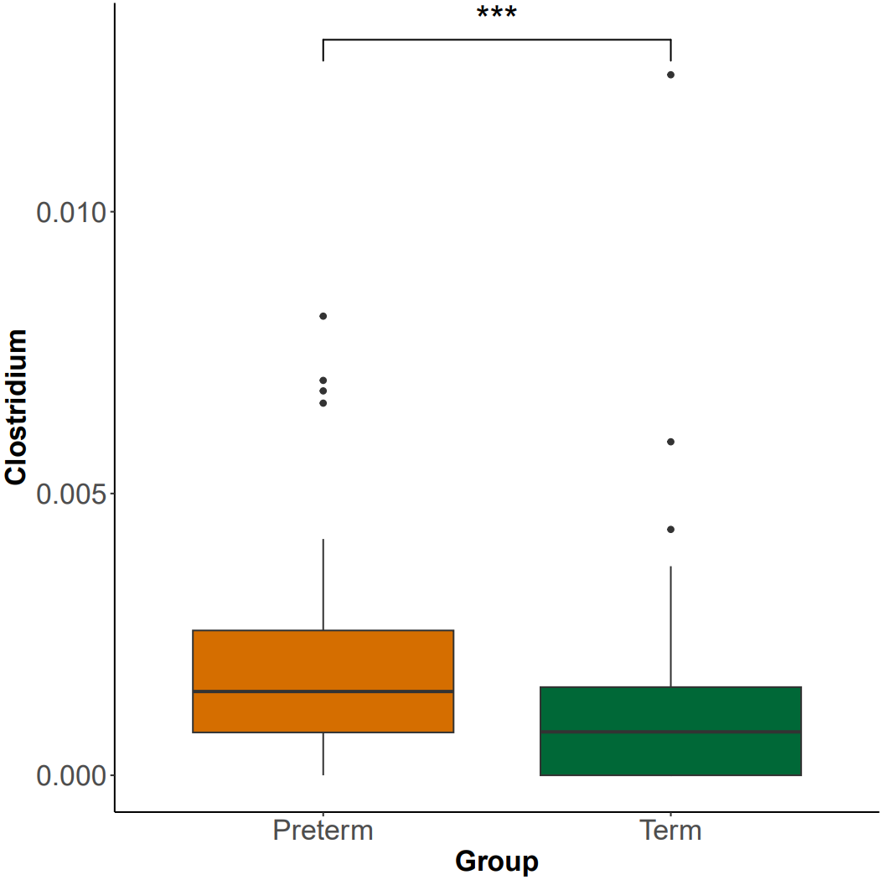
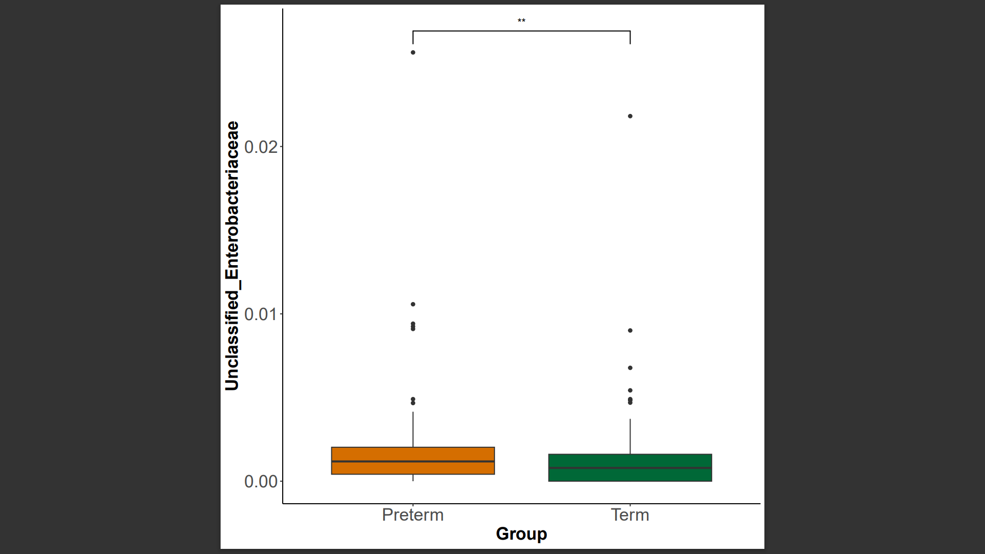
A
B
C
D
E
Additional file 1: Figure S8
Differences in mean relative abundance of A) Prevotella B) Faecalibacterium C) Bacteroides D) Clostridium E) Unclassified Enterobacteriaceae in the term and preterm BM sample.

Slide 9
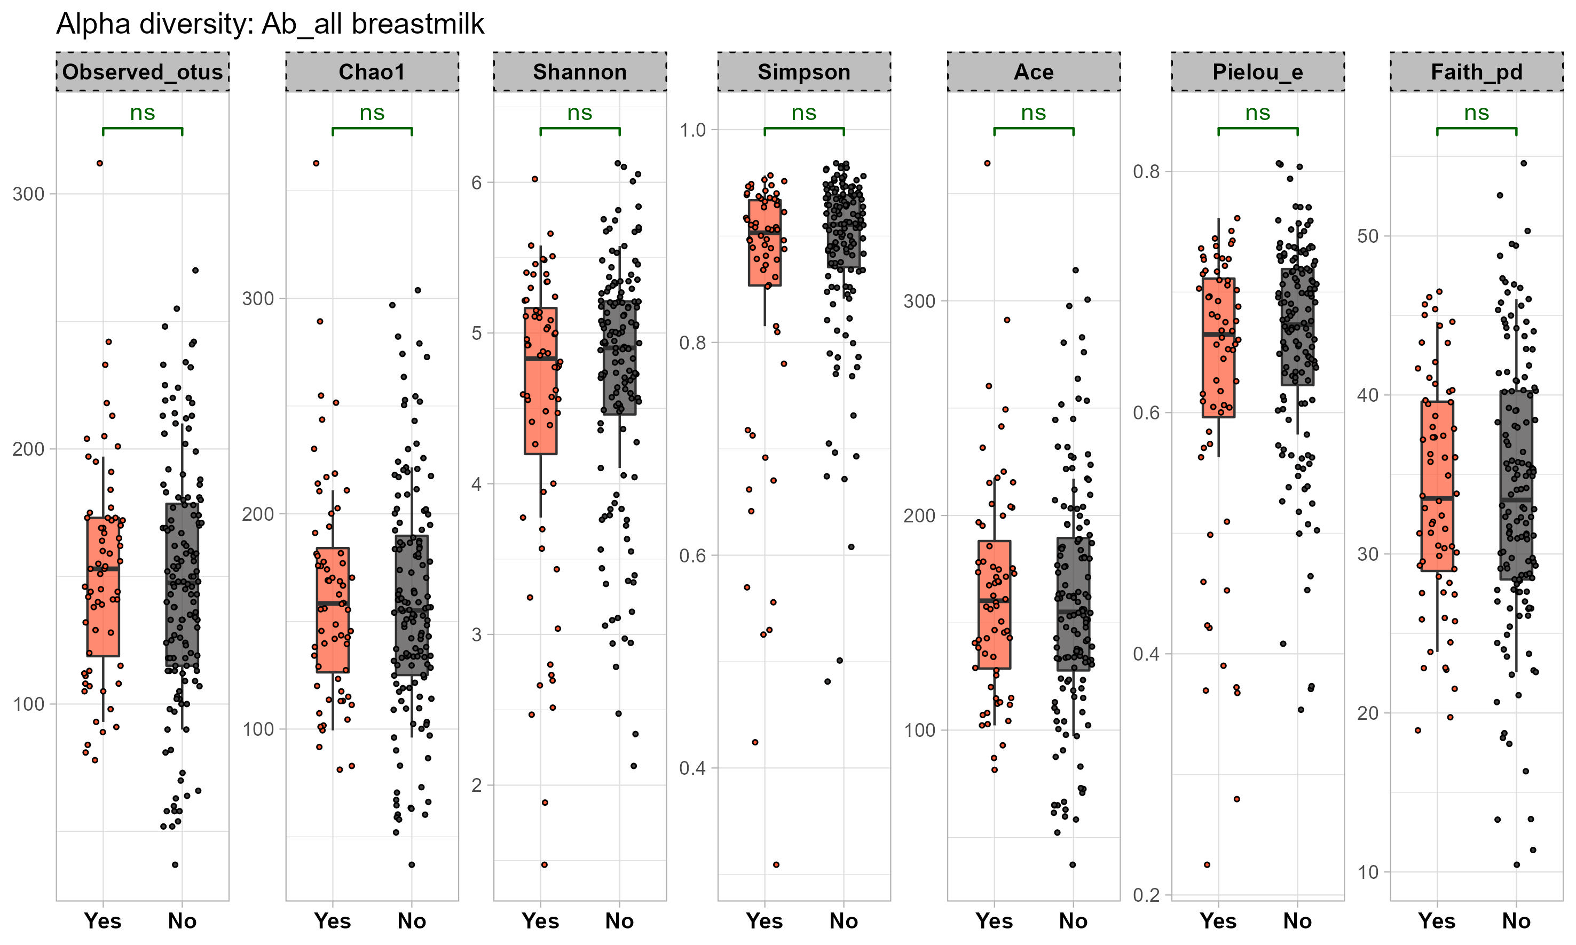
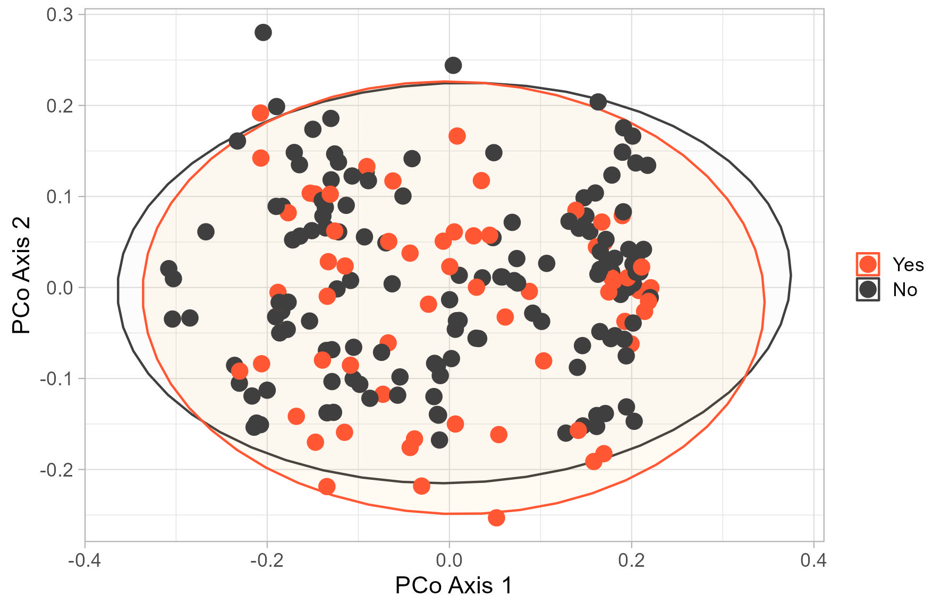
A
B
Additional file 1: Figure S9
A) Alpha diversity boxplots of comparison of breastmilk samples relative to antibiotics exposure. Orange: Yes, and grey: no antibiotics
B) Unweighted unifrac distances (p =0.147 determined by ADONIS) to compare breastmilk samples relative to antibiotics exposure: yes (orange), no antibiotics
(grey)

