Slide 1
Supplementary Figure 1. (a) Differentially modified or expressed liver proteins in the rats fed a 7% casein diet with 0 or 1.5% Lys supplementation were analysed by 2-Dimensional Difference Gel Electrophoresis (2D DIGE). Total liver proteins from three rats randomly selected from each group were labelled with either Cy3 (green) or Cy5 (red) and then equally mixed and separated by 2D DIGE. (b) Identified liver proteins modified by supplemental Lys. Eighty-eight spots were identified and further analysed for the identification of peptides and proteins. Among them, 29 proteins were downregulated by supplemental Lys, as shown in the Supplementary Table 3.

Slide 2
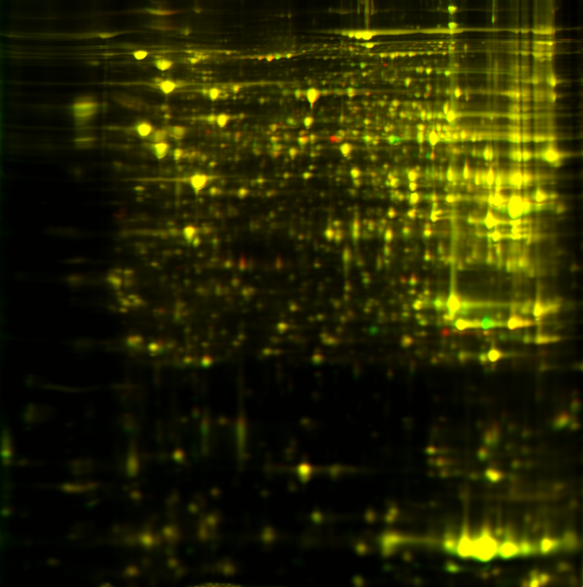
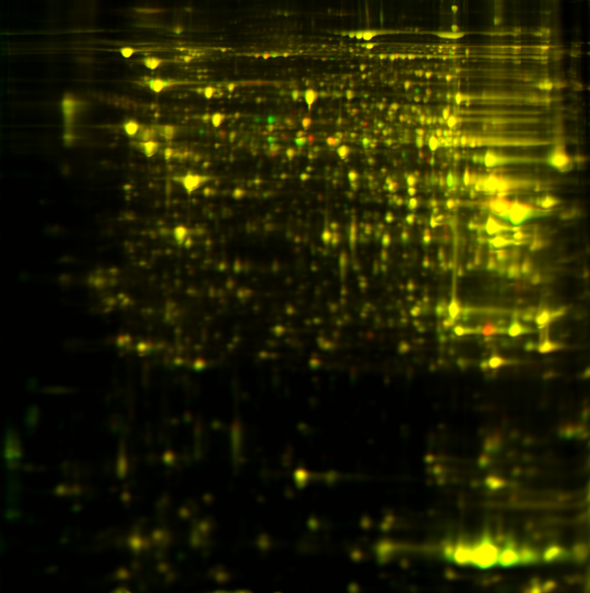
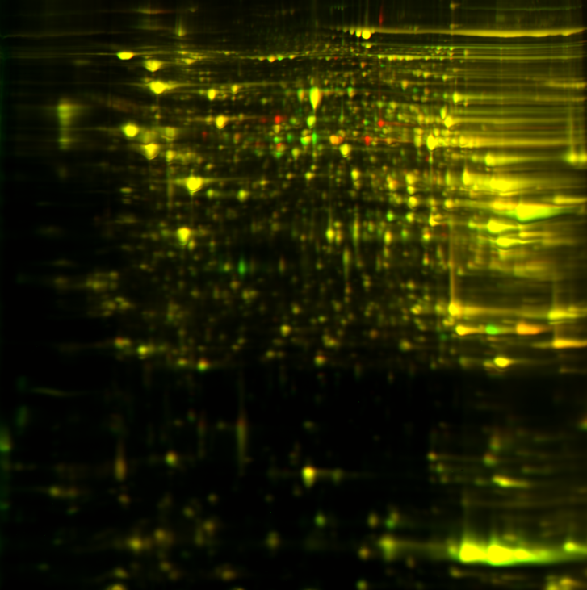
Supplementary Figure 1a. Differentially Expressed Liver Proteins in Male Rats Fed 7% Casein with 0 or 1.5% Added L-Lys
Cy3: Casein-1
Cy5: Casein+Lys-1
Casein-2
Casein+Lys-2
Casein-3
Casein+Lys-3
Green: 0% Lys Red: 1.5% Lys
Notes:
To determine the potential adverse effects of Lys supplementation in the livers, differentially modified or expressed liver proteins (or genes) in the rats fed 7% casein diet with 0 or 1.5% Lys supplementation were analysed by 2-Dimensional Difference Gel Electrophoresis (2D DIGE). Total liver proteins from 3 rats randomly selected from each group were labelled with either Cy3 (green) or Cy5 (red) and then equally mixed and separated by 2D DIGE.

Slide 3
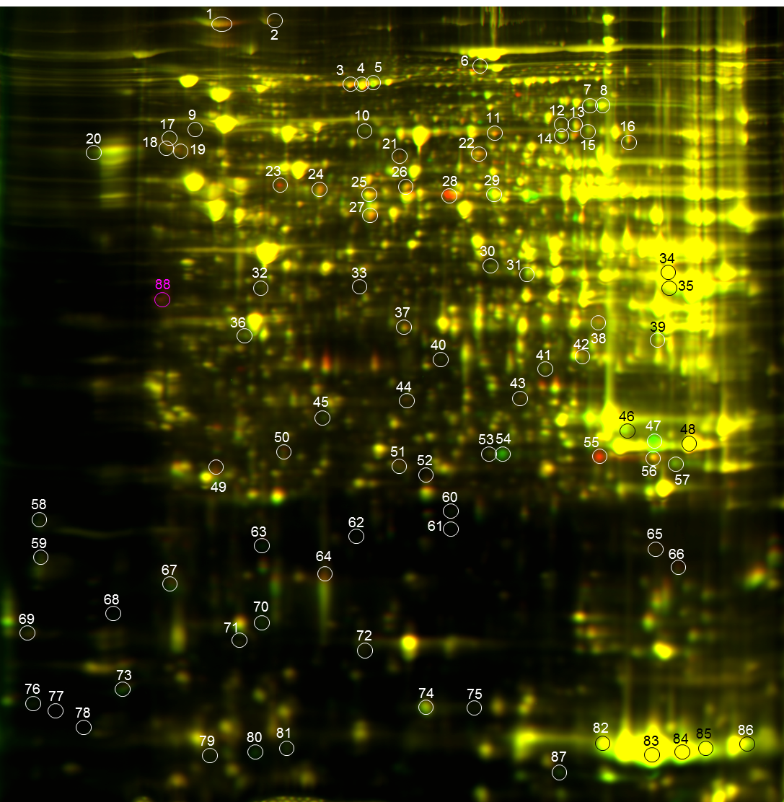
Supplementary Figure 1b. Differentially Expressed Liver Proteins Identified in Male Rats Fed 7% Casein with 0 or 1.5% Added L-Lys
Fed 7% Casein with 0 or 1.5% Added L-Lys
Green: 0% Lys Red: 1.5% Lys
Notes:
88 spots were identified and picked up. 60 of them were analysed by LC/MS/MS system and a bioinformatics software package for the characterization and identification of peptide and proteins.10 liver mitochondrial proteins have been identified to be modulated by L-Lys. 7 were downregulated and 3 were upregulated. Additional 29 proteins were downregulated and 17 were upregulated by Lys in the livers. The dose-effects of L-Lys on some of these markers will be further analysed.

