Slide 1
Supplementary Figures

Slide 2
sFig. 1A (Full images for Fig. 1C)
Transcription enhancement
EBNA1
Luc
Shown in figures
and legends
OriP
SV40p
1
2
3
4
5
6
7
EBNA1
-
+
+
+
+
+
+
-
-
0.3
-
FMAP30
0.1
0.5
-
-
-
-
1.0
(ng)
-
-
FGAP31
1
EBNA1
Actin
Original uncropped images
Marker
2
3
4
6
7
Marker
1
5
93
93
72
72
57
EBNA1
57
Bright field
kDa
kDa
Marker
Marker
1
2
3
4
5
6
7
57
57
42
42
31
31
Actin
kDa
kDa
Bright field

Slide 3
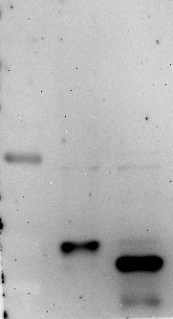
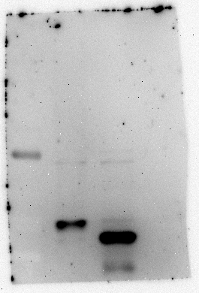
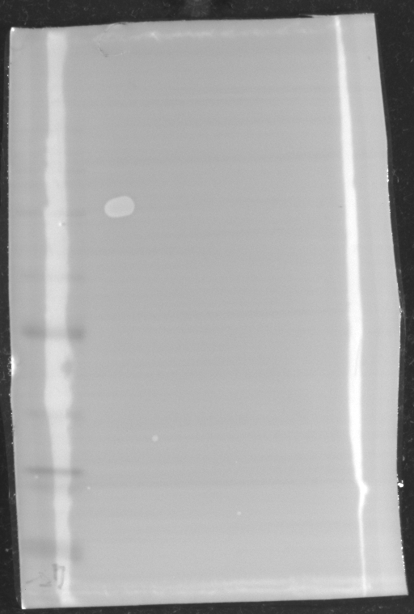
sFig. 1B (Full images for Fig. 1D)
M
2
1
63
Shown in figures and legends
35
25
1: rGAP31
2: rMAP30
Original uncropped images
Marker
Marker
M
1
2
72
93
72
31
31
24
24
Bright field
kDa
kDa

Slide 4
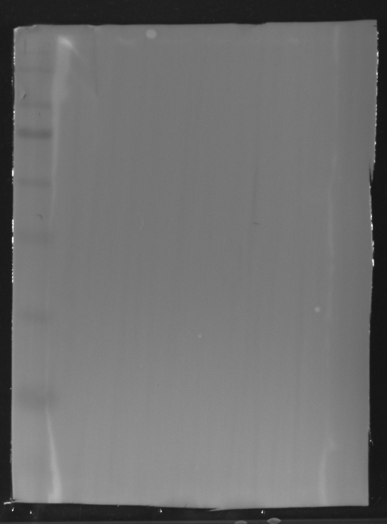
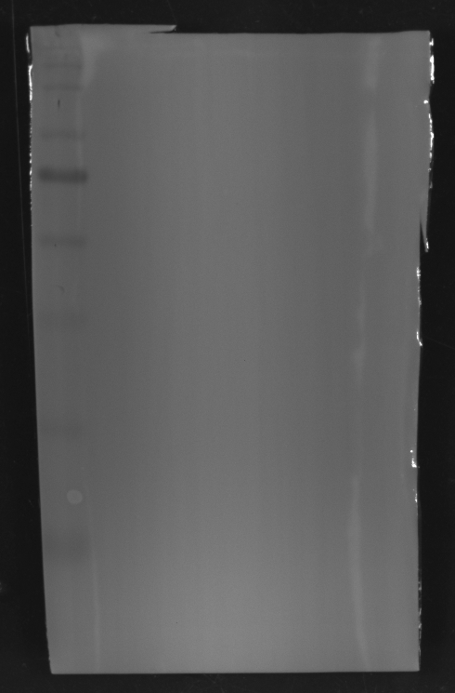
sFig.1C (Full images for Fig. 1E left panel )
BJAB-E1/oriP-Luc
BJAB
Shown in figures
and legends
EBNA1
Actin
Original uncropped images
BJAB-E1/oriP-Luc
BJAB
Marker
Marker
72
72
57
57
42
42
EBNA1
Bright field
kDa
kDa
Marker
Marker
72
72
57
57
42
42
Actin
kDa
Bright field

Slide 5
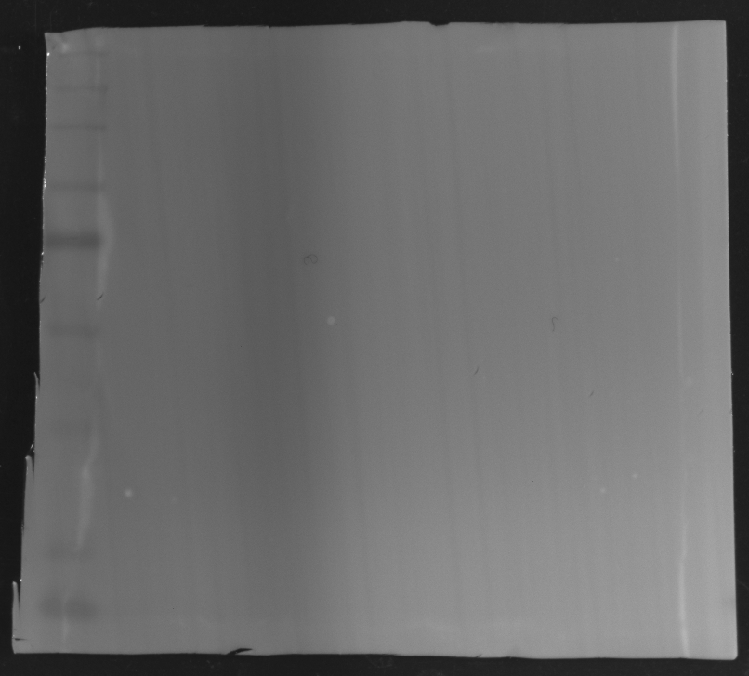
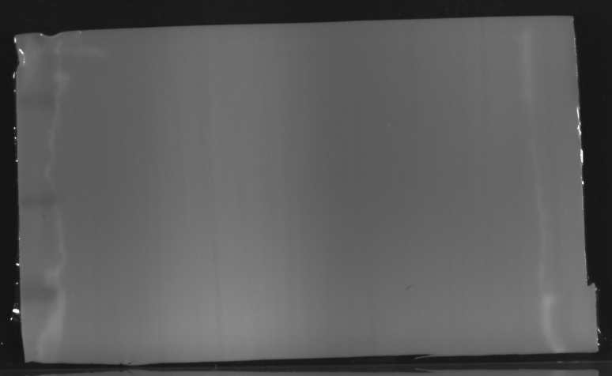
sFig. 1D (Full images for Fig. 1E left panel )
BJAB-E1/oriP-Luc
Relative activity
*
**
Shown in figures
and legends
BJAB
**
**
rMAP30
-
0
0
100
100
0
20
-
50
(ng)
rGAP31
-
-
-
-
100
100
0
EBNA1
1 2 3 456 7 8
Actin
Original uncropped images
Marker
Marker
1 2 3 4 5 6 7 8
72
72
57
57
EBNA1
Bright field
Marker
Marker
1 2 3 4 5 6 7 8
42
42
24
Actin
24
15
15
Bright field

Slide 6
sFig. 2 A (Full images for Fig. 2A )
206
68 108 174 202 221
M1
M2
M3
24 DVNFDLSTATAKTYTKFIED 43 WT
Shown in figures
and legends
24 DVNCDLSTATAKTYTKFIED 43 F27C
24 DVNFDLSTGTAKTYTKFIED 43 A32G
24 DVNFDLSTATAKTCTKFIED 43 Y37C
β α helix
Original uncropped images

Slide 7
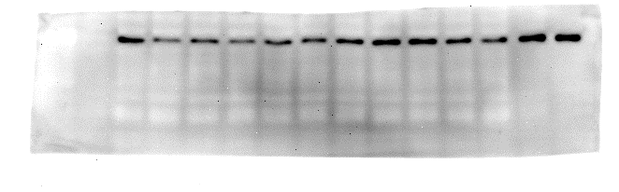
sFig. 2B
(Full images for Fig. 2B )
oriP-Luc
**
**
**
*
Fold activation
Shown in figures and legends
Relative
mRNA
EBNA1
-
+
+
+
+
+
+
+
+
+
+
+
+
Actin
EBNA1
-
+
-
FMAP30
WT
F27C
A32G
Y37C
Marker
1 2 3 4 5 6 7 8 9 10 11 12 13 14
1 2 3 4 5 6 7 8 9 10 11 12 13 14
72
57
kDa
EBNA1
Marker
72
57
Bright field
kDa
Marker
1 2 3 4 5 6 7 8 9 10 1112 1314
57
Original uncropped images
42
Actin
kDa
Marker
57
42
kDa
Bright field

Slide 8
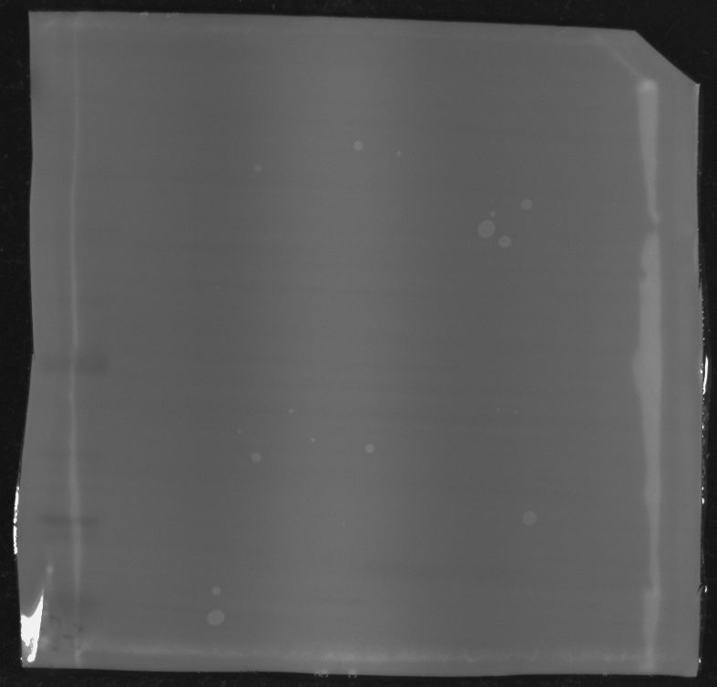
sFig. 2C (Full images for Fig. 2C left panel )
1
rMAP30
Shown in figures and legends
2
3
4
1.WT 2.F27C
3.A32G 4.Y37C
Original uncropped images
Marker
Marker
1 2 3 4
57
57
GAP31
MAP30
31
31
24
24
Bright field
kDa
kDa

Slide 9
sFig. 2D (Full images for Fig. 2C right panel)
ns
Shown in figures and legends
ns
Relative luciferase
activity
*
*
*
ns
*
*
*
*
-
*
*
rMAP30
WT
F27C
A32G
Y37C
EBNA1
Actin
Original uncropped images
72
72
57
57
EBNA1
42
42
Actin
24
15

Slide 10
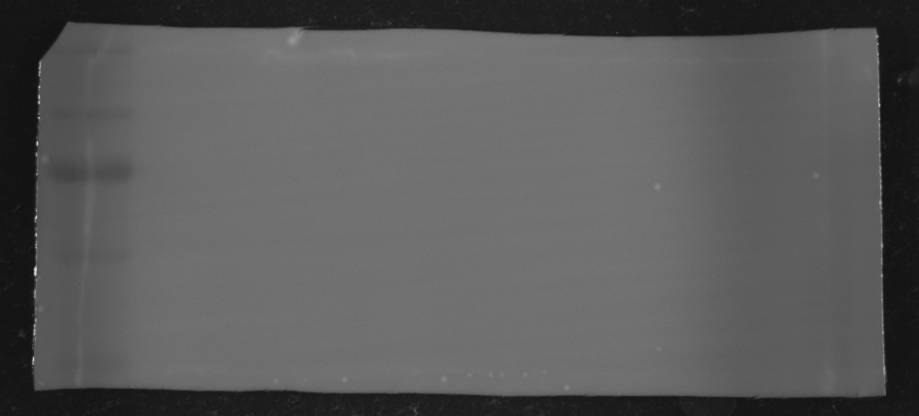
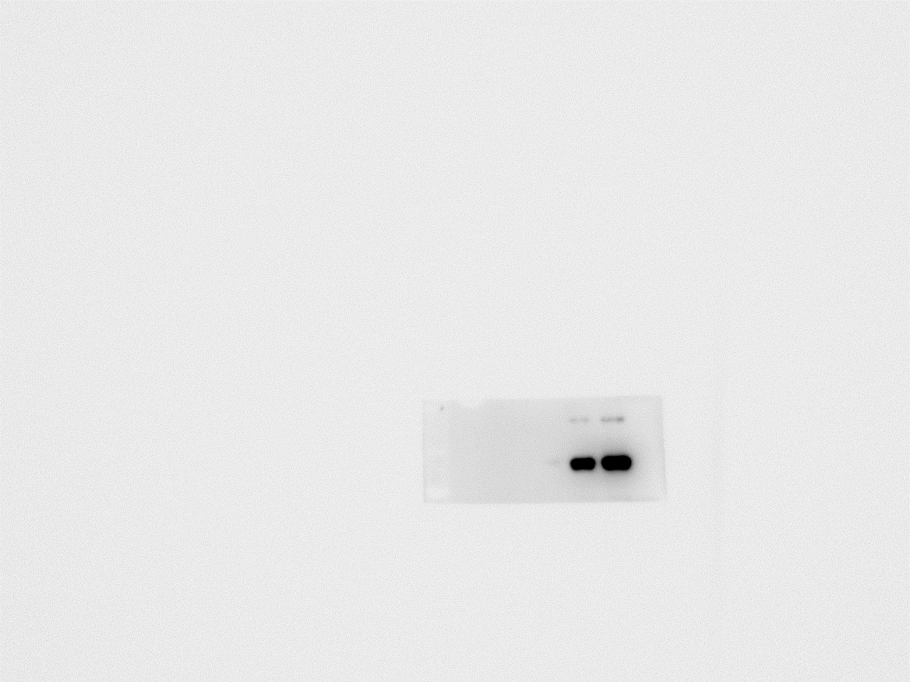
sFig. 3A (Full images for Fig. 3A upper panel )
LMP1
oriP
Shown in figures and legends
1
2
1
2
1: Biotin-labeled DNA
2: Naked DNA
oriP-DNA
1
1
2
1
1
1
-
-
50
rMAP30
BSA
20
100 (ng)
EBNA1
1.0
.98
.83
.34
.11
Original uncropped images
DNA gel
LMP1
oriP
1
2
1
2
1000
200
bp
Marker
1 2 1 1 1 1
Marker
93
93
72
72
EBNA1
Bright field
kDa
kDa
Marker
Marker
1 2 1 1 1 1
His blot
48
48
35
35
25
rMAP30
25
Bright field
kDa
kDa

Slide 11
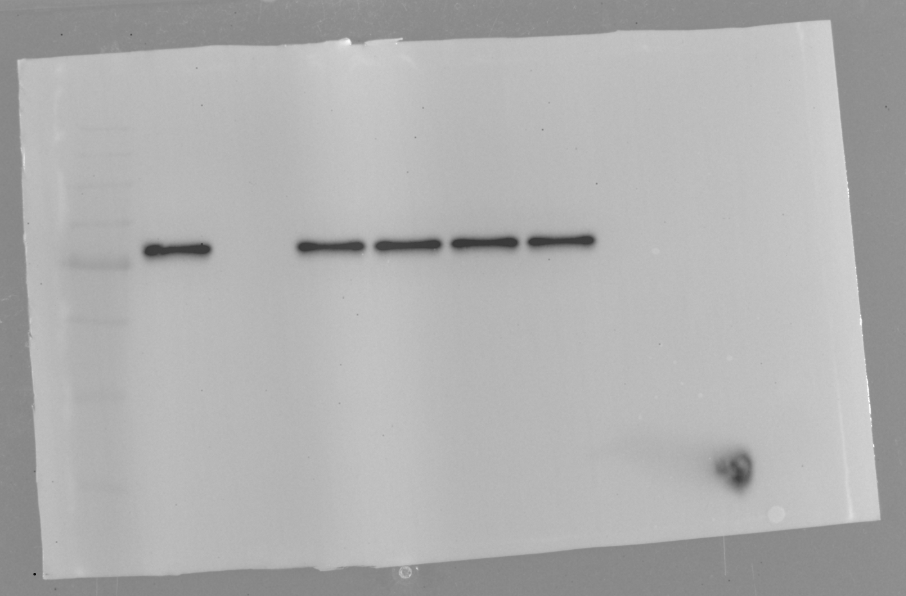
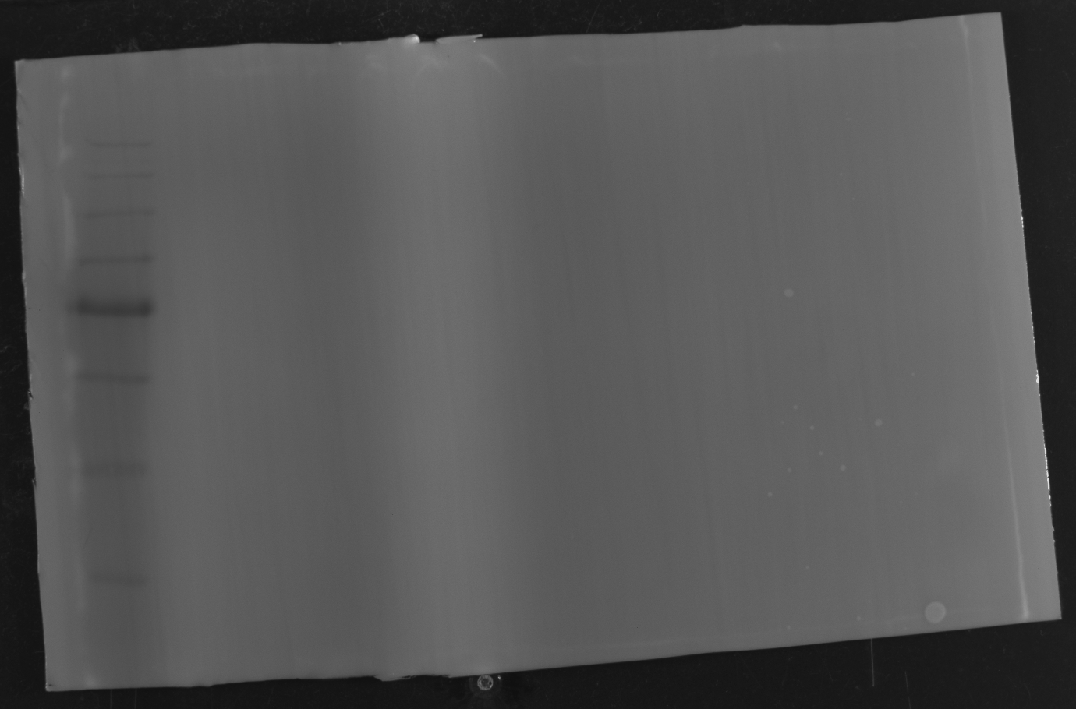
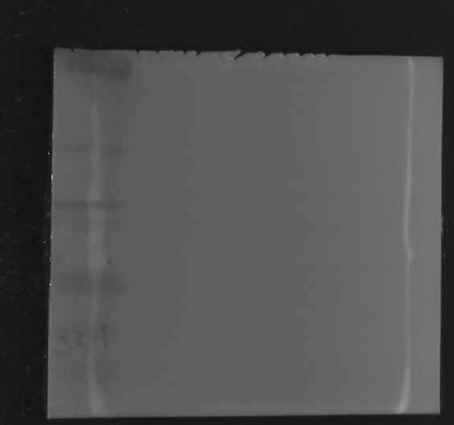
sFig. 3B (Full images for Fig. 3A lower panel )
Shown in figures and legends
1
2
LMP1-DNA
1
1
1
1
-
-
20
50
rMAP30
BSA
100 (ng)
EBNA2
rMAP30
Original uncropped images
Marker
Marker
1 2 1 1 1 1
93
93
72
72
EBNA2
Bright field
kDa
kDa
Marker
Marker
1 2 1 1 1 1
57
57
31
31
24
24
Bright field
rMAP30

Slide 12
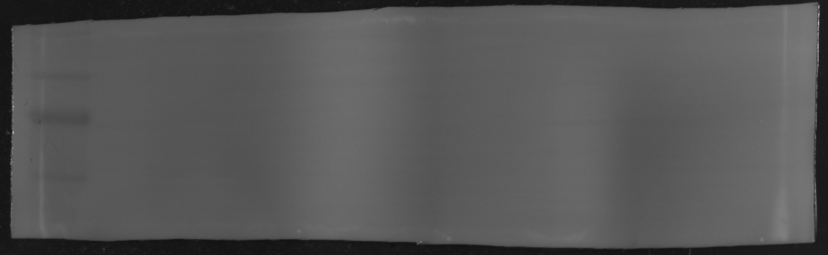
sFig. 3C (Full images for Fig. 3B )
1
oriP-DNA
2
1
1
1
1
1
Shown in figures and legends
2%
input
A32G
-
-
BSA
F27C
Y37C
WT
EBNA1
1.0
1.02
.15
.19
1.04
.84
rMAP30/
mutants
1.0
.97
.56
Original uncropped images
Marker
2%
input
2 1 1 1 1 1 1
Marker
93
93
72
72
kDa
EBNA1
kDa
Bright field
Marker
2 1 1 1 1 1 1
Marker
A32G
WT
Y37C
42
rMAP30/mutants
42
31
31
kDa
kDa
Bright field

Slide 13
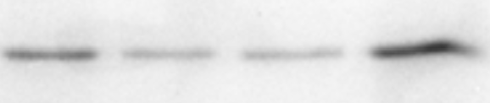
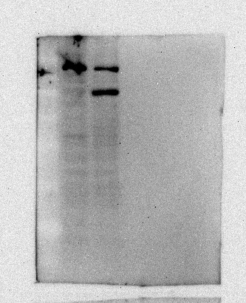
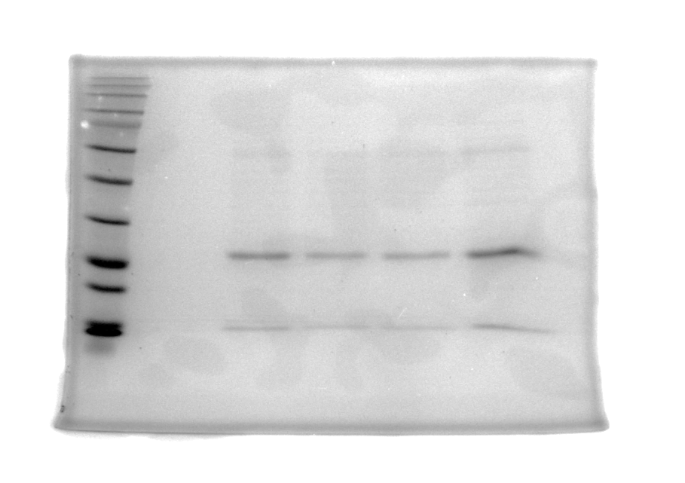
sFig. 3D (Full images for Fig. 3C)
A32G
Shown in figures and legends
F27C
Y37C
WT
EBNA1
rMAP30/mutants
(baits)
Original uncropped images
Control (BJAB)
input
A32G
WT
F277C
Y37C
F27C
A32G
Y37C
WT
Pulldown
lysates
rMAP30/mutants
(baits)
EBNA1

Slide 14
sFig. 4A (Full images for Fig. 4A )
LCL1
Relative genome
accumulation
**
*
*
*
Shown in figures and legends
**
**
**
**
**
**
-
**
**
rMAP30
WT
F27C
A32G
Y37C
EBNA1
Actin
Original uncropped images
Marker
rMAP30
-
WT
F27C
A32G
Y37C
93
72
EBNA1
125
93
72
Bright field
Marker
rMAP30
-
WT
F27C
A32G
Y37C
42
31
Actin
24
Marker
42
31
24
Bright field

Slide 15
sFig. 4B (Full images for Fig. 4B)
AKATA(+)
**
*
*
*
Shown in figures and legends
Relative genome
accumulation
**
**
**
**
**
**
**
**
-
rMAP30
WT
F27C
A32G
Y37C
EBNA1
Actin
Original uncropped images
Marker
rMAP30
-
WT
F27C
A32G
Y37C
93
72
EBNA1
kDa
Marker
93
Bright field
72
kDa
Marker
rMAP30
-
WT
F27C
A32G
Y37C
57
42
31
Actin
kDa
Marker
57
42
31
kDa
Bright field

