Slide 1
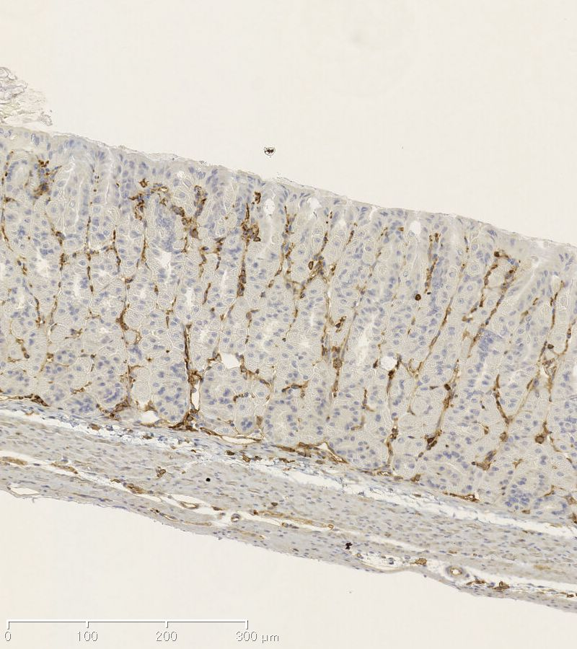
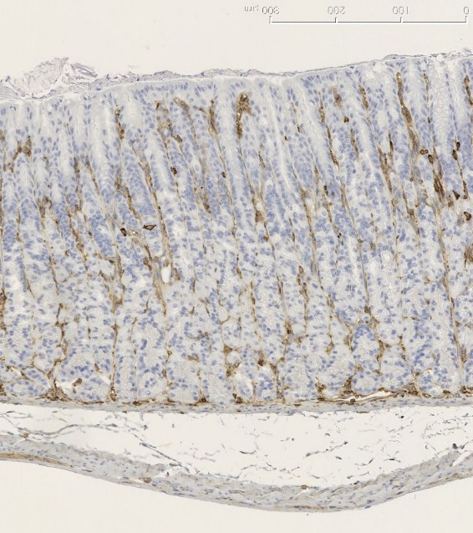
Supplementary Fig. S4
WT
Vil2^{kd/kd}
A
B

