Slide 1
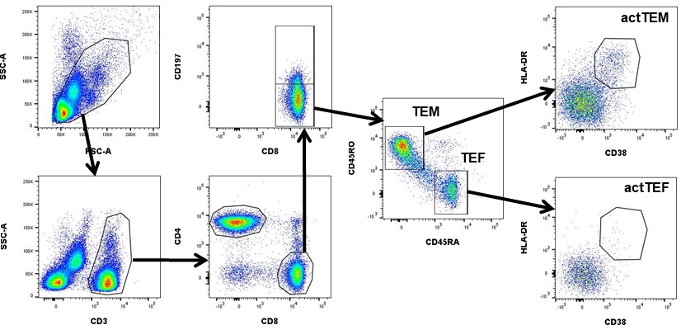
Figure S1. Gating strategy for flow cytometric identification of activated CD8⁺ T effector memory (TEM) and T effector cells (TEF).

