Slide 1
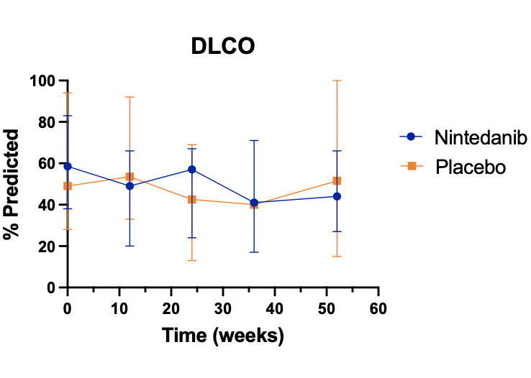
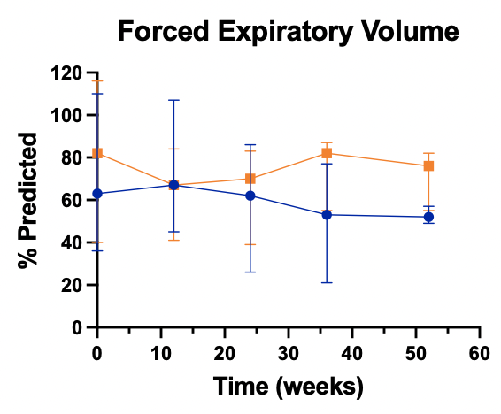
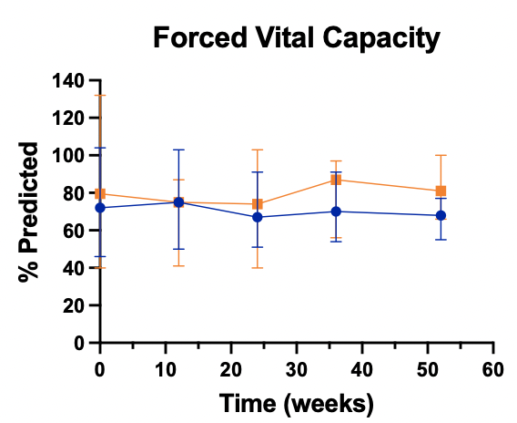
Supplemental Figure 4. Pulmonary Function Tests
A.
B.
C.
Pulmonary function tests in each treatment arm normalized to percent predicted with bars denoting range. A) Diffusion capacity for carbon monoxide (DLCO). B) Forced expiratory volume in one second (FEV₁). C) Forced vital capacity (FVC). Changes in parameters were not statistically significant by Wilcoxon rank-sum test (p>0.05).

