Slide 1


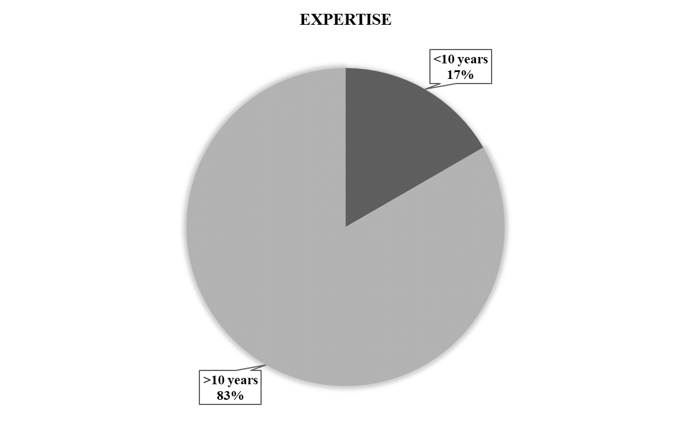
Supplementary Figure 1. Demographics of respondents from Europe (n=83).

Slide 2

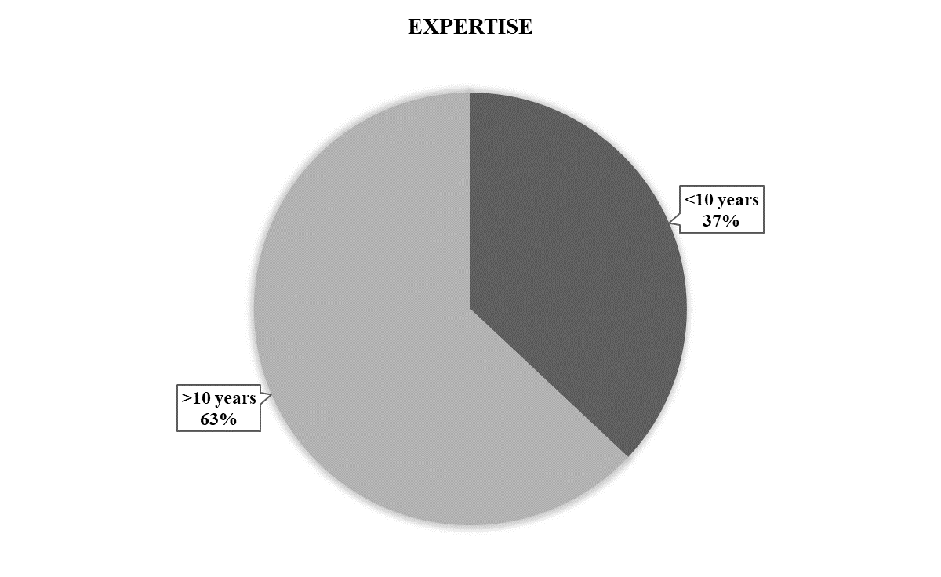

Supplementary Figure 2. Demographics of respondents from America (n=73).

Slide 3


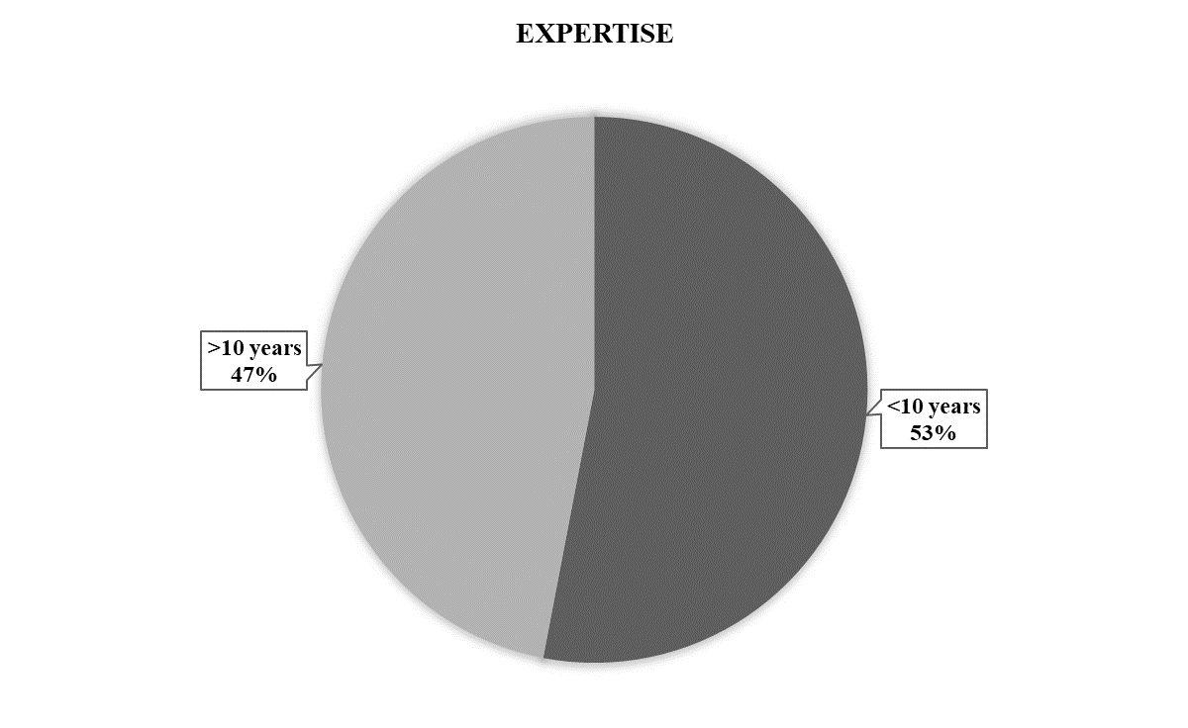
Supplementary Figure 3. Demographics of respondents from the rest of the world (n=60).

Slide 4
