Slide 1
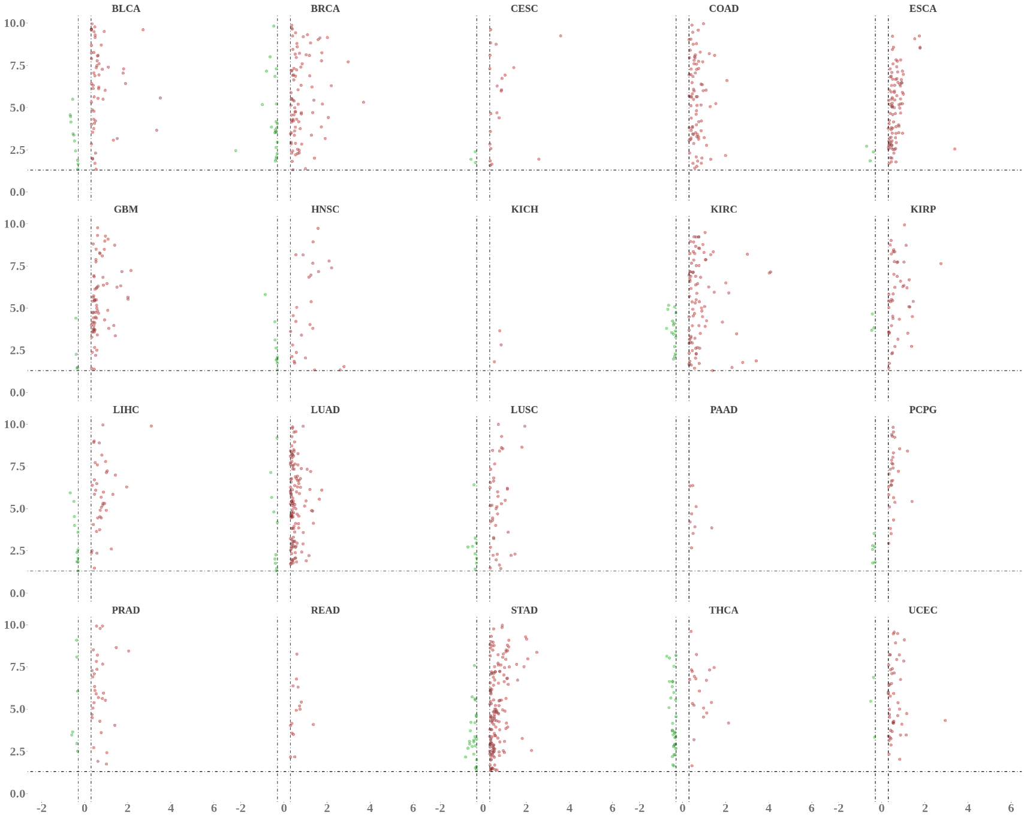
BLCA BRCA CESC COAD ESCA
10.0
7.5
5.0
2.5
0.0
DDX58
CAediting_1478179
APOL1
RNF213
CAediting_1478179
APOL1
HOMER2
10.0
7.5
5.0
2.5
0.0
GBM HNSC KICH KIRC KIRP
APOL1
APOL1
CAediting_1478179
APOL1
CD70
CAediting_543208 IGFBP3
−Log₁₀(P value)
LIHC LUAD LUSC PAAD PCPG
10.0
7.5
5.0
2.5
0.0
APOL1
APOL1
APOL1
EPHA2
CAediting_390714
GRIA2
PRAD READ STAD THCA UCEC
10.0
7.5
5.0
2.5
0.0
MSMB
CAediting_1478179
APOL1
CAediting_1478179
APOL1
DAPK2
CAediting_1478179
APOL1
-2 0 2 4 6
-2 0 2 4 6
-2 0 2 4 6
-2 0 2 4 6
-2 0 2 4 6
Log₂(Fold change)

